Slide 1
Chapter 6
Secondary Data Research in a Digital Age
© 2019 Cengage. All rights reserved.

Slide 2
Learning Outcomes
After studying this chapter, you should
Discuss pros and cons of secondary data and assess its reliability
Understand common objectives addressed by secondary data
Identify various internal and proprietary sources of secondary data
Give examples of various external sources of secondary data
Describe the impact of single-source data and globalization on big data research

Slide 3
Introduction
Market researchers are always working under budget constraints
If the data for a given research question already exists, it can save both time and money

Slide 4
Using Secondary Data in Marketing Research (1 of 5)
Secondary data are facts and information gathered and recorded by someone else prior to and for a purpose other than the current project
  Historical and already assembled
LO01
Notes:
Learning Objective 01

Slide 5
Using Secondary Data in Marketing Research (2 of 5)
Advantages
  Available
  Faster than acquiring primary data
  Requires no access to subjects
  Inexpensive
  May provide information otherwise not accessible
LO01
Notes:
Learning Objective 01

Slide 6
Using Secondary Data in Marketing Research (3 of 5)
Disadvantages
  The data are too old,
  Variation in definitions of terms
  The use of different units of measurement
  Inadequate information to verify the data’s validity or to allow any potential explanation for behavior
LO01
Notes:
Learning Objective 01

Slide 7
Using Secondary Data in Marketing Research (4 of 5)
Units of measurement may cause problems if they do not conform exactly to a researcher’s needs
  Data transformation is the process of changing the original form of the data to a format suitable to achieve the research objective
LO01
Notes:
Learning Objective 01

Slide 8
Using Secondary Data in Marketing Research (5 of 5)
The usefulness of secondary data results still depends on data quality
Reliability represents data accuracy
Validity represents data trustworthiness
The researcher must work diligently to assess the reputation of the organization that gathers and reports data
  Cross-checks are the comparison of data from one source with data from another source to determine the similarity of independent projects
LO01
Notes:
Learning Objective 01

Slide 9
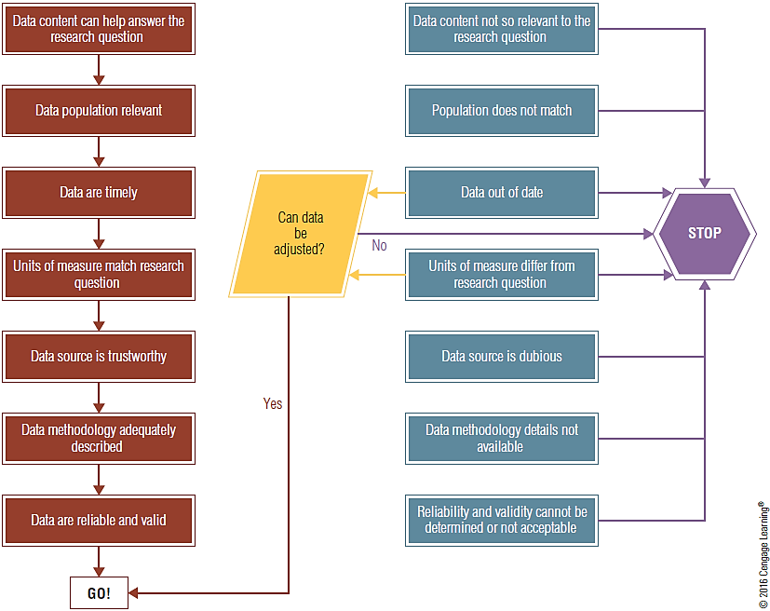
EXHIBIT 6.1 To Use or Not to Use Secondary Data? (1 of 2)
LO01
Notes:
Learning Objective 01

Slide 10
EXHIBIT 6.1 To Use or Not to Use Secondary Data? (2 of 2)
Broad Objective | Specific Research Example
Fact-Finding | Identifying Web traffic, consumption patterns, tracking trends
Model Building | Forecasting market potential, sales in a time-period, selecting locations, determining relationships with sales
Database Marketing | Developing prospect lists, predicting future customer behavior, data mining
LO02
Notes:
Learning Objective 02

Slide 11
Fact-finding
The simplest objective of secondary-data research is fact-finding
  Identification of consumer behavior for a product category
  Marketers watch for trends in the marketplace and the environment
    Market tracking is the observation and analysis of trends in industry volume and brand share over time
  Environmental scanning entails information gathering and fact-finding that is designed to detect indications of environmental changes in their initial stages of development
LO02
Notes:
Learning Objective 02

Slide 12
Model building
Model building involves specifying relationships between two or more variables
  Estimating market potential for geographic areas
  Forecasting sales
  Analysis of trade areas and sites
    Index of retail saturation describes the relationship between retail demand and supply
  Advertising analytics and metrics
    Focus on how advertising influences consumers and business performance
    Google analytics is one of the most used advertising tracking services today
LO02
Notes:
Learning Objective 02

Slide 13
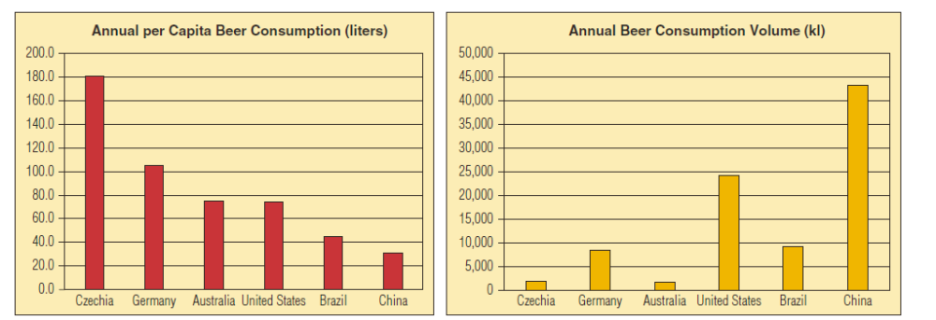
EXHIBIT 6.3 The Same Secondary Data Presented in Different Ways Addresses Different Research Objectives
LO02
Notes:
Learning Objective 02

Slide 14
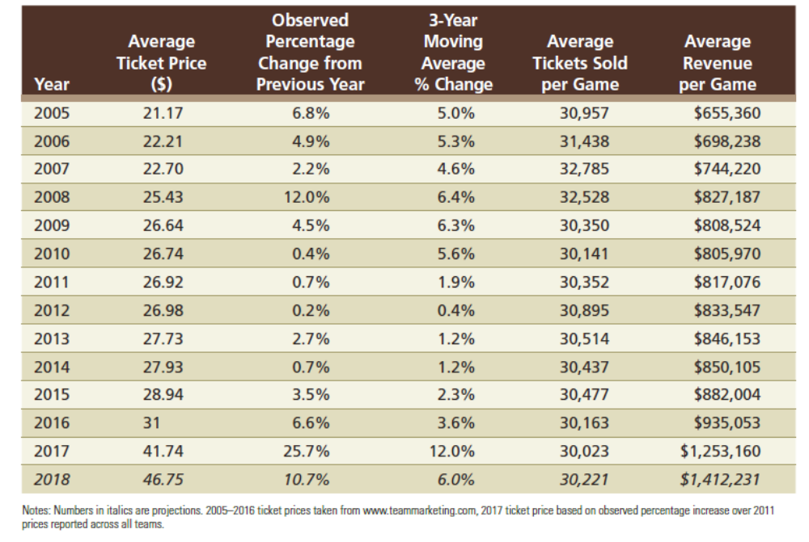
EXHIBIT 6.4 Secondary Data for Major League Baseball Ticket Prices, Attendance, and Revenue
LO02
Notes:
Learning Objective 02

Slide 15
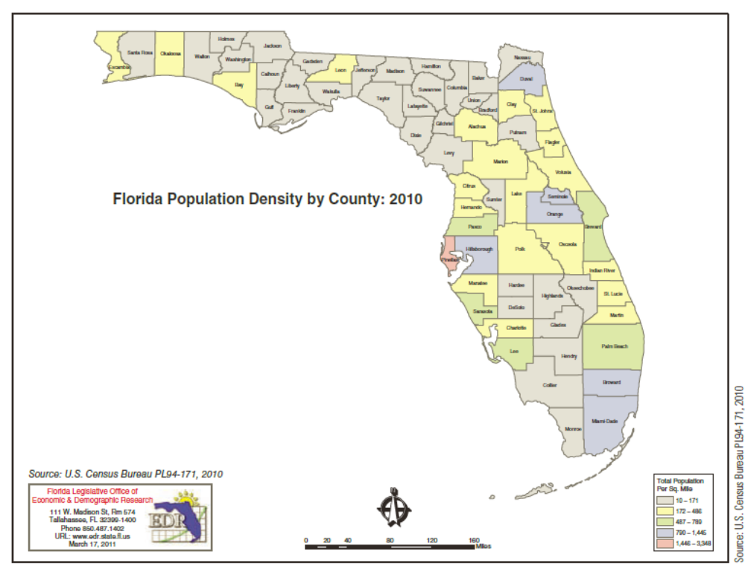
EXHIBIT 6.5 Data Mining Tools May Analyze Population Densities or Traffic Patternsto Help with Location Decisions
LO02
Notes:
Learning Objective 02

Slide 16
Data Mining (1 of 2)
Data mining is the use of powerful computer analytical routines to dig automatically through huge volumes of data searching for useful patterns of relationships
  Applies to many different forms of analytics
Neural network is a form of artificial intelligence in which a computer is programmed to mimic the way that human brains process information and make decisions
LO02
Notes:
Learning Objective 02

Slide 17
Data Mining (2 of 2)
Market-basket analysis is a form of data mining that analyzes anonymous point-of-sale transaction databases to identify coinciding purchases or relationships between products purchased and other retail shopping information
Although the push marketing efforts resulting from data mining discoveries sometimes make us feel creepy, evidence suggests they can produce value for customers
LO02
Notes:
Learning Objective 02

Slide 18
Database Marketing
Database marketing is the practice of using CRM databases to develop one-to-one relationships and precisely targeted promotional efforts with individual customers
  Effective database marketing requires vast amounts of secondary data to be integrated into a CRM system
  Analysts supplement these records with data customers provide directly
LO02
Notes:
Learning Objective 02

Slide 19
Sources of Internal Secondary Data
Internal data are data that originate in the organization
  Represent events recorded by or generated by the organization
Proprietary data is secondary data owned and controlled by the organization
LO03
Notes:
Learning Objective 03

Slide 20
Internal and Proprietary Data
Most organizations routinely gather, record, and store internal data to help them solve future problems
  Examples - sales invoices, salespeoples’ call reports, customer complaints, service records, warranty card returns, product returns, etc.
Enterprise search focuses on data within the enterprise’s internal network
Open-source innovation is an effort that involves allowing other firms real-time access to otherwise proprietary data within the enterprise
LO03
Notes:
Learning Objective 03

Slide 21
External Secondary Data Sources
External data are facts observed, recorded by an entity other than the researcher’s organization
Information as a product and its distribution
  Libraries
  The Internet
  Vendors
  Producers
    Periodicals, government, media, trade associations, commercial sources and consumer data
LO04
Notes:
Learning Objective 04

Slide 22
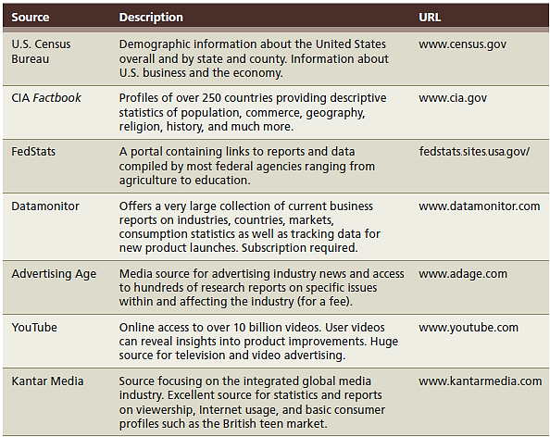
EXHIBIT 6.6 Selected Internet Sources for Secondary Data (1 of 2)
LO04
Notes:
Learning Objective 04

Slide 23
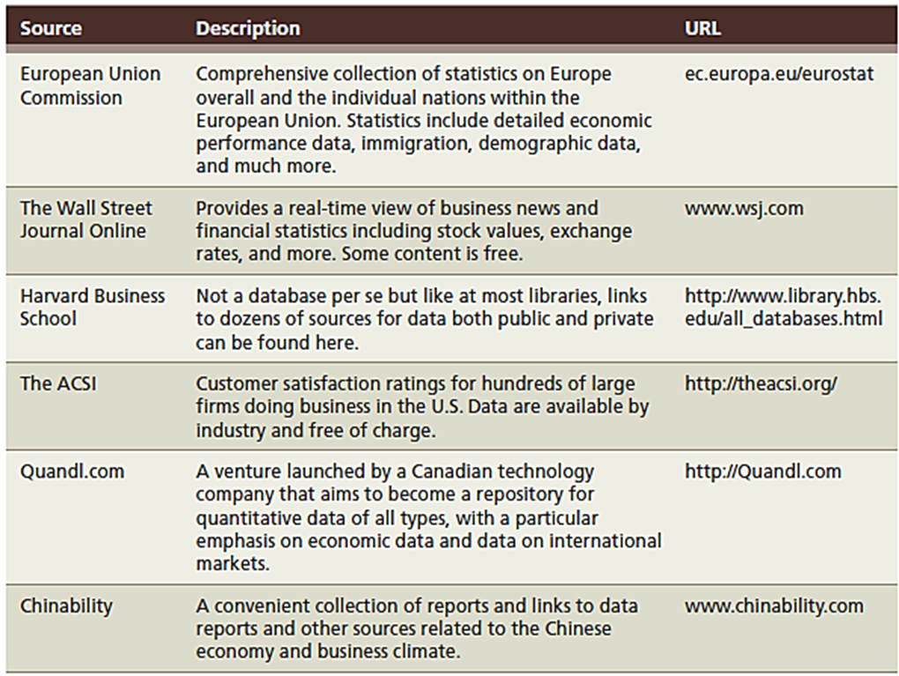
EXHIBIT 6.6 Selected Internet Sources for Secondary Data (2 of 2)
LO04
Notes:
Learning Objective 04

Slide 24
Commercial Sources
Market-share data
Consumer attitude and public opinion research
Consumption and purchase behavior data
Advertising research
LO04
Notes:
Learning Objective 04

Slide 25
Single-Source and Global Research Data
Single-source data-integrated information
  Diverse types of data offered by a single company
  Usually integrated on the basis of a common variable
Government agencies
  Global secondary data has the same limitations as domestic secondary data
  Additional pitfalls of global secondary data: unavailability in some countries, questionable accuracy (political influences), etc.
  CIA’s World Factbook and National Trade Data Bank (NTDB) are useful for overseas marketing
LO05
Notes:
Learning Objective 05

Slide 26
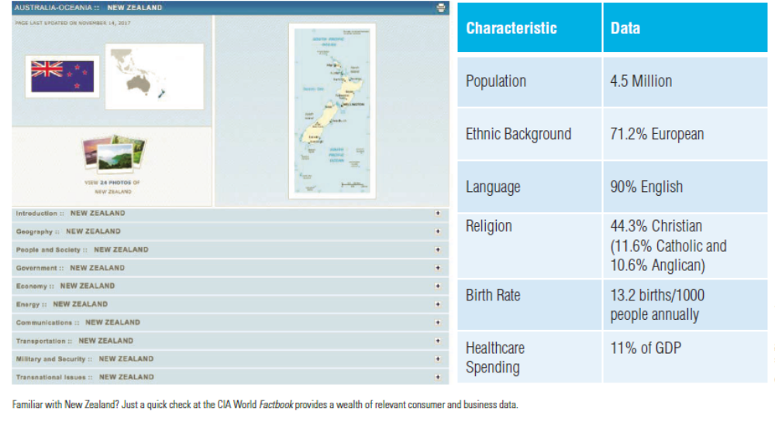
EXHIBIT 6.7 Familiar with New Zealand?
LO04
Notes:
Learning Objective 04

