Slide 1
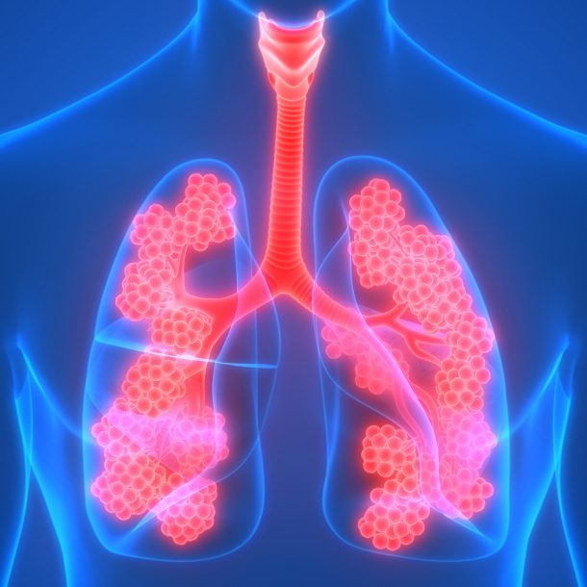
THE EFFECTIVENESS OF UPDATED 2023–2024 (MONOVALENT XBB.1.5) COVID-19 VACCINES AGAINST COVID-19-ASSOCIATED HOSPITALIZATION AMONG ADULTS AGED ≥18 YEARS WITH IMMUNOCOMPROMISING CHRONIC RESPIRATORY CONDITIONS SUCH AS CYSTIC FIBROSIS
Name
Course
Professor
Date of submission

Slide 2
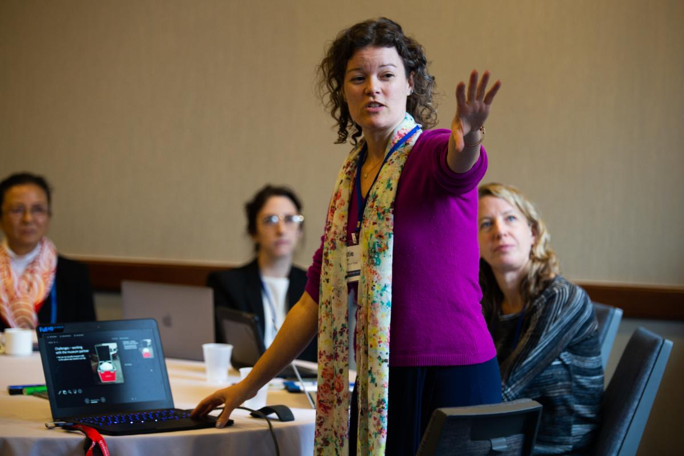
AUDIENCE APPROPRIATE DATA DISSEMINATION
THE IMPORTANCE OF AUDIENCE-APPROPRIATE MESSAGES FOR DATA DISSEMINATION
The primary aim of audience-appropriate data dissemination is to facilitate non-technical audiences' comprehension of scientific research findings.
This way, there is an increase in their engagement and participation in implementing evidence-based best practices through positive behavioral changes (Ross-Hellauer et al., 2020).
Notes:
The dissemination of research data must be appropriately planned and implemented to suit the specific needs of the target population (Ross-Hellauer et al., 2020). The primary aim of audience-appropriate data dissemination is to facilitate non-technical audiences' comprehension of scientific research findings. This way, there is an increase in their engagement and participation in implementing evidence-based best practices through positive behavioral changes (Ross-Hellauer et al., 2020). Audience-appropriate messages must be clear, population-specific, actionable, repeated, and factually correct (AHRQ, 2014). This way, the audience will have a higher chance of retaining and practicing the intended behavior change.

Slide 3
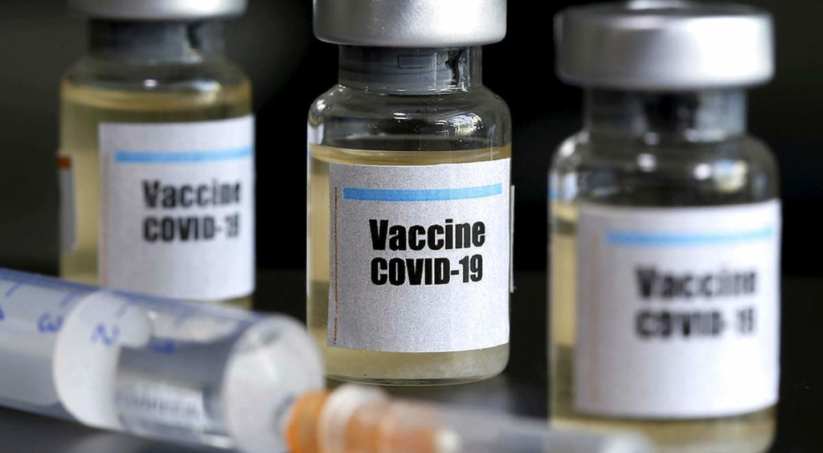
AUDIENCE APPROPRIATE DATA DISSEMINATION
IDENTIFICATION OF HEALTH ISSUE, AUDIENCE, AND REASON FOR DISSEMINATION
The health issue selected for this project is cystic fibrosis.
This initiative targets all individuals aged 18 years and above who are diagnosed with cystic fibrosis.
The primary objective of this dissemination is to promote the uptake of the updated covid-19 vaccine among adults diagnosed with cystic fibrosis to reduce COVID-19-related hospitalizations.
Notes:
The health issue selected for this project is cystic fibrosis. The effectiveness of the updated COVID-19 vaccines against COVID-related hospitalizations among the target population will be explored.
This initiative targets all individuals aged 18 years and above who are diagnosed with cystic fibrosis.
The technical audiences for this dissemination include public health professionals, clinicians, and policymakers. The non-technical audiences include all adults above the age of 18 years suffering from cystic fibrosis.
The primary objective of this dissemination is to promote the uptake of the updated COVID-19 vaccine among adults diagnosed with cystic fibrosis to reduce COVID-19-related hospitalizations.

Slide 4

DATA COLLECTION
The morbidity and mortality weekly report (MMWR) selected for this dissemination initiative is Link-Gelles et al.’s (2024) ‘interim effectiveness of updated 2023–2024 (monovalent XBB.1.5) COVID-19 vaccines against COVID-19–associated hospitalization among adults aged ≥18 years with immunocompromising conditions — VISION network, September 2023–February 2024’.
Notes:
The Morbidity and Mortality Weekly Report (MMWR) selected for this dissemination initiative is Link-Gelles et al.’s (2024) ‘Interim Effectiveness of Updated 2023–2024 (Monovalent XBB.1.5) COVID-19 Vaccines Against COVID-19–Associated Hospitalization Among Adults Aged ≥18 Years with Immunocompromising Conditions — VISION Network, September 2023–February 2024’. Among the immunocompromising conditions discussed by Link-Gelles et al. (2024) are chronic respiratory conditions such as cystic fibrosis, which play a crucial role in the progression of COVID-19 and related hospitalization of patients.

Slide 5

DATA COLLECTION
The researchers utilized a method of virtual data collection and analysis with the help of virtual sars-cov-2, influenza, and other respiratory viruses network (VISION).
Data collected and analyzed included hospitalizations of adults (>18 years) with immune-compromising illnesses who exhibited symptoms similar to those of COVID-19 between September 2023 and February 2024 (Link-Gelles et al., 2024).
Data collected and analyzed included hospitalizations of adults (>18 years) with immune-compromising illnesses who exhibited symptoms similar to those of COVID-19 (Link-Gelles et al., 2024).
Notes:
The researchers utilized a method of virtual data collection and analysis with the help of Virtual SARS-CoV-2, Influenza, and Other Respiratory Viruses Network (VISION), which is a multisite electronic health record (EHR) that uses data on negative COVID-19 tests to determine the effectiveness of the COVID-19 vaccine. Data collected and analyzed included hospitalizations of adults (>18 years) with immune-compromising illnesses who exhibited symptoms similar to those of COVID-19 between September 2023 and February 2024. These adults had also been subjected to SARS-CoV-2 molecular testing within 10 days before or 72 hours following their admission to the hospital. Case patients were any individuals whose molecular test results came back positive but had negative respiratory syncytial virus and influenza tests. Control patients are those who had negative SARS-CoV-2 molecular tests and negative or unknown influenza tests.

Slide 6
DATA ANALYSIS
Out of14,586 patients, 1,392 were selected as case patients and 13,194 as control patients (Link-Gelles et al., 2024).
The most frequent immunocompromising conditions recorded among selected patients included solid organ malignancy and immune conditions.
Cumulatively, 195 case patients received an updated COVID-19 vaccine while 2,401 control patients received the same vaccine.
For the first 7 to 59 days after administration of the updated COVID-19 vaccine, the vaccine effectiveness in preventing COVID-19-associated hospitalization was at 38% and 34% in the following 60 to 119 days (refer to table in the next slide) (Link-Gelles et al., 2024).
Notes:
A total of 14,586 patients were identified as potential participants in this research initiative. However, 1,392 were selected as case patients and 13,194 were selected as control patients.
The most frequent immunocompromising conditions recorded among selected patients included solid organ malignancy (36% in case patients and 43% in control patients) and immune conditions (38% and 35% respectively).
Cumulatively, 195 case patients (14% of this demographic) received an updated COVID-19 vaccine while 2,401 control patients (18%) received the same vaccine. For the first 7 to 59 days after administration of the updated COVID-19 vaccine, the vaccine effectiveness in preventing COVID-19-associated hospitalization was at 38% and 34% in the following 60 to 119 days.

Slide 7
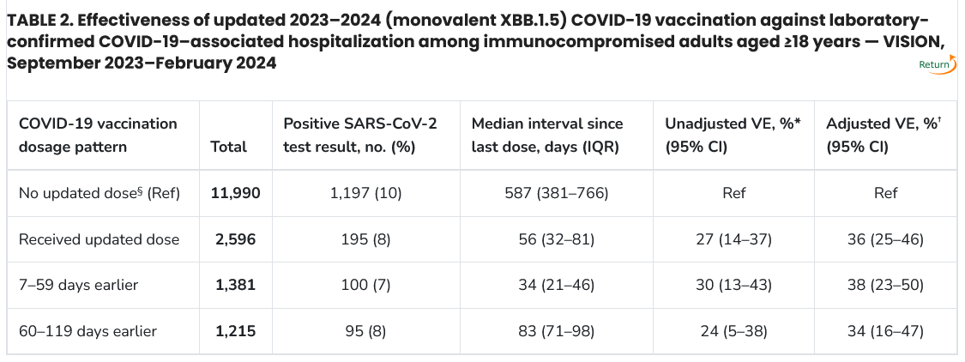
DATA ANALYSIS
The table attached represents the COVID-19 vaccine effectiveness among immunocompromised adults aged above 18 years (Source: Link-Gelles et al., 2024).
Notes:
The table attached represents the updated COVID-19 vaccine’s effectiveness among immunocompromised adults aged above 18 years.

Slide 8
Data interpretation
The data analyzed also revealed that a small portion of the research population received an updated COVID-19 vaccine, even among the high-risk populations.
On the other hand, 5,012 individuals with chronic respiratory conditions did not receive the updated vaccine, risking the chance of developing severe COVID-19-associated symptoms (Link-Gelles et al., 2024).
The results of this study will be useful in the successful management of COVID-19-associated symptoms among patients with chronic respiratory disorders such as cystic fibrosis.
With such knowledge, public health professionals can motivate target populations to adopt desirable behavioral change by promoting the uptake of the updated 2023–2024 (monovalent XBB.1.5) COVID-19 vaccines (Schimmelpfennig et al., 2021).
Notes:
The data analyzed also revealed that a small portion of the research population received an updated COVID-19 vaccine, even among the high-risk populations. For instance, out of the 6,142 patients diagnosed with chronic respiratory conditions (such as lung disease, asthma, and cystic fibrosis), only 628 received the updated COVID-19 vaccine between the first 7 to 59 days and 552 received the vaccine between 60 to 119 days. On the other hand, 5,012 individuals with chronic respiratory conditions did not receive the updated vaccine, risking the chance of developing severe COVID-19-associated symptoms.
The results of this study will be useful in the successful management of COVID-19-associated symptoms among patients with chronic respiratory disorders such as cystic fibrosis. The results highlight the importance of the administration of COVID-19 vaccines among at-risk populations. With such knowledge, public health professionals can motivate target populations to adopt desirable behavioral change by promoting the uptake of the updated 2023–2024 (Monovalent XBB.1.5) COVID-19 vaccines (Schimmelpfennig et al., 2021). This way, the health outcomes of patients with chronic respiratory diseases, among other immunosuppressing conditions, will exhibit improved health outcomes and quality of life.

Slide 9

Data interpretation
The results of the data analysis indicated that adults who were diagnosed with immunocompromising conditions between September 2023 and February 2024 and received an updated COVID-19 vaccine were less likely to experience COVID-19-related hospitalizations (Link-Gelles et al., 2024).
However, individuals with immunocompromising conditions reported lower COVID-19 vaccine effectiveness compared to individuals without immunocompromising conditions (Link-Gelles et al., 2024).
Notes:
The results of the data analysis indicated that adults who were diagnosed with immunocompromising conditions between September 2023 and February 2024 and received an updated COVID-19 vaccine were less likely to experience COVID-19-related hospitalizations. The vaccine boosted the immunity of these individuals since they were less likely to be hospitalized for COVID-19-associated issues compared to unvaccinated individuals.
However, individuals with immunocompromising conditions reported lower COVID-19 vaccine effectiveness compared to individuals without immunocompromising conditions. This means that all individuals diagnosed with immunocompromising conditions, such as cystic fibrosis, are more likely to develop severe COVID-19 because of their reduced response to the vaccine.

Slide 10

Recommendations for action
The best way to inspire behavioral change among the target population in the form of increased uptake of the updated COVID-19 vaccine is to apply social influence mechanisms.
According to Schimmelpfennig et al. (2021), social influence can inspire change among a population that could not be reached or convinced using previously implemented interventions.
Notes:
The best way to inspire behavioral change among the target population in the form of increased uptake of the updated COVID-19 vaccine is to apply social influence mechanisms. According to Schimmelpfennig et al. (2021), social influence can inspire change among a population that could not be reached or convinced using previously implemented interventions. Members of a population become influenced to behave like those around them. This is one of the best public health interventions as the positive behavioral change spillover to parts of the population that were not directly reached by public health professionals. It is also a cost-effective approach.

Slide 11

Recommendations for action
For this intervention, public health professionals will develop A population-specific educational program that will educate a portion of the target population about the importance of the COVID-19 vaccine in preventing the development of severe COVID-19-associated symptoms among people with chronic respiratory conditions.
This intervention will go hand-in-hand with the increased availability of updated COVID-19 vaccines among the target population.
Notes:
For this intervention, public health professionals will develop a population-specific educational program that will educate a portion of the target population about the importance of the COVID-19 vaccine in preventing the development of severe COVID-19-associated symptoms among people with chronic respiratory conditions. This intervention will go hand-in-hand with the increased availability of updated COVID-19 vaccines among the target population. Therefore, policy development by local governments to fund the administration of subsidized or free administration of updated COVID-19 vaccines. Ease of access to vaccines coupled with educational initiatives to ensure that the target population is aware of the benefits of the updated COVID-19 for individuals with chronic respiratory conditions will go a long way in motivating behavioral change among target populations.

Slide 12
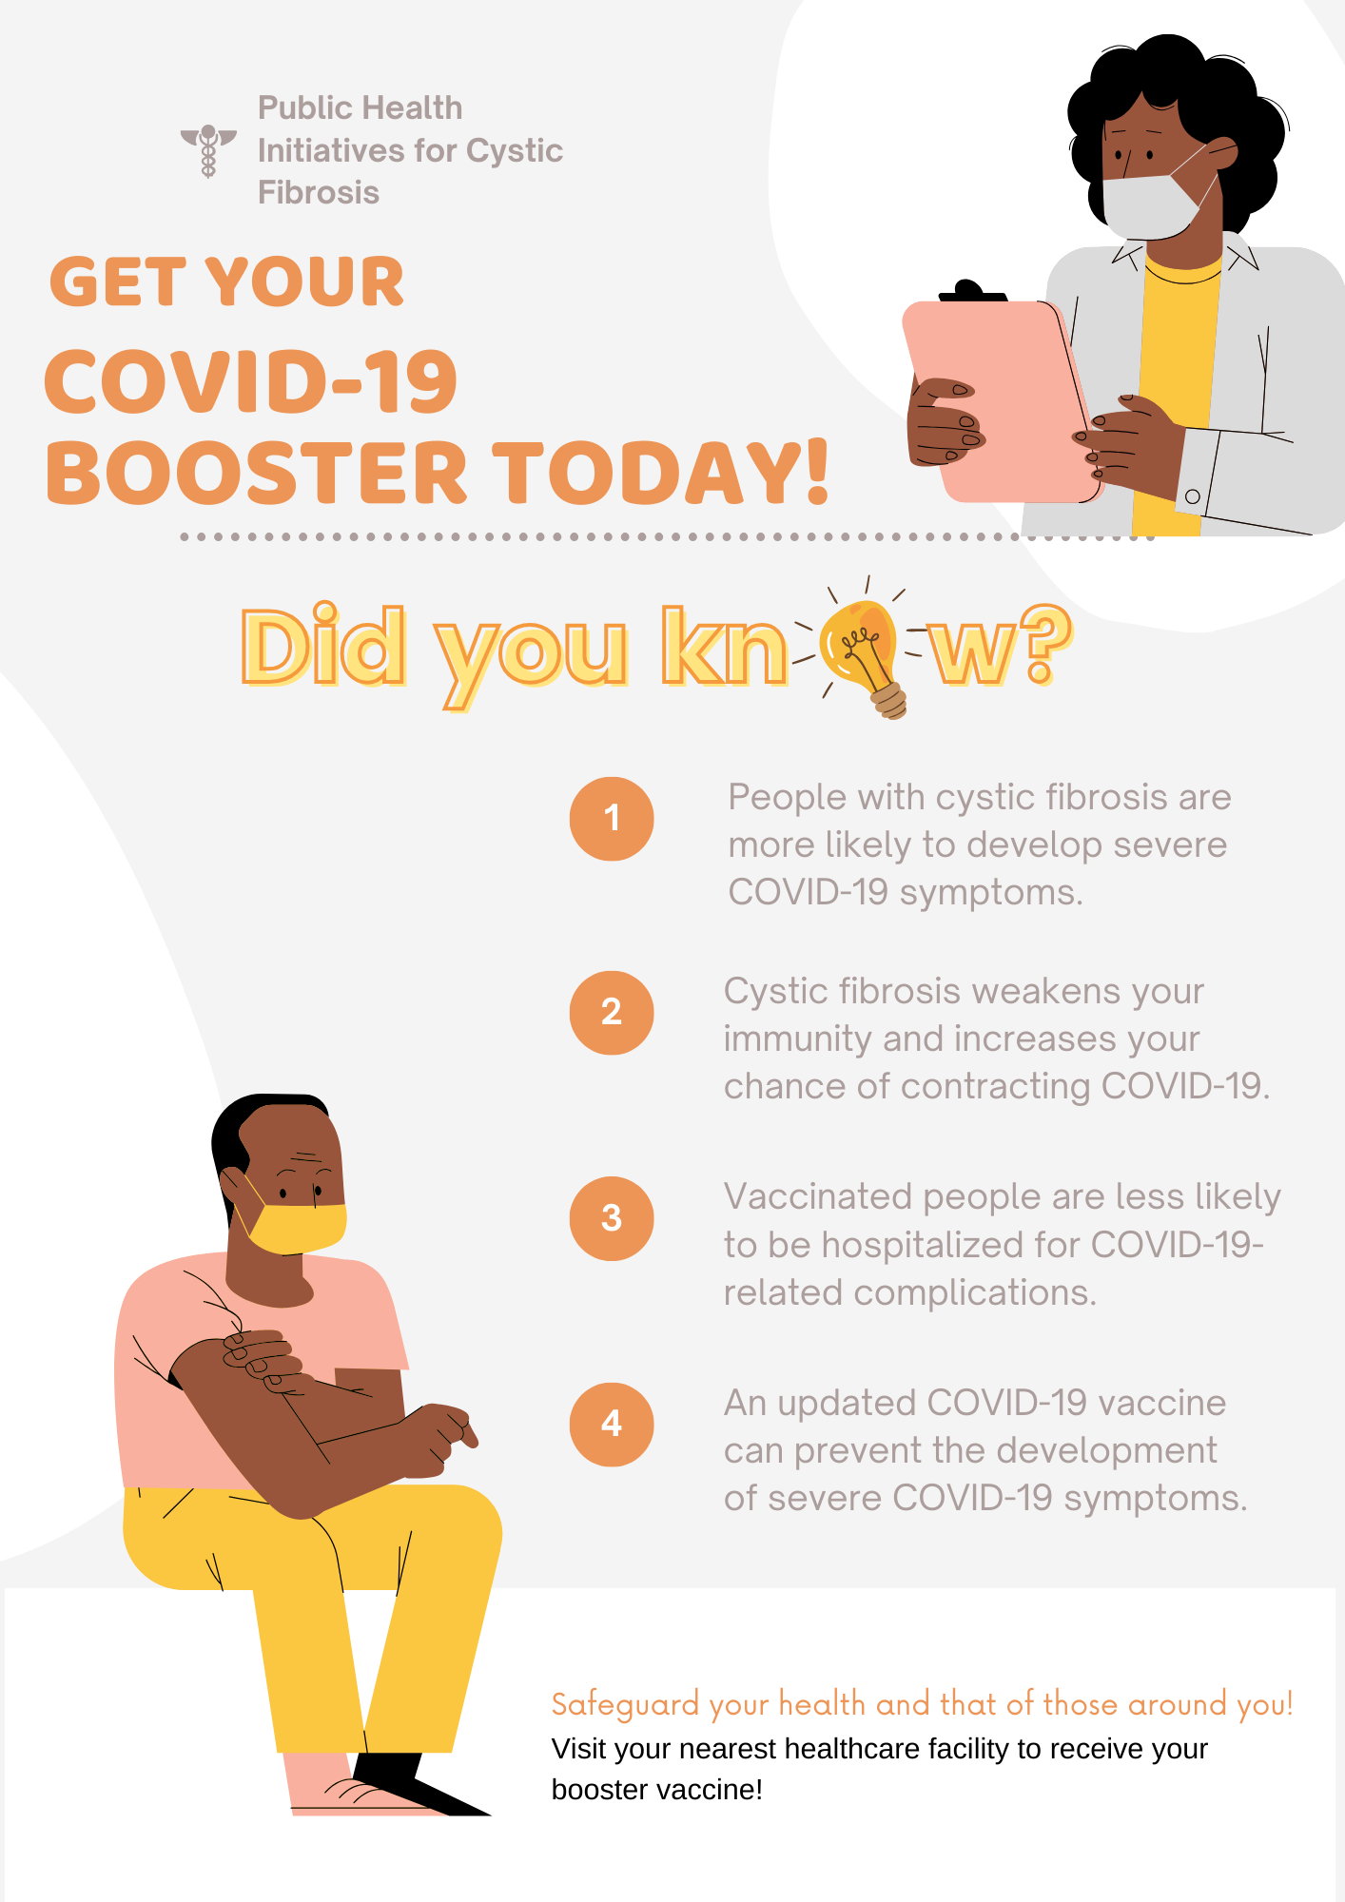
Fact sheet
Notes:
I managed to design a brief fact sheet that summarizes all the important facts that the non-technical audience should know from this presentation and the MMWR chosen.

Slide 13
conclusion
Research has proven that the interaction between COVID-19 and other chronic respiratory conditions, such as cystic fibrosis, is likely to increase one’s chance of hospitalization as A result of the development of severe COVID-19-associated symptoms.
However, receiving the updated covid-19 vaccine reduces these chances significantly.
More awareness must be created to ensure that affected populations understand the importance of receiving an updated dose of the covid-19 vaccine in improving their health outcomes and quality of life.
The government must also actively increase access to the updated covid-19 vaccine to ensure target populations have access to the vaccine.
Notes:
Research has proven that the interaction between COVID-19 and other chronic respiratory conditions, such as cystic fibrosis, is likely to increase one’s chance of hospitalization as a result of the development of severe COVID-19-associated symptoms.
However, receiving the updated COVID-19 vaccine reduces these chances significantly.
More awareness must be created to ensure that affected populations understand the importance of receiving an updated dose of the COVID-19 vaccine in improving their health outcomes and quality of life.
The government must also actively increase access to the updated COVID-19 vaccine to ensure target populations have access to the vaccine.

Slide 14
REFERENCES
Agency For Healthcare Research And Quality (AHRQ). (2014). Quick-start guide to dissemination for practice-based research networks. Https://Www.Ahrq.Gov/Sites/Default/Files/Wysiwyg/Ncepcr/Resources/Dissemination-quick-start-guide.Pdf
Link-gelles, R., Rowley, E. A. K., Desilva, M. B., Dascomb, K., Irving, S. A., Klein, N. P., Grannis, S. J., Ong, T. C., Weber, Z. A., Fleming-dutra, K. E. … And Payne, A. B. (2024). Interim effectiveness of updated 2023–2024 (Monovalent XBB.1.5) COVID-19 Vaccines against Covid-19–associated hospitalization among adults aged ≥18 Years with immunocompromising conditions — VISION Network, September 2023–February 2024. MMWR, 73(12).
Ross-hellauer T, Tennant Jp, Banelytė V, Gorogh E, Luzi D, Kraker P, Pisacane L, Ruggieri R, Sifacaki E, And Vignoli M. (2020). Ten Simple Rules For Innovative Dissemination Of Research. Plos Computational Biology, 16(4). DOI: 10.1371/Journal.Pcbi.1007704.
Schimmelpfennig, R., Vogt, S., Ehret, S., And Efferson, C. (2021). Promotion of behavioral change for health in a heterogeneous population. Bulletin Of The World Health Organization, 99(11):819-827. DOI: 10.2471/Blt.20.285227.

Slide 15
The end
Thank you!

