Slide 1

Chapter Five
Estimating Project Times and Costs

Slide 2
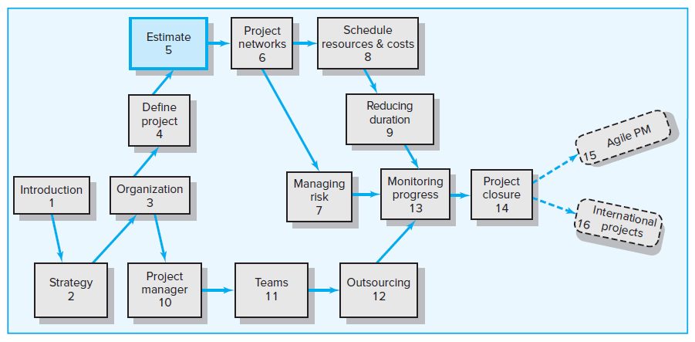
Where We Are Now

Slide 3
Learning Objectives
05-01 Understand estimating project times and costs is the foundation for
project planning and control.
05-02 Describe guidelines for estimating time, costs, and resources.
05-03 Describe the methods, uses, and advantages and disadvantages of
top-down and bottom-up estimating methods.
05-04 Distinguish different kinds of costs associated with a project.
05-05 Suggest a scheme for developing an estimating database for future projects.
05-06 Understand the challenge of estimating mega projects and describe steps that lead to better informed decisions.
05-07 Define a “white elephant” in project management and provide
examples.

Slide 4
Chapter Outline
5.1 Factors Influencing the Quality of Estimates
5.2 Estimating Guidelines for Times, Costs, and Resources
5.3 Top-Down versus Bottom-Up Estimating
5.4 Methods for Estimating Project Times and Costs
5.5 Level of Detail
5.6 Types of Costs
5.7 Refining Estimates
5.8 Creating a Database for Estimating
5.9 Mega Projects: A Special Case

Slide 5
Project Estimating
Estimating Defined
Is the process of forecasting or approximating the time and cost of completing project deliverables.
Is a trade-off, balancing the benefits of better accuracy against the costs of secured increased accuracy.
Types of Estimates
Top-down (macro) estimates—analogy, group consensus, or mathematical relationships
Bottom-up (micro) estimates—based on estimates of elements found in the work breakdown structure

Slide 6
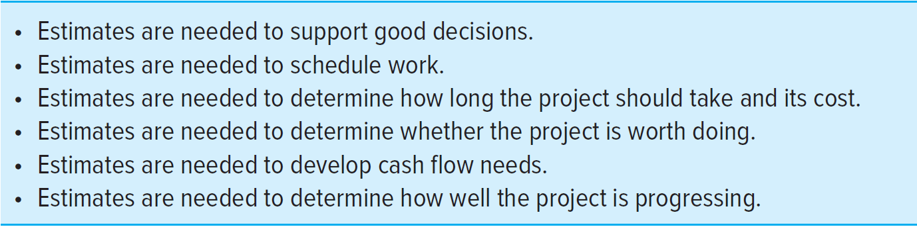
Why Estimating Time and Cost Is Important
EXHIBIT 5.1

Slide 7
5.1 Factors Influencing the Quality of Estimates
Planning Horizon
Project Complexity
People
Project Structure and Organization
Padding Estimates
Organizational Culture
Other Factors

Slide 8
5.2 Estimating Guidelines for Times, Costs, and Resources
Responsibility
The use of several people to estimate
Normal conditions
Time units
Independence
Contingencies
Risk assessment added to the estimate to avoid surprises to stakeholders

Slide 9
5.3 Top-Down versus Bottom-Up Estimating
Top-Down Estimates
Are usually derived from someone who uses experience and/or information to determine the project duration and total cost.
Are sometimes made by top managers who have very little knowledge of the component activities used to complete the project.
Bottom-Up Estimates
Can take place after the project has been defined in detail.
Can serve as a check on cost elements in the WBS by rolling up the work packages and associated cost accounts to major deliverables.
Provide the customer with an opportunity to compare the low-cost, efficient method approach with any imposed restrictions.

Slide 10
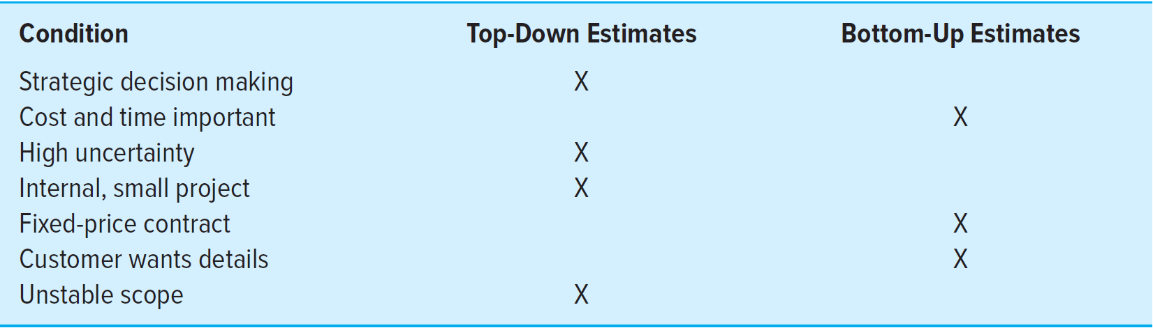
Conditions for Preferring Top-Down or Bottom-Up Time and Cost Estimates
TABLE 5.1

Slide 11
The Preferred Approach in Defining the Project
Make rough top-down estimates
Develop the WBS/OBS
Make bottom-up estimates
Develop schedules and budgets
Reconcile differences between top-down and bottom-up estimates

Slide 12
5.4 Methods for Estimating Project Times and Costs
Top-Down Approaches
Consensus Method
Ratio Method
Apportion Method
Function Point Methods for Software and System Projects
Learning Curves
Bottom-Up Approaches
Template Method
Parametric Procedures Applied to Specific Tasks
Range Estimating

Slide 13
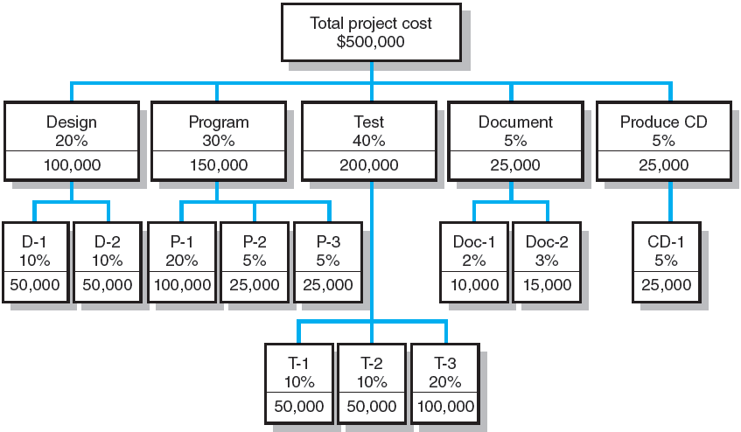
Apportion Method of Allocating Project Costs Using the WBS
FIGURE 5.1

Slide 14
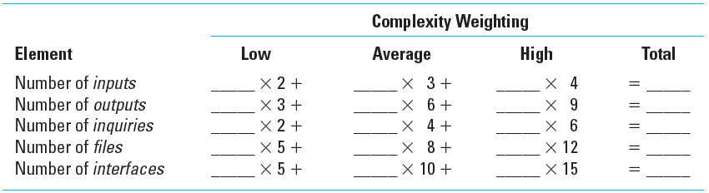
Simplified Basic Function Point Count Process for a Prospective Project or Deliverable
TABLE 5.2

Slide 15
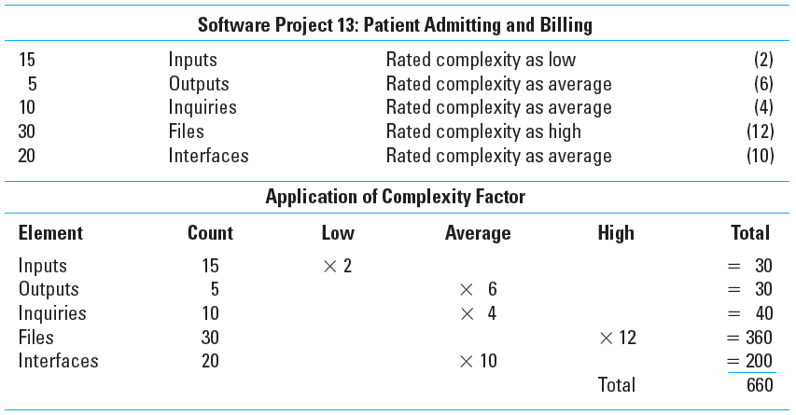
Example: Function Point Count Method
TABLE 5.3

Slide 16
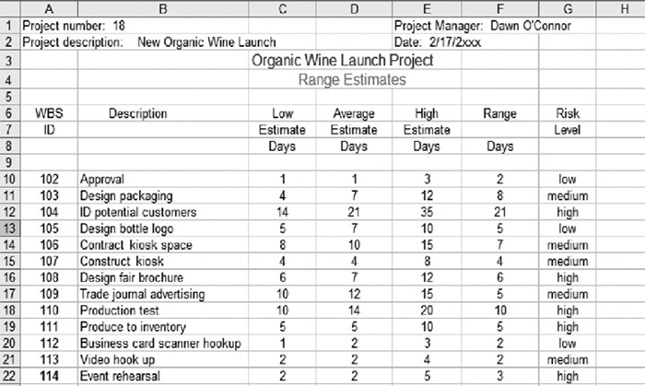
Range Estimating Template
FIGURE 5.2

Slide 17
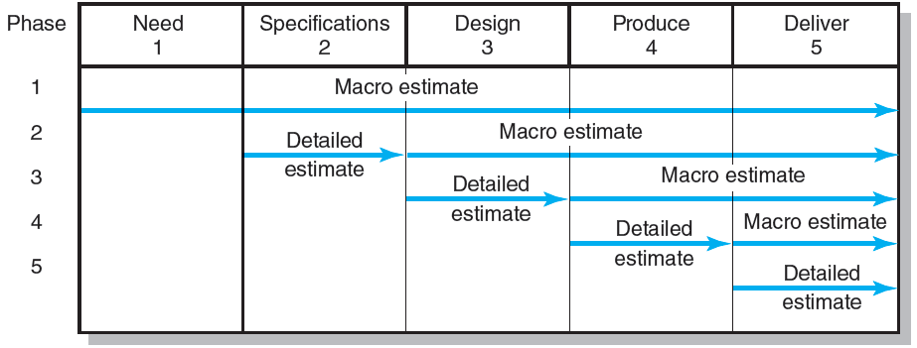
A Hybrid: Phase Estimating
FIGURE 5.3

Slide 18
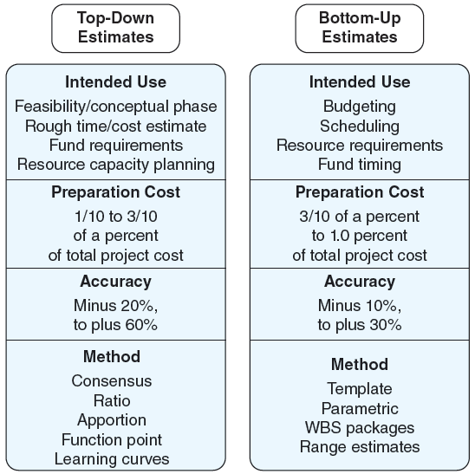
Top-Down and Bottom-Up Estimates
FIGURE 5.4

Slide 19
5.5 Level of Detail
The level of detail in the WBS varies with:
The complexity of the project
The need for control
The project size, cost, and duration
Other factors
Excessive detail:
Emphasizes departmental outcomes rather than deliverable outcomes
Creates more unproductive paperwork
Inadequate detail:
Falls short of meeting the structure’s needs

Slide 20
5.6 Types of Costs
Direct Costs
Are clearly chargeable to a specific work package
  Examples: Labor, materials, equipment, and other
Direct Project Overhead Costs
Can be tied to project deliverables or work packages
  Examples: Salary of the project manager, temporary rental space for the project team, supplies, specialized machinery
General and Administrative (G&A) Overhead Costs
Are not directly linked to a specific project
  Examples: Advertising, accounting, salary of senior management above the project level

Slide 21
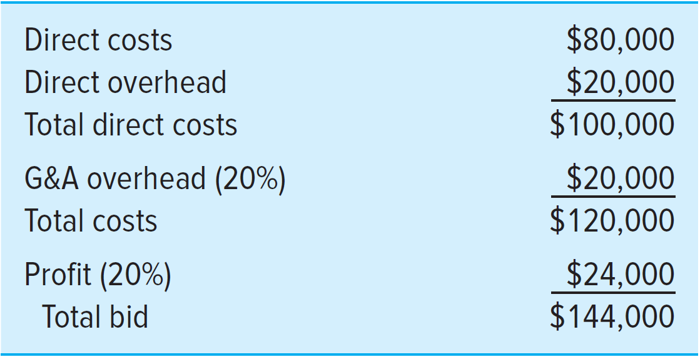
Contract Bid Summary Costs
FIGURE 5.5

Slide 22
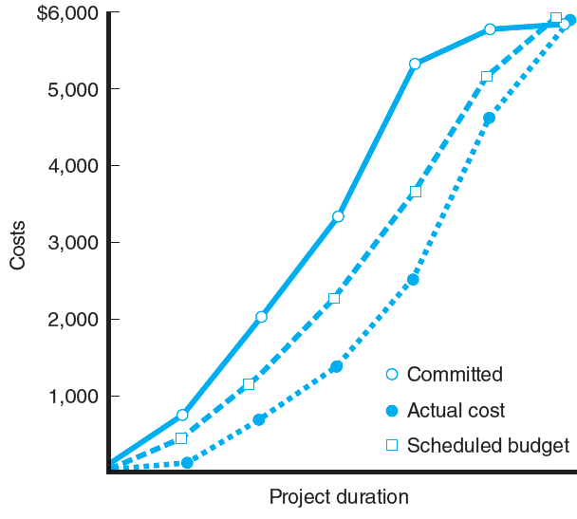
Three Views of Cost
FIGURE 5.6

Slide 23
5.7 Refining Estimates
Reasons for adjusting estimates
Interaction costs are hidden in estimates.
Normal conditions do not apply.
Things go wrong on projects.
Project scope and plans change.
People are overly optimistic.
People engage in strategic misrepresentation.

Slide 24
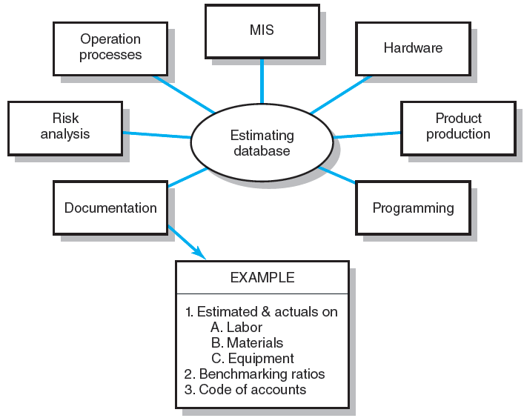
5.8 Creating a Database for Estimating
FIGURE 5.7

Slide 25
5.9 Mega Projects: A Special Case
Mega Projects Defined
Are large-scale, complex ventures that typically cost $1 billion or more, take many years to complete, and involve multiple private and public stakeholders.
  Examples: High-speed rail lines, airports, healthcare reform, the Olympics, development of new aircraft
Often involve a double whammy.
  Projects cost much more than expected and under-deliver on benefits the projects were to provide.
Are sometimes referred to as “white elephant.”
  Projects are over budget, under value and the costs of maintaining the project exceed the benefits received.

Slide 26
The Reference Class Forecasting (RCF)
Three Major Steps:
Select a reference class of projects similar to your potential project.
Collect and arrange outcome data as a distribution. Create a distribution of cost overruns as a percentage of the original project estimate (low to high).
Use the distribution data to arrive at a realistic forecast. Compare the original cost estimate for the project with the reference class projects.
Benefits:
Outside empirical data mitigates human bias.
Politics, strategic, and promoter forces have difficulty ignoring outside RCF information.
RCF serves as a reality check for funding large projects.
RCF helps executives avoid unsound optimism.
RCF leads to improved accountability.
RCF provides a basis for project contingency funds.

Slide 27
Key Terms
Apportionment
Bottom-up estimates
Delphi Method
Direct costs
Function points
Learning curve
Overhead costs
Phase estimating
Range estimating
Ratio method
Reference class forecasting (RCF)
Template method
Time and cost databases
Top-down estimates
White elephant

