Slide 1

Chapter 6
International Trade Theory
naqiewei/DigitalVision Vectors/Getty Images
© 2022 McGraw Hill. All rights reserved. Authorized only for instructor use in the classroom. No reproduction or further distribution permitted without the prior written consent of McGraw Hill.

Slide 2
Learning Objectives
6-1 Understand why nations trade with each other.
6-2 Summarize the different theories explaining trade flows between nations.
6-3 Recognize why many economists believe that unrestricted free trade between nations will raise the economic welfare of countries that participate in a free trade system.
6-4 Explain the arguments of those who maintain that government can play a proactive role in promoting national competitive advantage in certain industries.
6-5 Understand the important implications that international trade theory holds for management practice.

Slide 3

Opening Case
Trade in Services
  Cross-border transactions increasingly involve services.
    Distribution, financial services, transportation, telecommunications, health, etc.
    About 20 percent of world trade; growing rapidly.
  Services account for over 75 percent of G D P today in most developed nations.
  Trade in services hampered by regulatory barriers.
  Need for common standards, rules, and regulations to realize trade gains.
Education Images/Getty Images
Notes:
Differences in professional standards, licensing requirements, investment restrictions, work visas, and tax codes have all made cross-border trade in services more difficult than they could be.
Sources: World Trade Report 2019, World Trade Organization; B. Fung, “US Threatens 100% Tariffs on French Cheese and Champagne,” CNN, December 3, 2019; Fact Sheet on 2019 National Trade Estimate: Key Barriers to Digital Trade, Office of U.S. Trade Representative, March 2019.

Slide 4
Introduction
Trade Policy
  Motivation for trade is to realize gains from trade.
  Economists generally advocate for lower barriers to cross-border trade, both in goods and services.
  Recent shift in U.S. trade policy away from free trade and toward managed trade.
    Pushed trade policy to political center stage.
Trade and investment policies have an extremely important impact on international business practices.
Notes:
When economists talk about the gains from trade, what they mean is that trade allows countries to specialize in the production (and export) of goods and services that they can produce most efficiently, while importing goods and services that they cannot produce so efficiently from other nations.

Slide 5
An Overview of Trade Theory 1
Trade Approaches
  Mercantilism (16th and 17th centuries) encouraged exports and discouraged imports.
  Adam Smith (17 76) promoted unrestricted free trade.
  David Ricardo (19th century) built on Smith’s ideas; advocated comparative advantage.
    Eli Heckscher and Bertil Ohlin (20th century ) refined Ricardo’s work.
Free trade: absence of barriers to the free flow of goods and services between countries.
Notes:
Although mercantilism is an old and largely discredited doctrine, its echoes remain in modern political debate and in the trade policies of many countries. Indeed, some have argued that Donald Trump espouses mercantilist views.

Slide 6
An Overview of Trade Theory 2
The Benefits of Trade
  Specialize in manufacture and export of products that can be produced most efficiently in that country.
  Import products that can be produced more efficiently in other countries.
  Gains arise because international trade allows a country to specialize in the manufacture and export of products.
Notes:
LO 6-1 Understand why nations trade with each other.
It is beneficial for a country to engage in international trade even for products it is able to produce for itself.
One of the key insights of international trade theory is that limits on imports are often in the interests of domestic producers but not domestic consumers.

Slide 7
An Overview of Trade Theory 3
The Pattern of International Trade
  Ricardo’s theory of comparative advantage:
    Trade patterns reflect differences in labor productivity.
  Heckscher-Ohlin theory:
    Trade reflects the interplay between the proportions in which the factors of production are available in different countries and the proportions in which they are needed for producing particular goods.
  Raymond Vernon:
    Trade patterns reflect a product’s life cycle.
Notes:
International trade theory helps explain trade patterns. Some patterns of trade are fairly easy to explain—it is obvious why Saudi Arabia exports oil, Ghana exports cocoa, and Brazil exports coffee. But why does Switzerland export chemicals, pharmaceuticals, watches, and jewelry? Why does Japan export automobiles, consumer electronics, and machine tools?

Slide 8

Comparative Advantage?
A Rolex Group logo sits on display above a luxury wristwatch store in Vienna, Austria.
Bloomberg/Getty Images

Slide 9
An Overview of Trade Theory 4
  Paul Krugman’s new trade theory:
    World market can only support a limited number of firms in some industries.
    Trade will skew toward countries that have firms that are able to capture first-mover advantages.
  Michael Porter’s theory of national competitive advantage:
    Country factors explain a nation’s dominance in the production and export of certain products.
Notes:
New trade theory: The observed pattern of trade in the world economy may be due in part to the ability of firms in a given market to capture first-mover advantages.
In addition to factor endowments, Porter points out the importance of country factors such as domestic demand and domestic rivalry in explaining a nation’s dominance in the production and export of particular products.

Slide 10
An Overview of Trade Theory 5
Trade Theory and Government Policy
  Mercantilism makes a case for government involvement in promoting exports and limiting imports.
  Smith, Ricardo, and Heckscher-Ohlin promote unrestricted free trade.
  New trade theory and Porter justify limited and selective government intervention to support development of certain export-oriented industries.
Notes:
While the theories all suggest that trade is beneficial, they lack agreement in their recommendations for government policy.

Slide 11
Mercantilism
Mercantilism
  In a country’s best interest to maintain a trade surplus—to export more than it imports.
    Gold and silver considered mainstays of national wealth.
    Advocated government intervention to achieve a surplus in balance of trade.
  Viewed trade as a zero-sum game: one in which a gain by one country results in a loss by another.
  Critics charge China with having a neo-mercantilist policy to keep currency value low in order to sell more goods to developed nations.
Notes:
LO 6-2 Summarize the different theories explaining trade flows between nations.
Neo-mercantilists equate political power with economic power and economic power with a balance-of-trade surplus. Critics argue that several nations have adopted a neo-mercantilist strategy that is designed to simultaneously boost exports and limit imports. Despite this, the mercantilist doctrine is by no means dead. For example, U.S. President Donald Trump appears to advocate neo-mercantilist policies.

Slide 12
Absolute Advantage
Absolute Advantage
  A country has absolute advantage in producing a product when it is more efficient than any other country in producing it.
  Smith (17 76): countries differ in their ability to produce goods efficiently.
    Trade is not a zero-sum game.
    Countries should specialize in production of goods they have an absolute advantage in and then trade these goods for goods produced by other countries.
Notes:
In his 1776 landmark book The Wealth of Nations, Adam Smith attacked the mercantilist assumption that trade is a zero-sum game. Smith argued that countries differ in their ability to produce goods efficiently.

Slide 13
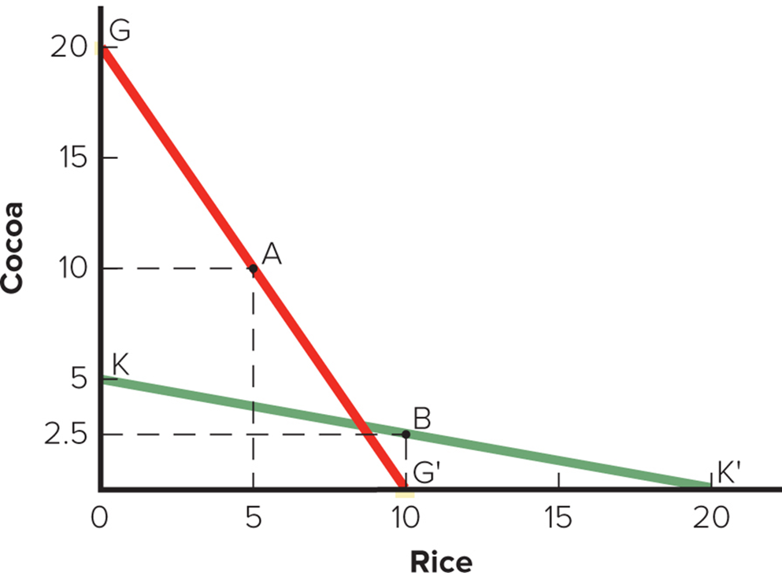
Figure 6.1 The Theory of Absolute Advantage
Access the text alternative for slide images.
Notes:
Assume that two countries, Ghana and South Korea, both have 200 units of resources that could either be used to produce rice or cocoa. In Ghana, it takes 10 units of resources to produce one ton of cocoa and 20 units of resources to produce one ton of rice. So, Ghana could produce 20 tons of cocoa and no rice, 10 tons of rice and no cocoa, or some combination of rice and cocoa between the two extremes.
In South Korea it takes 40 units of resources to produce one ton of cocoa and 10 resources to produce one ton of rice. So, South Korea could produce 5 tons of cocoa and no rice, 20 tons of rice and no cocoa, or some combination in between.
Ghana has an absolute advantage in the production of cocoa.
South Korea has an absolute advantage in the production of rice.

Slide 14
Table 6.1 Absolute Advantage and the Gains from Trade 1
Resources Required to Produce 1 Ton of Cocoa and Rice
 | Cocoa | Rice
Ghana | 10 | 20
South Korea | 40 | 10
Production and Consumption without Trade
 | Cocoa | Rice
Ghana | 10.0 | 5.0
South Korea | 2.5 | 10.0
Total Production | 12.5 | 15.0
Production with Specialization
 | Cocoa | Rice
Ghana | 20.0 | 0.0
South Korea | 0.0 | 20.0
Total Production | 20.0 | 20.0
Notes:
We can see that trade is a positive-sum game; it produces net gains for all involved.

Slide 15
Table 6.1 Absolute Advantage and the Gains from Trade 2
Consumption after Ghana Trades 6 Tons of Cocoa for 6 Tons of South Korean Rice
 | Cocoa | Rice
Ghana | 14.0 | 6.0
South Korea | 6.0 | 14.0
Increase in Consumption as a Result of Specialization and Trade
 | Cocoa | Rice
Ghana | 4.0 | 1.0
South Korea | 3.5 | 4.0
Notes:
We can see that trade is a positive-sum game; it produces net gains for all involved.

Slide 16
Comparative Advantage 1
Theory of Comparative Advantage
  Ricardo (18 17): What happens when one country has an absolute advantage in the production of all goods?
  A country should specialize in production of goods that it produces most efficiently and buy goods that it produces less efficiently from other countries.
Notes:
Ricardo’s theory holds that this is true, even if it means the country buys goods from other countries that it could produce more efficiently itself.

Slide 17
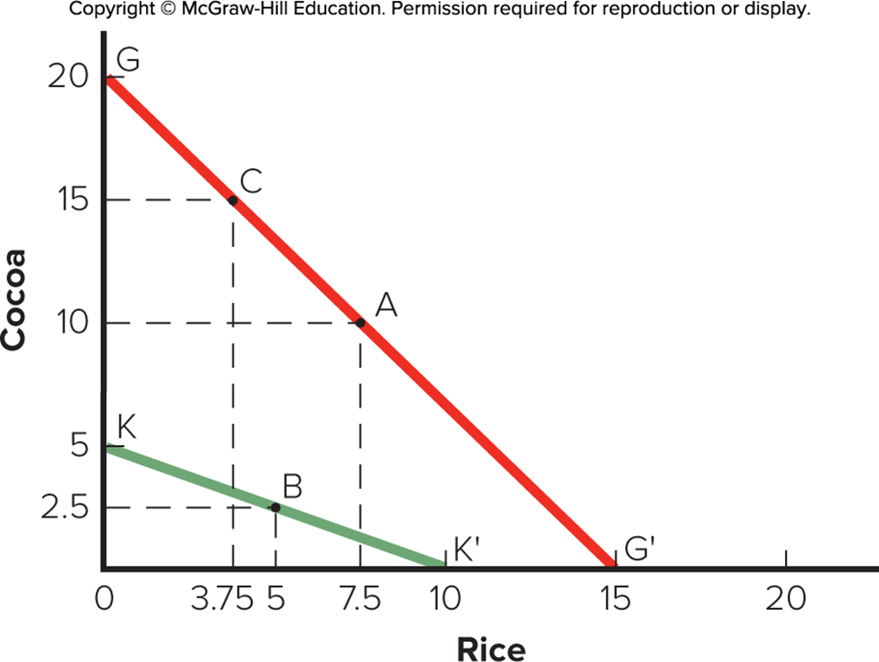
Figure 6.2 The Theory of Comparative Advantage
Access the text alternative for slide images.
Notes:
Assume that Ghana is more efficient in the production of both cocoa and rice. In Ghana, it takes 10 resources to produce one tone of cocoa, and 13 1/3 resources to produce one ton of rice. So, Ghana could produce 20 tons of cocoa and no rice, 15 tons of rice and no cocoa, or some combination of the two. In South Korea, it takes 40 resources to produce one ton of cocoa and 20 resources to produce one ton of rice. So, South Korea could produce 5 tons of cocoa and no rice, 10 tons of rice and no cocoa, or some combination of the two.

Slide 18
Comparative Advantage 2
The Gains from Trade
  Trade is a positive-sum game in which all gain.
    Potential world production is greater with unrestricted free trade than with restricted trade.
    Provides a strong rationale for encouraging free trade.
Notes:
The basic message of the theory of comparative advantage is that potential world production is greater with unrestricted free trade than it is with restricted trade. Ricardo’s theory suggests that consumers in all nations can consume more if there are no restrictions on trade.

Slide 19
Table 6.2 Comparative Advantage and the Gains from Trade 1
Resources Required to Produce 1 Ton of Cocoa and Rice
 | Cocoa | Rice
Ghana | 10 | 13.33
South Korea | 40 | 20
Production and Consumption without Trade
 | Cocoa | Rice
Ghana | 10.0 | 7.5
South Korea | 2.5 | 5.0
Total Production | 12.5 | 12.5
Production with Specialization
 | Cocoa | Rice
Ghana | 15.0 | 3.75
South Korea | 0.0 | 10.0
Total Production | 15.0 | 13.75
Notes:
The theory of comparative advantage suggests that trade is a positive-sum game in which all countries that participate realize economic gains.

Slide 20
Table 6.2 Comparative Advantage and the Gains from Trade 2
Consumption after Ghana Trades 4 Tons of Cocoa for 4 Tons of South Korean Rice
 | Cocoa | Rice
Ghana | 11.0 | 7.75
South Korea | 4.0 | 6.0
Increase in Consumption as a Result of Specialization and Trade
 | Cocoa | Rice
Ghana | 1.0 | 0.25
South Korea | 1.5 | 1.0
Notes:
The theory of comparative advantage suggests that trade is a positive-sum game in which all countries that participate realize economic gains.

Slide 21
Comparative Advantage 3
Qualifications and Assumptions
  Only two countries and two goods.
  Zero transportation costs.
  Similar prices and values.
  Resources can move freely from production of one good to another within a country.
  Constant returns to scale.
  Fixed stocks of resources.
  No effects on income distribution within countries.
Notes:
LO 6-3 Recognize why many economists believe that unrestricted free trade between nations will raise the economic welfare of countries that participate in a free trade system.
Once all the assumptions are dropped, the case for unrestricted free trade, while still positive, has been argued by some economists associated with the “new trade theory” to lose some of its strength.

Slide 22
Comparative Advantage 4
Extensions of the Ricardian Model
  Suppose the following assumptions are relaxed:
    Resources move freely from the production of one good to another within a country.
    Constant returns to scale.
    Trade does not change a country’s stock of resources or the efficiency with which those resources are utilized.

Slide 23
Comparative Advantage 5
  Immobile Resources.
    Resources do not always move freely from one economic activity to another.
    Governments may help retrain displaced workers.
  Diminishing Returns.
    Simple model assumes constant returns to specialization: the units of resources required to produce a good are assumed to remain constant.
    Assumption of diminishing returns is more realistic since not all resources are the same quality and different goods use resources in different proportions.
Notes:
The pain caused by the movement toward a free trade regime is a short-term phenomenon, while the gains from trade once the transition has been made are both significant and enduring.

Slide 24
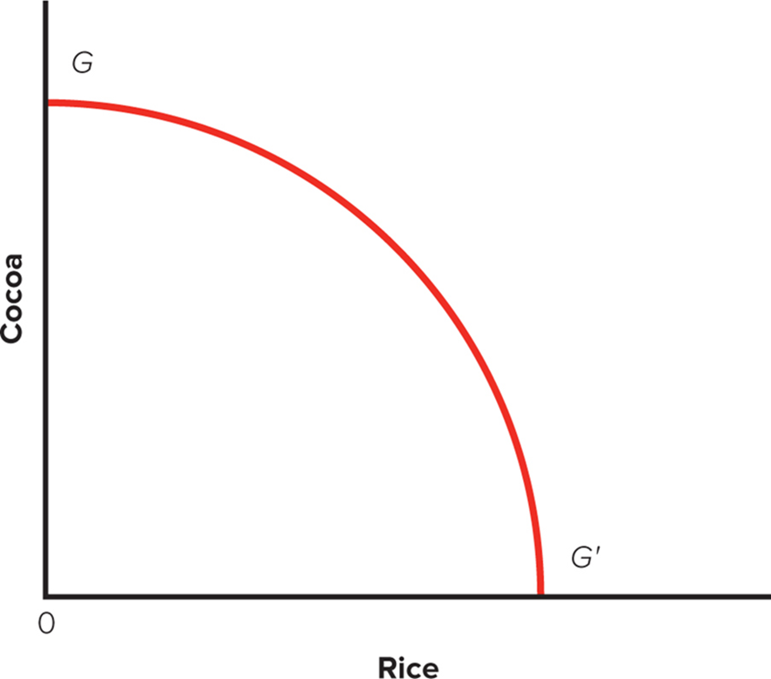
Figure 6.3 Ghana’s P P F under Diminishing Returns
Access the text alternative for slide images.
Notes:
Diminishing returns to specialization occur when more units of resources are required to produce each additional unit. While 10 units of resources may be sufficient to increase Ghana’s output of cocoa from 12 tons to 13 tons, 11 units of resources may be needed to increase output from 13 to 14 tons, 12 units of resources to increase output from 14 tons to 15 tons, and so on. Diminishing returns imply a convex PPF for Ghana.

Slide 25
Comparative Advantage 6
  Dynamic Effects and Economic Growth.
    Trade might increase a country's stock of resources as increased supplies become available from abroad.
    Free trade might increase the efficiency of resource utilization and free up resources for other uses.
    Dynamic gains will cause a country’s P P F to shift outward.
Notes:
LO 6-3 Recognize why many economists believe that unrestricted free trade between nations will raise the economic welfare of countries that participate in a free trade system.
The simple comparative advantage model assumed that trade does not change a country’s stock of resources or the efficiency with which it utilizes those resources. This static assumption makes no allowances for the dynamic changes that might result from trade.

Slide 26
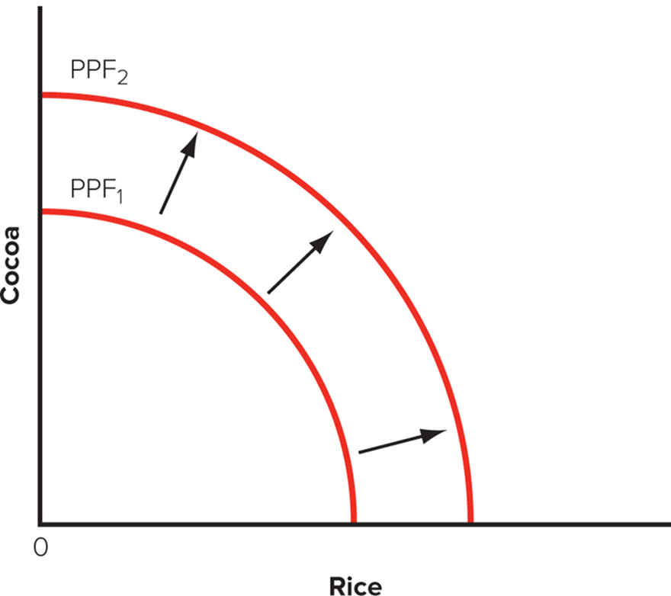
Figure 6.4 The Influence of Free Trade on the P P F
Access the text alternative for slide images.
Notes:
Dynamic gains in both the stock of a country’s resources and the efficiency with which resources are utilized will cause a country’s PPF to shift outward. This is illustrated in Figure 6.4, where the shift from PPF₁ to PPF₂ results from the dynamic gains that arise from free trade. As a consequence of this outward shift, the country in Figure 6.4 can produce more of both goods than it did before introduction of free trade. The theory suggests that opening an economy to free trade not only results in static gains of the type discussed earlier but also results in dynamic gains that stimulate economic growth.

Slide 27
Comparative Advantage 7
  Trade, Jobs, and Wages: The Samuelson Critique.
    Dynamic gains can lead to less beneficial outcomes.
    Technology advances allow companies to offshore service jobs that were not traditionally internationally mobile.
    Lowers market clearing wage rate enough to outweigh positive benefits.
    Concedes that free trade has historically benefited rich countries, and that protectionist measures may be harmful.
Notes:
One recent study found evidence in support of Samuelson’s thesis. The study looked at every county in the United States for its manufacturers’ exposure to competition from China. The researchers found that regions most exposed to China tended not only to lose more manufacturing jobs but also to see overall employment decline. Areas with higher exposure to China also had larger increases in workers receiving unemployment insurance, food stamps, and disability payments. The costs to the economy from the increased government payments amounted to two-thirds of the gains from trade with China. In other words, many of the ways trade with China has helped the United States—such as providing inexpensive goods to U.S. consumers—have been wiped out.
Other economists have dismissed Samuelson’s fears. While not questioning his analysis, they note that as a practical matter, developing nations are unlikely to be able to upgrade the skill level of their workforce rapidly enough to give rise to the situation in Samuelson’s model. In other words, they will quickly run into diminishing returns.

Slide 28
Comparative Advantage 8
  Evidence for the Link between Trade and Growth.
    Countries that are open to trade have higher growth rates than countries that close economies to trade.
    Higher growth rates raise income levels and living standards.
Notes:
The message seems clear: Adopt an open economy and embrace free trade, and your nation will be rewarded with higher economic growth rates. Higher growth will raise income levels and living standards.
Research indicates that for every 10 percent increase in the importance of international trade in an economy, average income levels will rise by at least 5 percent.

Slide 29
Heckscher–Ohlin Theory 1
Heckscher–Ohlin Theory
  Comparative advantage reflects differences in national factor endowments: extent to which a country is endowed with resources such as land, labor, and capital.
  Theory has commonsense appeal.
    Export goods that make intensive use of factors that are locally abundant.
    Import goods that make intensive use of factors that are locally scarce.
Notes:
LO 6-2 Summarize the different theories explaining trade flows between nations.
The Heckscher–Ohlin theory has commonsense appeal. For example, the United States has long been a substantial exporter of agricultural goods, reflecting in part its unusual abundance of arable land. In contrast, China has excelled in the export of goods produced in labor-intensive manufacturing industries. This reflects China’s relative abundance of low-cost labor.

Slide 30
Heckscher–Ohlin Theory 2
The Leontief Paradox
  Leontief (19 53): Since U.S. was relatively abundant in capital, it would export capital-intensive goods and import labor-intensive goods.
    U.S. exports were less capital intensive than U.S. imports.
  Possible explanations include:
    U.S. has a special advantage in producing products made with innovative technologies that are less capital intensive.
    Differences in technology lead to differences in productivity, which then drives trade patterns.
Notes:
Tests of the Heckscher–Ohlin theory using data for a large number of countries tend to confirm the existence of the Leontief paradox. This leaves economists with a difficult dilemma. They prefer the Heckscher–Ohlin theory on theoretical grounds, but it is a relatively poor predictor of real-world international trade patterns. On the other hand, the theory they regard as being too limited, Ricardo’s theory of comparative advantage, actually predicts trade patterns with greater accuracy. The best solution to this dilemma may be to return to the Ricardian idea that trade patterns are largely driven by international differences in productivity.

Slide 31
The Product Life-Cycle Theory 1
Product Life-Cycle Theory
  Vernon (mid-19 60s): proposed product life-cycle theory; based on ideas that:
    For most of 20th century, majority of world’s new products produced and sold in U.S. market.
    At the time, the wealth and size of U.S. market gave a strong incentive for U.S. firms to develop new products.
  As products mature both in location of sales and optimal production, location will change, affecting flow and direction of trade.
  Product becomes standardized and price becomes main competitive weapon.
  U.S. switches from an exporter to an importer as production goes to lower-cost foreign locations.
Notes:
LO 6-2 Summarize the different theories explaining trade flows between nations.
Just because a new product is developed by a U.S. firm and first sold in the U.S. market, it does not follow that the product must be produced in the United States. It could be produced abroad at some low-cost location and then exported back into the United States. However, Vernon argued that most new products were initially produced in America. Apparently, the pioneering firms believed it was better to keep production facilities close to the market and to the firm’s center of decision making, given the uncertainty and risks inherent in introducing new products. Also, the demand for most new products tends to be based on nonprice factors. Consequently, firms can charge relatively high prices for new products, which obviates the need to look for low-cost production sites in other countries.

Slide 32
The Product Life-Cycle Theory 2
Product Life-Cycle Theory in the Twenty-First Century
  Product life-cycle theory may not be as relevant today.
    Many products are now introduced in Japan or South Korea.
    Many new products are introduced simultaneously into U.S., Europe, and Asia.
    Production is often globally dispersed.
Notes:
In sum, although Vernon’s theory may be useful for explaining the pattern of international trade during the period of American global dominance, its relevance in the modern world seems more limited.

Slide 33
New Trade Theory 1
New Trade Theory
  Trade can increase variety of goods available and decrease average cost of goods.
    Economies of scale: unit cost reductions associated with large scale output.
  When output required to attain economies of scale represents a significant proportion of total world demand, global market may only support a small number of firms.
Notes:
LO 6-2 Summarize the different theories explaining trade flows between nations.
World trade in certain products may be dominated by countries whose firms were first movers in their production.

Slide 34
New Trade Theory 2
Increasing Product Variety and Reducing Costs
  Without trade:
    A small nation may not be able to support demand necessary for producers to realize required economies of scale, so certain products may not be produced.
  With trade:
    A nation may be able to specialize in producing a narrower range of products and then buy goods that it does not make from other countries.
    Each nation then simultaneously increases variety of goods available to its consumers and lowers costs of those goods.
Notes:
LO 6-3 Recognize why many economists believe that unrestricted free trade between nations will raise the economic welfare of countries that participate in a free trade system.
Trade is mutually beneficial because it allows the specialization of production, the realization of scale economies, the production of a greater variety of products, and lower prices.

Slide 35
New Trade Theory 3
Economies of Scale, First-Mover Advantages, and the Pattern of Trade
  First-mover advantages: economic and strategic advantages that accrue to early entrants into an industry.
  Firms develop economies of scale and create barriers to entry for other firms.
    Pattern of trade in world economy may be result of first-mover advantages and economies of scale.
Notes:
New trade theory argues that for those products where economies of scale are significant and represent a substantial proportion of world demand, the first movers in an industry can gain a scale-based cost advantage that later entrants find almost impossible to match. Thus, the pattern of trade that we observe for such products may reflect first-mover advantages.
Example: commercial aerospace industry.

Slide 36
New Trade Theory 4
Implications of New Trade Theory
  Nations may benefit from trade even when they do not differ in resource endowments or technology.
  A country may predominate in export of goods because it was lucky enough to have one or more firms be first to produce them.
  New trade theory:
    At a variance with Heckscher-Ohlin theory.
    Useful in explaining trade patterns.
    Provides economic rationale for proactive trade policy that is at variance with other free trade theories.
Notes:
New trade theorists stress the role of luck, entrepreneurship, and innovation in giving a firm first-mover advantages.

Slide 37
National Competitive Advantage: Porter’s Diamond 1
International Trade
  Harvard strategist Michael Porter believed existing theories of international trade only told part of story.
  Wanted to explain why a nation achieves international success in a particular industry.
  Porter’s Diamond: four attributes of a nation that shape the environment in which local firms compete.
  Chance and government can influence national diamond.
Notes:
LO 6-2 Summarize the different theories explaining trade flows between nations.
For Porter, the essential task was to explain why a nation achieves international success in a particular industry.
Why does Japan do so well in the automobile industry?
Why does Switzerland excel in the production and export of precision instruments and pharmaceuticals?
Why do Germany and the United States do so well in the chemical industry?

Slide 38
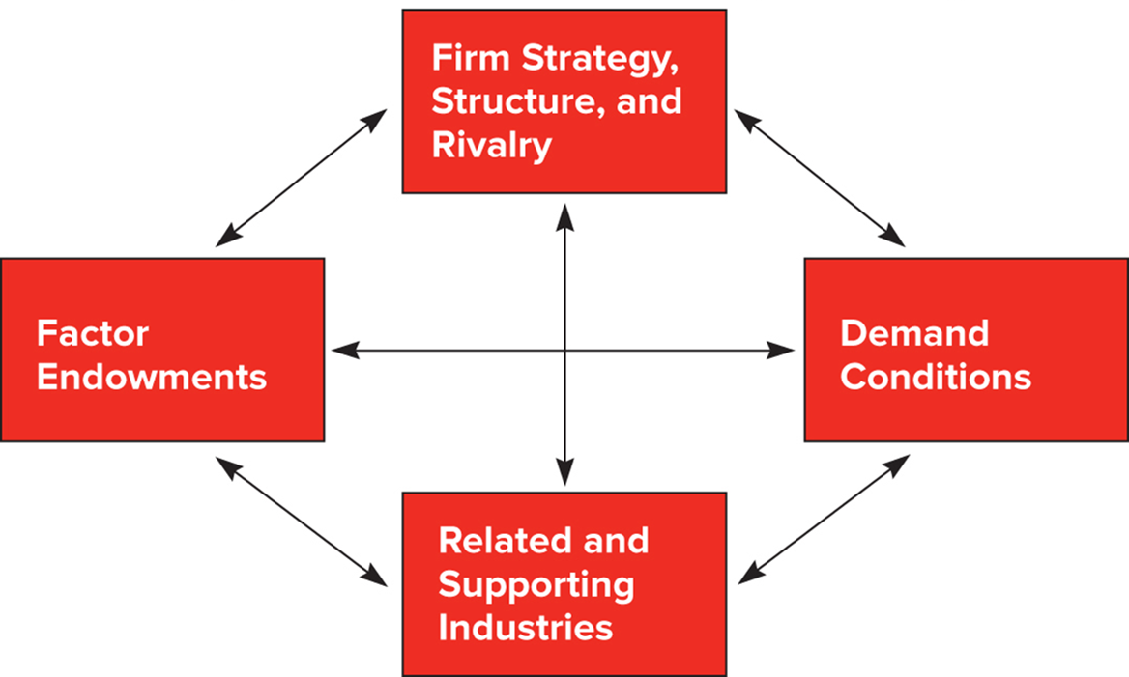
Figure 6.5 The Determinants of National Competitive Advantage: Porter’s Diamond
Access the text alternative for slide images.
Source: Michael E. Porter, The Competitive Advantage of Nations (New York: Free Press, 19 90; republished with a new introduction, 19 98), p. 72
Notes:
Porter (1990) tried to explain why a nation achieves international success in a particular industry.
Porter identified four attributes he calls the diamond that promote or impede the creation of competitive advantage:
Factor endowments
Demand conditions
Related and supporting industries
Firm strategy, structure, and rivalry
In addition, Porter identified two additional variables (chance and government) that can influence the diamond in important ways.

Slide 39
National Competitive Advantage: Porter’s Diamond 2
Factor Endowments
  Hierarchies among factors:
    Basic: natural resources, climate, location, demographics.
    Advanced: communication infrastructure, skilled labor, research facilities, technological know-how.
  Basic factors can provide initial advantage that is extended by investment in advanced factors.
  Advanced factors are most significant for competitive advantage.
    Example: Japan’s large pool of engineers.
Notes:
Factor endowments lie at the center of the Heckscher–Ohlin theory. While Porter does not propose anything radically new, he does analyze the characteristics of factors of production. He recognizes hierarchies among factors, distinguishing between basic factors (for example, natural resources, climate, location, and demographics) and advanced factors (for example, communication infrastructure, sophisticated and skilled labor, research facilities, and technological know-how).

Slide 40
National Competitive Advantage: Porter’s Diamond 3
Demand Conditions
  Nature of home demand for an industry’s product or service.
  Influence the development of capabilities.
  Sophisticated and demanding customers pressure firms to be more competitive and produce high-quality, innovative products.
Notes:
Porter emphasizes the role home demand plays in upgrading competitive advantage. Firms are typically most sensitive to the needs of their closest customers. Thus, the characteristics of home demand are particularly important in shaping the attributes of domestically made products and in creating pressures for innovation and quality.

Slide 41
National Competitive Advantage: Porter’s Diamond 4
Related and Supporting Industries
  Presence of supplier industries and related industries that are internationally competitive.
  Investing in these industries can spill over and contribute to success in other industries.
  Successful industries are grouped in clusters within countries, prompting knowledge flows between firms.
    Example: Germany’s textile and apparel sector.
Notes:
The benefits of investments in advanced factors of production by related and supporting industries can spill over into an industry, thereby helping it achieve a strong competitive position internationally. Swedish strength in fabricated steel products (for example, ball bearings and cutting tools) has drawn on strengths in Sweden’s specialty steel industry.

Slide 42
National Competitive Advantage: Porter’s Diamond 5
Firm Strategy, Structure, and Rivalry
  Different nations are characterized by different management ideologies.
    Either help or do not help them build national competitive advantage.
  Strong association between vigorous domestic rivalry and creation and persistence of competitive advantage in an industry.
Notes:
Nations are characterized by different management ideologies which influence the ability of firms to build national competitive advantage. According to Porter, one consequence of these different management ideologies was a relative loss of U.S. competitiveness in those engineering-based industries where manufacturing processes and product design issues are all-important (for example, the automobile industry).

Slide 43
National Competitive Advantage: Porter’s Diamond 6
Evaluating Porter’s Theory
  If Porter is correct, his model should predict pattern of international trade in real world.
    Countries should export products from industries where diamond is favorable.
    Countries should import products from areas where diamond is not favorable.
  Little empirical testing of theory.
Notes:
LO 6-4 Explain the arguments of those who maintain that government can play a proactive role in promoting national competitive advantage in certain industries.
Porter contends that the degree to which a nation is likely to achieve international success in a certain industry is a function of the combined impact of factor endowments, domestic demand conditions, related and supporting industries, and domestic rivalry.
Porter also contends that government can influence each of the four components of the diamond—either positively or negatively. Government can shape domestic demand through local product standards or with regulations that mandate or influence buyer needs. Government policy can influence supporting and related industries through regulation and influence firm rivalry through such devices as capital market regulation, tax policy, and antitrust laws.

Slide 44
360° View: Managerial Implications 1
Location, First-Mover Advantages, Government Policy, Investments, and Strategy
  Location.
    Different countries have particular advantages in different productive activities.
  First-mover advantages.
    Particularly true in industries where global market can profitably support a limited number of firms.
  Government policy.
    Businesses can exert strong influence on government trade policy.
Notes:
LO 6-5 Understand the important implications that international trade theory holds for business practice.
Underlying most of the theories we have discussed is the notion that different countries have particular advantages in different productive activities. These differences influence a firm’s decision about where to locate productive activities. A firm should disperse its productive activities to those countries where they can be performed most efficiently.
Firms that establish a first-mover advantage in the production of a new product may later dominate global trade in that product.
Government policies on free trade or protecting domestic industries can significantly impact global competitiveness. Businesses should encourage free trade policies.

Slide 45
360° View: Managerial Implications 2
Changes in Government Policy, Investments, and Business Strategy
  International order regarding trade has been based on rules established by World Trade Organization.
    Works toward lowering trade barriers for goods and services.
    Created predictable environments that made trade less risky.
Shift in U.S. trade policy under Trump administration has resulted in unpredictability and uncertainty about the future for businesses.
Notes:
When investment risks increase, businesses typically do three things.
First, they reduce their investments in risky projects, which in this context would probably mean lower investments in countries involved in a trade war.
Second, they hedge their bets. Hedging bets might require a firm like Apple to source a component from several different locations and, perhaps, to assemble in multiple locations so that if a trade dispute and higher tariff barriers make one location less economical, the firm can shift some of its production to another location. Hedging bets might also require the firm to increase its domestic production, even if doing do raises costs. It should be noted that reducing investments risks, and hedging by sourcing from multiple locations, will reduce the efficiency of resource allocation in the global economy, depress and/or distort trade flows, and lower economic growth rates going forward.
Third, to counteract all of this, business can and will lobby governments to encourage them to resolve disputes and create a more stable and predictable environment.

Slide 46
Summary
In this chapter, we have
Understood why nations trade with each other.
Summarized the different theories explaining trade flows between nations.
Recognized why many economists believe that unrestricted free trade between nations will raise the economic welfare of countries that participate in a free trade system.
Explained the arguments of those who maintain that government can play a proactive role in promoting national competitive advantage in certain industries.
Understood the important implications that international trade theory holds for business practice.

Slide 47
End of Main Content
© 2022 McGraw Hill. All rights reserved. Authorized only for instructor use in the classroom. No reproduction or further distribution permitted without the prior written consent of McGraw Hill.

Slide 48
Accessibility Content: Text Alternatives for Images

Slide 49
Figure 6.1 The Theory of Absolute Advantage – Text Alternative
Return to parent-slide containing images.
The vertical axis is labeled Cocoa and ranges from 0 to 20 in increments of 5. The horizontal axis is labelled Rice and ranges from 0 to 20 in increments of 5. A line goes from a point G at 0 rice and 20 cocoa to a point marked G prime at 10 rice and 0 cocoa. A line goes from a point K at 0 rice and 5 cocoa to a point marked K prime at 20 rice and 0 cocoa. Point A is marked at 5 rice and 10 cocoa. Point B is marked at 10 rice and 2.5 cocoa.
Return to parent-slide containing images.

Slide 50
Figure 6.2 The Theory of Comparative Advantage – Text Alternative
Return to parent-slide containing images.
The vertical axis is labelled Cocoa and ranges from 0 to 20 in increments of 5. The horizontal axis is labelled Rice and ranges from 0 to 20 in increments of 5. A line goes from a point G at 0 rice and 20 cocoa to a point marked G prime at 15 rice and 0 cocoa. A line goes from a point K at 0 rice and 5 cocoa to a point marked K prime at 10 rice and 0 cocoa. Point A is marked at 7.5 rice and 10 cocoa. Point B is marked at 5 rice and 2.5 cocoa. Point C is marked at 3.75 rice and 15 cocoa.
Return to parent-slide containing images.

Slide 51
Figure 6.3 Ghana’s P P F under Diminishing Returns – Text Alternative
Return to parent-slide containing images.
The vertical axis is labelled Cocoa. The horizontal axis is labelled Rice. A curve starts at a point G with 0 rice and a high number of cocoa and curves down to the right to a point G prime high in rice and 0 cocoa.
Return to parent-slide containing images.

Slide 52
Figure 6.4 The Influence of Free Trade on the P P F – Text Alternative
Return to parent-slide containing images.
The vertical axis is labelled Cocoa. The horizontal axis is labelled Rice. A curve labelled P P F 1 starts above the middle of the vertical axis and goes down to the right to about the center of the horizontal axis. A bigger curve labelled P P F 2 forms a wider similar arc to the right of the first curve. Arrows from the first curve point to the second.
Return to parent-slide containing images.

Slide 53
Figure 6.5 The Determinants of National Competitive Advantage: Porter’s Diamond – Text Alternative
Return to parent-slide containing images.
4 boxes are connected by arrows forming a diamond. The boxes are labelled as follows. 1. Firm Strategy, Structure, and Rivalry. 2. Demand Conditions. 3. Related and Supporting Industries. 4. Factor Endowments.
Return to parent-slide containing images.

