Slide 1

Chapter 7
Government Policy and International Trade
naqiewei/DigitalVision Vectors/Getty Images
© 2022 McGraw Hill. All rights reserved. Authorized only for instructor use in the classroom. No reproduction or further distribution permitted without the prior written consent of McGraw Hill.

Slide 2
Learning Objectives
7-1 Identify the policy instruments used by governments to influence international trade flows.
7-2 Understand why governments sometimes intervene in international trade.
7-3 Summarize and explain the arguments against strategic trade policy.
7-4 Describe the development of the world trading system and the current trade issue.
7-5 Explain the implications for managers of developments in the world trading system.

Slide 3
Opening Case
America and Kenya Negotiate a Trade Deal
  Although he spent much time erecting trade barriers while in office, in 2020 President Trump wanted to negotiate a free trade deal with Kenya.
    Africa is only a few years away from being the world’s population center.
    Trade deal seen as step toward countering China's influence there.
  Kenya is East Africa’s economic, financial, and transportation hub, with a reputation for entrepreneurial activity.
  Kenya has signaled interest in a trade deal with the U.S., although some concerns remain.
Notes:
Some current Chinese projects, including those in Kenya, have left African governments saddled with billions of dollars of debt to China. They have also sparked distrust and resentment at China, which has often used Chinese companies and managers to complete the projects, leading to charges of neocolonialism. It hasn’t helped China’s case that some of these managers have been caught on phone videos making racist comments to their African workers.
Sources: “America and Kenya Eye Up a Trade Deal,” The Economist, February 6, 2020; C. Felter, “What Would a U.S.-Kenya Trade Deal Mean?” Council on Foreign Relations, February 21, 2020; J. Goldstein, “Kenyans Say Chinese Investment Brings Racism and Discrimination,” The New York Times, October 15, 2018; A. Swanson, “U.S. to Start Trade Talks with Kenya to Counter China’s Influence,” The New York Times, February 6, 2020.

Slide 4
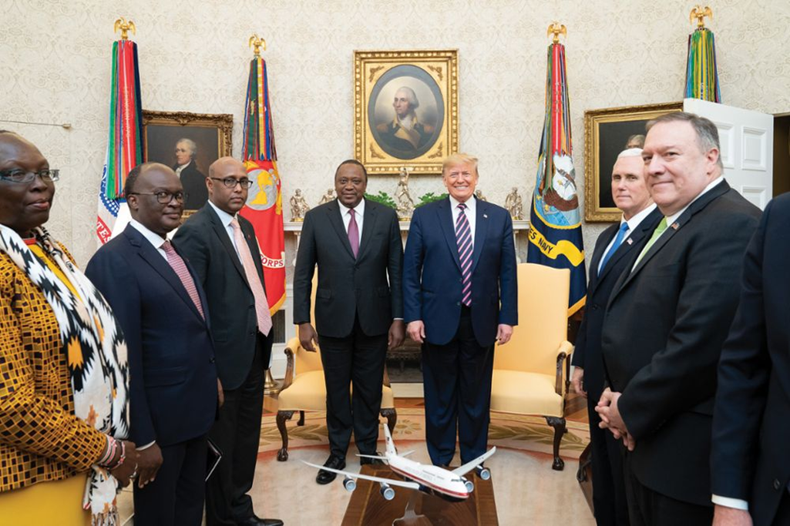
Trade Deal
President Donald J. Trump meets with Kenya’s President Uhuru Kenyatta on February 6, 2020, in the Oval Office of the White House.
Tia Dufour/Official White House Photo

Slide 5
Introduction
Free Trade
  Absence of barriers to the free flow of goods and services between countries.
    Government does not attempt to restrict what its citizens can buy from another country or what they can sell to another country.
  While many nations are nominally committed to free trade, they tend to intervene in international trade to protect the interests of politically important groups.
  General Agreement on Tariffs and Trade (G A T T): international treaty that committed signatories to lowering barriers to the free flow of goods across national borders and led to the W T O.
Notes:
The theories of Smith, Ricardo, and Heckscher–Ohlin predict that the consequences of free trade include both static economic gains (because free trade supports a higher level of domestic consumption and more efficient utilization of resources) and dynamic economic gains (because free trade stimulates economic growth and the creation of wealth).

Slide 6
Instruments of Trade Policy 1
Seven Main Instruments of Trade Policy
  Tariffs.
  Subsidies.
  Import quotas.
  Voluntary export restraints.
  Local content requirements.
  Administrative policies.
  Antidumping duties.
Notes:
LO 7-1 Identify the policy instruments used by governments to influence international trade flows.
Tariffs are the oldest and simplest instrument of trade policy.

Slide 7
Instruments of Trade Policy 2
Rise in Nontariff Barriers
  Subsidies.
  Quotas.
  Voluntary export restraints.
  Antidumping duties.
Notes:
Until the income tax was introduced, for example, the U.S. government received most of its revenues from tariffs.

Slide 8
Instruments of Trade Policy 3
Tariffs
  A tax levied on imports that effectively raises the cost of imported products relative to domestic products.
    Specific tariffs: levied as a fixed charge for each unit of an imported good.
    Ad valorem tariffs: levied as a proportion of the value of an imported good.
Notes:
In most cases, tariffs are placed on imports to protect domestic producers from foreign competition by raising the price of imported goods. However, tariffs also produce revenue for the government. Until the income tax was introduced, for example, the U.S. government received most of its revenues from tariffs.

Slide 9
Instruments of Trade Policy 4
  Increase government revenues.
  Provide protection to domestic producers against foreign competitors by increasing the cost of imported foreign goods.
  Force consumers to pay more for certain imports.
  Tariffs are generally pro-producer and anticonsumer.
  Import tariffs reduce the overall efficiency of the world economy.
Notes:
Sometimes tariffs are levied on exports of a product from a country. Export tariffs are less common than import tariffs. In general, export tariffs have two objectives: first, to raise revenue for the government, and second, to reduce exports from a sector, often for political reasons.

Slide 10
Instruments of Trade Policy 5
Subsidies
  Subsidy: a government payment to a domestic producer.
  Subsidies help domestic producers:
    Compete against low-cost foreign imports.
    Gain export markets.
  Consumers typically absorb the costs of subsidies.
  Debatable if subsidies generate worthwhile national benefits.
Notes:
Subsidies take many forms, including cash grants, low-interest loans, tax breaks, and government equity participation in domestic firms.
Whether subsidies generate national benefits that exceed their national costs is debatable. In practice, many subsidies are not that successful at increasing the international competitiveness of domestic producers. Rather, they tend to protect the inefficient and promote excess production.

Slide 11
Instruments of Trade Policy 6
Import Quotas and Voluntary Export Restraints
  Import quota: a direct restriction on the quantity of some good that may be imported into a country.
  Tariff rate quota: hybrid of a quota and a tariff; a lower tariff is applied to imports within the quota than those over the quota.
  Voluntary export restraint (V E R): quota on trade imposed by the exporting country, typically at the request of the importing country’s government.
  Quota rent: extra profit that producers make when supply is artificially limited by an import quota.
Notes:
Import quotas and voluntary export restraints benefit domestic producers by limiting import competition, but they raise the prices of imported goods for consumers.

Slide 12
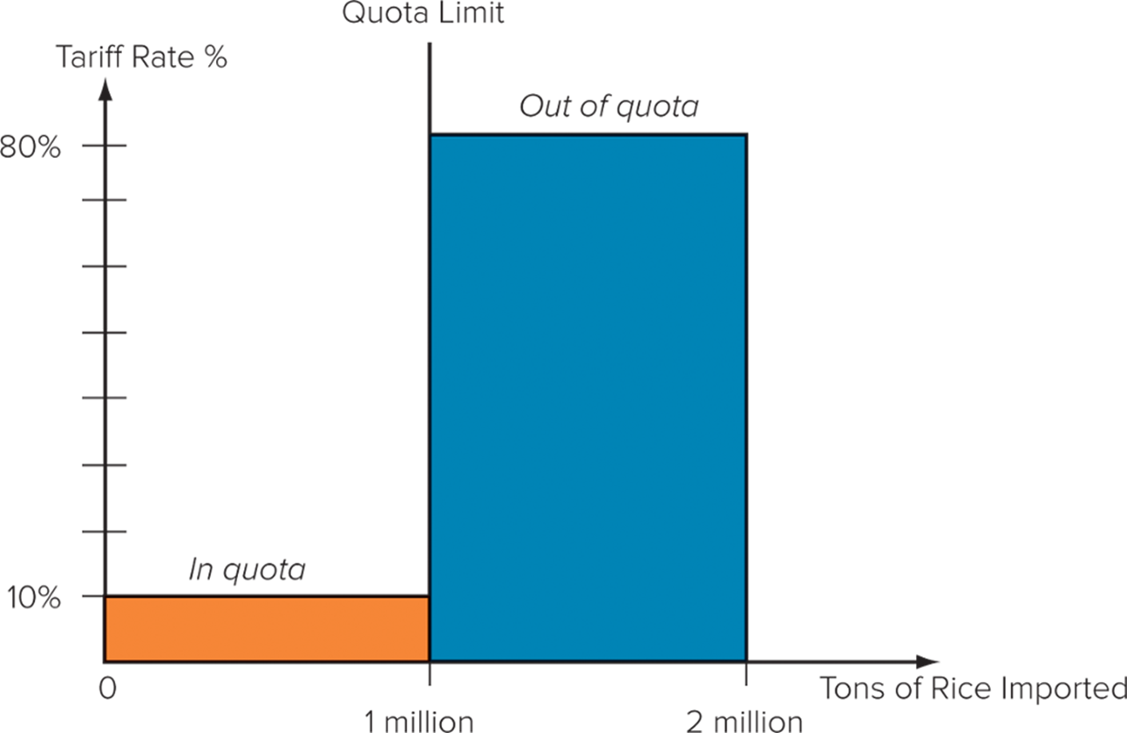
Figure 7.1 Hypothetical Tariff Rate Quota
Access the text alternative for slide images.
Notes:
As illustrated in Figure 7.1, an ad valorem tariff rate of 10 percent might be levied on 1 million tons of rice imports into South Korea, after which an out-of-quota rate of 80 percent might be applied. Thus, South Korea might import 2 million tons of rice, 1 million at a 10 percent tariff rate and another 1 million at an 80 percent tariff. Tariff rate quotas are common in agriculture, where their goal is to limit imports over quota.

Slide 13
Instruments of Trade Policy 7
Export Tariffs and Bans
  Export tariff: tax placed on the export of a good.
    Goal is to discriminate against exporting to ensure supply.
  Export ban: policy that partially or entirely restricts the export of a good.
    Ban of exports of U.S. crude oil in 19 75 to ensure sufficient supply of domestic oil at home.
Notes:
For example, in the past, China has placed an export tariff on the export of grain to ensure that there is sufficient supply in China. Similarly, during its infrastructure building boom, China had an export tari f in place on certain kinds of steel products to ensure that there was sufficient supply of steel within the country. The steel tariffs were removed in late 2015. Because most countries try to encourage exports, export tariffs are relatively rare.

Slide 14
Instruments of Trade Policy 8
Local Content Requirement (L C R)
  Demands that some specific fraction of a good be produced domestically.
    Can be in physical terms or in value terms.
  Local content requirements benefit domestic producers and jobs, but consumers face higher prices.
Notes:
A little-known law in the United States, the Buy America Act, specifies that government agencies must give preference to American products when putting contracts for equipment out to bid unless the foreign products have a significant price advantage. The law specifies a product as “American” if 51 percent of the materials by value are produced domestically. This amounts to a local content requirement.

Slide 15
Instruments of Trade Policy 9
Administrative Policies
  Administrative trade policies: bureaucratic rules designed to make it difficult for imports to enter a country.
  Hurt consumers by denying access to possibly superior foreign products.
Notes:
It has been argued that the Japanese are the masters of this trade barrier. In recent decades, Japan’s formal tariff and nontariff barriers have been among the lowest in the world. However, critics charge that the country’s informal administrative barriers to imports more than compensate for this.

Slide 16
Instruments of Trade Policy 10
Antidumping Policies
  Dumping: selling goods in a foreign market below their cost of production or below their “fair” market value.
  Antidumping policies punish foreign firms that engage in dumping, thus protecting domestic producers from unfair foreign competition.
    Vary from country to country.
  U.S. firms that believe a foreign firm is dumping can file a complaint with two government agencies: Commerce Department and the International Trade Commission (I T C).
    If the complaint has merit, antidumping duties, also known as countervailing duties, may be imposed.
Notes:
Dumping is viewed as a method by which firms unload excess production in foreign markets. Some dumping may be the result of predatory behavior, with producers using substantial profits from their home markets to subsidize prices in a foreign market with a view to driving indigenous competitors out of that market. Once this has been achieved, so the argument goes, the predatory firm can raise prices and earn substantial profits.

Slide 17
The Case for Government Intervention 1
Political Arguments
Protecting the interests of certain groups within a nation (normally producers), often at the expense of other groups (normally consumers).
Achieving some political objective such as protecting the environment or human rights.
Economic Arguments
  Boosting the overall wealth of a nation (to the benefit of both producers and consumers).
Notes:
LO 7-2 Understand why governments sometimes intervene in international trade.

Slide 18
The Case for Government Intervention 2
Political Arguments for Intervention
  Protecting jobs and industries.
  Protecting national security.
  Retaliating.
    Use intervention as a bargaining tool and force trading partners to “play by the rules of the game.”
    Risky strategy.
Notes:
Protecting jobs and industries is the most common political reason for trade restrictions. The national security argument is less common today than in the past.
When the Trump Administration announced tariffs on imports of foreign steel and aluminum on March 1, 2018, national security issues were cited as a primary justification. This was the first time since 1986 that a national security threat was used to justify tariffs imposed by the United States. In 2017, the United States was importing about 30 percent of steel used in the country, with the largest source of imports being Canada and Mexico. Interestingly, and counter to the argument of the Trump Administration, critics argued that by raising input prices for many U.S. defense contractors, who tend to be big consumers of steel and aluminum, the tariffs would actually harm the U.S. defense industry and have a negative impact on national security.

Slide 19
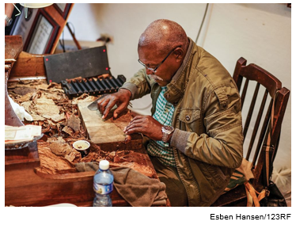
The Case for Government Intervention 3
  Protecting consumers.
    Ban unsafe products.
  Furthering foreign policy objectives.
    Grant preferential trade terms to a country it wants to build relations with.
    Pressure or punish “rogue” states.
Protecting human rights.
The famous cigar maker Jose Castelar Cairo, better known as El Cueto, about to roll a cigar, in Havana, Cuba.
Notes:
Other countries can undermine unilateral trade sanctions. The U.S. sanctions against Cuba, for example, did not stop other Western countries from trading with Cuba. The U.S. sanctions have done little more than help create a vacuum into which other trading nations, such as Canada and Germany, have stepped.

Slide 20
The Case for Government Intervention 4
Economic Arguments for Intervention
  The infant industry argument.
    An industry should be protected until it can develop and be viable and competitive internationally.
    This argument has been criticized because:
      It is useless unless it makes the industry more efficient.
      If a country has the potential to develop a viable competitive position, its firms should be capable of raising necessary funds.
Notes:
This argument has had substantial appeal for the governments of developing nations during the past 50 years, and the GATT has recognized the infant industry argument as a legitimate reason for protectionism.

Slide 21
The Case for Government Intervention 5
  Strategic trade policy.
    By appropriate actions, government can help raise national income if it can ensure firms that gain first-mover advantages in an industry are domestic.
    Might be beneficial for a government to intervene in an industry by helping domestic firms overcome barriers to entry created by foreign firms with first-mover advantages.
Notes:
If these arguments are correct, they support a rationale for government intervention in international trade. Governments should target technologies that may be important in the future and use subsidies to support development work aimed at commercializing those technologies. Furthermore, government should provide export subsidies until the domestic firms have established first-mover advantages in the world market. Government support may also be justified if it can help domestic firms overcome the first-mover advantages enjoyed by foreign competitors and emerge as viable competitors in the world market.

Slide 22
The Revised Case for Free Trade 1
New Trade Theorists
  Believe government intervention in international trade is justified.
  Classical trade theorists disagree.
    Adam Smith and David Ricardo.
Some new trade theorists believe that while strategic trade theory is appealing in theory, it may not be workable in practice—they suggest a revised case for free trade.
Notes:
LO 7-3 Summarize and explain the arguments against strategic trade policy.

Slide 23
The Revised Case for Free Trade 2
Retaliation and Trade War
  Krugman: strategic trade policies to establish domestic firms in a dominant position in a global industry are beggar-thy-neighbor policies that boost national income at the expense of other countries.
    A country that attempts to use such policies will probably provoke retaliation.
    A trade war could leave both countries worse off.
    Don’t engage in retaliation but help establish rules to minimize the use of trade-distorting subsidies.
Notes:
Krugman may be right about the danger of a strategic trade policy leading to a trade war. The problem, however, is how to respond when one’s competitors are already being supported by government subsidies.

Slide 24
The Revised Case for Free Trade 3
Domestic Policies
  Governments can be influenced by special interest groups.
    A government’s decision to intervene in a market may appease a certain group but not necessarily support the interests of the country as a whole.
    Krugman sees this as a further reason for not embracing strategic trade policy.
Notes:
The European Union’s support for the Common Agricultural Policy (CAP), which arose because of the political power of French and German farmers, is an example. The CAP benefits inefficient farmers and the politicians who rely on the farm vote but not consumers in the EU, who end up paying more for their foodstuffs.

Slide 25
Development of the World Trading System 1
International Trading Framework
  Evolved since World War I I to govern world trade.
  In its first 50 years, the framework was known as the General Agreement on Tariffs and Trade (G A T T).
  Since 19 95, the framework has been known as the World Trade Organization (W T O).
Notes:
LO 7-4 Describe the development of the world trading system and the current trade issue.
Economic arguments support unrestricted free trade. While many governments have recognized the value of these arguments, they have been unwilling to unilaterally lower their trade barriers for fear that other nations might not follow suit.

Slide 26
Development of the World Trading System 2
From Smith to the Great Depression
  Repeal of British Corn Laws was first free trade government policy; British continued pushing for trade liberalization.
  But up until the Great Depression of the 1930s, most countries had some degree of protectionism.
  U.S. enacted the Smoot-Hawley Act (19 30): created significant import tariffs on foreign goods.
    Damaged employment abroad.
Other nations took similar steps, and as the depression deepened, world trade fell further.
Notes:
Free trade as a government policy was first officially embraced by Great Britain in 1846, when the British Parliament repealed the Corn Laws. The Corn Laws placed a high tariff on imports of foreign corn. The objectives of the Corn Laws tariff were to raise government revenues and to protect British corn producers. There had been annual motions in Parliament in favor of free trade since the 1820s, when David Ricardo was a member. However, agricultural protection was withdrawn only as a result of a protracted debate when the effects of a harvest failure in Great Britain were compounded by the imminent threat of famine in Ireland. Faced with considerable hardship and suffering among the populace, Parliament narrowly reversed its long-held position.
During the next 80 years or so, Great Britain, as one of the world’s dominant trading powers, pushed the case for trade liberalization, but the British government was a voice in the wilderness.

Slide 27
Development of the World Trading System 3
19 47 to 19 79: G A T T, Trade Liberalization, and Economic Growth
  The General Agreement on Tariffs and Trade (G A T T) was established in 19 47.
    Multilateral agreement to liberalize trade and gradually eliminate barriers to trade.
    Membership grew from 19 to more than 120 nations.
    Tariff reduction was spread over eight rounds.
    Very successful in early rounds.
G A T T superseded by the World Trade Organization (W T O).
Notes:
In its early years, the GATT was by most measures very successful. For example, the average tariff declined by nearly 92 percent in the United States between the Geneva Round of 1947 and the Tokyo Round of 1973 to 1979. Consistent with the theoretical arguments first advanced by Ricardo, the move toward free trade under the GATT appeared to stimulate economic growth.

Slide 28
Development of the World Trading System 4
19 80 to 19 93: Protectionist Trends
  Trading system erected by the G A T T came under strain as pressures for greater protectionism increased.
  Japan’s economic success strained what had been more equal trading patterns.
  Persistent trade deficits by the U.S caused significant problems in some industries and political problems for the government.
  Many countries found that although G A T T limited the use of tariffs, other forms of intervention had the same effect but did not technically violate G A T T.
Notes:
Bilateral voluntary export restraints (VERs) circumvented GATT agreements, because neither the importing country nor the exporting country complained to the GATT bureaucracy in Geneva—and without a complaint, the GATT bureaucracy could do nothing.

Slide 29
Development of the World Trading System 5
The Uruguay Round and the World Trade Organization
  Uruguay Round emphasized services, intellectual property, and agricultural subsidies.
    Dragged on for seven years.
The World Trade Organization.
The W T O encompassed G A T T, the General Agreement on Trade in Services (G A T S), and the Agreement on Trade Related Aspects of Intellectual Property Rights (T R I P S).
Procedures subject to strict time limits.
Notes:
The Uruguay Round dragged on for seven years before an agreement was reached on December 15, 1993. It went into effect July 1, 1995. The Uruguay Round contained the following provisions:
Tariffs on industrial goods were to be reduced by more than one-third, and tariffs were to be scrapped on more than 40 percent of manufactured goods.
Average tariff rates imposed by developed nations on manufactured goods were to be reduced to less than 4 percent of value, the lowest level in modern history.
Agricultural subsidies were to be substantially reduced.
GATT fair trade and market access rules were to be extended to cover a wide range of services.
GATT rules also were to be extended to provide enhanced protection for patents, copyrights, and trademarks (intellectual property).
Barriers on trade in textiles were to be significantly reduced over 10 years.
The World Trade Organization was to be created to implement the GATT agreement.

Slide 30
Development of the World Trading System 6
W T O: Experience to Date
  Members account for 98 percent of world trade.
  It was hoped that it would emerge as an effective advocate and facilitator of future trade deals.
  Started strong but has fallen off since late 19 90s.
  Brexit and Trump administration indicated a return to greater protectionism.
Notes:
By 2020, the WTO had 164 members, including China, which joined at the end of 2001, and Russia, which joined in 2012.

Slide 31
Development of the World Trading System 7
  W T O as global police.
    First two decades suggest that it is having a positive effect.
    Resolved three-fourths of cases via informal consultations.
  Expanded trade agreements.
    Uruguay Round extended global trading rules to cover services.
    Telecommunications, financial services.
    Foreign direct investment.
Notes:
Seventy countries agreed to dramatically lower or eradicate barriers to foreign direct investment in their financial services sector. The United States and the European Union (with minor exceptions) are fully open to inward investment by foreign banks, insurance, and securities companies. As part of the deal, many Asian countries made important concessions that allow significant foreign participation in their financial services sectors for the first time.

Slide 32
Development of the World Trading System 8
W T O: Unresolved Issues and the Doha Round
  Antidumping actions.
    Encourage members to strengthen regulations governing the imposition of antidumping duties.
Protectionism in agriculture.
Concerned with high level of tariffs and subsidies in agricultural sector of many economies.
Protection of intellectual property.
Members believe protection of intellectual property rights is essential to the international trading system.
Notes:
TRIPS obliges WTO members to grant and enforce patents lasting at least 20 years and copyrights lasting 50 years.

Slide 33
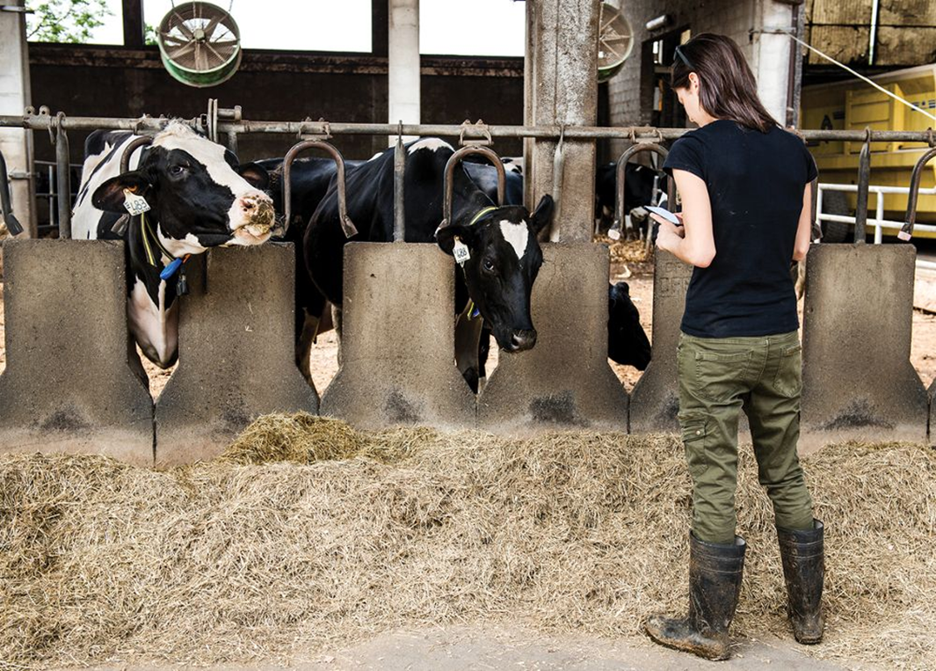
Protecting Agriculture
Production operations at J.M. Larson Dairy.
Bonfanti Diego/Getty Images
Notes:
The historically high tariff rates on agricultural products reflect a desire to protect domestic agriculture and traditional farming communities from foreign competition. In addition to high tariffs, agricultural producers also benefit from substantial subsidies.
The net effect is to raise prices to consumers, reduce the volume of agricultural trade, and encourage the overproduction of products that are heavily subsidized (with the government typically buying the surplus). Because global trade in agriculture currently amounts to around 10 percent of total merchandized trade, the WTO argues that removing tariff barriers and subsidies could significantly boost the overall level of trade, lower prices to consumers, and raise global economic growth by freeing consumption and investment resources for more productive uses.

Slide 34
Development of the World Trading System 9
  Market access for nonagricultural goods and services.
    Tariffs on services remain higher than on industrial goods.
  A new round of talks: Doha.
    Ongoing since 2001.
    Concerned with cutting tariffs on industrial goods and services, phasing out subsidies to agricultural producers, reducing barriers to cross-border investment, and limiting use of antidumping laws.
Notes:
As of 2018, the goal for the Doha round was to reduce tariffs for manufactured and agricultural goods by 60 to 70 percent and to cut subsidies to half of their current level—but getting nations to agree to these goals was proving exceedingly difficult.

Slide 35
Development of the World Trading System 10
Multilateral and Bilateral Trade Agreements
  Reciprocal trade agreements between two or more partners.
  Trump administration withdrew from the T P P and trade agreement with the E U was put on hold.
  Agreements are designed to capture gain from trade beyond those agreements currently attainable under W T O treaties.
Notes:
In response to the apparent failure of the Doha Round to progress, many nations have pushed forward with multilateral or bilateral trade agreements, which are reciprocal trade agreements between two or more partners. For example, in 2014 Australia and China entered into a bilateral free trade agreement.
Multilateral and bilateral trade agreements are designed to capture gain from trade beyond those agreements currently attainable under WTO treaties.

Slide 36
Development of the World Trading System 11
The World Trading System Under Threat
  Two events suggest that global consensus on free trade isn’t accurate:
    Decision by the British to withdraw from the E U.
    2016 election of Donald Trump, who appeared to hold mercantilist views on trade.
      Withdrew from Trans-Pacific Partnership.
      Placed tariffs on certain imports.
      Renegotiated N A F T A.
      Expressed hostility to the W T O.
Notes:
In late 2019, the Trump administration also blocked replacements for two judges on the WTO’s appellate body, which hears appeals in trade disputes. With just one judge remaining, it will no longer be able to hear new cases, which effectively undermines the WTO’s enforcement mechanism. The significance of these developments is that heretofore both Britain and America have been leaders in the global push toward greater free trade.

Slide 37
Development of the World Trading System 12
In 2020, the Director General of the W T O noted that in its first 25 years, the binding rules governing international trade facilitated dramatic growth in cross-border activity.
Also noted the W T O faces unmatched challenges today that will affect the global economy for decades.
Notes:
The Director General of the WTO is referring to the rise of tariffs, the ongoing trade dispute between the world’s two largest economies, the United States and China, and the apparent belief of the Trump administration that bilateral agreements, and managed trade deals, are superior to the rules-based multilateral trade order embodied in the WTO.

Slide 38
360° View: Managerial Implications 1
Trade Barriers, Firm Strategy, and Policy Implications
  Trade Barriers and Firm Strategy.
    Tariff barriers raise the costs of exporting.
    Quotas may limit a firm’s ability to serve a country.
    Firms may need to conform to local content requirements.
    Future trade barriers can influence firm strategy.
    Antidumping actions limits ability to use aggressive pricing to gain market share.
Notes:
LO 7-5 Explain the implications for managers of developments in the world trading system.
When trade barriers are targeted at exports from a particular nation, firms based in that nation are at a competitive disadvantage to firms of other nations. The firm may deal with such targeted trade barriers by moving production into the country imposing barriers. Another strategy may be to move production to countries whose exports are not targeted by the specific trade barrier.

Slide 39
360° View: Managerial Implications 2
  Policy Implications.
    International firms have incentive to lobby for free trade and keep protectionist pressures from causing them to have to change strategies.
    Drawbacks to government intervention:
      Self-defeating, as it protects the inefficient.
      Dangerous, as it might invite retaliation.
      Unlikely to be well-executed, as can be captured by special interest groups.
Notes:
Most economists would probably argue that the best interests of international business are served by a free trade stance but not a laissez-faire stance. It is probably in the best long-run interests of the business community to encourage the government to aggressively promote greater free trade by, for example, strengthening the WTO. Business probably has much more to gain from government efforts to open protected markets to imports and foreign direct investment than from government efforts to support certain domestic industries in a manner consistent with the recommendations of strategic trade policy.

Slide 40
Summary
In this chapter, we have
  Identified the policy instruments used by governments to influence international trade flows.
  Understood why governments sometimes intervene in international trade.
  Summarized and explained the arguments against strategic trade policy.
  Described the development of the world trading system and the current trade issues.
  Explained the implications for managers of developments in the world trading system.

Slide 41
End of Main Content
© 2022 McGraw Hill. All rights reserved. Authorized only for instructor use in the classroom. No reproduction or further distribution permitted without the prior written consent of McGraw Hill.

Slide 42
Accessibility Content: Text Alternatives for Images

Slide 43
Figure 7.1 Hypothetical Tariff Rate Quota – Text Alternative
Return to parent-slide containing images.
The vertical axis has tariff rate percentage. The horizontal axis has tons of rice imported. In Quota, 1 million tons of rice, 10% tariff rate. Out of quota, 2 million tons of rice, 80%.
Return to parent-slide containing images.

