Slide 1
Chapter 14
Stage 4: Hypothesis Testing

Slide 2
Learning Objectives
Understand . . .
The nature and logic of hypothesis testing.
A statistically significant difference
The six-step hypothesis testing procedure.
The differences between parametric and nonparametric tests and when to use each.
The factors that influence the selection of an appropriate test of statistical significance.
How to interpret the various test statistics.

Slide 3
Hypothesis Testing
Induction
Reasoning
Deduction
Reasoning
Notes:
Referenced Exhibit 14-1
A hypothesis is an unsubstantiated assumption about the relationship between concepts and constructs; it is conjecture. It guides the research and is formulated for testing.
Induction moves from specific facts to general, but tentative, conclusions. With the aid of probability estimates, we can qualify our results and state the degree of confidence we have in them. Statistical inference is an application of inductive reasoning. It allows us to reason from evidence found in the sample to conclusions we wish to make about the population.
Deduction is a form of reasoning in which the conclusion must necessarily follow from the premises given. Any hypothesis based on a deduction is only as good as the premises on which it is based.
Recall that induction and deduction were discussed in the Chapter on Research Foundations and Fundamentals. The two hidden slides that follow are the slides that appeared in that chapter’s slide deck. Reveal them if you want to review these concepts in more detail.
Use next two hidden slides to explore inductions and deductions. To unhide the slide, right click on the slide in the left slide panel, chose HIDE SLIDE at the bottom of the options.

Slide 4


Reasoning and Hypotheses
Inductions are an inferential leap
from the evidence presented.
=
Notes:
Referenced Exhibit 14-1
Induction starts with drawing a conclusion (desserts cause weight gain) from one or more particular facts or pieces of evidence (people who eat dessert are heavier than those who don’t eat dessert).
Inductions are an inferential leap beyond the evidence presented (lots of other factors contribute to a person’s weight, not just the consumption of dessert).
An Induction is a hypothesis that must be tested.
PHOTO CREDITS
Left: walenga/123RF
Right: MedicalRF.com

Slide 5


Reasoning and Hypotheses
Deductions are only as good as
the premises on which they are based.
REGISTERED
=
Notes:
References Exhibit 14-1
Deduction starts with one or more premises (thieves steal to fence the items they steal for money; thieves know they can’t fence registered computers;) and the conclusion must follow from the premise (Thieves won’t steal registered computers).
Deductions are only as good as the premise(s) on which they are based. If one of the premises is false (that thieves know that registered computers are hard to fence), the conclusion cannot be true. Deductions often seem logical to us, as they reflect our beliefs and we have a hard time believing they might not be true.
A deduction is a hypothesis that must be tested.
PHOTO CREDITS
LEFT: CostinT/Getty Images
RIGHT: © Image Source, all rights reserved.

Slide 6
Statistical Procedures
Inferential
Statistics
Descriptive
Statistics
Notes:
Inferential statistics includes the estimation of population values and the testing of statistical hypotheses. Descriptive statistics simply describe the characteristics of the data by giving frequencies, measures of central tendency, and dispersion. These concepts were discussed in Chapter 13: Collect, Prepare and Examine Data and the Appendix Describing Data Statistically.
Under the heading inferential statistics, two topics are discussed. The first, estimation of population values, was used with sampling (chapter 5) and it will be discussed again here.
The second, testing statistical hypotheses, is the primary subject of this chapter.

Slide 7
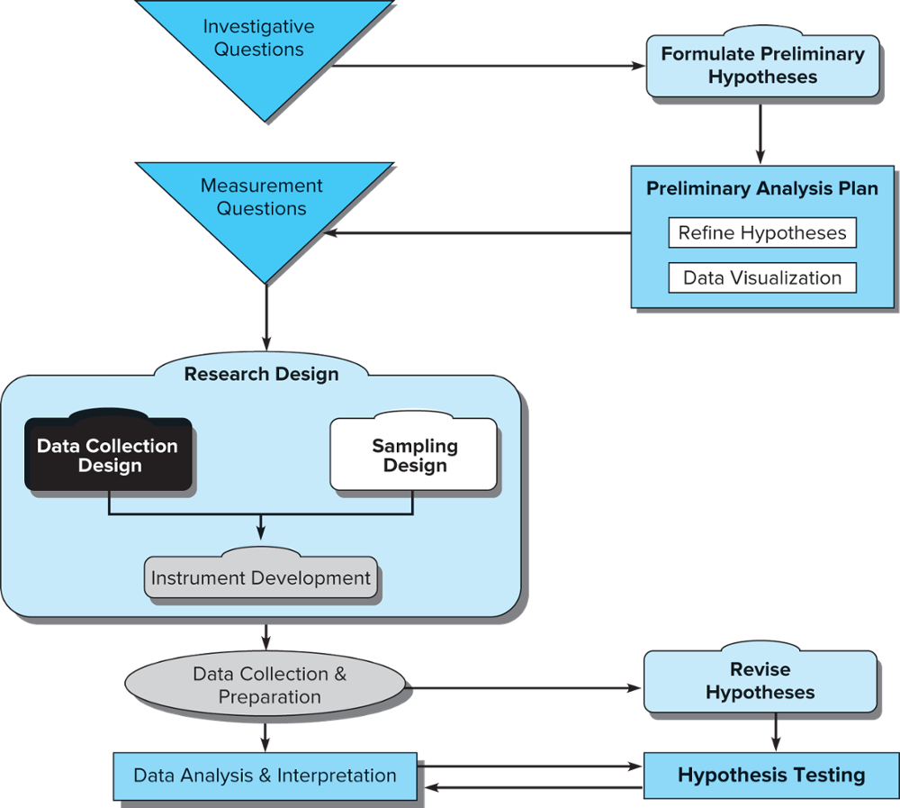
Hypothesis Testing and the Research Process
Notes:
Exhibit 14-2 illustrates the relationships among design strategy, data collection activities, preliminary analysis, and hypothesis testing.
The purpose of hypothesis testing is to determine the accuracy of hypotheses due to the fact that a sample of data was collected, not a census.

Slide 8

The “Ah-Ha” Moment
When researchers sift through the chaos and find what matters.
Notes:
While exploratory data analysis revealed some relationships worth testing, those results do not carry the weight of results revealed when the hypothesis is tested for significance.
PHOTO CREDIT
Caiaimage/Glow Images

Slide 9
Approaches to Hypothesis Testing
Classical statistics
Objective view of probability
Established hypothesis is rejected or fails to be rejected
Analysis based on sample data
Bayesian statistics
Extension of classical approach
Analysis based on sample data
Also considers established subjective probability estimates
Notes:
There are two approaches to hypothesis testing, but classical (sampling-theory) approach is more established.
Following the classical statistics approach, we accept or reject a hypothesis on the basis of sampling information alone. Since any sample will almost surely vary from its population, we must judge whether the differences are statistically significant or insignificant.
A difference has statistical significance; is there is good reason to believe the difference does not represent random sampling fluctuations only.

Slide 10

Significance & Hypotheses
Statistical Significance
Practical Significance
Notes:
Consider this example: The hybrid Toyota Prius, shown above, inspires a cult-like devotion from its drivers, maintaining satisfaction rates at 98 percent. Let’s say that the Prius has maintained an average of about 51 miles per gallon city with a standard deviation of 10 miles per gallon and researchers discover by analyzing all production vehicles that the miles per gallon is now 51.
Is the difference statistically significant? If 51 significantly different than 50?
In this case, the difference is based on a census of the production vehicles and there is no sampling involved.
Since it would really be too expensive to analyze all of the manufacturer’s vehicles, we could resort to sampling.
Assume a sample of 25 cars is randomly selected and the average miles per gallon city is calculated to be 54. Is 51 significantly different from 54 or is it only sampling error? Hypothesis testing will answer this question.
A difference has statistical significance if there is good reason to believe the difference does not represent random sampling fluctuations only.
A difference has practical significance if it is large enough to be meaningful—to have real value to the decision-maker.
The null hypothesis is used for testing. It is a statement that no difference exists between the parameter and the statistic being compared to it. The parameter is a measure taken by a census of the population or a prior measurement of a sample of the population.
Analysts usually test to determine whether there has been no change in the population of interest or whether a real difference exists.
In the hybrid-vehicle example, the null hypothesis states that the population parameter of 50 mpg has not changed. An alternative hypothesis holds that there has been no change in average mpg. The alternative is the logical opposite of the null hypothesis. This is a two-tailed test. A two-tailed test is a nondirectional test to reject the hypothesis that the sample statistic is either greater than or less than the population parameter.
A one-tailed test is a directional test of a null hypothesis that assumes the sample parameter is not the same as the population statistic, but that the difference can be in only one direction. The other hypotheses shown are directional.
PHOTO CREDIT
© McGraw-Hill Education/Mark Dierker

Slide 11
Null vs. Alternative Hypotheses
Null
  H₀: μ = 60 mpg
  H₀: μ < 60 mpg
  H₀: μ > 60 mpg
Alternative
  H_{A}: μ ≠ 60 mpg
  H_{A}: μ > 60 mpg
  H_{A}: μ < 60 mpg
Notes:
Consider this example: The hybrid Toyota Prius, shown above, inspires a cult-like devotion from its drivers, maintaining satisfaction rates at 98 percent. Let’s say that the Prius has maintained an average of about 61 miles per gallon city with a standard deviation of 10 miles per gallon and researchers discover by analyzing all production vehicles that the miles per gallon is now 61.
Is the difference statistically significant? If 61 significantly different than 60?
In this case, the difference is based on a census of the production vehicles and there is no sampling involved, so it is statistically significant.
Since it would really be too expensive to analyze all of the manufacturer’s vehicles, we could resort to sampling.
Assume a sample of 25 cars is randomly selected and the average miles per gallon city is calculated to be 64. Is 64 significantly different from 60 or is it only sampling error? Hypothesis testing will answer this question.
A difference has statistical significance if there is good reason to believe the difference does not represent random sampling fluctuations only.
A difference has practical significance if it is large enough to be meaningful—to have real value to the decision-maker.
The null hypothesis is used for testing. It is a statement that no difference exists between the parameter and the statistic being compared to it. The parameter is a measure taken by a census of the population or a prior measurement of a sample of the population.
Analysts usually test to determine whether there has been no change in the population of interest or whether a real difference exists.
In the hybrid-vehicle example, the null hypothesis states that the population parameter of 50 mpg has not changed. An alternative hypothesis holds that there has been no change in average mpg. The alternative is the logical opposite of the null hypothesis. This is a two-tailed test. A two-tailed test is a nondirectional test to reject the hypothesis that the sample statistic is either greater than or less than the population parameter.
A one-tailed test is a directional test of a null hypothesis that assumes the sample parameter is not the same as the population statistic, but that the difference can be in only one direction. The other hypotheses shown are directional.
PHOTO CREDIT
© McGraw-Hill Education/Mark Dierker

Slide 12
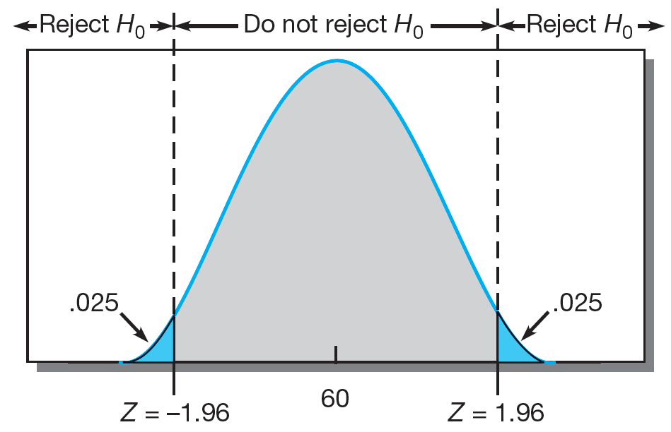
Two-Tailed Test of Significance
Notes:
Exhibit 14-3, left side
This is an illustration of a two-tailed test. It is a non-directional test.

Slide 13
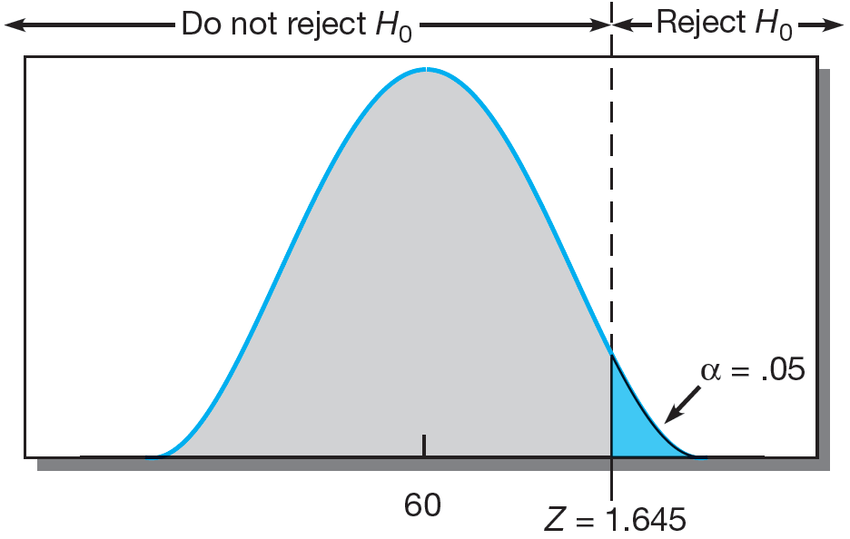
One-Tailed Test of Significance
Notes:
Exhibit 14-3, right side
This is an illustration of a one-tailed, or directional, test.

Slide 14
Decision Rule
Take no corrective action if the analysis shows that one cannot reject the null hypothesis.
Notes:
Note the language “cannot reject” rather than “accept” the null hypothesis. It is argued that a null hypothesis can never be proved and therefore cannot be accepted.

Slide 15
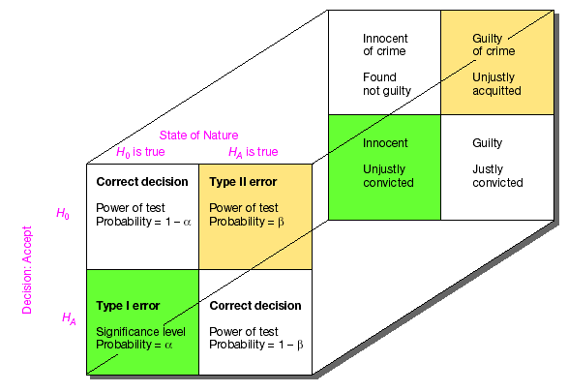
Statistical Decisions
Notes:
Exhibit 14-4
In our system of justice, the innocence of an indicted person is presumed until proof of guilt beyond a reasonable doubt can be established. In hypothesis testing, this is the null hypothesis; there should be difference between the presumption of innocence and the outcome unless contrary evidence is furnished. Once evidence establishes beyond a reasonable doubt that innocence can no longer be maintained, a just conviction is required. This is equivalent to rejecting the null hypothesis and accepting the alternative hypothesis. Incorrect decisions or errors are the other two possible outcomes. We can justly convict an innocent person or we can acquit a guilty person.
Exhibit 14-4 compares the statistical situation to the legal system. One of two conditions exists – either the null hypothesis is true or the alternate is true.
When a Type I error (α) is committed,
a true null is rejected; the innocent is unjustly convicted.
The alpha value is called the level of significance and is the probability of rejecting the true null.
With a Type II error (β),
one fails to reject a false null hypothesis; the result is an unjust acquittal, with the guilty person going free.
The beta value I the probability of failing to reject a false null hypothesis.
Like our justice system, hypothesis testing places a greater emphasis on Type I errors.

Slide 16
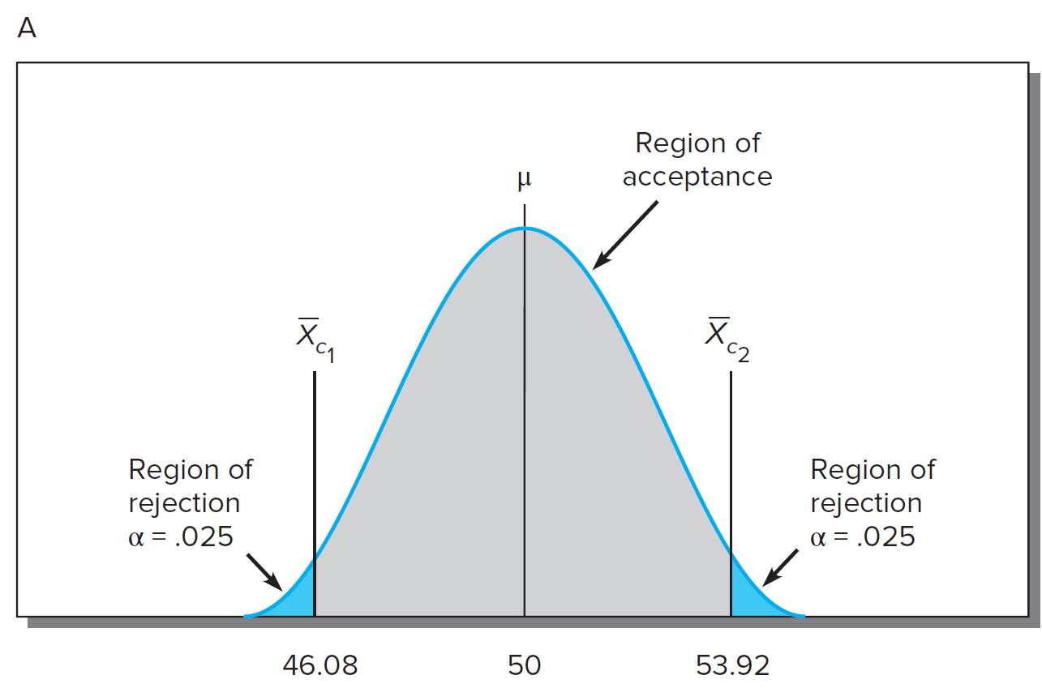
Probability of Making a Type I Error
Notes:
Exhibit 14-5 (top)
Assume the hybrid car manufacturer’s problem is complicated by a consumer testing agency’s assertion that the average mpg has changed.
Assume the population mean is 50 mpg, the standard deviation is 10 mpg, and the size of the sample is 25 vehicles.
With this information, one can calculate the standard error of the mean (the standard deviation of the distribution of sample means). This hypothetical distribution is pictured in Exhibit 17-4. The standard error of the mean is calculated to be 2 mpg.
If the decision is to reject Ho with a 95% confidence interval (alpha = .05), a Type I error of .025 in each tail is accepted (assuming a two-tailed test).
The regions of rejection are indicated by green shaded areas. The area between is the region of acceptance.

Slide 17




Critical Values
Notes:
Since the distribution of sample means is normal, the critical values can be computed in terms of the standardized random variable. In this example, the critical values that provide a Type I error of .05 are 46.08 and 53.92.

Slide 18
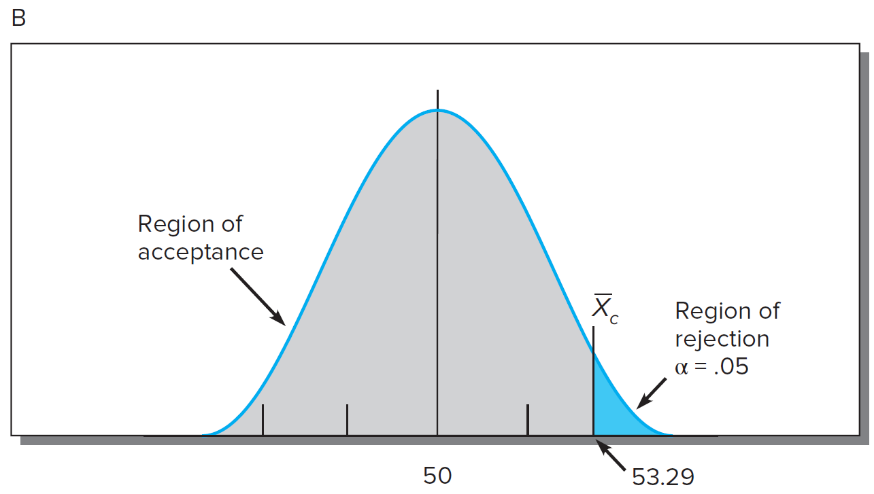
Probability of Making A Type I Error
Notes:
Exhibit 14-5 (bottom)
In this diagram, the manufacturer is interested only in increases in mpg and uses a one-tailed alternate hypothesis. In this case, the entire region of rejection is in the upper tail of the distribution. One can accept a 5% alpha risk and compute a new critical value.
Solving for the critical value:
Use the formula from page 435.

Slide 19
Factors Affecting Probability of
Committing a β Error
True value of parameter
Alpha level selected
One or two-tailed test used
Sample standard deviation
Sample size
Notes:
Type II error is difficult to detect and the probability of committing a Type II error depends on the five factors listed in the slide. An illustration is provided on the next slide.

Slide 20
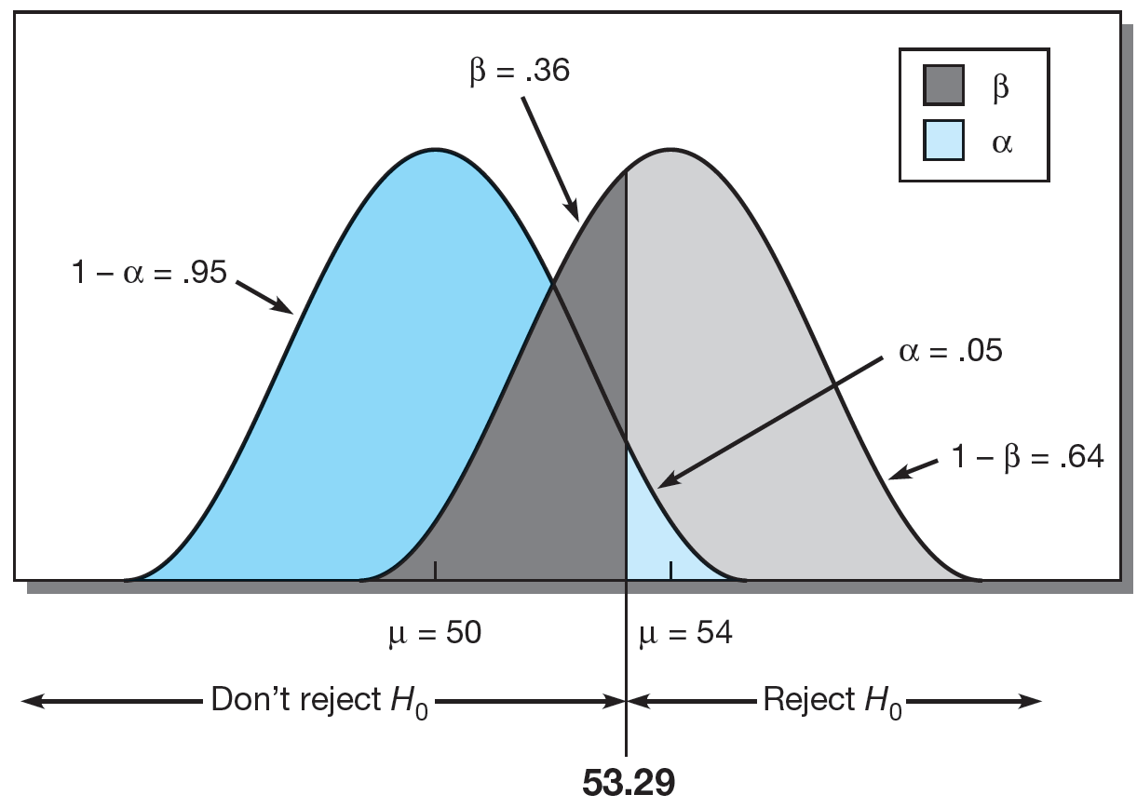
Probability of Making A Type II Error
Notes:
Exhibit 14-6
The manufacturer would commit a Type II error by accepting the null hypothesis when in truth the mpg had changed. This kind of error is difficult to detect.
To illustrate, assume μ has actually moved to 54 from 50.
Use the formula from page 499.
Using Exhibit C-1 in Appendix C, we interpolate between .35 and .36 Z scores to find the .355 Z score. The area between the mean and Z is .1387. β is the tail area, or the area below the Z and is calculated as:
Use the formula from page 499.
This shown in the Exhibit. It is the percent of the area where we would not reject the null, when in fact it was false because the true mean was 54. There is a 36% probability of a Type II error if the μ is 54. The power of the test is 1 minus the probability of committing a Type II error. In this example, the power of the test equals 64%. In other words, we will correctly reject the false null hypothesis with a 64% probability. A power of 64% is less than the 80% recommended by statisticians.

Slide 21
Statistical Testing Procedures
State null hypothesis
Interpret the test
Stages
Choose statistical test
Obtain critical test value
Select level of significance
Compute difference value
Notes:
Testing for statistical significance follows a relatively well-defined pattern.
State the null hypothesis. While the researcher is usually interesting in testing a hypothesis of change or differences, the null hypothesis is always used for statistical testing purposes.
Choose the statistical test. To test a hypothesis, one must choose an appropriate statistical test. There are many tests from which to choose. Test selection is covered more later in this chapter.
Select the desired level of significance. The choice of the level of significance should be made before data collection. The most common level is .05. Other levels used include .01, .10, .025, and .001. The exact level is largely determined by how much risk one is willing to accept and the effect this choice has on Type II risk. The larger the Type I risk, the lower the Type II risk.
Compute the calculated difference value. After data collection, use the formula for the appropriate statistical test to obtain the calculated value. This can be done by hand or with a software program.
Obtain the critical test value. Look up the critical value in the appropriate table for that distribution.
Interpret the test. For most tests, if the calculated value is larger than the critical value, reject the null hypothesis. If the critical value is larger, fail to reject the null.

Slide 22
Tests of Significance
Parametric
Nonparametric
Notes:
Parametric tests are significance tests for data from interval or ratio scales. They are more powerful than nonparametric tests.
Nonparametric tests are used to test hypotheses with nominal and ordinal data.
Parametric tests should be used if their assumptions are met.

Slide 23

Assumptions for Using Parametric Tests
Independent observations
Normal distribution
Equal variances
Interval or ratio scales
Notes:
The assumptions for parametric tests include the following:
The observations must be independent – that is, the selection of any one case should not affect the chances for any other case to be included in the sample.
The observations should be drawn from normally distributed populations.
These populations should have equal variances.
The measurement scales should be at least interval so that arithmetic operations can be used with them.
PHOTO CREDIT
© Anatolii Babii / Alamy

Slide 24
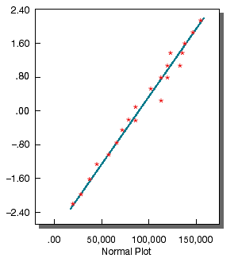
Probability Plot
Notes:
Exhibit 14-7 (top left)
The normality of the distribution may be checked in several ways. One such tool is the normal probability plot.
This plot compares the observed values with those expected from a normal distribution. If the data display the characteristics of normality, the points will fall within a narrow band along a straight line. An example is shown in the slide.

Slide 25
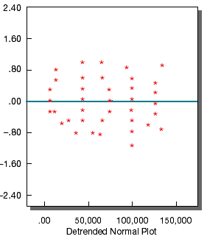
Probability Plot
Notes:
Exhibit 14-7 (top right)
An alternative way to look at this is to plot the deviations from the straight line. Here we would expect the points to cluster without pattern around a straight line passing horizontally through 0.

Slide 26
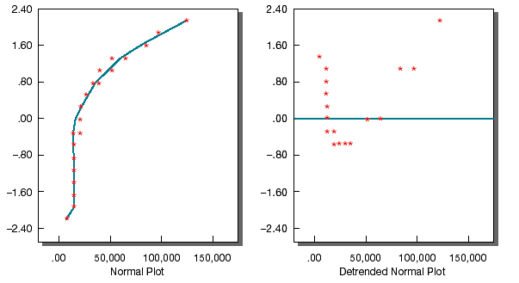
Probability Plot
Notes:
Exhibit 14-7 (bottom)
In these panels, there is neither a straight line in the normal probability plot nor a random distribution of points about 0 in the detrended plot. This tells us that the variable is not normally distributed.

Slide 27

Advantages of Nonparametric Tests
Easy to understand and use
Usable with nominal data
Appropriate for ordinal data
Appropriate for non-normal population distributions
Notes:
This slide lists the advantages of nonparametric tests.
Pizza preference is an example of nominal data…preference for toppings, thin vs. thick, crust, etc.
PHOTO CREDIT
Shutterstock / Anton Gepolov

Slide 28

How to Select a Test
How many samples are involved?
If > 2
Are the individual cases
independent or related?
Is the measurement
nominal, ordinal, interval, or ratio?
Notes:
Reference Exhibit 14-8, on the next slide, to see the recommended tests.
PHOTO CREDIT
Image Source/Takahiro Igarashi

Slide 29
Recommended Statistical Techniques
 |  | Two-Sample Tests ________________________________________ |  | k-Sample Tests ________________________________________
Measurement Scale | One-Sample Case | Related Samples | Independent Samples | Related Samples | Independent Samples
Nominal | Binomial x² one-sample test | McNemar | Fisher exact test x² two-samples test | Cochran Q | x² for k samples
Ordinal | Kolmogorov-Smirnov one-sample test Runs test | Sign test Wilcoxon matched-pairs test | Median test Mann-Whitney U Kolmogorov-Smirnov Wald-Wolfowitz | Friedman two-way ANOVA | Median extension Kruskal-Wallis one-way ANOVA
Interval and Ratio | t-test Z test | t-test for paired samples | t-test Z test | Repeated-measures ANOVA | One-way ANOVA n-way ANOVA
Notes:
Exhibit 14-8

Slide 30

Questions Answered by
One-Sample Tests
Difference between observed and
expected frequencies?
Difference between observed and
expected proportions?
Significant difference between some
measure of central tendency and the
population parameter?
Notes:
PHOTO CREDIT
© Monalyn Gracia/Fancy/age fotostock RF

Slide 31
Parametric Tests
Z-test
t-test
Notes:
The Z test or t-test is used to determine the statistical significance between a sample distribution mean and a parameter.
The Z distribution and t distribution differ. The t has more tail area than that found in the normal distribution. This is a compensation for the lack of information about the population standard deviation. Although the sample standard deviation is used as a proxy figure, the imprecision makes it necessary to go farther away from 0 to include the percentage of values in the t distribution necessarily found in the standard normal.
When sample sizes approach 120, the sample standard deviation becomes a very good estimation of the population standard deviation; beyond 120, the t and Z distributions are virtually identical.

Slide 32
One-Sample t-Test Example
Null | Ho: = 50 mpg
Statistical test | t-test
Significance level | .05, n=100
Calculated value | 1.786
Critical test value | 1.66 (from Appendix C, Exhibit C-2)
Notes:
The slide shows the six steps recommended for conducting the significance test. The formula for the calculated value is shown here. The t-test was chosen because the data are ratio measurements. The population is assumed to have a normal distribution and the sample was randomly selected.
The critical test value is obtained by entering the table of critical values of t (Appendix Exhibit C-2) with 99 degrees of freedom and a level of significance value of .05. We secure a critical value of about 1.65 (interpolated between d.f. = 60 and d.f. = 120 in Exhibit C-2).
In this case, the calculated value is greater than the critical value so we reject the null hypothesis and conclude that the average mpg has increased.

Slide 33
One Sample Chi-Square Test Example
Living Arrangement | Intend to Join | Number Interviewed | Percent (no. interviewed/200) | Expected Frequencies (percent x 60)
Dorm/fraternity | 16 | 90 | 45 | 27
Apartment/rooming house, nearby | 13 | 40 | 20 | 12
Apartment/rooming house, distant | 16 | 40 | 20 | 12
Live at home | 15 _____ | 30 _____ | 15 _____ | 9 _____
Total | 60 | 200 | 100 | 60
Notes:
In a one-sample situation, a variety of nonparametric tests may be used, depending on the measurement scale and other conditions. If the measurement scale is nominal, it is possible to use either the binomial test or the chi-square test. The binomial test is appropriate when the population is viewed as only two classes such as male and female. It is also useful when the sample size is so small that the chi-square test cannot be used.
The table illustrates the results of a survey of student interest in Metro University Dining Club. 200 students were interviewed about their interest in joining the club. The results are classified by living arrangement. Is there a significant difference among these students?
The next slide illustrates a chi-square test.

Slide 34
One-Sample Chi-Square Example
Null | Ho: 0 = E
Statistical test | One-sample chi-square
Significance level | .05
Calculated value | 9.89
Critical test value | 7.82
(from Appendix C, Exhibit C-3)
Notes:
The null hypothesis states that the proportion in the population who intend to join the club is independent of living arrangement. The alternate hypothesis states that the proportion in the population who intend to join the club is dependent on living arrangement.
The chi-square test is used because the responses are classified into nominal categories.
Calculate the expected distribution by determining what proportion of the 200 students interviewed were in each group. Then apply these proportions to the number who intend to join the club. Then calculate the following:
Enter the table of critical values of X2 (Exhibit C-3) with 3 d.f., and secure a value of 7.82 at an alpha of .05.
The calculated value is greater than the critical value so the null is rejected and we conclude that intending to join is dependent on living arrangement.

Slide 35
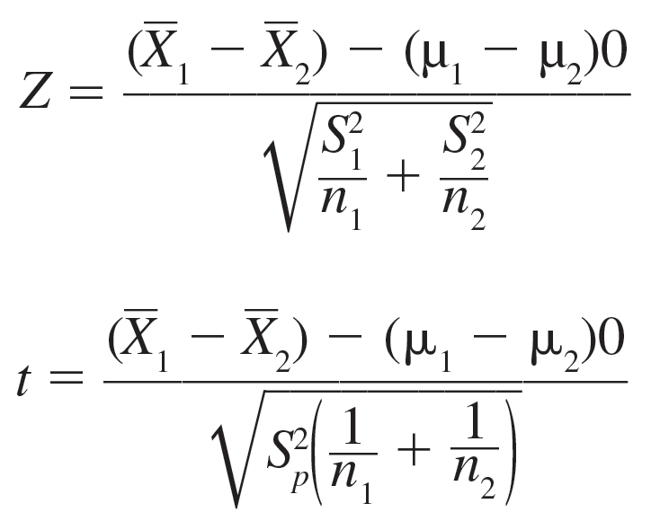
Two-Sample Parametric Tests
Notes:
The Z and t-tests are frequently used parametric tests for independent samples, although the F test can also be used.
The Z test is used with large sample sizes (exceeding 30 for both independent samples) or with smaller samples when the data are normally distributed and population variances are known. The formula is shown in the slide.
With small sample sizes, normally distributed populations, and the assumption of equal population variances, the t-test is appropriate. The formula is shown in the slide.
An example is covered on the next slide.

Slide 36
Two-Sample t-Test Example
 | A Group | B Group
Average hourly sales | X₁ = $1,500 | X2 = $1,300
Standard deviation | s₁ = 225 | s2 = 251
Notes:
Consider a problem facing a manager at KDL, a media firm that is evaluating account executive trainees. The manager wishes to test the effectiveness of two methods for training new account executives. The company selects 22 trainees who are randomly divided into two experimental groups. One receives type A and the other type B training. The trainees are then assigned and managed without regard to the training they have received. At the year’s end, the manager reviews the performances of these groups and finds the results presented in the table shown in the slide.
To test whether one training method is better than the other, we will follow the standard testing procedure shown in the next slide.

Slide 37
Two-Sample t-Test Example
Null | Ho: A sales = B sales
Statistical test | t-test
Significance level | .05 (one-tailed)
Calculated value | 1.97, d.f. = 20
Critical test value | 1.725
(from Appendix C, Exhibit C-2)
Notes:
The null hypothesis states that there is no difference is sales for group A compared group B. The alternate hypothesis states that group A produced more sales than group B.
The t-test is chosen because the data are at least interval and the samples are independent.
The calculated value is computed as follows:
Enter Appendix Exhibit C-2 with d.f. = 20, one-tailed test, alpha = .05. The critical value is 1.725.
The calculated value is greater than the critical value so the null is rejected and we conclude that training method A is superior.

Slide 38
Two-Sample Nonparametric Tests:
Chi-Square
 |  | On-the-Job-Accident
 | Cell Designation Count Expected Values | Yes | No | Row Total
Smoker | Heavy Smoker | 1,1 12, 8.24 | 1,2 4 7.75 | 16
 | Moderate | 2,1 9 7.73 | 2,2 6 7.27 | 15
 | Nonsmoker | 3,1 13 18.03 | 3,2 22 16.97 | 35
 | Column Total | 34 | 32 | 66
Notes:
The chi-square test is appropriate for situations in which a test for differences between samples is required. It is especially valuable for nominal data but can be used with ordinal measurements. Preparing to solve this problem with the chi-square formula is similar to that presented earlier.
In the example in the slide, MindWriter is considering implementing a smoke-free workplace policy. It has reason to believe that smoking may affect worker accidents. Since the company has complete records on on-the-job accidents, a sample of workers is drawn from those who were involved in accidents during the last year. A similar sample is drawn from among workers who had no reported accidents in the last year. Members of both groups are interviewed to determine if each smokes on the job and whether each smoker classifies himself or herself as a heavy or moderate smoker. The expected values are calculated and shown in the slide.
The testing procedure is shown on the next slide.

Slide 39
Two-Sample Chi-Square Example
Null | There is no difference in distribution channel for age categories.
Statistical test | Chi-square
Significance level | .05
Calculated value | 6.86, d.f. = 2
Critical test value | 5.99
(from Appendix C, Exhibit C-3)
Notes:
The null hypothesis states that there is no difference in distribution channel for age categories of purchasers. The alternate hypothesis states that there is a difference in distribution channel for age categories of purchasers.
The chi-square is chosen because the data are ordinal.
The calculated value is computed as follows:
Use the formula from page 512
The expected distribution is provided by the marginal totals of the table. The numbers of expected observations in each cell are calculated by multiplying the two marginal totals common to a particular cell and dividing this product by n. For example, in cell 1,1, 34 * 16/ 66 = 8.24
Enter Appendix Exhibit C-3 with d.f. = 2, and find the critical value of 5.99.
The calculated value is greater than the critical value so the null is rejected.

Slide 40
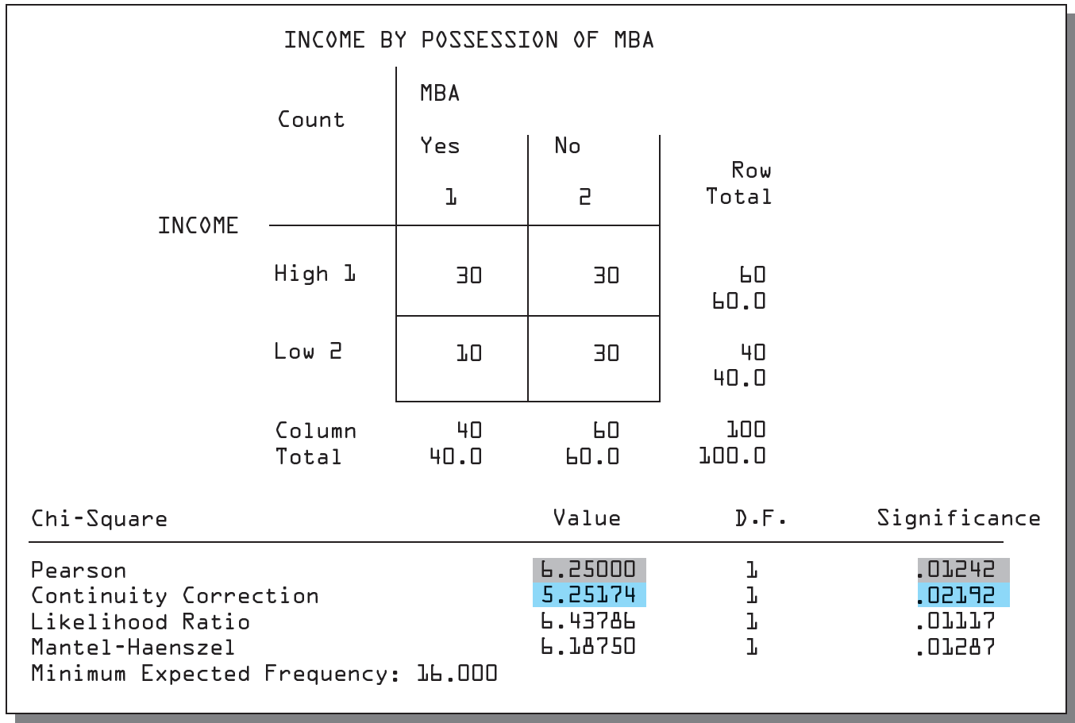
SPSS Cross-Tabulation Procedure
Notes:
Exhibit 14-9
In another type of chi-square, the 2 x 2 table, a correction factor known as Yates’ correction for continuity is applied when sample sizes are greater than 40 or when the sample is between 20 and 40 and the values of Ei are 5 or more.
When the continuity correction is applied to the data shown in Exhibit 14-9, a chi-square of 5.25 is obtained. The observed level of significance for this value is .02192. If the level of significance were set at .01, we would accept the null hypothesis. However, had we calculated chi-square without the correction, the value would have been 6.25 with an observed level of significance of .01242. The literature is in conflict over the merits of Yates’ correction.
The Mantel-Haenszel test and the likelihood ratio also appear in Exhibit 14-9. The former is used with ordinal data; the latter, based on maximum likelihood theory, produces results similar to Pearson’s chi-square.

Slide 41
Two-Related-Samples Tests
Parametric
Nonparametric
Notes:
The two-related samples tests concern those situations in which persons, objects, or events are closely matched or the phenomena are measured twice. For instance, one might compare the consumption of husbands and wives.
Both parametric and nonparametric tests are applicable under these conditions.
Parametric
The t-test for independent samples is inappropriate here because of its assumption that observations are independent. The problem is solved by a formula where the difference is found between each matched pair of observations, thereby reducing the two samples to the equivalent of a one-sample case. In other words, there are now several differences, each independent of the other, for which one can compute various statistics.
Nonparametric Tests
The McNemar test may be used with either nominal or ordinal data and is especially useful with before-after measurement of the same subjects.

Slide 42
Sales Data for
Paired-Samples t-Test
Company | Sales Year 2 | Sales Year 1 | Difference D | D²
GM GE Exxon IBM Ford AT&T Mobil DuPont Sears Amoco Total | 126932 54574 86656 62710 96146 36112 50220 35099 53794 23966 | 123505 49662 78944 59512 92300 35173 48111 32427 49975 20779 | 3427 4912 7712 3192 3846 939 2109 2632 3819 3187 ΣD = 35781 . | 11744329 24127744 59474944 10227204 14971716 881721 4447881 6927424 14584761 10156969 ΣD = 157364693 .
Notes:
Exhibit 14-10 shows two years of Forbes sales data (in millions of dollars) from 10 companies. The next slide illustrates the hypothesis test.

Slide 43
Paired-Samples t-Test Example
Null | Year 1 sales = Year 2 sales
Statistical test | Paired sample t-test
Significance level | .01
Calculated value | 6.28, d.f. = 9
Critical test value | 3.25
(from Appendix C, Exhibit C-2)
Notes:
The null hypothesis states that there is no difference in sales data between years one and two. The alternate hypothesis states that there is a difference.
The matched or paired-sample t-test is chosen because there are repeated measures on each company, the data are not independent, and the measurement is ratio.
Enter Appendix Exhibit C-2 with d.f. = 9, two-tailed test, alpha = .01, and find the critical value of 3.25.
The calculated value is greater than the critical value so the null is rejected. We conclude that there is a significant difference between the two years of sales.

Slide 44
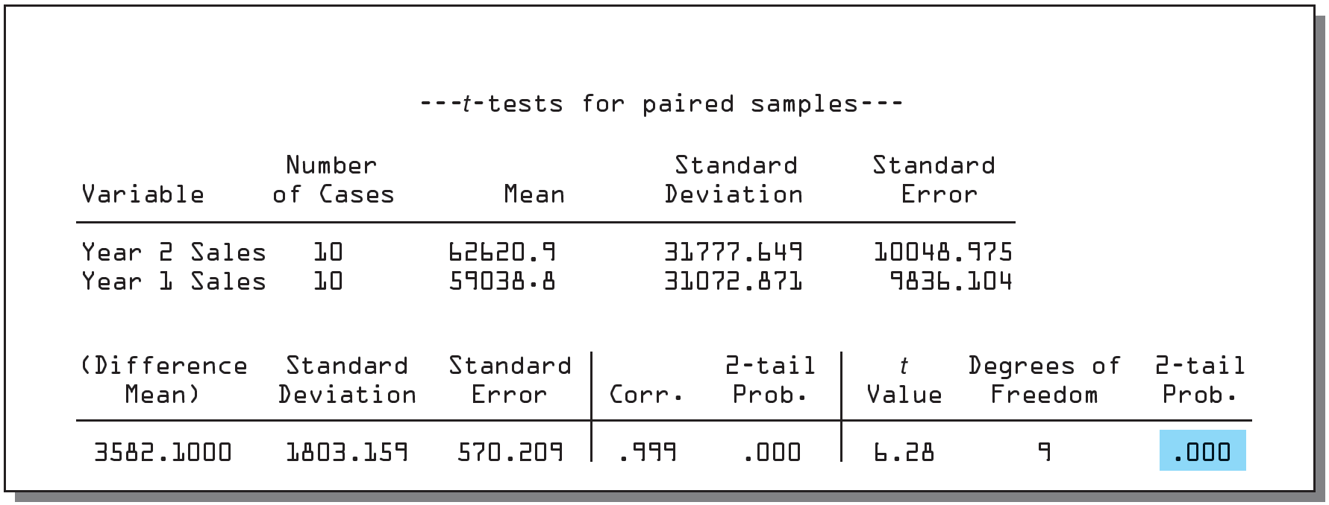
SPSS Output for Paired-Samples t-Test
Notes:
Exhibit 14-11
A computer solution to the problem is illustrated in Exhibit 14-11. Notice that an observed significance level is printed for the calculated t value (highlighted). The observed significance level is the probability value compared to the significance level chosen for testing and on this basis, the null hypothesis is either rejected or not rejected.

Slide 45
Related Samples Nonparametric Tests: McNemar Test
Before | After Do Not Favor | After Favor
Favor | A | B
Do Not Favor | C | D
Notes:
The McNemar test may be used with either nominal or ordinal data and is especially useful with before-after measurement of the same subjects. One can test the significance of any observed change by setting up a fourfold table of frequencies to represent the first and second set of responses. An example is provided in the slide.
Since A + D represents the total number of people who changed (B and C are no change responses), the null hypothesis is that ½ (A+D) cases change in one direction and the same proportion in the other direction. The McNemar test uses a transformation of the chi-square test.
Use formula from page 515
The minus 1 in the equation is a correction for continuity since the chi-square is a continuous distribution and the observed frequencies represent a discrete distribution. An example is provided on the next slide.

Slide 46
Related Samples Nonparametric Tests: McNemar Test
Before | After Do Not Favor | After Favor
Favor | A=10 | B=90
Do Not Favor | C=60 | D=40
Notes:
The McNemar test may be used with either nominal or ordinal data and is especially useful with before-after measurement of the same subjects. One can test the significance of any observed change by setting up a fourfold table of frequencies to represent the first and second set of responses. An example is provided in the slide.
Since A + D represents the total number of people who changed (B and C are no change responses), the null hypothesis is that ½ (A+D) cases change in one direction and the same proportion in the other direction. The McNemar test uses a transformation of the chi-square test.
Use formula from page 516
The minus 1 in the equation is a correction for continuity since the chi-square is a continuous distribution and the observed frequencies represent a discrete distribution. An example is provided on the next slide.

Slide 47
k-Independent-Samples Tests: ANOVA
Tests the null hypothesis that the means of three or more populations are equal.
One-way: Uses a single-factor, fixed-effects model to compare the effects of a treatment or factor on a continuous dependent variable.
Notes:
In a fixed-effects model, the levels of the factor are established in advance and the results are not generalizable to other levels of treatment.
To use ANOVA, certain conditions must be met.
The samples must be randomly selected from normal populations and the populations should have equal variances.
The distance from one value to its group’s mean should be independent of the distances of other values to that mean.
Unlike the t-test, which uses sample standard deviations, ANOVA uses squared deviations of the variance to that computation of distances of the individual data points from their own mean or from the grand mean can be summed (recall that standard deviations sum zero).
In an ANOVA model, each group has its own mean and values that deviate from that mean. The total deviation is the sum of the squared differences between each data point and the overall grand mean.
The total deviation of any particular data point may be partitioned into between-groups variance and within-groups variance. The between-groups variance represents the effect of the treatment or factor. The differences of between-groups means imply that each group was treated differently and the treatment will appear as deviations of the sample means from the grand mean.
The within-groups variance describes the deviations of the data points within each group from the sample mean. It is often called error.

Slide 48
ANOVA Example
______________________________Model Summary_________________________________________
Source | d.f. | Sum of Squares | Mean Square | F Value | p Value
Model (airline) | 2 | 11644.033 | 5822.017 | 28.304 | 0.0001
Residual (error) | 57 | 11724.550 | 205.694
Total | 59 | 23368.583
 | _______________Means Table________________________
 | Count | Mean | Std. Dev. | Std. Error
Lufthansa | 20 | 38.950 | 14.006 | 3.132
Malaysia Airlines | 20 | 58.900 | 15.089 | 3.374
Cathay Pacific | 20 | 72.900 | 13.902 | 3.108
All data are hypothetical
Notes:
Exhibit 14-13, top two parts
Malaysia Airlines
The test statistic for ANOVA is the F ratio.
Use formula from page 497
To compute the F ratio, the sum of the squared deviations for the numerator and denominator are divided by their respective degrees of freedom. By dividing, we are computing the variance as an average or mean, thus the term mean square. The degrees of freedom for the numerator, the mean square between groups, are one less than the number of group (k-1). The degrees of freedom for the denominator, the mean square within groups, are the total number of observations minus the number of groups (n-k).
If the null is true, there should be no difference between the population means and the ratio should be close to 1. If the population means are not equal, the F should be greater than 1. The F distribution determines the size of the ratio necessary to reject the null for a particular sample size and level of significance.

Slide 49
ANOVA Example Continued
Null | μA1 = μA2 = μA3
Statistical test | ANOVA and F ratio
Significance level | .05
Calculated value | 28.304, d.f. = 2, 57
Critical test value | 3.16
(from Appendix C, Exhibit C-9)
Notes:
To illustrate, consider the report about the quality of in-flight service on various carriers from the US to Europe. Three airlines are compared. The data are shown in Exhibit 14-12. The dependent variable is service rating and the factor is airline.
he null hypothesis states that there is no difference in the service rating score between airlines.
ANOVA and the F test is chosen because we have k independent samples, can accept the assumptions of analysis of variance, and have interval data for the dependent variable. The significance level is .05. The calculated F value is 28.30 (see summary table in the last slide).
Enter Appendix Exhibit C-9 with d.f. = 2, 57, and find the critical value of 3.16.
The calculated value is greater than the critical value so the null is rejected. We conclude that there is a significant difference in flight service ratings.
Note that the p value provided in the summary table can also be used to reject the null.

Slide 50
Post Hoc: Scheffe’s S Multiple Comparison Procedure
 | Verses | Diff | Crit. Diff. | p Value
Lufthansa | Malaysia Airlines | 19,950 | 11.400 | .0002
 | Cathay Pacific | 33.950 | 11.400 | .0001
Malaysia Airlines | Cathay Pacific | 14.000 | 11.400 | .0122
Notes:
Exhibit 14-13, bottom part
With an ANOVA, we cannot tell which pairs are not equal. We can use a post hoc test to determine where the differences lie.
These tests find homogeneous subsets of means that are not different from each other. Multiple comparison tests use group means and incorporate the MS error term of the F ratio. Together they produce confidence intervals for the population means and a criterion score. Differences between the mean values may be compared.
There are more than a dozen such tests. The exhibit in the slide uses Scheffe’s test. It is a conservative test that is robust to violations of assumptions. In the example, all the differences between the pairs of means exceed the critical difference criterion.

Slide 51
Multiple Comparison Procedures
Test | Complex Comparisons | Pairwise Comparisons | Equal n’s Only | Unequal n’s | Equal Variances Assumed | Unequal Variances Not Assumed
Fisher LSD | X |  |  | X | X
Bonferroni | X |  | X | X
Tukey HSD | X |  | X |  | X
Tukey-Kramer | X |  |  | X | X
Games-Howell | X |  |  | X |  | X
Tamhane T2 | X |  |  | X |  | X
Scheffé S |  | X | X | X | X
Brown-Forsythe |  | X | X | X |  | X
Newman-Keuls | X |  |  |  | X
Duncan | X |  |  |  | X
Dunnet’s T3 |  |  |  |  |  | X
Dunnet’s C |  |  |  |  |  | X
Notes:
Exhibit 14-14
There are several multiple comparison procedures one can use after rejecting the null with the F ratio. This slide compares the available tests.

Slide 52

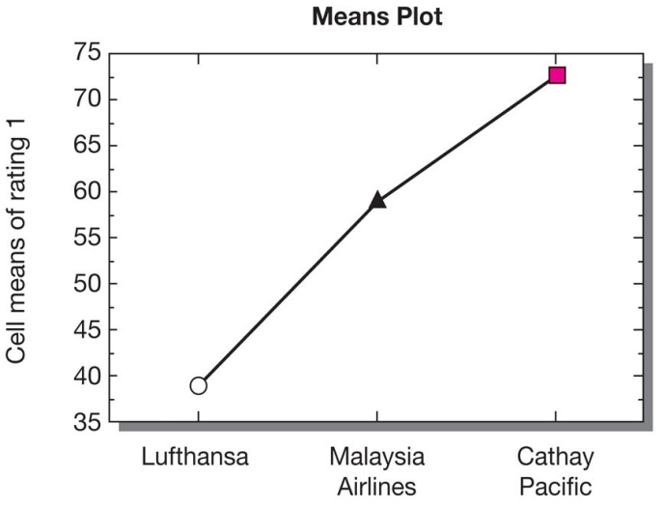
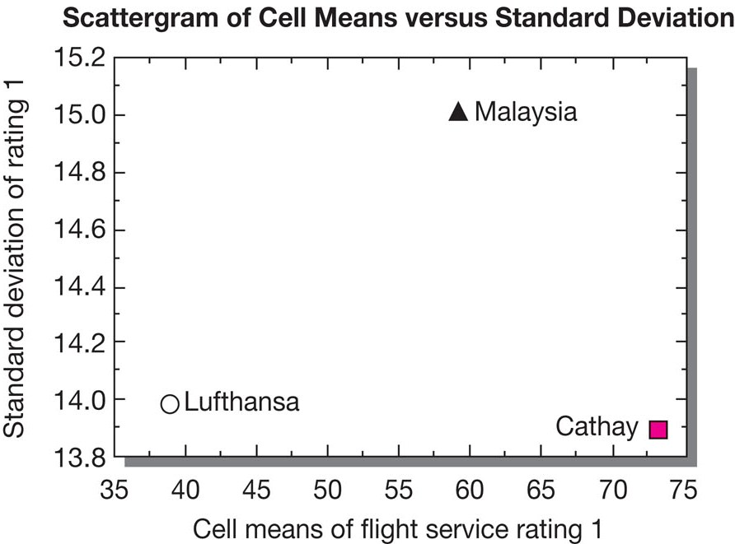
ANOVA Plots
Notes:
Exhibit 14-15
In this exhibit, plots illustrate the comparison. The means plot shows relative differences among the three levels of the factor. The means by standard deviations plot reveals lower variability in the opinions recorded by the hypothetical Lufthansa and Cathay Pacific passengers. These two groups are sharply divided on the quality of in-flight service and that is apparent in the plot.
PHOTO CREDIT
© Blend Images / Alamy Stock Photo

Slide 53
Two-Way ANOVA Example
________________________________Model Summary________________________
Source | d.f. | Sum of Squares | Mean Square | F Value | p Value
Airline | 2 | 11644.033 | 5822.017 | 39.178 | 0.0001
Seat selection | 1 | 3182.817 | 3182.817 | 21.418 | 0.0001
Airline by seat selection | 2 | 517.033 | 258.517 | 1.740 | 0.1853
Residual | 54 | 8024.700 | 148.606
 | Means Table Effect: Airline by Seat Selection
 | Count | Mean | Std. Dev. | Std. Error
Lufthansa economy | 10 | 35.600 | 12.140 | 3.839
Lufthansa business | 10 | 42.300 | 15.550 | 4.917
Malaysia Airlines economy | 10 | 48.500 | 12.501 | 3.953
Malaysia Airlines business | 10 | 69.300 | 9.166 | 2.898
Cathay Pacific economy | 10 | 64.800 | 13.037 | 4.123
Cathay Pacific business | 10 | 81.000 | 9.603 | 3.037
All data are hypothetical
Notes:
Exhibit 14-16
Recall that in Exhibit 14-12 data were entered for the variable seat selection: economy and business-class travelers. If we add this factor to our model, we have a two-way analysis of variance. We can now answer three questions:
Are differences in flight service ratings attributable to airlines?
Are differences in flight service ratings attributable to seat selection?
Do the airline and seat selections interact with respect to flight service ratings?
Exhibit 14-16, shown in the slide, tests the hypotheses for these questions. The significance level chosen is .01. First, we consider the interaction effect of airline by seat selection. The null is accepted (p value is not significant). But note that there are significant differences by airline and by seat selection.
When k independent samples are collected with nominal data, the chi-square is the appropriate nonparametric technique. The Kruskal-Wallis test is appropriate for ordinal scale data or interval data tat do not meet the F-test assumptions.

Slide 54
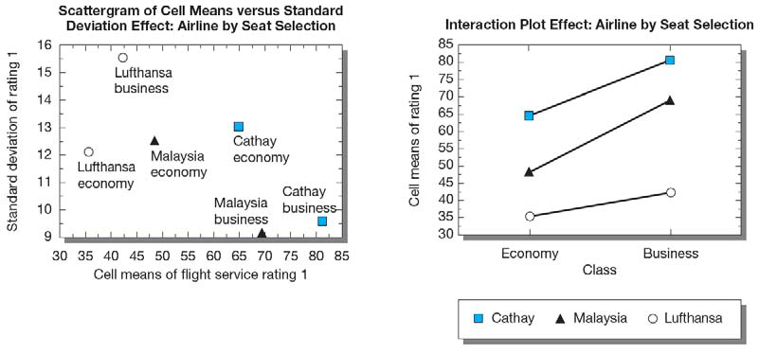
Two-way Analysis of Variance Plots
Notes:
Exhibit 14-17

Slide 55
k-Related-Samples Tests
More than two levels in
grouping factor
Observations are matched
Data are interval or ratio
Notes:
In test marketing experiments or ex post facto designs with k samples, it is often necessary to measure subjects several times. These repeated measures are called trials.
The repeated-measures ANOVA is a special type of n-way analysis of variance. In this design, the repeated measures of each subject are related just as they are in the related t-test where only two measures are present. In this sense, each subject serves as its own control requiring a within-subjects variance effect to be assessed differently than the between-groups variance in a factor like airline or seat selection.
This model is presented in Exhibit 14-18.

Slide 56
Summary
Tables for
Repeated-Measures ANOVA
__________________Model Summary____________________
Source | d.f. | Sum of Squares | Mean Square | F Value | p Value
Airline | 2 | 3552735.50 | 17763.775 | 67.199 | 0.0001
Subject (group) | 57 | 15067.650 | 264.345
Ratings | 1 | 625.633 | 625.633 | 14.318 | 0.0004
Ratings by air....... | 2 | 2061.717 | 1030.858 | 23.592 | 0.0001
Ratings by subj..... | 57 | 2490.650 | 43.696
______________________Means Table by Airline _____________________
 | Count | Mean | Std. Dev. | Std. Error
Rating 1, Lufthansa | 20 | 38.950 | 14.006 | 3.132
Rating 1, Malaysia Airlines | 20 | 58.900 | 15.089 | 3.374
Rating 1, Cathay Pacific | 20 | 72.900 | 13.902 | 3.108
Rating 2, Lufthansa | 20 | 32.400 | 8.268 | 1.849
Rating 2, Malaysia Airlines | 20 | 72.250 | 10.572 | 2.364
Rating 2, Cathay Pacific | 20 | 79.800 | 11.265 | 2.519
___________________Means Table Effect: Ratings_________________________
 | Count | Mean | Std. Dev. | Std. Error
Rating 1 | 60 | 56.917 | 19.902 | 2.569
Rating 2 | 60 | 61.483 | 23.208 | 2.996
All data are hypothetical.
Notes:
Exhibit 14-18
Null hypotheses:
Airline: μA1 = μA2 = μA3
Ratings: μR1 = μR2
Rating * Airline: (μR2A1 - μR2A2 - μR2A3) = ((μR1A1 - μR1A2 - μR1A3)
The F test for repeated measures is chosen because we have related trials on the dependent variable for k samples, accept the assumptions of analysis of variance, and have interval data.
The significance level is .05.
The calculated values are shown in the exhibit.
The critical test values come from Appendix Exhibit C-9; they are 3.16 and 4.01.
Based on the results, all three null hypotheses are rejected. There are significant differences in all three cases.

Slide 57
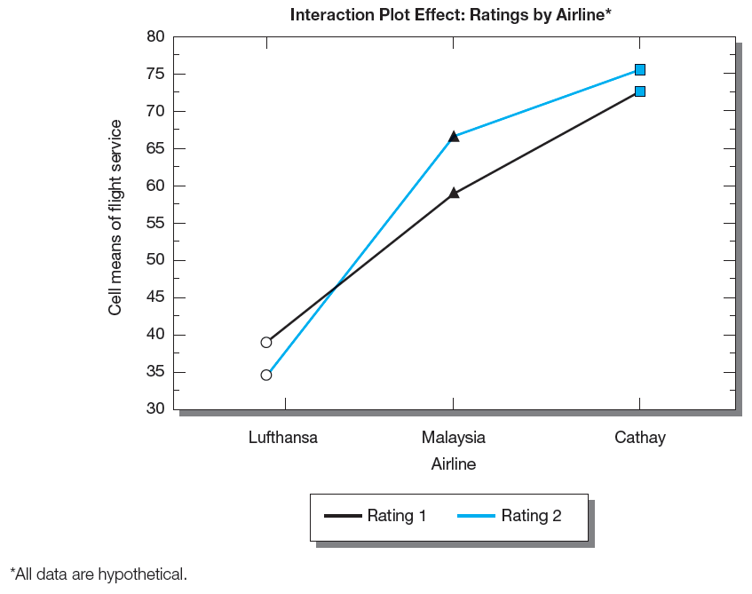
Repeated Measures ANOVA Plot
Notes:
Exhibit 14-19

Slide 58
Key Terms
a priori contrasts
Alternative hypothesis
Analysis of variance (ANOVA)
Bayesian statistics
Chi-square test
Classical statistics
Critical value
F ratio
Inferential statistics
K-independent-samples tests
K-related-samples tests
Level of significance
Mean square
Multiple comparison tests (range tests)
Nonparametric tests
Normal probability plot
Null hypothesis
Observed significance level
One-sample tests
One-tailed test
17-58

Slide 59
Key Terms
p value
Parametric tests
Power of the test
Practical significance
Region of acceptance
Region of rejection
Statistical significance
t distribution
Trials
t-test
Two-independent-samples tests
Two-related-samples tests
Two-tailed test
Type I error
Type II error
Z distribution
Z test
17-59

