Slide 1
What is an ethical dilemma in the business world? Can you think of any?

Slide 2
How do you determine what is ‘right’ or ‘wrong’ when faced with an ethical dilemma?

Slide 3
In a Business Ethics class, we often start by learning about normative theories which are theories about what is ‘right’ and ‘wrong’

Slide 4
Normative Approaches

Slide 5
Normative Theories
Utilitarian Approach: “To analyze an issue using the utilitarian approach, we first identify the various courses of action available to us. Second, we ask who will be affected by each action and what benefits or harms will be derived from each. And third, we choose the action that will produce the greatest benefits and the least harm. The ethical action is the one that provides the greatest good for the greatest number.” https://www.scu.edu/ethics/ethics-resources/ethical-decision-making/thinking-ethically/

Slide 6
Normative Theories
Rights Approach: “In deciding whether an action is moral or immoral using this second approach, then, we must ask, Does the action respect the moral rights of everyone? Actions are wrong to the extent that they violate the rights of individuals; the more serious the violation, the more wrongful the action.” https://www.scu.edu/ethics/ethics-resources/ethical-decision-making/thinking-ethically/

Slide 7
Normative Theories
Justice Approach: “How fair is an action? Does it treat everyone in the same way, or does it show favoritism and discrimination? Favoritism gives benefits to some people without a justifiable reason for singling them out; discrimination imposes burdens on people who are no different from those on whom burdens are not imposed. Both favoritism and discrimination are unjust and wrong..” https://www.scu.edu/ethics/ethics-resources/ethical-decision-making/thinking-ethically/

Slide 8
Normative Theories
Virtue Approach: “Virtues are attitudes or character traits that enable us to be and to act in ways that develop our highest potential. They enable us to pursue the ideals we have adopted. Honesty, courage, compassion, generosity, fidelity, integrity, fairness, self-control, and prudence are all examples of virtues.”
“In dealing with an ethical problem using the virtue approach, we might ask, What kind of person should I be? What will promote the development of character within myself and my community?” https://www.scu.edu/ethics/ethics-resources/ethical-decision-making/thinking-ethically/

Slide 9
Dilemma
Your team member has just told you that the Ethics Office has received a report from a whistleblower that someone within your offices is sending some intellectual property to a foreign government’s Ministry of Intelligence in order to build up the country’s technological infrastructure. Your firm wants to monitor all non-executive employees’ internal and external internet usage in the office and at home to see with whom they are communicating. Some of this data may be turned over to the United States government for further investigation. Should such monitoring be allowed?

Slide 10
Which Normative Approaches appear in your reasons?

Slide 11
Normative Approaches in Organizations

Slide 12
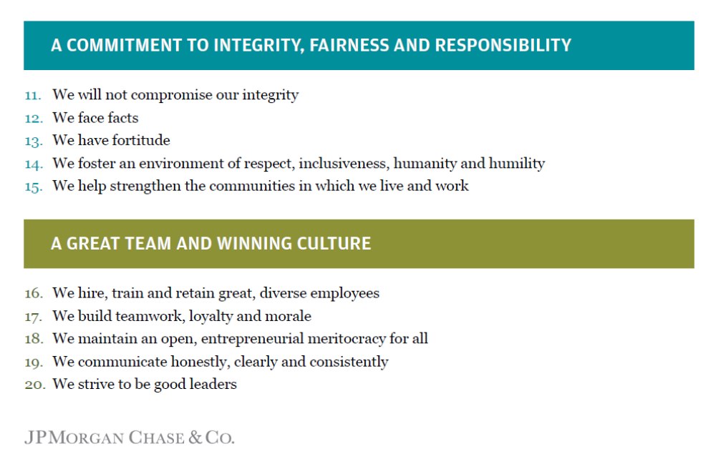
https://www.jpmorganchase.com/corporate/About-JPMC/ab-business-principles.htm

Slide 13
Which Normative Approaches appear in
J.P. Morgan Chase & Co.’s Business Principles ?

Slide 14
REFERENCES
1. Benjamin, K. & Skinner, C. 2020. Get It Done. NY Federal Reserve Bank: Education & Industry Forum.
2. JP Morgan Chase Principles. 2020. Business Principles. https://www.jpmorganchase.com/corporate/About-JPMC/ab-business-principles.htm
3. Stanford Encyclopedia of Philosophy. https://plato.stanford.edu/
4. Velasquez, M. & Andre, C. 2015. Thinking Ethically. https://www.scu.edu/ethics/ethics-resources/ethical-decision-making/thinking-ethically/
5. Von Kriegstein, H. 2017. In Your Face: A Decision Regarding Privacy and Technology in a Hiring Process. Ted Rogers School of Management: Ethical Leadership Case Study Collection.

