Slide 1
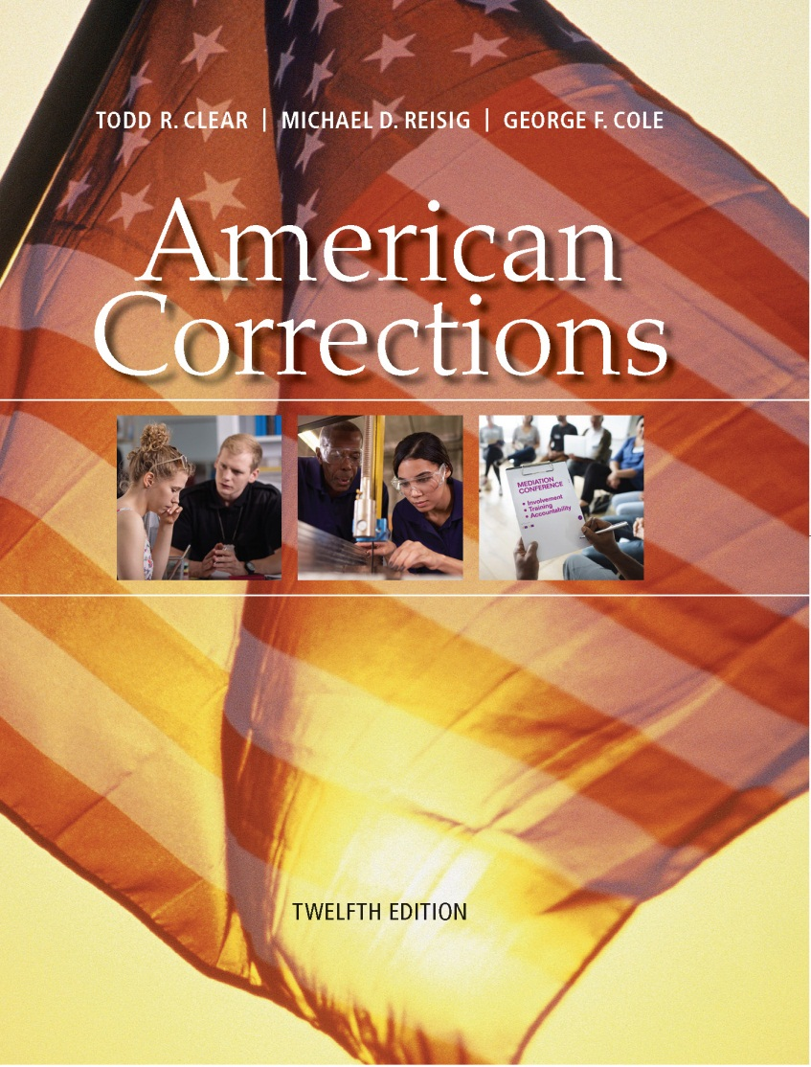

AMERICAN CORRECTIONS
Twelfth Edition
Chapter 17
Corrections for Juveniles
© 2019 Cengage. All rights reserved.

Slide 2
Learning Objectives (1 of 2)
Describe the nature and extent of youth crime today.
Analyze the history of the development of juvenile corrections in the United States.
Describe the new “evidence-based” movement in juvenile corrections, and explain how it has affected juvenile justice.
Present the rationale for dealing differently with juveniles and adults.

Slide 3
Learning Objectives (2 of 2)
Explain how serious juvenile delinquency differs from most delinquency and what this implies for the juvenile justice system.
List the ways that juveniles are sanctioned.
Describe the special problems that youth gangs pose.
Assess the future of juvenile corrections.

Slide 4
The Problem of Youth Crime
2014:
  667 youths under 18 were arrested for homicide
  7,500 for forcible rape
  26,900 for aggravated assault
Since 2005:
  Juvenile crime rate has dropped by 60 percent
Juvenile crime now lowest since 1980
This is an important issue as the youth represent the future of our country
Notes:
Learning Objective 1: Describe the nature and extent of youth crime today.

Slide 5
The History of Juvenile Corrections (1 of 4)
Juvenile Corrections: English Antecedents:
  Parens patriae:
    The “parent of the country” the role of the state as guardian and protector of all people (particularly juveniles) who are unable to protect themselves.
Juvenile Corrections in the United States:
  Puritan Period (1646–1824)
  The Refuge Period (1824–1899)
  The Juvenile Court Period (1899–1960)
  The Juvenile Rights Period (1960–1980)
  The Crime Control Period (1980–2005)
  The Evidence-Based Period (2005–Present)
Notes:
Learning Objective 2: Analyze the history of the development of juvenile corrections in the United States.

Slide 6
The History of Juvenile Corrections (2 of 4)
Delinquent:
  A child who has committed an act that if committed by an adult would be criminal.
Neglected:
  Describing a child who is not receiving proper care because of some action or inaction of his or her parents.
Dependent:
  A child who has no parents or guardian or whose parents are unable to give proper care.

Slide 7
The History of Juvenile Corrections (3 of 4)
  The Evidence-Based Period (2005–Present)
    Policy makers rethinking the get-tough approach
    Emergence of a new generation of community-based strategies to reduce juvenile crime before justice system is invoked
    Looks at a host of studies to determine what works and what does not
Notes:
Learning Objective 3: Describe the new “evidence-based” movement in juvenile corrections, and explain how it has affected juvenile justice.

Slide 8
The History of Juvenile Corrections (4 of 4)
Three principles of evidence-based movement in juvenile corrections:
  Limited use of detention and incarceration
  Focus on prevention in the community
    At-risk youths
      Young people who demonstrate characteristics of being more likely than others at their age to end up as juvenile delinquents in their teen years
  Designing programs based on proven strategies

Slide 9
Discussion Question 1
How do you think the evidence-based movement will affect juvenile justice moving forward?

Slide 10
Table 17.3 Major Decisions by the U.S. Supreme Court Regarding the Rights of Juveniles (1 of 2)
Case | Significance for Juveniles
Kent v. United States (1966) | “Essentials of due process” are required for juveniles.
In Re Gault (1967) | The “essentials” of due process required by Kent—notice, hearing, counsel, cross-examination—are specified.
In Re Winship (1970) | A standard of “beyond a doubt” is required for delinquency matters.
McKeiver v. Pennsylvania (1971) | Jury trials are not required for juvenile court hearings.
Breed v. Jones (1975) | Waiver to adult court following adjudication in juvenile court violates the constitutional guarantee against double jeopardy.
Smith v. Daily Mail Publishing Co. (1979) | The press may report certain aspects of juvenile court cases and matters.
Eddings v. Oklahoma (1982) | The ages of an accused person must be considered as a mitigating factor in capital crimes.
Schall v. Martin (1984) | Preventive pretrial definition is allowed for juvenile respondents who are found to be “dangerous.”
Stanford v. Kentucky (1989) | Minimum age for capital punishment if 16.
Notes:
Since the mid-1960s, the Supreme Court has gradually expanded the rights of juveniles but has continued to recognize that the logic of separate system for juveniles justifies differences from some adult rights.

Slide 11
Table 17.3 Major Decisions by the U.S. Supreme Court Regarding the Rights of Juveniles (2 of 2)
Roper v. Simmons (2005) | To impose the death penalty on someone for a crime committed before the age of 18 violates the Eight Amendment prohibition of “cruel and unusual punishments.”
Graham v. Florida (2010) | Extends Roper v. Simmons to prohibit life without parole sentences for juveniles who do not commit homicide.
Miller v. Alabama (2012) | The Eighth Amendment forbids a sentencing scheme that mandates life in prison without the possibility of parole for juveniles convicted of homicide.
Montgomery v. Louisiana (2016) | Holds that Miller v. Alabama is retroactive and applies to all juveniles.

Slide 12
Why Treat Juveniles and Adults Differently? (1 of 2)
Juveniles Are Young and May Easily Change:
  The younger the juvenile and the more serious the misconduct, the more likely they will be arrested again.
Juveniles Have a High Rate of “Desistence”:
  The younger the juvenile, the more likely that he or she will fail under community supervision.
  Age is typically the best predictor or recidivism.
  Less than one-fourth of the youth who end up in custodial placement are returned to incarceration.
Notes:
Learning Objective 4: Present the rationale for dealing differently with juveniles and adults.

Slide 13
Why Treat Juveniles and Adults Differently? (2 of 2)
Juveniles’ Families Are an Important Part of Their Lives:
  Role of family is essential to the success of correctional efforts.
Juveniles Are Easily Influenced by Their Peers:
  Juvenile crime is a group phenomenon.
Juveniles Have Little Responsibility for Others:
  For the most part, they only have to worry about their own behavior.

Slide 14
The Problem of Serious Delinquency
Status offenses:
  Misbehaviors that are not against the law but are troubling when done by juveniles because they are so young:
    Running away
    Underage drinking
    Being truant
    Being ungovernable
  Juvenile justice system must become involved
  It is important to consider the age appropriateness of all behaviors when deciding on consequences.
Notes:
Learning Objective 5: Explain how serious juvenile delinquency differs from most delinquency and what this implies for the juvenile justice system.

Slide 15
Discussion Question 2
Status offenses are only offenses because of the person’s age. What do you think the most appropriate way to deal with these offenses?

Slide 16
Sanctioning Juveniles ( 1 of 9)
Disposition of Juveniles:
  More than 1 million juveniles were referred to juvenile court in 2013.
  Nearly half of those referred do not result in a petition.
  Of these, 40 percent have their charges dismissed, with another 23 percent assigned to informal probation.
  Waiver:
    Transfer to adult court
    4 percent of cases waived by early 1990s, dropped to less than 2 percent by 2013
    More than half of the juveniles who are waived have committed drug, property, or public order offenses
Notes:
Learning Objective 6: List the ways that juveniles are sanctioned.

Slide 17
Sanctioning Juveniles ( 2 of 9)
  Diversion:
    Conceptual opposite of waiver
    Seeks to avoid burdensome consequences of formal processing
    Two forms:
      Stop processing the case: Most direct form of diversion, but seldom final.
      Divert the juvenile to a specific program: Juveniles are diverted to specific programs when it is decided that delinquency is a result of certain problems and can be best addressed by a program to help the juvenile.

Slide 18
Sanctioning Juveniles ( 3 of 9)
  Correctional Programs for Juveniles:
    Juvenile programs show somewhat greater success than adult programs
    Benefits of juvenile correctional programming considerably surpass those of their adult counterparts
    Early intervention programs most successful

Slide 19
Sanctioning Juveniles ( 4 of 9)
  Detention:
    Approximately 21 percent of juveniles who have been arrested are detained
    Median stay is just over two weeks:
      Until initial court appearance
    Detention experiences significantly worsen later behavior and increase the chance of continued delinquency
  Adjudication:
    In 2013, 582,800 cases brought to juvenile court were adjudicated delinquent

Slide 20
Sanctioning Juveniles ( 5 of 9)
  Juvenile Probation:
    Roughly 50 percent of cases
    Declined by almost two-thirds since 1997
  Working in the Schools:
    School-to-prison pipeline:
      The fact that many youth who fail in school end up in prison
    Objectives:
      Keep potential truants in school
      Reduce school violence
      Improve academic performance of at-risk youths

Slide 21
Sanctioning Juveniles ( 6 of 9)
  Intermediate Sanctions for Juveniles:
    About 15 percent receive intermediate sanctions
    Intensive supervision probation
    Boot camp
  Juvenile Community Corrections:
    Continued interest for two main reasons:
      Most people realize that removing a young person from the community is an extreme solution, for extreme cases
      For most youths, the institutional stay will be short; six months to a year

Slide 22
Sanctioning Juveniles ( 7 of 9)
  Juvenile Community Corrections (cont.):
    Advantages:
      The cost of custody in a juvenile training school is usually at least double that for an adult
      Public opinion is not as harsh for juveniles
      Youth incarceration numbers are smaller than adults; therefore, it’s easier to show success in saving money

Slide 23
Sanctioning Juveniles ( 8 of 9)
  Juvenile Incarceration:
    National incarceration rate is 173 per 100,000 juveniles ages 10 to 18
    Highest rate in South Dakota; lowest rate in Vermont
    Overrepresentation of incarcerated African American juveniles is a concern to policy makers
    Important that states make the effort to reduce delinquency
    Issues with disparity, or the probability of receiving a certain outcome

Slide 24
Sanctioning Juveniles ( 9 of 9)
  Juvenile Aftercare:
    Services provided to juveniles after they have been removed from their home and put under some form of custodial care.
    Equivalent of parole, in which a delinquent is released from a custodial sentence and supervised in the community.
    Operates in a way similar to adult parole.
    Aftercare worker must negotiate a juvenile through first months of return to community.

Slide 25
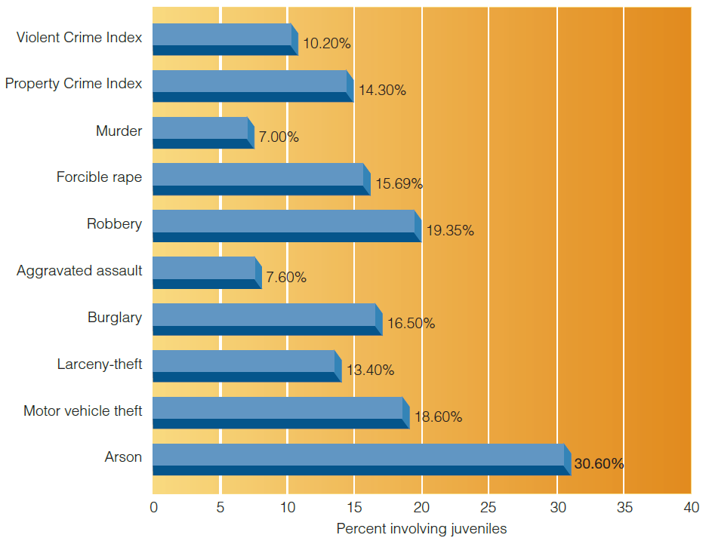
Figure 17.2 Percentage of All Arrests That Are Juveniles, 2015
Notes:
Juveniles are involved in a much smaller proportion of violent crime arrests than property arrests.

Slide 26
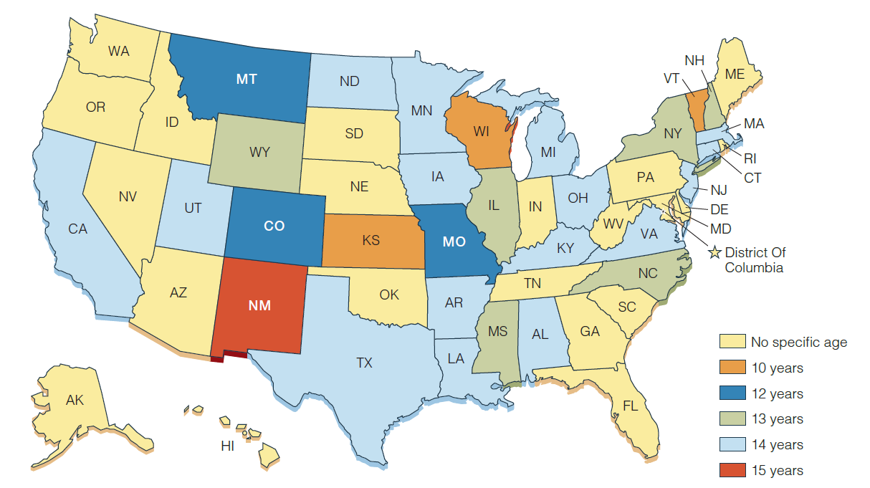
Figure 17.5 The Youngest Ages at Which Juveniles May Be Transferred to Adult Criminal Court

Slide 27
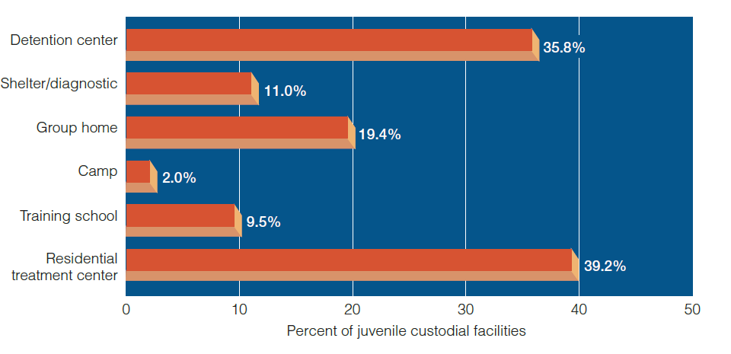
Figure 17.7 Types of Juvenile Custodial Facilities
Notes:
Most juvenile facilities are low security, but almost two of five juvenile facilities are for detention or long-term placement.

Slide 28
The Special Problem of Gangs
850,000 active gang members in 30,700 gangs operating in every state.
Almost half of urban violence is connected to gangs.
Gangs negatively impact the effectiveness of correctional officials.
Recent initiatives, such as Chicago’s Little Village Gang Project, have shown some success with gangs.
Notes:
Learning Objective 7: Describe the special problems that youth gangs pose.

Slide 29
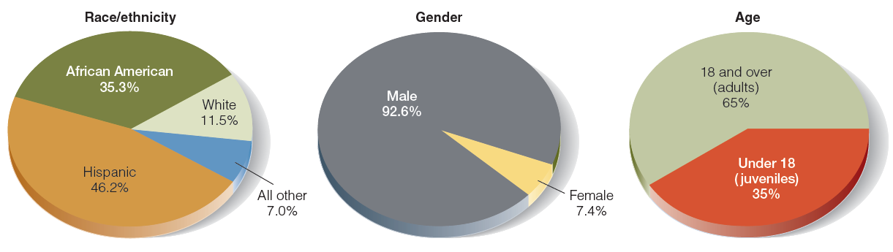
Figure 17.10 Characteristics of Youths Who Belong to a Gang

Slide 30
Discussion Question 3
What do you think can be done to decrease the number of youth gangs? What are some ways you could steer at-risk youth away a life of crime?

Slide 31
The Future of Juvenile Justice
In the 1990s, themes of reform in adult corrections from the 1970s were replayed in juvenile justice.
Reform efforts today are turning away from adult processes.
The everyday juvenile remains unsophisticated and susceptible to change under appropriate programs.
Most juvenile crime is still minor misbehavior, not at all like the highly charged cases of serious violence that dominate the news.
Notes:
Learning Objective 8: Assess the future of juvenile corrections.

