Slide 1


AMERICAN CORRECTIONS
Twelfth Edition
Chapter 16
Making It: Supervision in the Community
© 2019 Cengage. All rights reserved.

Slide 2
Learning Objectives (1 of 2)
Describe the major characteristics of the postrelease function of the corrections system.
Define community supervision and revocation of community supervision.
Explain how community supervision is structured.
Analyze the constraints on community supervision.

Slide 3
Learning Objectives (2 of 2)
Describe residential programs and how they help people on parole.
Identify the major problems that people on parole confront.
Understand why some people on parole are viewed as dangerous and how society handles this problem.
Describe the effectiveness of postrelease supervision.

Slide 4
Overview of the Postrelease Function (1 of 5)
Conditions of Release:
  Restrictions on conduct that people on parole must obey as a legally binding requirement of being released.
Parole boards only release about one-fourth of people from prison (down from 65 percent in 1976).
80 percent of those released now under parole supervision (compared to 60 percent in 1960).
No truly “clean” start is possible.
Important to remember that the experience of a “former convict” is almost as stigmatizing as that of a “convict,” and can be more frustrating.
Notes:
Learning Objective 1: Describe the major characteristics of the postrelease function of the corrections system.

Slide 5
Overview of the Postrelease Function (2 of 5)
Community Supervision:
  Restrictions on people on parole:
    Personal and material problems are staggering
  Most are unskilled or semiskilled, and have trouble finding any type of reasonable employment.
  Nearly one-fourth of people on parole fail within six months.
  With little preparation, people move from the structured environment of the prison into a complex/temptation-filled free world.
Notes:
Learning Objective 2: Define community supervision and revocation of community supervision.

Slide 6
Overview of the Postrelease Function (3 of 5)
Revocation:
  Parole revoked for two reasons:
    Committing a new crime
    Violating conditions of parole (technical violation):
  Revocation usually involves noncriminal conduct (e.g., failure to change address)
  Most occur when person on parole is arrested on a serious charge or cannot be located.
  Parole is a privilege.
  The Supreme Court requires a two-step process involving probable cause and potentially returning the individual to prison.

Slide 7
Overview of the Postrelease Function (4 of 5)
Two-stage Revocation Proceeding:
  Parole board determines whether there is probable cause that a violation has occurred. The person on parole has the right to:
    Be notified of charges
    Be informed of witnesses
    Be heard
    Present witnesses
    Confront parole board witnesses (safety)

Slide 8
Overview of the Postrelease Function (5 of 5)
  Parole board decides if the violation is severe enough to warrant return to prison.
Parole agency has several options:
  Return person on parole to prison
  Note violation but strengthen supervision
  Note violation but take no action
Highest rate of failure in first year
    Number of revocations is hard to determine. Within three years, nearly 68 percent of parolees are arrested for a new violation, and 43 percent are arrested during the first year after their release.

Slide 9
Discussion Question 1
Do you think depriving a released individual of a “clean start” is a good deterrent or the result of a flawed system? Why?

Slide 10
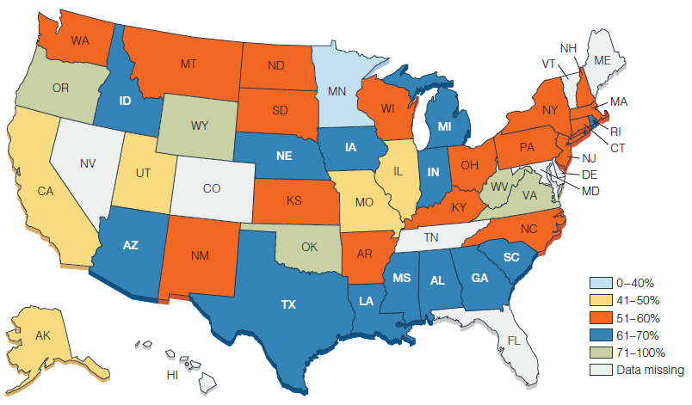
Figure 16.5 Percentage of Success After Release from State Prison to Parole Supervision
Notes:
Why do some states seem to do a better job at helping people make it after prison?

Slide 11
Discussion Question 2
If technical violations were no longer sufficient cause for revocation of parole, how do you think recidivism rates would change? Do you think these violations are necessary to supervise the behavior of the person on parole?

Slide 12
The Structure of Community Supervision (1 of 3)
Three forces influence released individual’s adjustment to free society:
  Parole officer
    Play two roles, cop and social worker
  Parole bureaucracy
    Workload of parole officers is extremely high
  Experiences of individual
    Always important to consider
Complex web of attitudes, situations, policies, and random events determines the outcome of the supervision process.
Notes:
Learning Objective 3: Explain how community supervision is structured.

Slide 13
The Structure of Community Supervision (2 of 3)
Agents of Community Supervision:
  Cop and social worker
  Two hidden conditions:
    Parole officer’s style. Officers have certain expectations about how clients will behave and how to treat them:
      Parental approach
      Welfare approach
      Punitive officers
      Passive agents
    Supervision plan. This plan states what the parole officer is going to do about his or her client’s problems and how they are going to supervise them.

Slide 14
The Structure of Community Supervision (3 of 3)
The Community Supervision Bureaucracy:
  Workload:
    Active versus reduced surveillance
    Parole officers spend as much as 80 percent of their time at nonsupervisory work
  Philosophy and Policy
  Constraints on Officers’ Authority:
    Go along with the system
    Unwritten rules
Notes:
Learning Objective 4: Analyze the constraints on community supervision.

Slide 15
Residential Programs (1 of 2)
Community Correctional Centers:
  A small-group living facility, especially those who have been recently released from prison:
  Typically house between 10 and 25 people at a time.
    Usually provide counseling and drug treatment
    Impose strict curfews
    Residents can gradually earn a reduction in restrictions
    Idea is to provide treatment while promoting step-by-step adjustment to community life
Notes:
Learning Objective 5: Describe residential programs and how they help people on parole.

Slide 16
Residential Programs (2 of 2)
Work Release Center:
  A facility that allows residents to work in the community during the day while residing in the center during nonworking hours
  Originated in Wisconsin with the 1913 Huber Law
  Two types:
    People in prison work during day and return at night
    People work and live at home during week; return to center on weekends

Slide 17
The Experience of Postrelease Life (1 of 2)
The Strangeness of Reentry
Supervision and Surveillance
The Problem of Unmet Personal Needs
Barriers to Success:
  Civil Disabilities:
    Right to vote
    Public assistance and food stamps
    Public housing
    Driver’s licenses
    Adoptions and foster care
    Student loans
Notes:
Learning Objective 6: Identify the major problems that people on parole confront.

Slide 18
The Experience of Postrelease Life (2 of 2)
  Many restrictions are statutory stemming from common law traditions of “civil death.”
  Securing housing, food stamps, and childcare are some of the many issues this population faces.
Expungement and Pardon:
  Expungement:
    A legal process that results in the removal of a conviction from official records.
  Pardon:
    An action of the executive branch of the state or federal government excusing an offense and absolving a person of the consequences of his or her crime.

Slide 19
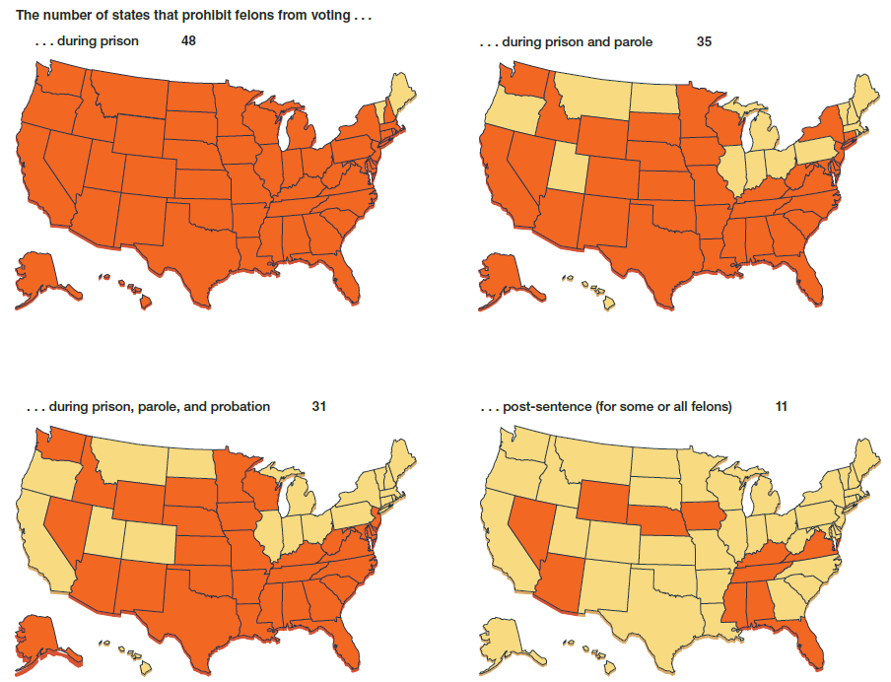
Figure 16.7 Voting Rights for People Convicted of Felonies
Notes:
Florida is the largest of 11 states that can permanently strip some or all felony-convicted people of their right to vote. States have clemency processes to restore voting rights in some cases.

Slide 20
The Person on Parole as “Dangerous”
More than two-third of states have passed sex offender notification laws:
  Notification laws seem to have heightened public discomfort
  Isolated tragedies can exaggerate the actual danger
No correlation between numbers of people on parole and crime rate
Statutes such as Megan’s Law come out of parole violations
Notes:
Learning Objective 7: Explain why some people on parole are viewed as dangerous and how society handles this problem.

Slide 21
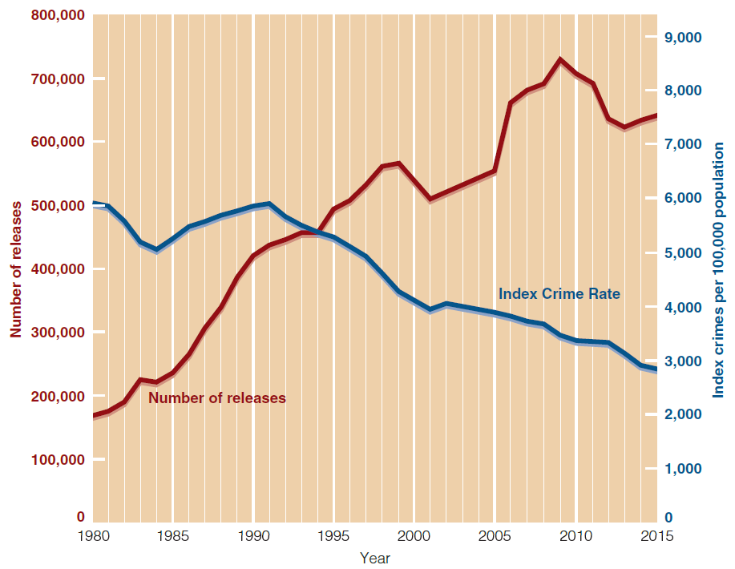
Figure 16.9 Crime Rate and Releases from State and Federal Prisons, 1980–2015
Notes:
Even though the number of people released into the community has increased steadily for almost three decades, crime has not increased during that time.

Slide 22
The Elements of Successful Reentry
Most important adjustments for successful reentry
  Getting substance abuse under control
  Getting a job
  Getting a community support system
  Getting a new sense of “who I am”

Slide 23
Postrelease Supervision (1 of 2)
How Effective Is Postrelease Supervision?
  Measured in terms of rates of recidivism
    Less than half of those released from prison remain arrest-free after three years
    Mandatory release only seems to work for those who committed property offenses
    Case management
    Overall, success of parole supervision is mixed
Notes:
Learning Objective 8: Describe the effectiveness of postrelease supervision.

Slide 24
Postrelease Supervision (2 of 2)
Evidence-based priorities for policy changes to help the parole process include:
  Develop and use of valid risk assessments
  Target supervision strategies to deal with critical needs of high-risk cases
  Creation of incentives for people who want to succeed
  Support and help those who do reenter comply with the restrictions
  Be sensible about revoking parole

Slide 25
Discussion Question 3
How do you see parole evolving in the future and how do you see these changes affecting the corrections system?

