Slide 1
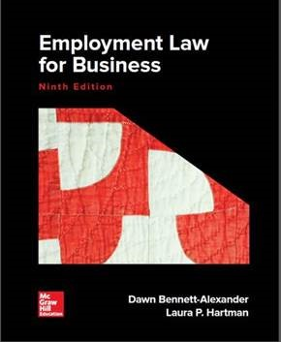
Chapter 2
The Employment Law Toolkit: Resources for Understanding the Law and Recurring Legal Concepts
Copyright 2019 McGraw-Hill Education. All rights reserved. No reproduction or distribution without the prior written consent of McGraw-Hill Education.

Slide 2
Learning Objectives (1)
Understand how to read and digest legal cases and citations
Explain and distinguish the concepts of stare decisis and precedent
Evaluate whether an employee is an at-will employee
Determine if an at-will employee has sufficient basis for wrongful discharge
Copyright 2019 McGraw-Hill Education. All rights reserved. No reproduction or distribution without the prior written consent of McGraw-Hill Education.

Slide 3
Learning Objectives (2)
Recite and explain at least three exceptions to employment-at-will
Distinguish between disparate impact and disparate treatment discrimination claims
Provide several bases for employer defenses to employment discrimination claims
Copyright 2019 McGraw-Hill Education. All rights reserved. No reproduction or distribution without the prior written consent of McGraw-Hill Education.

Slide 4
Learning Objectives (3)
Determine if there is sufficient basis for a retaliation claim by an employee
Identify sources for further legal information and resources
Copyright 2019 McGraw-Hill Education. All rights reserved. No reproduction or distribution without the prior written consent of McGraw-Hill Education.

Slide 5
Stare Decisis and Precedent (1)
Stare decisis (stand by a decision)
  Process of a court using prior decisions to determine decision for case before it
  Decision may be a concurring or a dissenting opinion
States have court systems parallel to the federal court system
  Trial court → intermediate court of appeals → state supreme court
Copyright 2019 McGraw-Hill Education. All rights reserved. No reproduction or distribution without the prior written consent of McGraw-Hill Education.

Slide 6
Stare Decisis and Precedent (2)
Interplay between states and the federal court system
  U.S. Supreme Court decisions are final
  Congress can pass a law to change a Court decision if it believes the Court’s interpretation is not in keeping with the law’s intended purpose
Copyright 2019 McGraw-Hill Education. All rights reserved. No reproduction or distribution without the prior written consent of McGraw-Hill Education.

Slide 7
Understanding the Case Parties
Key Terms | Meaning
Plaintiff | One who brings a civil action in court
Defendant | One against whom a case is brought
Appellant | One who brings an appeal
Appellee | One against whom an appeal is brought
Petitioner | One who appeals a case to the Supreme Court
Respondent | One against whom a case is appealed at the Supreme Court
Copyright 2019 McGraw-Hill Education. All rights reserved. No reproduction or distribution without the prior written consent of McGraw-Hill Education.

Slide 8
Understanding the Case: Information
Key Terms | Meaning
Law reporter | Book in which court opinions are placed
Case citation | The line after the case name in the law reporter that has several numbers and a few letters
Motion to dismiss | Request by a defendant for the court to dismiss the plaintiff’s case
Motion for summary judgment | Defendant’s request for the court to rule on the plaintiff’s case based on the documents submitted, alleging there are no triable issues of fact to be decided
Per curiam | Brief determination made by an appellate court, not issued by a particular judge
Copyright 2019 McGraw-Hill Education. All rights reserved. No reproduction or distribution without the prior written consent of McGraw-Hill Education.

Slide 9
Prima Facie Case
Cause of action: Right provided by law for a party to sue for remedies when certain legal rights are violated
Prima facie case: Presentation of evidence that fits each requirement of a cause of action
  Establishes plaintiff’s claim to a cause of action
  Requires defendant to establish all the elements of the claim(s)
Copyright 2019 McGraw-Hill Education. All rights reserved. No reproduction or distribution without the prior written consent of McGraw-Hill Education.

Slide 10
At-Will Employment
Employment relationship where there is no contractual obligation to remain in the relationship
  Employee could work for the employer as long as he or she wished and leave when he or she no longer wished to work
  Either party may terminate the relationship
Employer cannot terminate a worker based on race, gender, religion, national origin, age, or disability
Copyright 2019 McGraw-Hill Education. All rights reserved. No reproduction or distribution without the prior written consent of McGraw-Hill Education.

Slide 11
Exclusions from At-Will Employment
Government employment
Employees under a collective bargaining agreement
Employees who have an individual contract with their employer
Copyright 2019 McGraw-Hill Education. All rights reserved. No reproduction or distribution without the prior written consent of McGraw-Hill Education.

Slide 12
Public Policy Exception
Public policy: Legal concept intended to ensure that no individual lawfully does that which may injure the public or damage the public good
Whistle-blowing: Occurs when an employee reports an employer’s wrongdoing
  Protections
    Federal Whistleblower Statute
    Whistleblowers Protection Act
    State protection
Copyright 2019 McGraw-Hill Education. All rights reserved. No reproduction or distribution without the prior written consent of McGraw-Hill Education.

Slide 13
Retaliatory Discharge
Terminations in response to an employee exercising rights provided by law
  E.g., filing a claim charging discrimination
Constitutional protections
  Employer is prohibited from terminating a worker or taking other adverse employment action against a worker on the basis of the worker’s engaging in constitutionally protected activities
  State action – Protections vary from state to state
Copyright 2019 McGraw-Hill Education. All rights reserved. No reproduction or distribution without the prior written consent of McGraw-Hill Education.

Slide 14
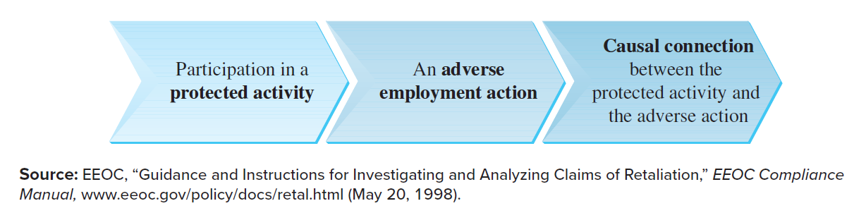
Retaliatory Discharge: Prima Facie Case
Burlington Northern & Santa Fe Railway Co. v. White
Copyright 2019 McGraw-Hill Education. All rights reserved. No reproduction or distribution without the prior written consent of McGraw-Hill Education.

Slide 15
Implied Covenant of Good Faith and Fair Dealing Exception
Implied contractual obligation to act in good faith in the fulfillment of each party’s reasonable contractual expectations
The court examines the parties’ actions to ascertain whether termination demonstrated bad faith
Case: Guz v. Bechtel National, Inc.
Copyright 2019 McGraw-Hill Education. All rights reserved. No reproduction or distribution without the prior written consent of McGraw-Hill Education.

Slide 16
Implied Contract Exception
Implied contract: Contract that is not expressed but is created by other words or conduct of the parties involved
  Courts have found contracts implied from off-hand statements made by employers during preemployment interviews
Melott v. ACC Operations, Inc.
Copyright 2019 McGraw-Hill Education. All rights reserved. No reproduction or distribution without the prior written consent of McGraw-Hill Education.

Slide 17
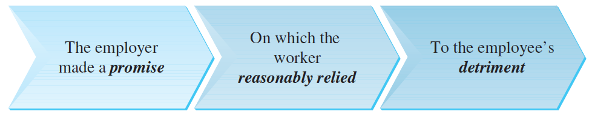
Promissory Estoppel Exception: Prima Facie Case; other statutes of note
Similar to the implied contract claim except that the promise, implied or expressed, does not rise to the level of a contract
Other statutory exceptions to employment at-will
  Occupational Safety and Health Act
  Fair Labor Standards Act
  Pregnancy Discrimination Act
Copyright 2019 McGraw-Hill Education. All rights reserved. No reproduction or distribution without the prior written consent of McGraw-Hill Education.

Slide 18
Constructive Discharge
Constructive discharge: Occurs when the employee is given no reasonable alternative but to end the employment relationship
  Considered an involuntary act on the part of the employee
  Restricts employers’ actions of wrongful termination
Paloni v. City of Albuquerque Police Department (no)
Nassar v. Univ. of Texas Southwestern Medical Center at Dallas (yes)
Copyright 2019 McGraw-Hill Education. All rights reserved. No reproduction or distribution without the prior written consent of McGraw-Hill Education.

Slide 19
Other Restrictions on At-Will Doctrine
The Worker Adjustment and Retraining Notification Act (WARN)
  Requires that employers with over 100 employees must give 60 days’ advance notice of a plant closing or mass layoff to affected employees
  Exceptions
    Faltering company exception
    Sudden, dramatic, unexpected business changes
    Certain natural calamities
Copyright 2019 McGraw-Hill Education. All rights reserved. No reproduction or distribution without the prior written consent of McGraw-Hill Education.

Slide 20
Other Exceptions to At-Will Doctrine
Wrongful Discharge Based on Other Tort Liability
  Tort of intentional and outrageous conduct
  Tort claim for emotional distress
  Tort action of defamation
  Wrongful invasion of privacy
Copyright 2019 McGraw-Hill Education. All rights reserved. No reproduction or distribution without the prior written consent of McGraw-Hill Education.

Slide 21
Employment Discrimination
Federal law prohibits employment discrimination on the basis of race, color, gender, religion, national origin, age, disability, and genetic information
Generally two types of discrimination claims:
  Disparate treatment
  Disparate impact
Copyright 2019 McGraw-Hill Education. All rights reserved. No reproduction or distribution without the prior written consent of McGraw-Hill Education.

Slide 22
Employment Discrimination Concepts: Disparate Treatment
Disparate treatment: Treating similarly situated employee differently because of prohibited Title VII or other employment discrimination law factors
  Considered intentional discrimination
Copyright 2019 McGraw-Hill Education. All rights reserved. No reproduction or distribution without the prior written consent of McGraw-Hill Education.

Slide 23
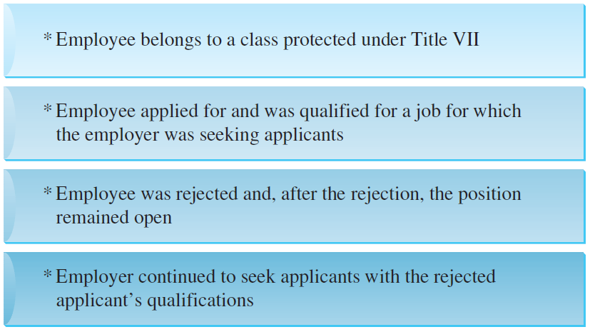
Employment Discrimination Concepts, Disparate Treatment: Prima Facie Case
Copyright 2019 McGraw-Hill Education. All rights reserved. No reproduction or distribution without the prior written consent of McGraw-Hill Education.

Slide 24
Employment Discrimination Concepts, Disparate Treatment: Defenses
Employer’s defense
  Legitimate, Nondiscriminatory Reason Defense
  Employee’s counter – Employee can counter with evidence that the employer’s legitimate, non-discriminatory reason was a mere pretext for the employer to discriminate
  The Bona Fide Occupational Qualification Defense: Permissible discrimination if legally necessary for employer’s particular business
    Legalized discrimination, narrowly construed by the courts
    Case: Wilson v. Southwest Airlines Company
Copyright 2019 McGraw-Hill Education. All rights reserved. No reproduction or distribution without the prior written consent of McGraw-Hill Education.

Slide 25
Employment Discrimination Concepts: Disparate Impact (1)
Disparate impact: Discriminatory effect of a facially neutral policy on a Title VII group
  Facially neutral policy: Workplace policy that applies equally to all appropriate employees
Case: Griggs v. Duke Power Company
Copyright 2019 McGraw-Hill Education. All rights reserved. No reproduction or distribution without the prior written consent of McGraw-Hill Education.

Slide 26
Employment Discrimination Concepts: Disparate Impact (2)
Screening device: Mechanism used to separate applicants from the general pool of candidates
Four-fifths rule: Minority group must perform at least 80 percent (four-fifths) as well as the majority group under a screening device
  If the requirement is not met, a presumption arises that the screening device has a disparate impact on the minority group and must be shown to serve a legitimate business necessity
Subjective or objective criteria are a concern
Copyright 2019 McGraw-Hill Education. All rights reserved. No reproduction or distribution without the prior written consent of McGraw-Hill Education.

Slide 27
Employment Discrimination Concepts:
Disparate Impact (3)
Preemployment interviews
Employment applications
Business necessity: Defense to a disparate impact case based on the employer’s need for the policy as a legitimate requirement for the job
Copyright 2019 McGraw-Hill Education. All rights reserved. No reproduction or distribution without the prior written consent of McGraw-Hill Education.

Slide 28
Other Defenses to Employment Discrimination Claims
Employee’s evidence is not true
Employer’s “bottom line” comes out correctly
Case: Connecticut v. Teal
Copyright 2019 McGraw-Hill Education. All rights reserved. No reproduction or distribution without the prior written consent of McGraw-Hill Education.

Slide 29
Other Common Concepts (1)
Accommodation: Employer’s duty in Title VII religious discrimination claims and under Americans With Disabilities Act (ADA) to accommodate workplace conflicts
  Should not cause undue hardship to the employer
  Extent of duty varies between religious and disability accommodations
Retaliation: Provisions allowing employees to file separate claims for negative consequences experienced from their employers for pursuing their lawful rights
Copyright 2019 McGraw-Hill Education. All rights reserved. No reproduction or distribution without the prior written consent of McGraw-Hill Education.

Slide 30
Other Common Concepts (2)
Exhaustion of Administrative Remedies
  Going through the EEOC administrative procedure before being permitted to seek judicial review of an agency decision
Copyright 2019 McGraw-Hill Education. All rights reserved. No reproduction or distribution without the prior written consent of McGraw-Hill Education.

Slide 31
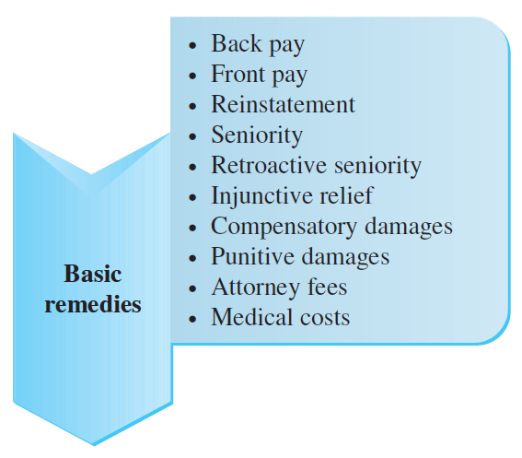
Exhibit 2.9 - Employment Discrimination Remedies
Copyright 2019 McGraw-Hill Education. All rights reserved. No reproduction or distribution without the prior written consent of McGraw-Hill Education.

Slide 32
Employment Discrimination Remedies (1)
Key Terms | Meaning
Back pay | Money awarded for time employee was not working because of illegal discrimination
Front pay | Equitable remedy of money awarded to claimant when reinstatement is not possible or feasible
Retroactive seniority | Seniority that dates back to the time the claimant was treated illegally
Copyright 2019 McGraw-Hill Education. All rights reserved. No reproduction or distribution without the prior written consent of McGraw-Hill Education.

Slide 33
Employment Discrimination Remedies (2)
Key Terms | Meaning
Make-whole relief | Attempt to put the claimant in position he or she would have been been in had there been no discrimination
Compensatory damages | Money damages given to a party to compensate for direct losses due to an injury suffered
Punitive damages | Money over and above compensatory damages, imposed by a court to punish employer or deter future acts
Copyright 2019 McGraw-Hill Education. All rights reserved. No reproduction or distribution without the prior written consent of McGraw-Hill Education.

Slide 34
Additional Legal Resources
Law Libraries
  Found everywhere from private law firms to public courthouses
  Can contain only a few necessary legal resources or vast ones
The Internet
  Includes legal databases for public consumption
Copyright 2019 McGraw-Hill Education. All rights reserved. No reproduction or distribution without the prior written consent of McGraw-Hill Education.

Slide 35
Management Tips (1)
Employers are always allowed to hire the best person for a job
  Allowed to fire an employee for any reason as long as it is not for one of the specific reasons prohibited by law
Company policies and procedures should create a space for employees to voice any concerns and complaints
Employers should subject termination decisions to internal review
Copyright 2019 McGraw-Hill Education. All rights reserved. No reproduction or distribution without the prior written consent of McGraw-Hill Education.

Slide 36
Management Tips (2)
Employees should be made aware of their rights under the law regarding any protected category to which they may belong
Policies that discriminate on their face should be discarded
Copyright 2019 McGraw-Hill Education. All rights reserved. No reproduction or distribution without the prior written consent of McGraw-Hill Education.

