Slide 1
Assignment 3a – Threats to the Global Environment
SOC450_Solution to Global Issues

Slide 2

Introduction
The selected four most critical threats to the global environment include:
  Climate Change
  Civil War
  Lack of educational opportunities
  Poor health of entire populations
Notes:
The selected four most critical threats to the global environment are climate change, civil war, lack of educational opportunities, as well as poor health of entire populations. While poor health of entire populations has an impact on the ecology, its impacts are less detrimental compared to other factors. As more pressure is levelled on reducing environmental impact, climate change increasing contributing to environmental impact. The other two factors also continue threatening the global environment today more than ever.

Slide 3
Climate Change
History and Assessment of Threat
  Since the pre-industrial period, the world has warmed by approximately 1 degrees Celsius.
  Two-thirds of this warming up is believed to have occurred during 1986.
  The warmest decades on record have happened during the last 22 years.
  In 2017, the globe was increasingly warm, compared to 2015 due to increasing temperatures across the world (Introcaso, 2018).
Notes:
Though the history of climate change is significantly long, much of the globe’s climate change has taken place since the post-industry era. The pre-industrial time is known to have experienced the least global warming. However, over the last 22 years, the world has warmed the most. In recent years, 2017 warmed the most compared to 2015.

Slide 4
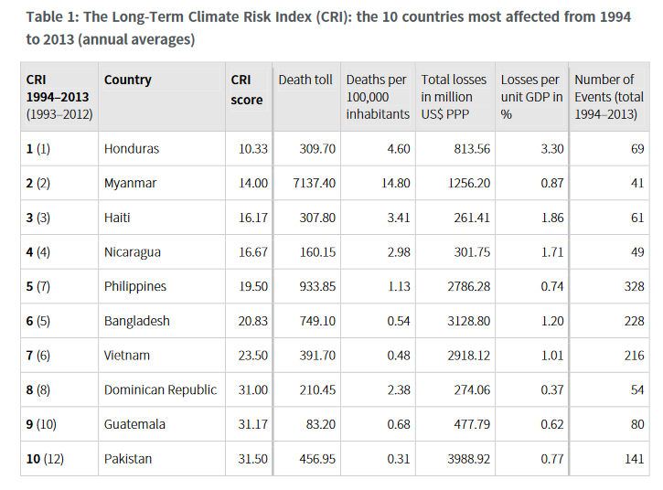
Climate Change
Countries most affected by climate change
Notes:
In relative terms, countries that are most affected are developing countries. Most of these countries are also the world’s poorest countries. As seen from the 2013 CRI, Honduras was the most affected countries, followed by Myanmar. Pakistan was the least affected country in this list (Kreft et al, 2015).

Slide 5
Climate Change
Effect of climate change in the world population
  Climate change impacts both the social and ecological determinants of health, including clean water, foods, shelter, and safe air.
  By 2050, climate change is projected cause more than 200,000 deaths per year from lack of food, disease, and heat stress.
  Decreasing emissions and other contributors can result in enhanced health for all, mainly through reduced pollution to air and water.
  According to the World health Organization, air pollution causes more than 4.5 million death each year (World Health Organization, 2018).
Notes:
Though the history

Slide 6
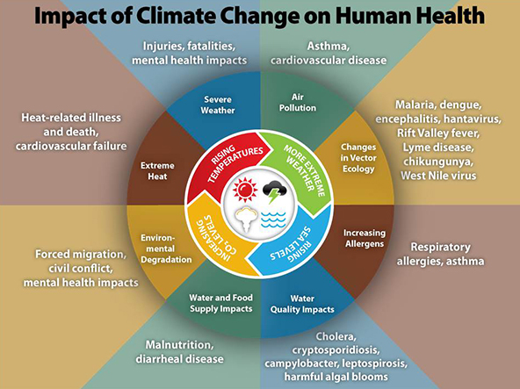
Climate Change
climate change Chart
Notes:
From the above chart, the effects of climate change are real, visible, and far-reaching. The climate changes are impacting every aspect of the world, including ecosystems, human population, among others. The consequences of these changes, especially in the future, might lead to detrimental effects. While the above consequences are also expected in the future, they are also being experienced today.

Slide 7
Civil War
Brief History and Assessment
  According to Brown (2004), war shares a close history with humanity. However, he says that its effects on the environment is recent.
  He argues that modern wars portray important departure from old forms.
  From 1900 through 1910 were evenly represented as opposed to 1990-2000 which represents most wars.
  Between 1945-70s, most European countries waged wars for independence as other countries fought to become independent.
  Today, there are a few of these wars. They have also become internationalized. Also, a few happen without the intervention from international communities.
Notes:
Brown (2004) argues that war has a similar history and is as old as humanity. He argues that it affects every aspect of the environment today. He also says that the modern warfare is characterized by a significant departure from earlier wars. The period 1990-2000 witnessed increased wars more than the 1900s. Besides, he argues that from 1945 through 75, most countries either waged war to retain territories or gain independence. Equally, he says that today’s wars are few and internationalized.

Slide 8
Civil War
Countries Most Affected by Civil War
  The most affected countries by war include African countries, such as Rwanda, the Democratic Republic of Congo, Central African Republic, Nigeria, Sudan, Somalia, Libya, and Egypt. Other countries include Iraq, Mexico, Afghanistan, Pakistan, Syria, and Yemen, among others.
Notes:
The Most affected countries include Rwanda, the Democratic Republic of Congo, Central African Republic, Nigeria, Sudan, Somalia, Libya, and Egypt. Other countries include Iraq, Mexico, Afghanistan, Pakistan, Syria, and Yemen, among others.

Slide 9
Civil War
Effect of Civil War on World Population
  According to Thayer (2009), war has a profound effect on world population. He says that war often comes in different forms.
  He argues that these wars are often costly in terms of people killed.
  While population growth causes no war, civil wars often lead to population changes (Thayer, 2009).
  The adverse effects of some wars, including Iraq and Syria, on population show how their effects can cause negative consequences on world population.
Notes:
According to Thayer (2009), war has a profound effect on world population. He says that war often comes in different forms. He argues that these wars are often costly in terms of people killed. While population growth causes no war, civil wars often lead to population changes (Thayer, 2009). The adverse effects of some wars, including Iraq and Syria, on population show how their effects can cause negative consequences on world population

Slide 10
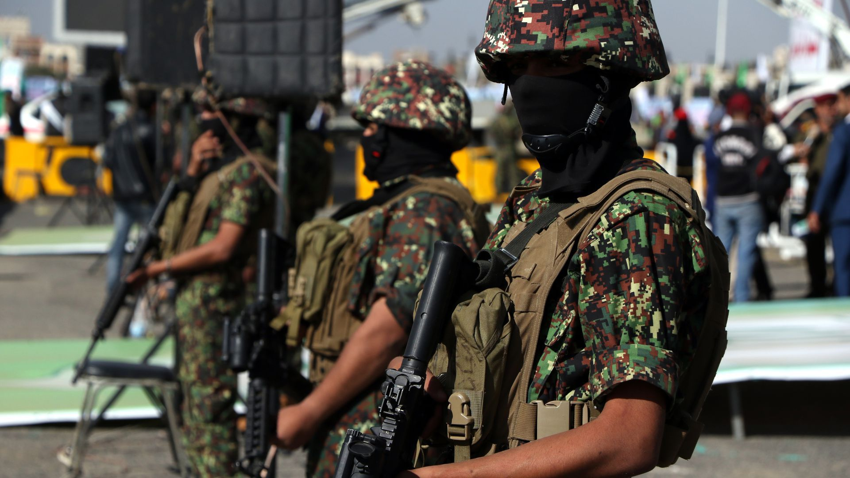
Civil War
Civil War Chart – A look at Yemen’s Civil War
Notes:
A look at Yemen’s civil war from 2015 to the present demonstrates a lot. What began as a minor disagreement between the country’s former head of state and the newly elected president quickly degenerated into a major conflict. This war has had devastating effects to both the public and the environment, almost with unprecedented outcomes. A civil war in this nation has lead to thousands of deaths, destruction of properties, starvation of people, and degradation of the environment.

Slide 11

Lack of Educational Opportunities
Brief History and Assessment
Notes:
Children in many of the underdeveloped nations experience significant obstacles in their attempts to gain education. Most of these barriers include lack of funds, insufficient schools to attend, and poor backgrounds. Many of these obstructions are more complex, including not having enough teachers in schools to poor education. Often, students do not receive the kind of education they deserve. Improving the quality of education in most of these areas can help to solve most of the social, economic, and environmental issues that have persisted for generations. Besides, improved educational opportunities would also solve most of the health issues faced in these areas.

Slide 12
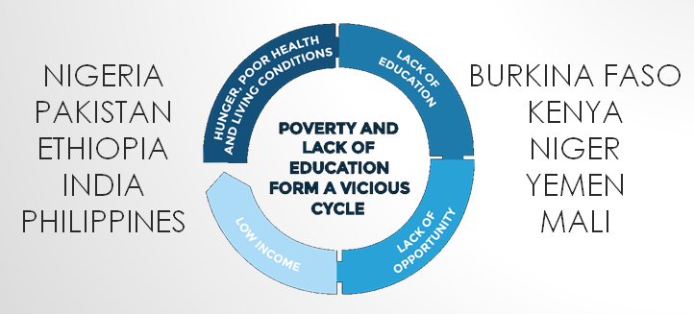
Lack of Educational Opportunities
Countries Most Affected
Notes:
Even though most of the countries in the world lack access to proper education, African countries are the most affected. In these nations, the level and quality of education is significantly low. Some of the countries that lack sufficient educational opportunities for their countries include Nigeria, Kenya, Mali, Niger, Burkina Faso, and Ethiopia. Outside Africa, countries with low education opportunities include Yemen, India, Pakistan, and Philippines.

Slide 13
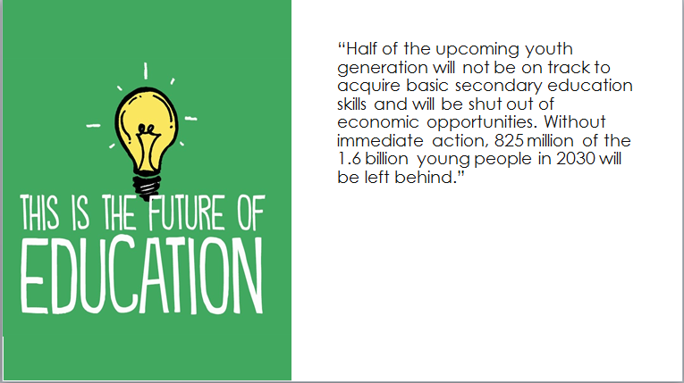
Lack of Educational Opportunities
Effect on World Population
Notes:
Nearly half of the youth and upcoming generation are likely to lack the fundamental skills they require in life due to lack of educational opportunities. without the necessary actions, more than 800 million of the world youths will be left behind by the year 2030. Due to poverty and other tough life situations in the most of the developing countries, millions of people face hard decisions between going to school or vending for their families.

Slide 14
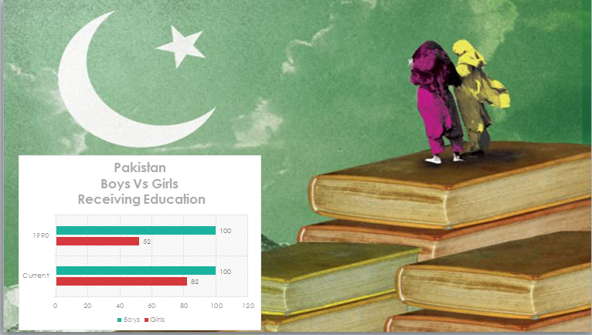
Lack of Educational Opportunities
Associated Chart
Notes:
From the above chart, it is clear that above all the obstacles that children face, gender is the most prevalent. In Pakistan, gender is a leading cause of lack of educational opportunities for girls. Unlike boys, girls in this country have limited chances of going and completing education.

Slide 15
Poor health of Entire populations
Brief History and Assessment
  The world Health Organization (2017), almost half of the world population have no access to vital health services.
  Every year, a large majority of people around the world are pushed into poverty because they are not able to pay for health services.
  More than 800 million individuals spend nearly 10% of their budgets on health services, for a sick child, or for themselves.
  For year, more than half of the world populations lack coverage for their vital health services (World Health Organization, 2017).
Notes:
From the

Slide 16
Poor health of Entire populations
Countries Most Affected
These countries include the following:
  Chad
  Guinea
  Central African Republic
  Liberia
  Benin
  Afghanistan
  Syria
Notes:
Some of the countries with poor health populations in the world include Chad, Syria, Guinea, Benin, Liberia, Afghanistan, and the Central African Republic, among others.

Slide 17
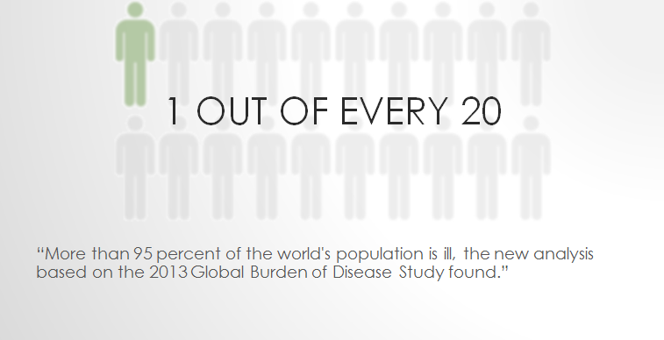
Poor health of Entire populations
Effect on World Population
Notes:
More than 90 percent of the world’s population is ill. In particular, one in 20 people in the world is ill. While these statistics might be years old, they offer a clear indication that health is an important aspect in the world. If anything is not done to improve people’s health outcomes, the costs, in terms of deaths and disease, would be significantly high.

Slide 18
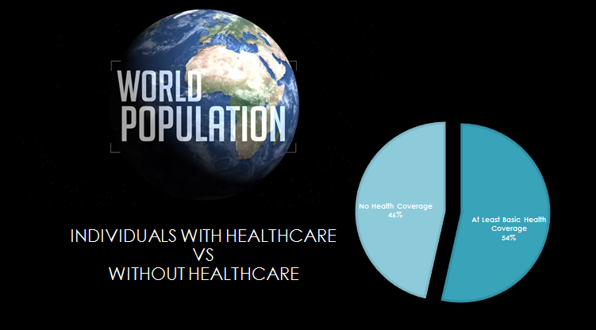
Poor health of Entire populations
Associated Chart
Notes:
This chart shows that nearly 54 percent of the world’s people have access to basic form of health coverage. The remaining percentage have no access to healthcare coverage.

Slide 19
Conclusion
From the above discussion, the most critical threats to the global environment include:
  Climate Change
  Civil War
  Lack of educational opportunities
  Poor health of entire populations

Slide 20
References
  Brown, V. J. (2004). BattleScars: Global Conflicts and Environmental Health.
  Kreft, S., Eckstein, D., Junghans, L., Kerestan, C., & Hagen, U. (2015). Germanwatch.org. Retrieved 23 May 2020, from https://germanwatch.org/sites/germanwatch.org/files/publication/10333.pdf.
  Introcaso, D. (2018). Climate Change Is The Greatest Threat To Human Health In History | Health Affairs. Healthaffairs.org. Retrieved 23 May 2020, from https://www.healthaffairs.org/do/10.1377/hblog20181218.278288/full/.
  Thayer, B. A. (2009). Considering population and war: a critical and neglected aspect of conflict studies. Philosophical Transactions of the Royal Society B: Biological Sciences, 364(1532), 3081-3092.
  World Health Organization. (2018). Climate change and health. Who.int. Retrieved 23 May 2020, from https://www.who.int/news-room/fact-sheets/detail/climate-change-and-health.
  World Health organization. (2017). World Bank and WHO: Half the world lacks access to essential health services, 100 million still pushed into extreme poverty because of health expenses. Who.int. Retrieved 24 May 2020, from https://www.who.int/news-room/detail/13-12-2017-world-bank-and-who-half-the-world-lacks-access-to-essential-health-services-100-million-still-pushed-into-extreme-poverty-because-of-health-expenses.

