Slide 1
Agenda
Misc Housekeeping
News Talks
Better World Books – in your groups
External Analysis
Ice Fili – in your groups

Slide 2

Agenda
Misc Housekeeping:
  Sign-ups: Good work. Don’t forget to pick a specific company.
  Don’t forget to sign up for News Talks (22 so far)
  MUST buy/read the cases and the textbook. Your grade depends on it.
  Quiz grades made it apparent that many aren’t reading textbook or cases.
  Vision Statement Homework – many (not all) asynchronous lectures will have homework assignments in them. Will need to watch them to see/hear it.
  Can only submit Class Convo videos on day we have an asynchronous class – by midnight – though by “midnight, China time” is fine too if you’re in inconvenient time zone

Slide 3


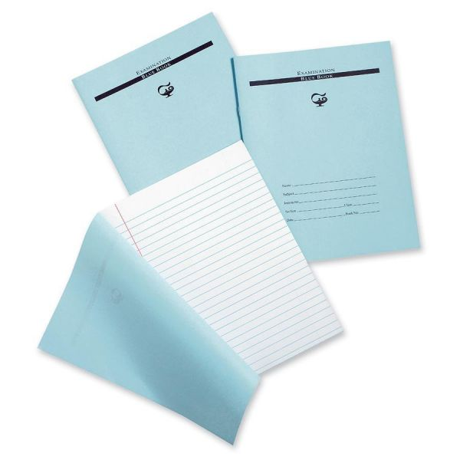


The Path To Success
The Reading
Class Discussion
Quizzes
Exam
What it Starts/Ends With:
Key Ingredient: Effort! and….???
#1 Most Desirable Trait in Employee?
Job

Slide 4
Conscientiousness

Slide 5
News Talks

Slide 6
Better World Books
What IS their Vision / Mission Statement?

Slide 7
BWB “Vision/Mission Statement”
“Global bookstore”
Bring “literacy and opportunity” to people around the world
Doesn’t identify focal customer group
Or, markets wishes to compete in
Unclear how mission helps employees make sounds decisions each day.

Slide 8
  What’s the Difference Between
  a “Vision” and a “Mission?

Slide 9

To Begin The Strategic Management Process….
  What is our Vision?
    What do we want to accomplish ultimately?
  What is our Mission?
    What is the firm about?
    How do we accomplish our goals?
  What are our Values?
    How do we accomplish our goals?
    What guardrails do we put in place to act ethically and legally as we pursue our vision and mission?
  Visionary organizations begin with the end in mind
    Similar to designing and building a house

Slide 10
  What’s the Difference Between
  a “Product-Oriented” Vision Statement
  and a
  “Customer-Oriented” Vision Statement?

Slide 11
Product-Oriented vs. Customer-Oriented Vision Statements?
Product-oriented vision statements are not very flexible.
Customer-oriented vision statements allow firms to adapt to changing environments.
Strategic flexibility is a necessary condition to achieve competitive advantage.

Slide 12
Product-Oriented Vision Statements
A product-oriented vision defines a business in terms of a good or service.
Product-oriented visions tend to force managers to take a myopic view of the business landscape.

Slide 13
Customer-Oriented Vision Statements
A customer-oriented vision defines a business in terms of providing solutions to customer needs and are more flexible.
Example: We are in the business of providing solutions to professional communication needs.

Slide 14
Better World Books -- Questions
What are their biggest problems? (besides digital/Amazon)
What are BWB’s resources and capabilities?
  ie, what core competencies do they have to help them compete in the used book industry?
Perform a SWOT* analysis for BWB
If you were a consultant for BWB, how would you recommend that they differentiate their product and services to create a competitive advantage?
* = we haven’t discussed the VRIO framework yet, so….

Slide 15
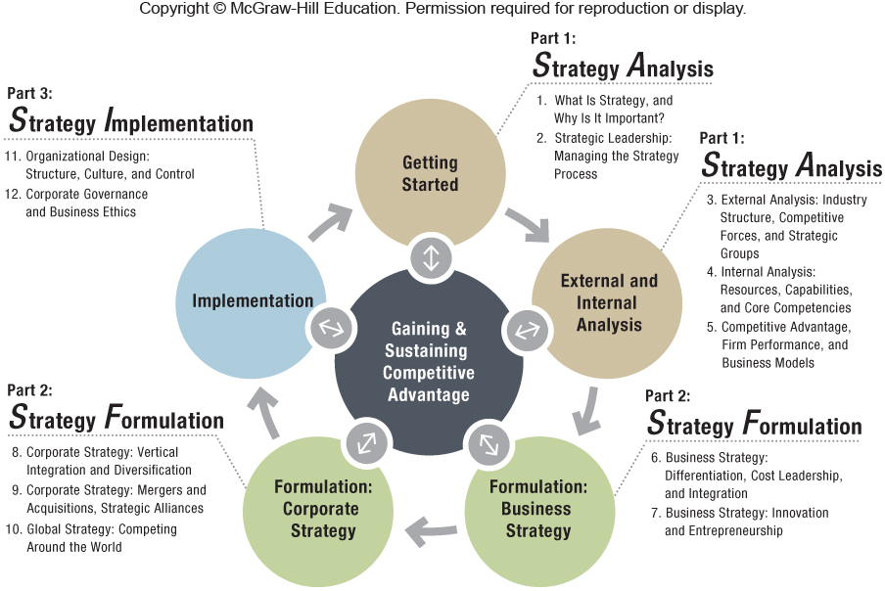

Slide 16
The Chapter – Analyzing External Forces
The PESTEL Framework – what does it measure?
Industry Structure and Firm Strategy: The Five Forces Model
  What does it measure?
Explaining Performance Differences within the Same Industry: Strategic Groups

Slide 17
What is PESTEL and why is it important?

Slide 18

Quest for Competitive Advantage
PESTEL: Scan, monitor, and evaluate changes and trends in the firm’s macro-environment to help determine strategy.

Slide 19
Why is PESTEL Important?
EXTERNAL ANALYSIS
INDUSTRY ANALYSIS
Five Forces Model
COMPETITOR ANALYSIS
Strategic Group Mapping
PESTEL Framework
MACRO
MICRO

Slide 20
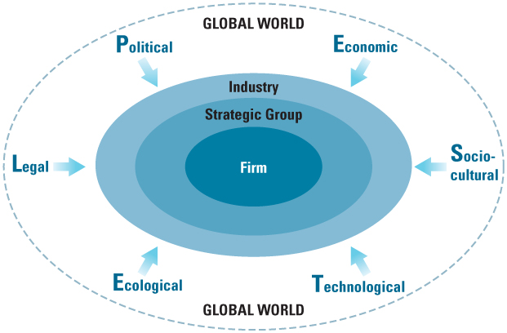
The Firm Embedded in Its External Environment
Notes:
INSTRUCTOR: An Interactive activity is available online through McGraw-Hill Connect on this section of the text.

Slide 21
PESTEL Framework
Technological – The Internet (for example): Amazon, eBay, etc.
  Innovation
  Diffusion
  Research & development
Environmental – Law’s effecting the following…
  Global warming
  Sustainability
  Pollution
Legal – CA’s zero emission vehicles effort (1990)…”10% of cars ZEV by 2003.” Defeated by lobbyists, but….
  Court system
  Legislation
  Hiring laws
Political – Swiss Bank account/UBS 2009. Dem vs. Rep?
  Gov’t pressures
  Subsidies & incentives
  Differences in countries, states, countries & regions
Economic – 2008 Housing Bubble Burst.
  Growth rates
  Interest rates
  Employment levels
  Currency exchange
Sociocultural – Health-conscious. Coke/Honest Tea
  Norms, culture, values
  Demographics
  Lifestyle changes

Slide 22
Industry Analysis
EXTERNAL ANALYSIS
INDUSTRY ANALYSIS
Five Forces Model
COMPETITOR ANALYSIS
Strategic Group Mapping
PESTEL Framework
MACRO
MICRO

Slide 23
Why Five Forces?
Identifies industry profit potential and firm positioning for gaining and sustaining competitive advantage.

Slide 24
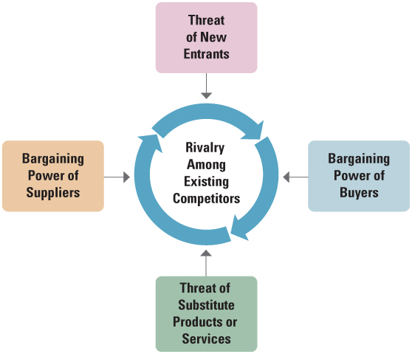
Porter’s Five Forces

Slide 25
Why Five Forces?
Five Forces is there to explain the drivers of industry profitability. Need to consider when analyzing industry environment and formulating strategy.
The stronger the Five Forces the lower the industry’s profit potential… and vice versa.
Being in a good industry helps, being in a bad industry is hard, but it’s not a deal breaker either way.
  Venture capitalists/investors would prefer an “A” team and a “B” idea vs. a “B” team and an “A” idea.

Slide 26
While the primary purpose of the five forces model is to assess the profitability of an industry
It is NOT to determine whether or not to enter an industry.
Porter’s Five Forces

Slide 27
What Does “Threat of Entry” Mean?
Why Is It Important?
Examples?

Slide 28
The Threat of New Entrants
Entry barriers
The risk that potential competitors will enter an industry
With new entrants, profit potential is depressed for incumbent firms:
  What have to do to prices?
  Will need to spend more/less? to satisfy existing customers?
Notes:
Instructors:
Suggestion from the IM for another exercise…. This one is fun and filling :
You can illustrate the impacts of new entrants, substitutes, and complements with a pizza example. Form four groups of students: new entrants, substitutes, complements, and focal industry rivals.
Bring three pizzas (one smaller than the other two and one of the larger ones a different type than the other) to class. Caution students not to eat pizza until teaching is done! Hand the smaller pizza to the industry rivals. Explain the drivers of rivalry intensity and what consequences that has for how evenly and civilly the pie is shared among all of the hungry incumbents. Hand one of the larger pizzas to the complements industry; explain how as the complements industry grows the size of pie available to the focal industry rivals
grows. Ask someone in the complements industry to swap out the focal industry’s small pie for the bigger one.
Hand one pizza to the substitutes industry and explain how they are a separate industry that has its own profits, but in this case they are close substitutes for the focal industry. The substitute industry begins to take customers/profit from the focal industry.
Ask someone from the substitutes industry to take a piece of pizza from the focal industry. Explain that new entrants are firms who are not in the focal industry, but decide to enter it. Send a students from the new entrants team over to the focal industry team and tell them to take a piece of pizza. Discuss the impact of the lost pieces of the focal industry pie on the original incumbents.
Then let the students eat your teaching materials!

Slide 29
The Threat of New Entrants
Entry barriers
The risk that potential competitors will enter an industry
With new entrants, profit potential is depressed for incumbent firms:
  Lower prices
  Will need to spend more to satisfy existing customers
Examples:
Compass Coffee
Caribou Coffee
Peet’s Coffee
= lower profit margins for Starbucks
Notes:
Instructors:
Suggestion from the IM for another exercise…. This one is fun and filling :
You can illustrate the impacts of new entrants, substitutes, and complements with a pizza example. Form four groups of students: new entrants, substitutes, complements, and focal industry rivals.
Bring three pizzas (one smaller than the other two and one of the larger ones a different type than the other) to class. Caution students not to eat pizza until teaching is done! Hand the smaller pizza to the industry rivals. Explain the drivers of rivalry intensity and what consequences that has for how evenly and civilly the pie is shared among all of the hungry incumbents. Hand one of the larger pizzas to the complements industry; explain how as the complements industry grows the size of pie available to the focal industry rivals
grows. Ask someone in the complements industry to swap out the focal industry’s small pie for the bigger one.
Hand one pizza to the substitutes industry and explain how they are a separate industry that has its own profits, but in this case they are close substitutes for the focal industry. The substitute industry begins to take customers/profit from the focal industry.
Ask someone from the substitutes industry to take a piece of pizza from the focal industry. Explain that new entrants are firms who are not in the focal industry, but decide to enter it. Send a students from the new entrants team over to the focal industry team and tell them to take a piece of pizza. Discuss the impact of the lost pieces of the focal industry pie on the original incumbents.
Then let the students eat your teaching materials!

Slide 30
The Threat of New Entrants
Incumbent firms can benefit from several important sources of entry barriers:
  Economies of scale
  Customer switching costs
  Capital requirements
  Advantages independent of size
  Government policy
  Credible threat of retaliation

Slide 31
What Does “Power of Suppliers” Mean?
Why Is It Important?
Examples?

Slide 32
The Power of Suppliers
  Signs of Strong Suppliers:
  Suppliers industry is concentrated
  They don’t depend heavily on the incumbent’s industry
  Incumbent firms face high switching costs
  Suppliers’ products are differentiated
  Limited substitutes to what suppliers provide
  Suppliers have credible forward integration threats
  Examples (Duopoly):
  Boeing
  Airbus
    (soon: Russia, China, Canada….)

Slide 33
What Does “Power of Buyers” Mean?
Why Is It Important?
Examples?
Who ARE “Buyers?”

Slide 34
The Power of Buyers
The bargaining power of buyers – wholesale or individual customers – impacts industry profit potential (note: who are the Buyers in Ice Fili?)
Signs of Strong Buyers:
Can demand a lower price or higher product quality
Company’s reaction might be the following, which would reduce industry profit potential????:
  Price discounts (limiting revenue)
  Increase quality / better service (higher costs)

Slide 35
Examples of Buyer Power (or Lack of It….)
Google
  Faces strong buyer power from Samsung who has extremely large % of Android-operated smartphones. Can demand larger % of Google search revenue. (to combat: acquired Motorola for $12.5B, sold for $2.9B!). Pixel.
Walmart
  As the world’s largest retailer, it leverages huge buyer power from its suppliers.

Slide 36
What Does “Threat of Substitutes” Mean?
Why Is It Important?
Examples?

Slide 37
The Threat of Substitutes
This threat derives from products/services fulfilling the needs of current customers from outside the industry – i.e., “competitors” are NOT ”substitutes.”
The Power of Substitutes Are High When…
Price-performance: it is an attractive trade-off to buyers.
The buyer’s switching cost is low.
Substitutes limit the price that industry competitors can charge for their products/services.
  Examples:
  RedBox for DVDs
  VoIP for wireless
  Intuit TurboTax for H&R Block
  Etc.

Slide 38
The Threat of Existing Competitors
Self-explanatory….

Slide 39
Five Forces
Examples

Slide 40
Michael Porter. Creator of “The Five Forces”
http://www.youtube.com/watch?v=mYF2_FBCvXw
(00:00 – 5:26)

Slide 41
Five Forces: Airlines vs. Soft Drinks
Airlines low profits for decades
  Entry threats – small airlines popping up
  Suppliers – few & large: aircraft, engines, unions
  Buyers – no switching costs; we have perfect information now
  Substitutes – can drive car for shorter flights
  Rivalry – intense and low profit
Each force is STRONG, yielding inferior profits = unattractive industry for investment/entry

Slide 42
Five Forces: Airlines vs. Soft Drinks
Soft Drinks high profits for decades
  Entry threats – strong brands (Coke & Pepsi)
  Suppliers – mostly commodities
  Buyers – bottlers locked into long-term contracts/consumers hooked on one or other
  Substitutes – other drinks (water, coffee, etc.)
  Rivalry – advertising-based
Each force is WEAK, yielding high profits.
Soft drink industry attractive/profitable….HOWEVER….doesn’t mean you’d want to go into it (Coke! Pepsi!). But, maybe…what “soft drink” category has been tried over the past few years?
High-caffeine “Energy Drinks”

Slide 43
What Is The Flaw In Porter’s Five Forces?
Changes over Time: Industry Dynamics
The static five forces model cannot determine the speed of change for an industry.
(and doesn’t factor in co-opetition)

Slide 44
Competitor Analysis
EXTERNAL ANALYSIS
INDUSTRY ANALYSIS
Five Forces Model
COMPETITOR ANALYSIS
Strategic Group Mapping
PESTEL Framework
MACRO
MICRO

Slide 45
The Firm Embedded in Its External Environment

Slide 46
Rivalry Between Strategic Groups More Intense or Less Intense?
Intra-group rivalry exceeds inter-group rivalry

Slide 47
Tools + Implications For The Strategist
PESTEL analysis???
  Guiding consideration: How the external factors identified affect the firm’s environment.
Porter’s Five Forces model???
  Identifies industry profit potential and firm positioning for gaining and sustaining competitive advantage
Strategic group map???
  Helps to find performance differences within the focal industry.

