Slide 1
Chapter 13:
Religion, Culture, and Nursing

Slide 2
Religion, Culture, and Nursing
As an integral component of culture, religious, and spiritual beliefs, influence a client’s explanation of the:
  Cause(s) of illness
  Perception of its severity
  Decisions about healing intervention(s)
  Choice of healer(s)

Slide 3
Dimensions of Religion #1
Five major dimensions of religion:
  Experiential—emotion and/or feeling about purpose in life and connection with a higher power
  Ritualistic—religious practices
  Ideologic—shared beliefs of members
  Intellectual—cognitive understanding
  Consequential—adherence to the prescribed standards of conduct

Slide 4
Dimensions of Religion #2
Religious Dimensions in Relation to Health and Illness
  Determine the dimensions important to the client for mutual goal setting and priorities.
  Determine what a given member of a specific religious affiliation believes to be important.
  Obtain accurate information.
  Understand religious virtues of clients.
  Assist clients to cope with differences between their own behaviors and the norms of their religion.

Slide 5
Religion and Spiritual Nursing Care
Nurses endeavor to provide holistic health care, in which the needs of the total person are recognized.
Religion is an organized system of beliefs about the cause, nature, and purpose of the universe, often including the belief in or worship of a Supreme Being.
Spirituality is a person’s personal effort to find meaning and purpose in his or her life. It is more focused on individual growth, more subjective, more emotionally based, and rising from personal experience.

Slide 6
Question #1
Is the following statement true or false?
Religion addresses questions related to what is true and right.

Slide 7
Answer to Question #1
True
Rationale: Religion addresses questions related to what is true and right and helps individuals determine where they belong in the scheme of their life’s journey.

Slide 8
Spiritual Nursing Care #1
Spiritual intervention is as appropriate as any other form of nursing intervention and recognizes that the balance of physical, psychosocial, and spiritual aspects of life is essential to overall good health.
Spiritual distress is disruption in the life principle that pervades a person’s entire being and that integrates and transcends the person’s biologic and psychosocial nature.
Cultural assessment includes assessment of religious and spiritual issues.

Slide 9
Spiritual Nursing Care #2
Spiritual Nursing Care for the Dying or Bereaved Client and Family
  Death practices
  Preparation of the body
  Funeral practices
  Taboos
  Unexpected and violent death
  Death of a child
  Bereavement, grief, mourning

Slide 10
Question #2
Is the following statement true or false?
While attention to a client’s spiritual needs is always important, most clients view religion as a private matter, especially at a time of crisis.

Slide 11
Answer to Question #2
False
Rationale: The goal of spiritual nursing care is to assist clients in integrating their own religious and spiritual beliefs into the ultimate reality that gives meaning to their lives in relation to the health care crisis that has precipitated the need for nursing care.

Slide 12
Religious Trends in the United States and Canada #1
  The United States and Canada are cosmopolitan nations to which all of the major and many of the minor faiths of Europe and other parts of the globe have been transplanted.
  Religious identification among people from different racial and ethnic groups is important because religion and culture are interwoven.

Slide 13
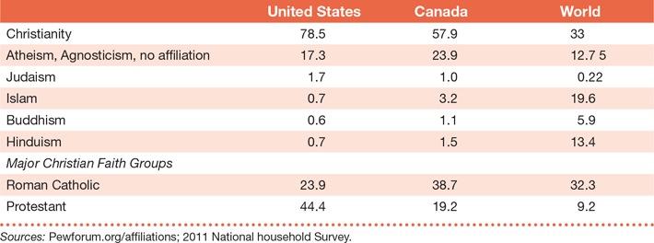
Religious Trends in the United States and Canada #2

Slide 14
Contributions of Religious Groups to the Health Care Delivery System
Many religious denominations own and operate health care institutions and make significant fiscal contributions that help control health care costs.
  Roman Catholic Church affiliated hospitals, health related centers, charities
  Jewish hospitals, day care centers, extended care facilities, and organizations
  Lutheran, Mennonite, Methodist, Muslim, and Seventh Day Adventist groups, also own and operate hospitals and health care organizations

Slide 15
Question #3
The second most popular religious affiliation identified by individuals in the United States is:
      Christianity
      Judaism
      Islam
      Atheism, Agnosticism, no affiliation

Slide 16
Answer to Question #3
D. Atheism, Agnosticism, no affiliation
Rationale: In the United States, Christianity is the most popular religious affiliation identified (at 78.5%). Second to that, at 17.3%, is the category Atheism, Agnosticism, no affiliation.
Worldwide, Islam is second to Christianity (at 19.6% and 33%, respectively).

Slide 17
Health-Related Beliefs and Practices of Selected Religions #1
Health-related beliefs and practices of select religions are important to understand, especially considering the diverse religious groups in the United States and Canada.
A brief overview of the following religions can be found in the text:
  Amish
  Baha’i International Community
  Buddhist Churches of America
  Catholicism According to the Roman Rite

Slide 18
Health-Related Beliefs and Practices of Selected Religions #2
A brief overview of the following religions can be found in the text (cont.):
  Christian Science
  The Church of Jesus Christ of Latter-day Saints
  Hinduism
  Islam
  Jehovah’s Witnesses
  Judaism
  Mennonite Church

Slide 19
Health-Related Beliefs and Practices of Selected Religions #3
A brief overview of the following religions can be found in the text (cont.):
  Mennonite Church
  Native North American Churches
  Protestantism
  Seventh-Day Adventists
  Unitarian Universalist Church

