Slide 1
Chapter 4
By the end of this lecture, you should be able to:
Understand and conduct a resource analysis
Understand and calculate financial ratios

Slide 2
PR 3 Requirements
Competitive Set
  Identify and describe your top 3 competitors
Resource Comparison
  List 5 categories and identify 2 resources under each that are important, evaluate the strength, and reach a conclusion.
Financial Analysis
Advantages and Vulnerabilities
All information for PR 3 is included in Ch. 4 and today’s slides

Slide 3
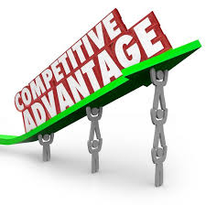
What is a competitive advantage?
  Competitive Advantage:
    When a firm has a long-lasting business advantage compared to rival firms and that advantage provides a significant edge over the competition.

Slide 4
Strategic Perspectives
Resources
Capabilities
Core Compentencies
Traditional
  Firm as an economic entity
Stakeholder
  Maximizing value
Resource-Based
  Financial
  Physical
  Human
  Knowledge & Learning
  General organizational

Slide 5
Examples of companies with a competitive advantage
  Apple-competitive advantage using innovation and brand name
  General Electric-competitive advantage using strategic assets, such as patents
  Oracle-assess to capital, allowed the company to make strategic acquisitions
  Virgin-superior CEO characteristics (Richard Branson) and brand name

Slide 6
Firm Resources and Capabilities
Financial
Human
Excellent cash flow
Strong balance sheet
Superior past performance
Strong links to financiers
Superior CEO characteristics
Experienced managers
Well trained, motivated, loyal
employees
High- performance structure or culture
Knowledge and Learning
Superior technology development
Excellent innovation processes and organizational entrepreneurship
Outstanding learning processes
Physical
General Organizational
State-of-the-art plant or machinery
Superiority in a value-adding process or function
Superior locations or raw materials
Outstanding products and/or services
Excellent reputation or brand name
Patents
Exclusive contracts
Superior linkages with stakeholders

Slide 7
Types of Resources
Tangible Resources
  Can be seen, touched and/or quantified
  Examples: manufacturing processes and products
  Tend to be easy to imitate
Intangible Resources
  Hard to quantify
  Examples: knowledge, skills, abilities and relationships with stakeholders
  Difficult to imitate. Makes them good sources of competitive advantage

Slide 8
Competitive resource comparison (partial example)
 | Banyan Tree | Mandarin Oriental | St. Regis | Ritz Carlton
Human 1.Employee Opportunities/ Career Future 2.Customers Service strategy | 4th 1.With close to 30 hotels mainly in Asia, career opportunities considered less than the competitor ones 2. Pursuit of excellence to both the customer as well as to the individual’s own high standards | 3rd 1. Have close to 30 properties in Asia, American, Africa and Europe, all in the luxury service level 2.Focus on delivering delightful experiences for the guests, bringing a quality and commitment to their work that is exceptional in the world of luxury | 2nd 1. Have 30 properties of it named brand and also have other opportunities in the Starwood Brand which including 1,175 properties in different varieties of services. 2. Thrive on the pursuit of excellence as they fulfill each guest request in an authentic and meaningful way | 1st 1. Operates 84 luxury hotels and also have over 4,022 properties to choose from in the Marriot brand. 2. Staff reflect the values that make them world’s finest luxury brand. Staff inspired to work alongside the fellow employees to bring special moments to life for the guests and each other.
Knowledge and Learning 1.Technology 2. Training program | 4th 1. Focuses on Energy saving and earth friendly technology. Has developed customized technical, project and planning advisory services for specialized products. 2. Providing tailor made training and career development programmes | 3rd 1. Offer the best when it comes to technology, with the hotels equipped to the highest specifications required by the global executive 2. An extensive range of Learning and Development programmes are provided to address the competency requirements at each level as well as individual learning needs. | 2nd 1. Integrates the uncompromising luxury of each venue with the latest technology. 2. Comprehensive training for associates provides a clear understanding of the behaviors and skills necessary to deliver the brand promise, while manager training focuses on leading and building a branded guest service culture | 1st 1. Want to use technology where guests want technology 2. Consistently wins top honors for its customer service and employee training, including number eight on this year's Businessweek customer service list.

Slide 9
Six Questions that Determine the Value of Firm Resources and Capabilities
1. Does the resource or capability have value in the market?
2. Is the resource or capability unique?
3. Is there a readily available substitute for the resource or capability?
4. Do organizational systems exist that allow realization of potential?
5. Is the organization aware of and realizing the advantages?
Firm Resources and Capabilities
Financial
Physical
Human
Knowledge
and Learning
General
Organizational
6. Is the resource or capability difficult or costly to imitate?
Potential Competitive
Advantage or Core Competency*
Actual Source of
Competitive Advantage
The Competitive Advantage or Core Competency Is Sustainable

Slide 10

Financial Metrics
Profitability
  Overall financial success
Liquidity
  Ability to pay short term obligations
Leverage
  Measure of risk
Activity
  Overall organizational efficiency
See Table 4.1 (p.129) for formulas
Other commonly used hospitality indices:
  ADR (Average Daily Rate)
  RevPAR (Revenue per Available Room)
  EBITDA (Earnings Before Interest, Taxes, Depreciation and Amortization)
  EPS (Earnings Per Share)

Slide 11
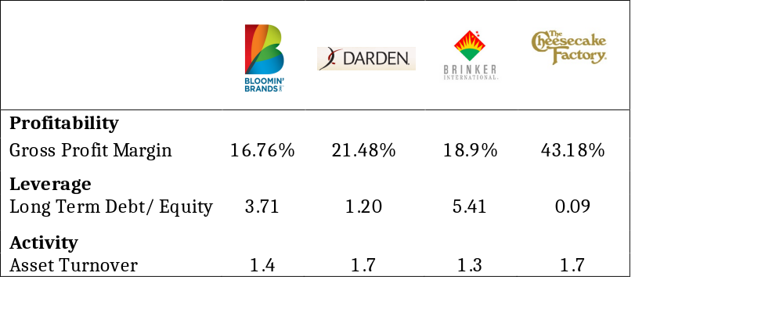
Competitive Financial Comparison (example)

Slide 12
Advantages/Vulnerabilities
Determine a company’s advantages (i.e., Strengths) and Vulnerabilities (i.e., Weaknesses) based on their resources and financial viability.
Resources:
  Advantage: The company possesses resources that are valuable, rare, or difficult to imitate.
  Disadvantage: The company is lacking key resources.
Financial Viability:
  Advantage: The company has strong financial resources (i.e., high profits, strong financial ratios, etc.)
  Disadvantage: The company has a lot of debt or is underperforming in certain areas

Slide 13
Next Steps
Research 2 resources in each of the 5 different resource categories for your company and your top 3 competitors
Collect information on your company’s financials as well as the financials of your competitors. Calculate ratios for your company and your competitors
Consider what advantage (i.e. strengths) and disadvantages (i.e., weaknesses) your company has

