Slide 1
Class Lecture
Week 12
Reproducing Gender and Difference

Slide 2
Important Points to Know and take notes on
Chapter 10—Mascia-Lees
  Important theories and theorists on Understanding Gender
  Language and Identity
  Gender Identity
  Third Gender
  Two Spirit

Slide 3
Chapter 11—Mascia-Lees
  Key theories and theorists on Sex and Sexuality
  Foucault on Sexuality
  Queer Theory
  Judith Butler and gender performativity
  Reproductive Politics
  Constructions/Theories on Motherhood and The Family

Slide 4
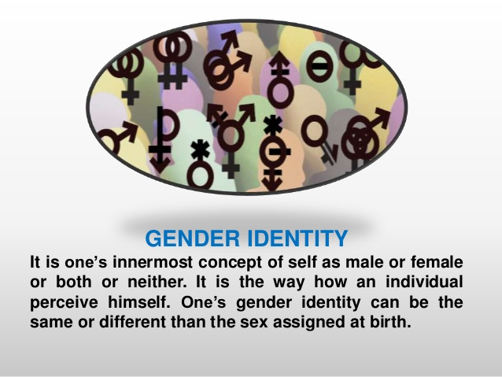

Slide 5
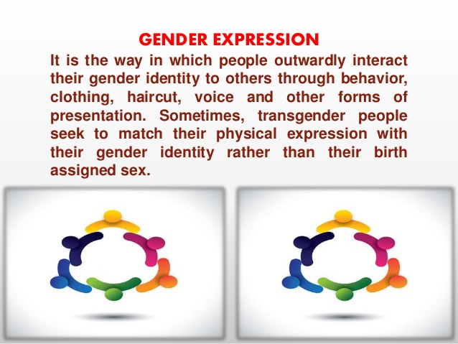

Slide 6
The terms third gender and third sex arose from attempts to describe individuals or societies whose sex, gender role, gender identity or sexual orientation does not fit within a binary scheme of (heterosexual) male and female.
It may represent an intermediate state between men and women, a state of being both (such as "the spirit of a man in the body of a woman"), the state of being neither (neuter), the ability to cross or swap genders, or another category altogether independent of male and female.
This last definition is favored by those who argue for a strict interpretation of the "third gender" concept.

Slide 7
Understanding the Queer Theory
The queer theory was introduced by writers and activists in the early 1990s as the result of studies of women discrimination and treatment in the literature and the issues of queer sexuality.
This theory explores the issues like sexuality, marginalization of women and other population, and power inequality in the society as well as the culture.
The goal of this theory is to change the monolithic thoughts, taxonomies and social norms about the sexuality including the exploration of the root cause of the creation and development of those norms in the society.

Slide 8
What is queer term
Queer is used as an umbrella term for sexual minorities.
These minorities are not heterosexual, so this term was originally used to show them as abnormal or strange.
It was used to show the negativity and a social discomfort towards those who have sexual relationships with the same gender.
Its use started in the late 1900s.

Slide 9
Queer sexuality is relatively new and is used when a behavior can’t be described or included within the categories of gay, lesbian, bisexual or transgender.
Since it is a new term and some people tend to call their own orientation as queer, the use of Q representing queerness or queer identity was started since 1996.
Basically, it was introduced as an addition to LGBT due to the people questioning a sexual identity when they don’t want to identify it as any of the four categories already in use.

Slide 10
History and usage of queer as a term
The scholars and activists started using this word to unite the community and have a distinct identity in the late 1980s.
People not willing to accept the gender identity established by the society started describing themselves as queer as a significantly large and ambiguous label as an option to the label LGBT.
For some people from the bisexual and transgender groups, queer gender seems more promising as an identity compared to the categories “gay”, “lesbian”, or “homosexual” which failed to identify their problems like isolation and alienation when considered the norms of sexuality and gender.

Slide 11
What is the purpose of queer theory?
Queer theory largely focuses on the differences between the gender, sex and desire. Basically, queerness is the term used for the bisexuality and the subject like gay and lesbian.
However, it also includes the analysis of the topics like intersex bodies and identities, cross-dressing, gender ambiguity and surgery for gender correction.
The main purpose of queer theory is to discuss the sexual orientation in the context of natural development or the set rules by the society or the belief of essentialists.

Slide 12
Queer theory was closely associated with the gay politics of radical groups like Outrage and ACT UP. Their goal was to establish the term “queer” as a label pointing to non-assimilationist.
The queer theorists found the ways to stabilize and consolidate the queer as a label around the other identity labels in the society

Slide 13
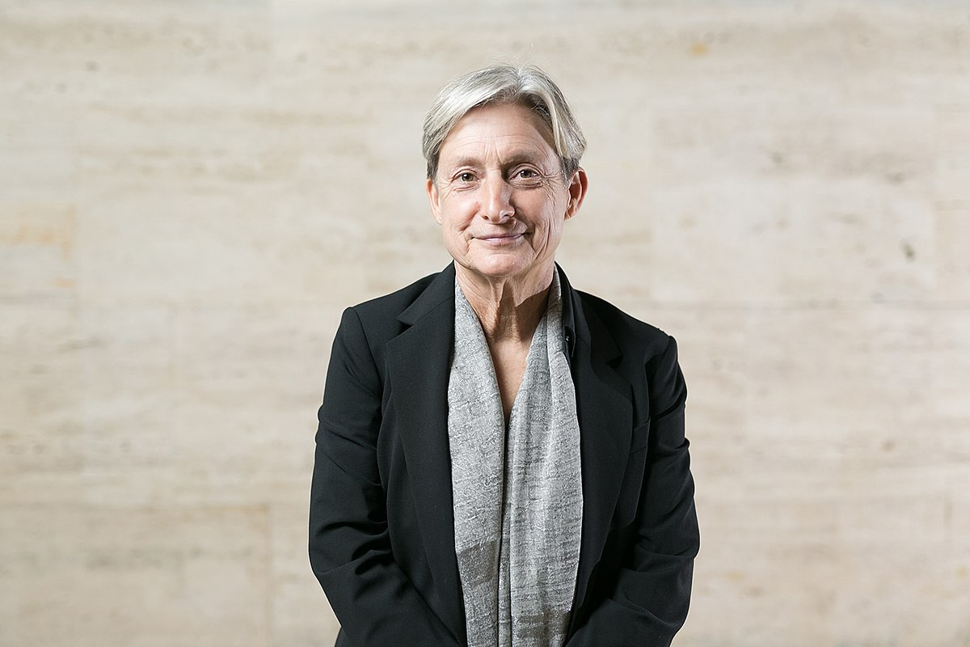
Judith Butler

Slide 14
Judith Butler, in full Judith Pamela Butler, (born February 24, 1956, Cleveland, U.S.), American academic whose theories of the performative nature of gender and sex were influential within Franco centric philosophy, cultural theory, queer theory, and some schools of philosophical feminism from the late 20th century.
In her best-known work, Gender Trouble: Feminism and the Subversion of Identity (1990), and its sequel, Bodies That Matter: On the Discursive Limits of ‘Sex’ (1993).

Slide 15
Butler built upon the familiar cultural-theoretic assumption that gender is socially constructed (the result of socialization, broadly conceived) rather than innate and that conventional notions of gender and sexuality serve to perpetuate the traditional domination of women by men and to justify the oppression of homosexuals and transgender persons.
Gender, according to Butler, “is performatively constituted by the very ‘expressions’ that are said to be its results.”

Slide 16
In Gender Trouble, Butler questioned the validity of much feminist political theorizing by suggesting that the subject whose oppression those theories attempted to explain—“women”—is an exclusionary construct that “achieves stability and coherence only in the context of the heterosexual matrix.
Butler’s Gender Trouble was one of the founding texts of queer theory, and her work continued to inform much debate within cultural theory, especially in the United States, in the early 21st century.

Slide 17
The 'Two-Spirit' People of Indigenous North Americans by Walter L Williams highlights

Slide 18
Native Americans have often held intersex, androgynous people, feminine males and masculine females in high respect.
The most common term to define such persons today is to refer to them as "two-spirit" people, but in the past feminine males were sometimes referred to as "berdache" by early French explorers in North America, who adapted a Persian word "bardaj", meaning an intimate male friend.
Because these androgynous males were commonly married to a masculine man, or had sex with men, and the masculine females had feminine women as wives, the term berdache had a clear homosexual connotation.

Slide 19
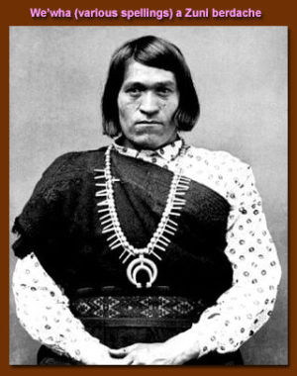
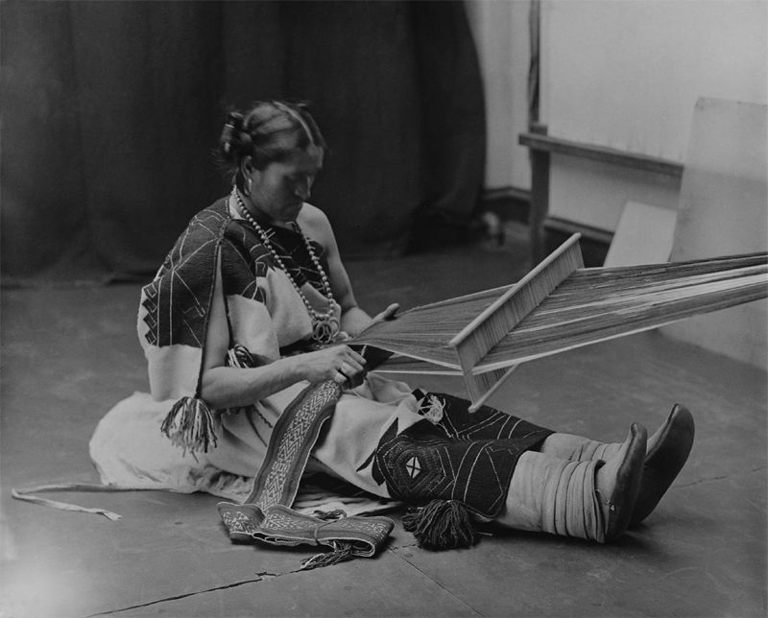

Slide 20
Rather than emphasizing the homosexuality of these persons, however, many Native Americans focused on their spiritual gifts.
American Indian traditionalists, even today, tend to see a person's basic character as a reflection of their spirit.
Since everything that exists is thought to come from the spirit world, androgynous or transgender persons are seen as doubly blessed, having both the spirit of a man and the spirit of a woman.
Thus, they are honored for having two spirits, and are seen as more spiritually gifted than the typical masculine male or feminine female.

Slide 21
Therefore, many Native American religions, rather than stigmatizing such persons, often looked to them as religious leaders and teachers.
Rather than the physical body, Native Americans emphasized a person's "spirit", or character, as being most important.
Instead of seeing two-spirit persons as transsexuals who try to make themselves into "the opposite sex", it is more accurate to understand them as individuals who take on a gender status that is different from both men and women.

Slide 22
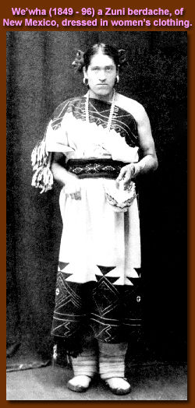
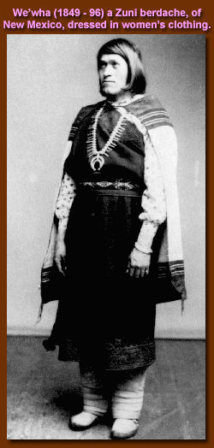

Slide 23
Two-spirit people were respected by native societies not only due to religious attitudes, but also because of practical concerns.
Because their gender roles involved a mixture of both masculine and feminine traits, two-spirit persons could do both the work of men and of women. They were often considered to be hard workers and artistically gifted, of great value to their extended families and community.
Among some groups, such as the Navajo, a family was believed to be economically benefited by having a "nadleh" (literally translated as "one who is transformed") androgynous person as a relative.

Slide 24
In the 20th-century, as homophobic European Christian influences increased among many Native Americans, respect for same-sex love and for androgynous persons greatly declined.
Two-spirit people were often forced, either by government officials, Christian missionaries or their own community, to conform to standard gender roles.
Some, who could not conform, either went underground or committed suicide

Slide 25
Because of this tradition of respect, in the 90s many gay and lesbian Native American activists in the United States and Canada rejected the French word berdache in favor of the term two-spirit people to describe themselves.
Many non-American Indians have incorporated knowledge of Native American two-spirit traditions into their increasing acceptance of same-sex love, androgyny and transgender diversity.
Native American same-sex marriages have been used as a model for legalizing same-sex marriages, and the spiritual gifts of androgynous persons have started to become more recognized.

Slide 26
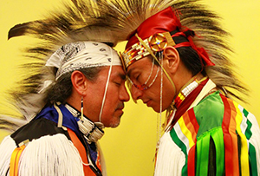
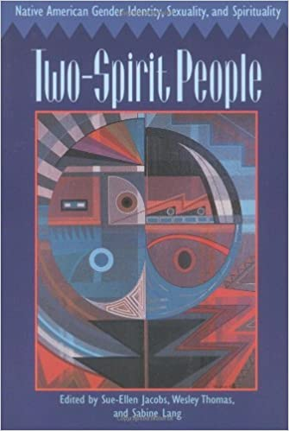
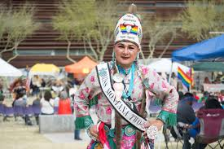

Slide 27
Meet Mexico’s Muxe Community Celebrating Gender queerness
In Oaxaca, the self-proclaimed “third gender” muxes mirror Western culture’s understanding of what it means to be genderqueer.
In Juchitán, a small indigenous town located in southern Oaxaca, a community of individuals known as muxes continue to challenge almost every Western idea of gender identity.
Muxes seek to live free of labels like male and female – a concept that still disorients even the most progressive parts of the world. These individuals are a model of how cultures make space for life outside of the binary.

Slide 28
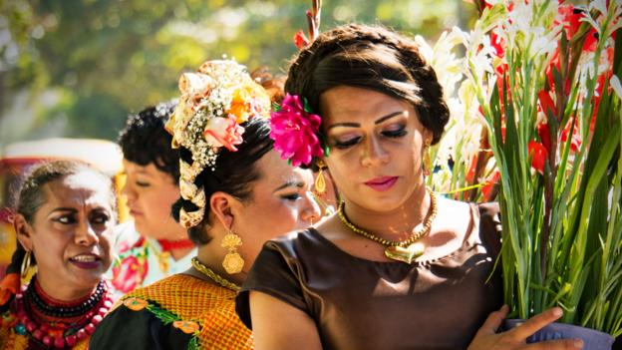

Slide 29
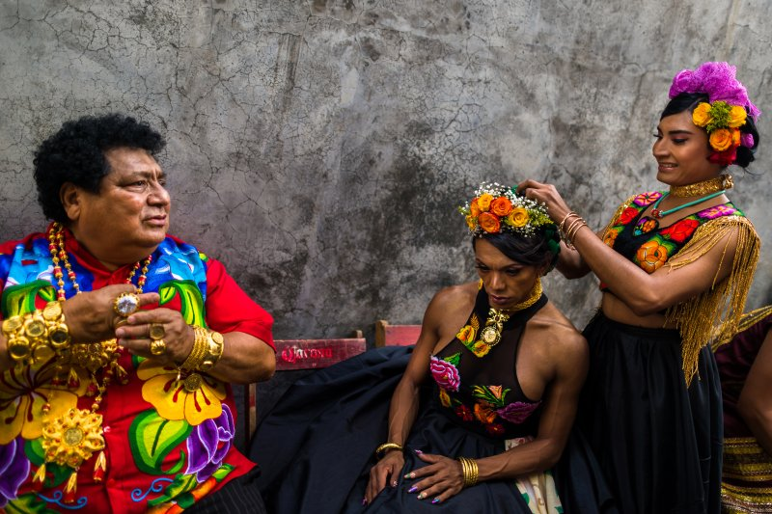

Slide 30
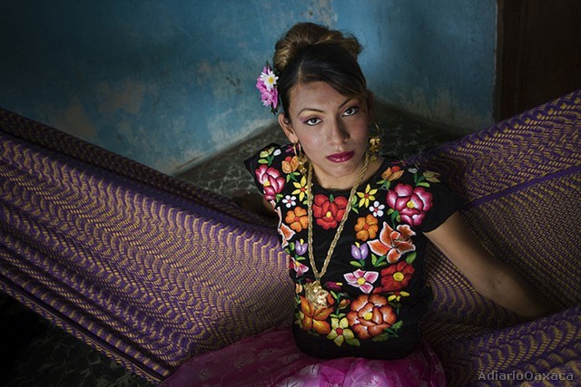

Slide 31
Derived from the Spanish word for woman (mujer), muxes (alternately spelled muxhes) generally represent people who are assigned male at birth and identify as different genders.
Often, they even identify the muxe word itself with its own gender identity. The iterations among the muxe community and their self-identifications vary – some identify as male but are female-expressing, while others identify as female and are more closely associated with Western culture’s understanding of transgender.
Others defy gender entirely. But, in Mexican culture, the term “third gender” is often tacked to the muxe community.

Slide 32
Further Reading:
https://theculturetrip.com/north-america/mexico/articles/a-brief-history-of-muxe-mexicos-third-gender/

