Slide 1
Groups
14

Slide 2
Learning Objectives
Explain how humans, as cultural animals, form groups that differ from the groups of other social animals, emphasizing how selves and roles alter the nature of human groups
Discuss how roles and the inner processes of the self affect group behavior
Notes:
Supplemental Lecture: See Roy Baumeister’s own PowerPoint© lecture on Groups.

Slide 3
Learning Objectives (cont’d.)
Describe group outcomes that result from being individually identified in the group versus feeling submerged in the group
Describe how individuals within a group share information, including brainstorming and groupthink
Describe the traits of successful leadership and the five crucial effects that power has on people

Slide 4
Introduction
Henry Ford
  Discovered Ford Motor Company could cut production time and costs down by using an assembly line
    Took division of labor to a new level; the group was far more than the sum of its members
    Interactive, complementary roles can make up a powerful system
Notes:
Discussion Idea: Can groups outperform individuals? What does the story of Ford’s success with the assembly line exemplify about the social psychology of groups?

Slide 5
What Groups Are and Do
What is a group?
  A collection of at least two people who are doing or being something together
    Common goals and loyalties
Social animals tend to live in groups; several clear benefits
  Promote safety, find and share food, and can do tasks that no one individual can do alone
Notes:
Technology Tip: The film United 93 demonstrates how a diverse group of people can come together in the face of a hijacking. (http://www.imdb.com/title/tt0475276/)
How can groups be defined on a continuum? Must a group do something together to be a group? Can a dyad (two people) be a group? How do common goals contribute to forming a group? How does the presence of an outgroup help create a group?
Discussion Idea: What do groups accomplish? What are the advantages of groups? Why did evolution design us to be part of groups? How are groups cultural as well as social? What do cultural groups accomplish?

Slide 6
Trade Offs
Diversity in groups involves tradeoffs
  Can be more creative and flexible
  May bring in different information
  Can make better decisions
  Can be harder to cooperate and work together
  Different backgrounds can result in poor communication and misunderstandings
  Diverse groups perform less well

Slide 7
Groups, Roles, and Selves
Each person has a different job
  Each person can specialize and become an expert
    Different jobs complement each other; joint effort improves total performance
Deindividuation can lead to problems
  Loss of self-awareness and of individual accountability in a group
Notes:
Discussion Idea: In what ways do complementary roles produce better results than having each member do the same thing? How are human groups different from other animal groups, such as bees or wolves? What would happen if everyone in a group wanted to play the same role?
Discussion Idea: What is deindividuation? Why does deindividuation produce negative outcomes? How does deindividuation relate to fascism?
Discussion Idea: Do individuals define their roles, or does society? In what ways do roles exist independently of the individual? Why must people remain flexible in taking on roles?

Slide 8
Group Action
Effect of working in a group is variable
  Improvement or disaster
Social facilitation
  Evaluation apprehension: concern about how others are judging your performance
  Dominant response: most common reaction to a given situation
  Social facilitation theory: presence of others increases dominant response tendency
Notes:
Technology Tip: To demonstrate this effect, students can type part of a paper alone, then type the rest while someone watches them. In which condition are they slower/faster? More/less prone to make errors? For a more precise comparison, have them take an online typing test in each condition. (A free typing test is available at http://www.typingtest.com/)
Discussion Idea: What is Zajonc’s theory of social facilitation?
Discussion Idea: Under what circumstances do people perform better with observers? Under what circumstances do they perform worse?

Slide 9
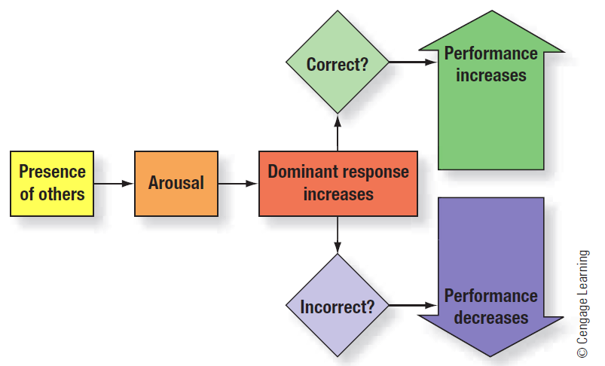
Theory of Social Facilitation
Notes:
Figure 14.1: Robert Zajonc’s theory of social facilitation: The presence of others increases arousal. Arousal increases whatever response is dominant. If the dominant response is correct, performance increases. If the dominant response is incorrect, performance decreases.

Slide 10
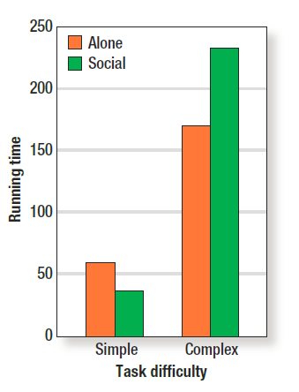
The Cockroach Study
Notes:
Figure 14.2: In a study, cockroaches completed simple mazes more quickly when they ran in the presence of four other cockroaches than when they ran alone. In contrast, cockroaches completed complex mazes more quickly when they ran alone than when they ran in the presence of four other cockroaches. Copyright © 1969 by the American Psychological Association. Reprinted by permission.

Slide 11
Group Action (cont’d.)
Social loafing
  People reduce effort when working in a group, compared to when working alone
    Also called the free rider problem
Bad apple effect
  One social loafer can cause other people to loaf as well
Notes:
Discussion Idea: What is social loafing? Why does social loafing occur?
Discussion Idea: Why is individual identification within a group important? Do students seem to work harder on group assignments? How might we modify group assignments to decrease social loafing?
Discussion Idea: How can we reconcile social loafing with social facilitation?

Slide 12
Food for Thought
Binge eating: socially contagious
  Binge eating has grown rapidly since the 1960s; particularly in college sororities
    Most popular girls in sororities are binge eaters
    Extreme binge eaters and non-binge eaters suffer from lower popularity
    By the end of the year, levels of binge eating become quite similar to friends

Slide 13
Group Action (cont’d.)
Punishing cheaters and free riders
  Altruistic punishment: people will sacrifice their own gain to punish cheaters
Deindividuation and mob violence
  Being anonymous makes people more willing to violate norms
Shared resources and commons dilemma
  Tendency for shared resources to be squandered and not used optimally
Notes:
Discussion Idea: What is altruistic punishment? Why would people give up some of their own gain for the group?
Teaching Tip: A vivid example of deindividuation and mob violence came in 2000 when mobs of men attacked women and girls in Central Park. See “More Women, Girls Tell of Attacks by Mob of Men in New York” (http://destee.com/index.php?threads/more-women-girls-tell-of-attacks-by-mob-of-men-in-new-york.46945/).
Discussion Idea: Why can deindividuation lead to antisocial behavior? How is accountability a predictor for violence?
Discussion Idea: What are some of the social costs of private ownership? What are some of the social costs of communal ownership?

Slide 14
How Groups Think
Brainstorming
  A form of creative thinking in groups
    All members are encouraged to generate as many ideas as possible while interacting and stimulating each other
Teams offer enjoyment and psychological benefits
Notes:
Technology Tip: Don Forsyth highlights important findings in research on groups on his website (https://facultystaff.richmond.edu/~dforsyth/gd/groups.pdf).
Discussion Idea: What are some benefits of brainstorming? What are some drawbacks? Do the benefits outweigh the drawbacks?
Discussion Idea: How is collective wisdom of the group better than individual experts? What conditions enable crowds to reach a high level of intelligent functioning?
Discussion Idea: Given what we know about brainstorming and collective wisdom, why do people love teamwork so much? How do people’s beliefs about teams shape their opinions of teamwork? What emotions color people’s beliefs about teamwork?

Slide 15
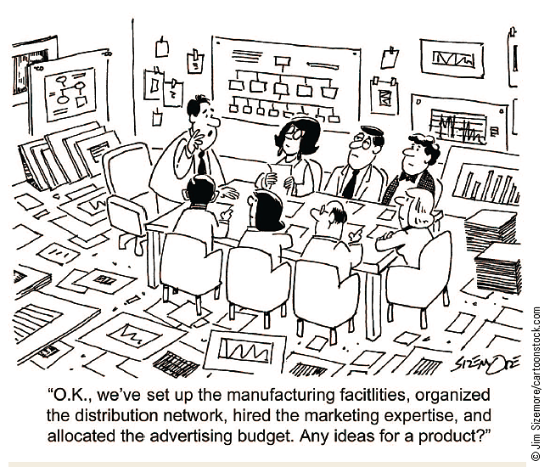
Does Brainstorming Work?
Notes:
People enjoy brainstorming and think it works, but it does not.

Slide 16
How Groups Think (cont’d.)
Transactive memory: here, you remember this
  Members of a small group remember different kinds of information
Groupthink
  Tendency of group members to think alike, especially when doing so leads to bad decisions
Notes:
Teaching Tip: Demonstrate the benefits of transactive memory by asking four students to remember a long list of numbers: 6, 12, 25, 16, 55, 29 45, 9, 32, 41, 2, 15. Likely the students will fail. Next ask four students to remember the list, but give each student only three numbers to remember. Student one remembers 6, 12, 25; student two remembers 16, 55, 29, etc.
Discussion Idea: What is transactive memory? How does transactive memory offer a solution to information overload? When should transactive memory begin? Under what circumstances does it work best?
Discussion Idea: What is groupthink? What are the roots of groupthink? Why does groupthink happen?

Slide 17
How Groups Think (cont’d.)
Factors that encourage groupthink
  Fairly similar and cohesive group to start
  Strong, directive leader
  Group is isolated in some sense from others
  Group regards itself as superior

Slide 18
How Groups Think (cont’d.)
Signs of groupthink
  Pressure toward conformity
  Appearance of unanimous agreement
    Self-censorship: choosing not to express doubts or other information that goes against a group’s plans and views
  Illusion of invulnerability
  Sense of moral superiority
  Tendency to underestimate opponents
Notes:
Technology Tip: NASA has been accused of groupthink in the loss of the Columbia and Challenger shuttles. See, for example, “NASA’s Culture of Denial" at MSNBC.com (http://www.msnbc.msn.com/id/3077543).

Slide 19
How Groups Think (cont’d.)
Foolish committees
  Committee can end up being less than the sum of its parts
    Pressures toward group harmony
Risky shift
  Groups take greater risks than the same individuals would have taken individually
Group polarization effect
  Shift toward a more extreme position resulting from group discussion
Notes:
Discussion Idea: Why do organizations form committees? Why aren’t committees effective? How does group harmony contribute to committee ineffectiveness?
Technology Tip: The Changing Minds website provides a nice overview of group polarization (http://changingminds.org/explanations/theories/group_polarization.htm) and of the risky shift phenomenon (http://changingminds.org/explanations/theories/risky_shift.htm).
Discussion Idea: What is risky shift? What is stingy shift?
Discussion Idea: How does the group polarization effect reconcile risky and stingy shift theories? Why does group polarization happen?

Slide 20
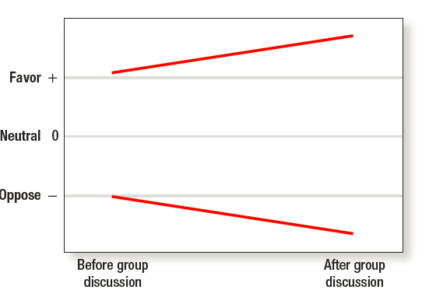

Group Polarization
Notes:
Figure 14.3: Group polarization occurs when group discussion leads people to become more extreme in the direction of their initial opinions. Copyright © 2008 The McGraw-Hill Companies, Inc. Reprinted by permission.

Slide 21
Power and Leadership
Characteristics of good leaders
  Decisive, competent, honest, good moral character , and possess a vision
Characteristics of toxic/dangerous leaders
  Indifference towards those suffering, intolerance of criticism, and grandiose sense of entitlement
Notes:
Technology Tip: Jim Collins (Good to Great) maintains an extensive website with many resources on leadership (http://www.jimcollins.com/).
Discussion Idea: What are some traits of successful leaders? What are some traits of people perceived as good leaders?
Discussion Idea: What makes a toxic leader? What four patterns emerge when studying bad bosses? What three characteristics are typical of dangerous leaders? How do Robert Mugabe, Napoleon Bonaparte, and Adolf Hitler illustrate these characteristics?

Slide 22
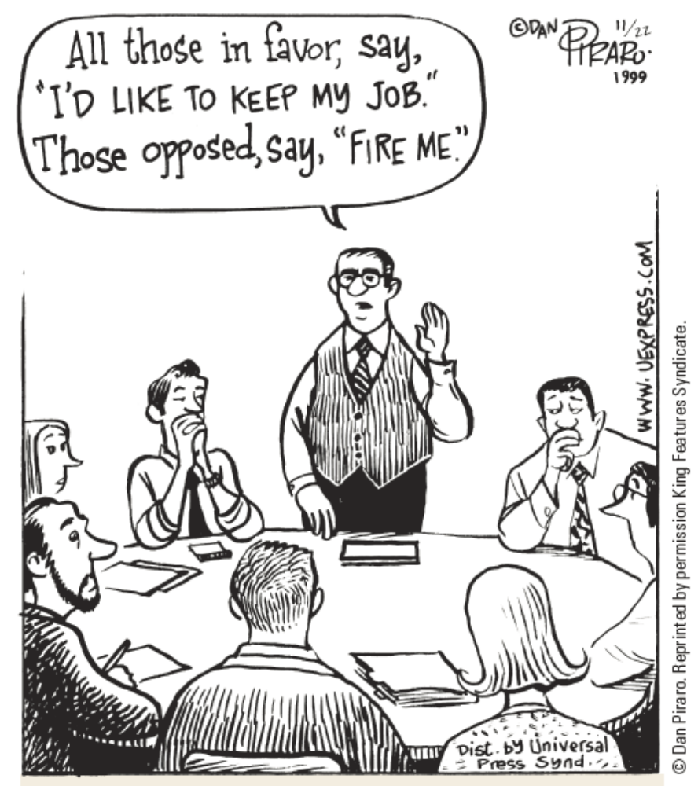
Questioning the Leader
Notes:
People are often afraid to question the leader. © Dan Piraro. Reprinted by permission King Features Syndicate.

Slide 23
Power and Leadership (cont’d.)
What is power?
  One person’s control over another person
Effects of power on leaders
  Feels good
  Alters attention to rewards and punishment
  Allows people to adapt plans and actions
  Makes people rely more on automatic processing
  Removes inhibitions against taking action
Notes:
Technology Tip: Additional details and resources on power are available at http://www.beyondintractability.org/.
Discussion Idea: What is power? Why do people seek power?

Slide 24
Power and Leadership (cont’d.)
Preserving power
  The more the perceived threat of losing power, the more it will be conserved
Effects of power on followers
  Subordinates pay extra attention to a powerful person and try to understand them
Legitimate leadership
  Legitimizing myths: explanations used to justify why people in power deserve to be
Notes:
Discussion Idea: Why do followers try to understand the powerful person? Why will people with less power be prone to fostering peace and harmony? How do subordinates adapt to the powerful person’s expectations?
Discussion Idea: What is a legitimizing myth? Why is it crucial for maintenance of power?

Slide 25
Summary
Groups are often formed to create or accomplish something together
The way groups operate inform whether they are successful or not
Leaders can exert positive influence, but many do not

