Slide 1
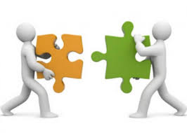
From Analysis to Policy

Slide 2

The best analysis in the world does not matter if it does not impact policy.

Slide 3
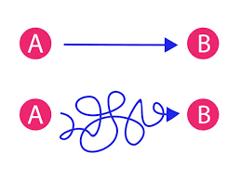
How do we get from Point A to Point B?

Slide 4
Intelligence Cycle
Requirements
Planning & Directing
Dissemination
Collection
Feedback
Processing &
Exploitation
Analysis and Production

Slide 5
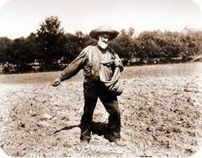
As an analyst, you need to be concerned about dissemination.
Where products go
Filters and roadblocks
Speed versus certainty

Slide 6
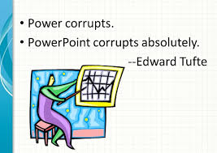
Important to know what kind of products users want:
Written
Face-to-face
Video
The infamous Power Point
All of the above?

Slide 7
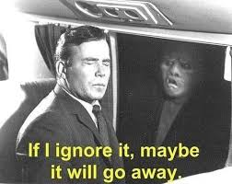
Even with good products, users can ignore them.

Slide 8

Ways of being Heard:
Routine briefings
Firm procedures in place for emergency briefs
MAKE IT WORTH THEIR TIME!

Slide 9
A broader issue: what is valued?
What is the focus of your agency/center?
Too much focus on a particular target set can lead to gaps elsewhere.
Centers typically focus on the short term.
-- Tactical rather than strategic
-- Who does the long-term analysis?
Do centers simply add to coordination problems; more actors?
How are personnel assigned?

Slide 10
Issues for analysis:
“Satisficing” behavior by most analysts
Difficult to overcome existing mind sets of analysts
Many improved techniques take more time, and time is the enemy for most analysts.
Some techniques – such as Red Teams & A Team/B Team – take more personnel.

Slide 11
Ongoing Issues
As “national” vs. “tactical” distinction blurs, intelligence agencies and military share systems, and compete for priority. Who leads?
How to shift from a culture of ‘means’ to one of ‘targets’: “To a hammer, every problem looks like a nail.”
Does relationship between intelligence agencies and policy makers need to change?

Slide 12
Should intelligence agencies be involved in policy making?
Under US system, there is a sharp line between intelligence and policy making.
The US Intelligence Community (IC) supports policy makers, but does not recommend policy.
Although IC cannot meddle in policy, nothing stops policy makers from involving themselves in intelligence matters.
For example, policy makers can reject specific intelligence assessments, but the IC cannot reject policy maker decisions.

Slide 13
Pros & Cons for Intelligence Involvement in Policy
Pro
Analysts should know the environment better and how specific policies can impact it.
Can help adapt policies ‘on the fly.’
Con
If IC agencies become too involved in policy, will it twist their analysis?
Previous US IC agency involvement in operations have had a very mixed record.

