Slide 1
Management and Organization Behavior
Critical Thinking
Ethics
Social Responsibility
Debbie Glick

Slide 2
Misc. Business
Assignments completion rate

Slide 3
Online Assignment Discussion
  Which principles did you find evidence of:
  McDonalds observation notes
  Football observation notes
  Modern Times observation notes

Slide 4
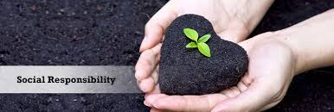
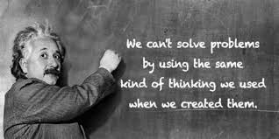
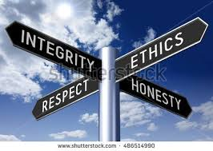
Critical Thinking, Ethics and Social Responsibility
What is Critical Thinking?
What is Ethics?
What is Social Responsibility?
Why are we studying them together?

Slide 5

The Case of the Bank of America/ Executive

Slide 6

Group Discussion Day
Form groups of 3 – 4 students

Slide 7
Apply Critical Thinking
Which of Senge’s 8 Archetypes apply to this case?
  Limits to growth
  Shifting the burden (to a future time)
  Eroding goals (short term solution to relieve symptoms)
  Escalation (aggressive competition)
  Success to the successful (resource allocation)
  Tragedy of the commons (resource competition)
  Fixes that fail (short term solution = long term problem)
  Growth and underinvestment (reduce resource allocation for risk avoidance)
How can we use our understanding of this to make an ethical decision?
What decision do you recommend?

Slide 8
Discussion
Limits to growth
Eroding goals
Shifting the burden

Slide 9
Triple Constraints***
TIME
COST
QUALITY

Slide 10
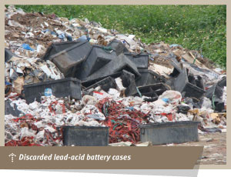
A Tale of an Indian Company in Ghana

Slide 11
Apply Critical Thinking
Which of Senge’s 8 Archetypes apply to this case?
  Limits to growth
  Shifting the burden (to a future time)
  Eroding goals (short term solution to relieve symptoms)
  Escalation (aggressive competition)
  Success to the successful (resource allocation)
  Tragedy of the commons (resource competition)
  Fixes that fail (short term solution = long term problem)
  Growth and underinvestment (reduce resource allocation for risk avoidance)
How can we use our understanding of this to make an ethical decision?
What decision do you recommend?

Slide 12
Discussion
Tragedy of the commons
Success to the successful
Fixes that fail

Slide 13
The Audit
The Players:
Sue – New CPA
John – Senior Accountant, Sue’s Manager
Paul – Partner in charge
Bill and Mike – co-workers
Client

Slide 14
Apply Critical Thinking
Which of Senge’s 8 Archetypes apply to this case?
  Limits to growth
  Shifting the burden (to a future time)
  Eroding goals (short term solution to relieve symptoms)
  Escalation (aggressive competition)
  Success to the successful (resource allocation)
  Tragedy of the commons (resource competition)
  Fixes that fail (short term solution = long term problem)
  Growth and underinvestment (reduce resource allocation for risk avoidance)
How can we use our understanding of this to make an ethical decision?
What decision do you recommend?

Slide 15
Discussion
Shifting the burden

Slide 16
Ethics as a Decision-Making Model
Apply the Principles of Ethics to our Audit Case to determine how to make your decision. Which principle (s) would you use and why?

Slide 17
Principles of Ethics as a Decision Making Model
Legal Principle
Individual Rights Principle
Virtuous Principle
Long Term Principle
Community Principle
Utilitarian Principle
Distributed Justice Principle

Slide 18
Stakeholder Risk Benefit Analysis
Which stakeholders are impacted by this decision?
What are each stakeholders’ desired outcomes?
What are the risks to each stakeholder?
How can you accommodate all stakeholders wants and mitigate all stakeholders’ risks?
What decision do you recommend?

Slide 19
Key Stakeholder
Risk Benefit Analysis
Risk | Benefit

Slide 20
Holistic Solution
Combining all elements of our analysis, what recommendation do you make?

Slide 21
The Holistic Approach***
The Holistic approach utilizes concepts from:
Critical Thinking
Ethics and Social Responsibility
Cost/ Benefit Analysis
Systems Analysis
Rational Decision-Making

Slide 22


Let’s Play the Ethics Game
Get your color cards out

Slide 23
Ethics Game
Your loan customer has just purchased a new home and is moving cross country to take possession of the new home tomorrow. Late today your underwriter notices that the borrower has not initialed one of the numerous loan documents. You cannot reach your borrower. If the documents are not signed today the loan won’t close today, and the customer cannot move into the home tomorrow. Since tomorrow is Friday, the customer will not be able to take possession until Monday. They will be homeless for three days!
What would you do?

Slide 24
What would you do?
Red | Initial the loan documents. I don’t want my borrower to be homeless!
Yellow | Initial the loan documents. I’m certain the borrower intended to, and won’t know the difference.
Blue | Initial the loan documents, and request that the borrower send me an email authorizing me to do so.
Green | Wait until the borrower gets to town and have them initial the documents. They can stay in a hotel for the weekend.

Slide 25
Other Options
What other options can you identify?
Which type of Critical Thinking or Ethical Decision Making tools did you use to identify these options?

Slide 26
Ethics Game
You are an accounting manager for XYZ company. You have discovered some discrepancies in the company’s cash balances and suspect employee embezzlement. Your research is not conclusive, but may point to John, your best employee. It is the start of tax season, and you know at this point in time you will be unable to replace John.

Slide 27
What would you do?
Red | Do nothing.
Yellow | Wait until after tax season and then share your findings with your boss.
Blue | Confront John with your findings and allow him to explain.
Green | Immediately share your findings with your boss.

Slide 28
Ethics Game
Final Round
Your closest friend at the company tells you in confidence that she has made an egregious error that could cost the company millions of dollars. She is certain that she has altered all the documentation so that the error could never be traced back to her.

Slide 29
What would you do?
Red | Do nothing.
Yellow | Tell her that she has to tell her boss or you will.
Blue | Tell your boss.
Green | Review the documentation to make certain she will not be discovered.

Slide 30
Homework
Complete Online Assignment # 2
  This is a CSUN Library Database research assignment
Read Chapter 11
Complete Online Quiz # 3
Case Study – Zappos.com, page 473
  Read case and come to class prepared to discuss
OA2 and OQ3 are due by 11:55 pm on the evening prior to your next class session.

