Slide 1
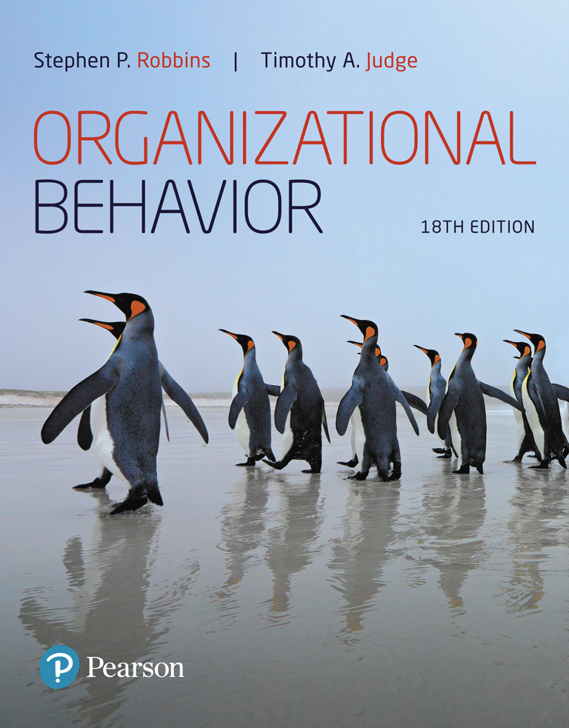
Organizational Behavior
Eighteenth Edition
Chapter 16
Organizational Culture
Copyright © 2019, 2017, 2015, 2013 Pearson Education, Inc. All Rights Reserved.
Notes:
If this PowerPoint presentation contains mathematical equations, you may need to check that your computer has the following installed:
1) MathType Plugin
2) Math Player (free versions available)
3) NVDA Reader (free versions available)
Welcome to this Organizational Behavior course that uses the 18th edition of the textbook, Organizational Behavior by Robbins and Judge. This is considered among the most widely used OB textbooks in the world. Robbins and Judge are recognized as definitive aggregators of OB concepts, applications, and practices. The course and this book will provide you with a resource that will benefit you throughout your degree program and your professional life.
Chapter 16: Organizational Culture

Slide 2
Learning Objectives
16.1 Describe the common characteristics of organizational culture.
16.2 Compare the functional and dysfunctional effects of organizational culture on people and the organization.
16.3 Identify the factors that create and sustain an organization’s culture.
16.4 Show how culture is transmitted to employees.
16.5 Describe the similarities and differences in creating an ethical culture, a positive culture, and a spiritual culture.
16.6 Show how national culture can affect the way organizational culture is transported to another country.
Notes:
After studying this chapter, you should be able to:
Describe the common characteristics of organizational culture.
Compare the functional and dysfunctional effects of organizational culture on people and the organization.
Identify the factors that create and sustain an organization’s culture.
Show how culture is transmitted to employees.
Describe the similarities and differences in creating an ethical culture, a positive culture, and a spiritual culture.
Show how national culture can affect the way organizational culture is transported to another country.

Slide 3
Common Characteristics of Organizational Culture (1 of 6)
A Definition of Organizational Culture
  Organizational culture refers to a system of shared meaning held by members that distinguishes the organization from other organizations.
Notes:
Organizational culture refers to a system of shared meaning held by members that distinguishes the organization from other organizations.

Slide 4
Common Characteristics of Organizational Culture (2 of 6)
Primary characteristics that capture the essence of an organization’s culture:
    Adaptability
    Detail orientation
    Results/Outcome orientation
    People/Customer orientation
    Collaboration/Team orientation
    Integrity
Notes:
Six primary characteristics capture the essence of an organization’s culture. Each of the characteristics exists on a continuum from low to high. They are:
1. Adaptability. The degree to which employees are encouraged to be innovative and flexible as well as to take risks and experiment.
2. Detail orientation. The degree to which employees are expected to exhibit precision, analysis, and attention to detail.
3. Results/Outcome orientation. The degree to which management focuses on results or outcomes rather than on the techniques and processes used to achieve them.
4. People/Customer orientation. The degree to which management decisions take into consideration the effect of outcomes on people within and outside of the organization.
5. Collaboration/Team orientation. The degree to which work activities are organized around teams rather than individuals.
6. Integrity. The degree to which people exhibit integrity and high ethical standards in their work.

Slide 5
Common Characteristics of Organizational Culture (3 of 6)
Another common cultural framework groups organizations into:
  The Clan
  The Adhocracy
  The Market
  The Hierarchy
Notes:
Another common culture framework groups organizations into one of four types, each which has its own assumptions, beliefs, values, artifacts, and even criteria for effectiveness:³
1. “The Clan.” A culture which is based on human affiliation. Employees value attachment, collaboration, trust, and support.
2. “The Adhocracy.” A culture which is based on change. Employees value growth, variety, attention to detail, stimulation, and autonomy.
3. “The Market.” A culture which is based on achievement. Employees value communication, competence, and competition.
4. “The Hierarchy.” A culture which is based on stability. Employees value communication, formalization, and routine.
The differences between these cultures are reflected in their internal vs. external focus and their flexibility and stability.

Slide 6
Common Characteristics of Organizational Culture (4 of 6)
Culture as a Descriptive Term
  Organizational culture is concerned with employees’ perceptions of the characteristics of the culture, not whether they like them.
    Does it encourage teamwork?
    Does it reward innovation?
    Does it stifle initiative?
  It differs from job satisfaction:
    Job satisfaction is evaluative.
    Organizational culture is descriptive.
Notes:
Organizational culture is concerned with employees’ perceptions of the characteristics of the culture, not whether they like them. Research has sought to measure how employees see their organization by asking questions like “Does it encourage teamwork? ,” “Does it reward innovation? ,” and “Does it stifle initiative?” Organizational culture differs from job satisfaction in that job satisfaction is evaluative while organizational culture is descriptive.

Slide 7
Common Characteristics of Organizational Culture (5 of 6)
Do Organizations Have Uniform Cultures?
  Most organizations have a dominant culture and numerous sets of subcultures.
  The dominant culture expresses the core values a majority of members share and that give the organization distinct personality.
    Subcultures tend to develop in large organizations to reflect common problems, situations, or experiences that members face.
Notes:
Most organizations have a dominant culture and numerous sets of subcultures. The dominant culture expresses the core values that are shared by a majority of the organization’s members. Subcultures tend to develop in large organizations to reflect common problems, situations, or experiences that members face.
If organizations were composed only of numerous subcultures, organizational culture as an independent variable would be significantly less powerful. It is the “shared meaning” aspect of culture that makes it such a potent device for guiding and shaping behavior. That’s what allows us to say, for example, that the Zappos culture values customer care and dedication over speed and efficiency, and to use that information to better understand the behavior of Zappos’ executives and employees. But subcultures can influence members’ behavior too.

Slide 8
Common Characteristics of Organizational Culture (6 of 6)
Strong versus Weak Cultures
  Strong culture: core values are intensely held and widely shared.
    The more members who accept the core values and the greater their commitment, the stronger the culture and the greater its influence on member behavior.
Notes:
In a strong culture, core values are intensely held and widely shared. Moreover, the more members accept the core values, and the greater their commitment to those values, the stronger the culture is. The unanimity of purpose builds cohesiveness, loyalty, and organizational commitment, and in doing so, reduces employee turnover. High formalization creates predictability, orderliness, and consistency.
A strong culture should more directly affect organizational outcomes because it demonstrates high agreement about what the organization represents. Such unanimity of purpose builds cohesiveness, loyalty, meaning, and organizational commitment.

Slide 9
What Do Cultures Do? (1 of 9)
The Functions of Culture
  Boundary-defining role.
  Conveys a sense of identity for members.
  Facilitates the generation of commitment.
  Enhances the stability of the social system.
  Serves as a sense-making and control mechanism.
Notes:
What role does culture perform? Cultures can be positive or negative for organizations. Culture is a boundary-defining role; it conveys a sense of identity for members; it facilitates the generation of commitment; it enhances the stability of the social system; and culture serves as a sense-making and control mechanism to guide and shape the attitudes and behavior of employees. In essence, culture defines the rules of the game.

Slide 10
What Do Cultures Do? (2 of 9)
Culture Creates Climate
  Organizational climate is shared perceptions about the organization and work environment.
    Team spirit at the organizational level.
  Climates can interact with one another to produce behavior.
  Climate also influences the habits people adopt.
Notes:
Organizational climate refers to the shared perceptions organizational members have about their organization and work environment. This aspect of culture is like team spirit at the organizational level. When everyone has the same general feelings about what’s important or how well things are working, the effect of these attitudes will be more than the sum of the individual parts. A positive overall workplace climate has been linked to higher customer satisfaction and financial performance.
Climates can interact with one another to produce behavior. For example, a positive climate for worker empowerment can lead to higher levels of performance in organizations that also have a climate for personal accountability.
Climate also influences the habits people adopt. If the climate for safety is positive, for example, everyone wears safety gear and follows safety procedures even if individually they wouldn’t normally think very often about being safe. Indeed, many studies have shown that a positive safety climate decreases the number of documented injuries on the job.

Slide 11
What Do Cultures Do? (3 of 9)
The Ethical Dimension of Culture
  Organizational cultures are not neutral in their ethical orientation, even when they are not openly pursuing ethical goals.
    Over time, the ethical culture, or the shared concept of right and wrong behavior in that workplace, develops as part of the organizational climate.
  The ethical climate reflects the true values of the organization and shapes the ethical decision making of its members.
Notes:
Organizational cultures are not neutral in their ethical orientation, even when they are not openly pursuing ethical goals. Over time, the ethical culture, or the shared concept of right and wrong behavior in that workplace, develops as part of the organizational climate. The ethical climate reflects the true values of the organization and shapes the ethical decision making of its members.

Slide 12
What Do Cultures Do? (4 of 9)
Ethical climate theory (ECT) and the ethical climate index (ECI) categorize and measure the ethical dimensions of organizational cultures.
  Five climate categories: instrumental, caring, independence, law and code, and rules.
  Each explains the general mindset, expectations, and values of the managers and employees in relationship to their organization.
Ethical climate powerfully influences the way its individual members feel they should behave.
Notes:
Researchers have developed the ethical climate theory (ECT) and the ethical climate index (ECI) to categorize and measure the ethical dimensions of organizational cultures. Of the nine identified climate categories, five are found to be most prevalent in organizations: instrumental, caring, independence, law and code, and rules. Each explains the general mindset, expectations, and values of the managers and employees in relationship to their organization.
Organizations often progress through different categories as they move through their business life cycle.
An organization’s ethical climate powerfully influences the way its individual members feel they should behave, so much so that researchers have been able to predict organizational outcomes from the climate categories. Instrumental climates are negatively associated with employee job satisfaction and organizational commitment, even though those climates appeal to self-interest (of the employee and the company). They are positively associated with turnover intentions, workplace bullying, and deviant behavior. Caring and rules climates have a positive association with job satisfaction. Caring, independence, rules, and law and code climates also reduce employee turnover intentions, workplace bullying, and dysfunctional behavior.

Slide 13
What Do Cultures Do? (5 of 9)
Studies of ethical climates and workplace outcomes suggest that some climate categories are likely to be found in certain organizations.
By measuring the collective levels of moral sensitivity, judgment, motivation, and character of our organizations, we may be able to judge the strength of the influence our ethical climates have on us.
Notes:
Studies of ethical climates and workplace outcomes suggest that some climate categories are likely to be found in certain organizations. Industries with exacting standards such as engineering, accounting, and law tend to have a rules or a law and code climate. Industries that thrive on competitiveness such as financial trading often have an instrumental ethical climate. Industries with missions of benevolence are likely to have a caring climate, even if they are for-profit as in an environmental protection firm. Research is exploring why organizations tend to fall into certain climate categories by industry, especially successful organizations.
We cannot conclude that instrumental climates are always bad, or that caring climates are always good. But by measuring the collective levels of moral sensitivity, judgment, motivation, and character of our organizations, we may be able to judge the strength of the influence our ethical climates have on us.

Slide 14
What Do Cultures Do? (6 of 9)
    Sustainability: practices that can be maintained over very long periods of time because the tools or structures that support the practices are not damaged by the processes.
        Social sustainability practices.
        Sustainable management doesn’t need to be purely altruistic.
      To create a truly sustainable business, an organization must develop a long-term culture and put its values into practice.
    Like other cultural practices we’ve discussed, sustainability needs time and nurturing to grow.
Notes:
As the name implies, sustainability refers to practices that can be maintained over very long periods of time because the tools or structures that support the practices are not damaged by the processes.
One survey found that a great majority of executives saw sustainability as an important part of future success.
Social sustainability practices address the ways social systems are affected by an organization’s actions over time, and in turn, how changing social systems may affect the organization. For example, farmers in Australia have been working collectively to increase water use efficiency, minimize soil erosion, and implement tilling and harvesting methods that ensure long-term viability for their farm businesses. In a very different context, 3M has an innovative pollution-prevention program rooted in cultural principles of conserving resources, creating products that have minimal effects on the environment, and collaborating with regulatory agencies to improve environmental effects.
Sustainable management doesn’t need to be purely altruistic. To create a truly sustainable business, an organization must develop a long-term culture and put its values into practice. In other words, there needs to be a sustainable system for creating sustainability! In one workplace study, a company seeking to reduce energy consumption found that soliciting group feedback reduced energy use significantly more than simply issuing reading materials about the importance of conservation. In other words, talking about energy conservation and building the value into the organizational culture resulted in positive employee behavioral changes.
Like other cultural practices we’ve discussed, sustainability needs time and nurturing to grow.

Slide 15
What Do Cultures Do? (7 of 9)
Culture and Innovation
  The most innovative companies have open, unconventional, collaborative, vision-driven, and accelerating cultures.
  Startup firms often have innovative cultures.
    They are usually small, agile, and focused on solving problems in order to survive and grow.
Notes:
The most innovative companies are often characterized by their open, unconventional, collaborative, vision-driven, and accelerating cultures. Startup firms often have innovative cultures by definition because they are usually small, agile, and focused on solving problems in order to survive and grow.

Slide 16
What Do Cultures Do? (8 of 9)
Culture as an Asset
  Culture can significantly contribute to an organization’s bottom line in many ways.
  There are many more cases of business success stories because of excellent organizational cultures than there are of success stories despite bad cultures, and almost no success stories because of bad ones.
Notes:
Culture can also significantly contribute to an organization’s bottom-line in many ways. There are many more cases of business success stories because of excellent organizational cultures than there are of success stories despite bad cultures, and almost no success stories because of bad ones.

Slide 17
What Do Cultures Do? (9 of 9)
Culture as a Liability
  Institutionalization
  Barriers to Change
  Barriers to Diversity
  Toxicity and Dysfunctions
  Barriers to Acquisitions and Mergers
Notes:
While culture can certainly enhance an organization, it can also be a liability. We can identify several dysfunctional elements.
The first element involves institutionalization, which is to say it becomes institutionalized—that is, it is valued for itself and not for the goods or services it produces—and it takes on a life of its own, apart from its founders or members. It doesn’t go out of business even if its original goals are no longer relevant. Acceptable modes of behavior become largely self-evident to members, and although this isn’t entirely negative, it does mean behaviors and habits that should be questioned and analyzed become taken for granted, which can stifle innovation and make maintaining the organization’s culture an end in itself.
Second, culture is a liability when the shared values are not in agreement with those that will further the organization’s effectiveness, thus becoming a barrier to change. This is most likely to occur when the environment is dynamic and where there is rapid change, an entrenched culture may no longer be appropriate.
Third is barriers to diversity. Diverse behaviors and strengths are likely to diminish in strong cultures as people attempt to fit in. Strong cultures can be liabilities when they effectively eliminate the unique strengths that people of different backgrounds bring to the organization, or when they support institutional bias or become insensitive to people who are different.
Fourth, toxicity and dysfunctions. Coherence around negativity and dysfunctional management systems in a corporation can produce downward forces that are equally powerful. For example, research on 862 bank employees over about 150 branches of a large bank in the US suggests that branch managers model conflict management styles, which then shape conflict cultures within each branch.59 Collaborative cultures (i.e., encouraging proactive, constructive, and collaborative conflict resolution) tended to increase the cohesion and satisfaction of the branch and decrease levels of burnout. Dominating cultures (i.e., encouraging active confrontation and aggressive competition among employees when there is conflict), tend to reduce branch cohesion and customer service performance. Finally, Avoidance cultures (i.e., that passively avoid conflict) tend to be less creative.
Finally, cultural compatibility has become the primary concern when considering acquisitions and/or mergers. A survey by consulting firm Bain and Company revealed that 70% of mergers failed to reach their financial goals. As one expert commented, “One of the biggest failings is people”— in other words, conflicting organizational cultures.

Slide 18
Creating and Sustaining Culture (1 of 6)
How a Culture Begins
  Ultimate source of an organization’s culture is its founders.
  Founders have the vision of what the organization should be.
  New organizations are typically small, which facilitates the founders’ imparting of their vision on all organizational members.
Notes:
So, how does a culture begin? The ultimate source of an organization’s culture is its founders. Founders have the vision of what the organization should be. New organizations are typically small, which facilitates the founders’ imparting of their vision on all organizational members.

Slide 19
Creating and Sustaining Culture (2 of 6)
Culture creation occurs in three ways:
  Founders hire employees who think and feel the way they do.
  Employees are indoctrinated and socialized into the founders’ way of thinking.
  Founders’ own behavior encourages employees to identify with them and internalize their beliefs, values, and assumptions.
Notes:
Culture creation occurs in three ways. First is when founders hire employees who think and feel the way they do. Second, employees are indoctrinated and socialized into the founders’ way of thinking. And third, the founders’ themselves act as role models, encouraging employees to identify with them and internalize their beliefs, values, and assumptions through their own behaviors.

Slide 20
Creating and Sustaining Culture (3 of 6)
Keeping a Culture Alive
  Selection
    Identify and hire individuals with the knowledge, skills, and abilities to perform successfully.
    Two-way street.
  Top Management
    Establish norms of behavior.
Notes:
So how can cultures be sustained? The first way is in the selection of employees. The explicit goal of the selection process is to identify and hire individuals with the knowledge, skills, and abilities to perform successfully. The final decision, because it’s significantly influenced by the decision maker’s judgment of how well the candidates will fit into the organization, identifies people whose values are essentially consistent with at least a good portion of the organization’s.
Selection also provides information to applicants. Those who perceive a conflict between their values and those of the organization can remove themselves from the applicant pool. Selection thus becomes a two-way street, allowing employer or applicant to avoid a mismatch and sustaining an organization’s culture by selecting out those who might attack or undermine its core values.
The actions of top management also have a major impact on the organization’s culture. Through words and behavior, senior executives establish norms that filter through the organization about, for instance, whether risk-taking is desirable, how much freedom managers give employees, what is appropriate dress, and what actions earn pay raises, promotions, and other rewards.

Slide 21
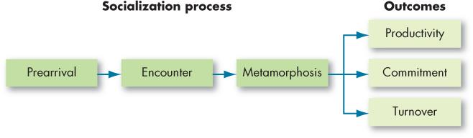
Creating and Sustaining Culture (4 of 6)
Exhibit 16-2 A Socialization Model
Notes:
The socialization component of sustaining a culture is shown in Exhibit 16-2. Socialization is the process of helping new employees adapt to the organization’s culture. The socialization model is a three-stage process.
The first stage is prearrival, which explicitly recognizes that each individual arrives with a set of values, attitudes, and expectations. One way to capitalize on prehire characteristics in socialization is to use the selection process to inform prospective employees about the organization as a whole. The selection process ensures the inclusion of the “right type”—those who will fit in.
The second stage is encounter, in which the individual confronts the possible dichotomy between expectations and reality. If expectations were fairly accurate, the encounter stage merely cements earlier perceptions. However, this is often not the case. At the extreme, a new member may become disillusioned enough to resign. Proper recruiting and selection should significantly reduce that outcome, along with encouraging friendship ties in the organization—newcomers are more committed when friends and coworkers help them “learn the ropes.”
Finally, to work out any problems discovered during the encounter stage, the new member changes or goes through the metamorphosis stage.

Slide 22
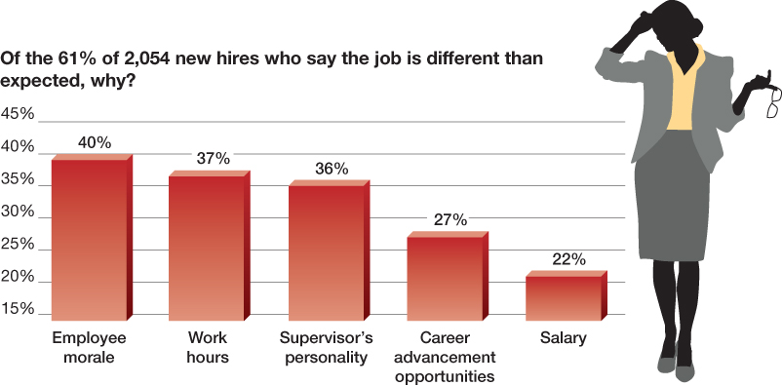
Creating and Sustaining Culture (5 of 6)
OB POLL Job Is Not as Good as Advertised
Notes:
Socialization can help alleviate the problem many employees report that their new jobs are different than expected (see OB Poll).

Slide 23
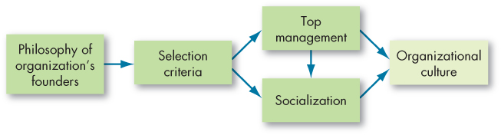
Creating and Sustaining Culture (6 of 6)
Exhibit 16-4 How Organizational Cultures Form
Notes:
The socialization component of sustaining a culture is shown in Exhibit 16-4. Socialization is the process of helping new employees adapt to the organization’s culture. The socialization model is a three-stage process.
The first stage is prearrival, which explicitly recognizes that each individual arrives with a set of values, attitudes, and expectations. One way to capitalize on prehire characteristics in socialization is to use the selection process to inform prospective employees about the organization as a whole. The selection process ensures the inclusion of the “right type”—those who will fit in.
The second stage is encounter, in which the individual confronts the possible dichotomy between expectations and reality. If expectations were fairly accurate, the encounter stage merely cements earlier perceptions. However, this is often not the case. At the extreme, a new member may become disillusioned enough to resign. Proper recruiting and selection should significantly reduce that outcome, along with encouraging friendship ties in the organization—newcomers are more committed when friends and coworkers help them “learn the ropes.”
Finally, to work out any problems discovered during the encounter stage, the new member changes or goes through the metamorphosis stage.

Slide 24
Show How Culture is Transmitted to Employees
How Employees Learn Culture
  Culture is transmitted to employees through:
    Stories
    Rituals
    Symbols
      Material symbols
    Language
Notes:
Organizational culture is transmitted to employees through several communication channels. Here we will discuss stories, rituals, symbols, and language.
Stories circulate through many organizations, anchoring the present in the past and legitimating current practices. They typically include narratives about the organization’s founders, rule-breaking, rags-to riches successes, reductions in the workforce, relocation of employees, reactions to past mistakes, and organizational coping. Employees also create their own narratives about how they came to either fit or not fit with the organization during the process of socialization, including first days on the job, early interactions with others, and first impressions of organizational life.
Rituals are repetitive sequences of activities that express and reinforce the key values of the organization.
Symbols are things such as the layout of corporation headquarters, the types of automobiles top executives are given, aircraft, (those are considered material symbols), or size of offices and executive perks. These convey to employees who is important, the degree of egalitarianism top management desires, and the kinds of behavior that are appropriate, such as risk-taking, conservative, authoritarian, participative, individualistic, or social.
Finally, many organizations and subunits within them use language to help members identify with the culture, attest to their acceptance of it, and help preserve it. Unique terms describe equipment, officers, key individuals, suppliers, customers, or products that relate to the business. New employees may at first be overwhelmed by acronyms and jargon that, once assimilated, act as a common denominator to unite members of a given culture or subculture.

Slide 25
Influencing an Organizational Culture (1 of 5)
How can management create a more ethical culture?
  Be a visible role model.
  Communicate ethical expectations.
  Provide ethics training.
  Visibly reward ethical acts and punish unethical ones.
  Provide protective mechanisms.
Notes:
Management can create a more ethical culture by following a few simple principles. First, be a visible role model: employees look to top management behavior as a benchmark. Second, communicate ethical expectations: a code of ethics can minimize ethical ambiguities. Third, provide ethical training: training sessions should reinforce standards of conduct and clarify permissible practices. Fourth, visibly reward ethical acts and punish unethical ones: performance appraisal of managers should include analysis of behavior against code of ethics. Finally, provide protective mechanisms: create a support network of ethical counselors, ombudsmen, or ethics officers.

Slide 26
Influencing an Organizational Culture (2 of 5)
There is a trend today for organizations to attempt to create a positive organizational culture:
  Emphasizes building on employee strengths.
  Rewards more than it punishes.
  Emphasizes individual vitality growth.
Positive culture is not a cure-all.
Notes:
There is a trend today for organizations to attempt to create a positive organizational culture, one that emphasizes building on employee strengths, rewards more than it punishes, and emphasizes individual vitality growth. Keep in mind though, that a positive culture is not a cure-all. It’s still a new enough idea for us to be uncertain about how and when it works best.

Slide 27
Influencing an Organizational Culture (3 of 5)
What Is Spirituality?
  Workplace spirituality is not about organized religious practices.
    It is not about God or theology.
  Workplace spirituality recognizes that people have an inner life that nourishes and is nourished by meaningful work that takes place in the context of community.
Notes:
Let’s begin by asking, what is spirituality? Workplace spirituality is not about organized religious practices. It is not about God or theology. Workplace spirituality recognizes that people have an inner life that nourishes and is nourished by meaningful work that takes place in the context of community.

Slide 28
Influencing an Organizational Culture (4 of 5)
Exhibit 16-5 Reasons for the Growing Interest in Spirituality
Spirituality can counterbalance the pressures and stress of a turbulent pace of life. Contemporary lifestyles—single-parent families, geographic mobility, the temporary nature of jobs, new technologies that create distance between people—underscore the lack of community many people feel and increase the need for involvement and connection.
Formalized religion hasn’t worked for many people, and they continue to look for anchors to replace lack of faith and to fill a growing feeling of emptiness.
Job demands have made the workplace dominant in many people’s lives, yet they continue to question the meaning of work.
People want to integrate personal life values with their professional lives.
An increasing number of people are finding that the pursuit of more material acquisitions leaves them unfulfilled.
Notes:
As we noted in our discussion of emotions in Chapter 4, the myth of rationality assumed the well-run organization eliminated feelings. Concern about an employee’s inner life had no role in the perfectly rational model. But just as we’ve now come to realize that the study of emotions improves our understanding of organizational behavior, an awareness of spirituality can help us better understand employee behavior in the twenty-first century. Of course, employees have always had an inner life. So why has the search for meaning and purposefulness in work surfaced now? A summary of reasons is shown in Exhibit 16-5.

Slide 29
Influencing an Organizational Culture (5 of 5)
Characteristics of a Spiritual Organization
  Cultural characteristics present in spiritual organizations include:
    Benevolence
    Strong sense of purpose
    Trust and respect
    Open-mindedness
Notes:
The concept of workplace spirituality draws on our previous discussions of values, ethics, motivation, and leadership. Several cultural characteristics tend to be evident in spiritual organizations:
Benevolence: spiritual organizations value showing kindness towards others and promoting the happiness of employees and other organizational stakeholders.
Strong sense of purpose: spiritual organizations build their cultures around a meaningful purpose. Although profits may be important, they’re not the primary value of the organization.
Trust and respect: spiritual organizations are characterized by mutual trust, honesty, and openness. Employees are treated with esteem and value, consistent with the dignity of each individual.
Open-mindedness: spiritual organizations value flexible thinking and creativity among employees.

Slide 30
Identify Characteristics of a Spiritual Culture (1 of 2)
Achieving a Spiritual Organization
  Many organizations have grown interested in spirituality but have had difficulty putting its principles into practice.
    Leaders can demonstrate values, attitudes, and behaviors that trigger intrinsic motivation and a sense of calling through work.
    Encouraging employees to consider how their work provides a sense of purpose through community building also can help achieve a spiritual workplace.
Notes:
Many organizations have grown interested in spirituality but have had difficulty putting its principles into practice. Several types of practices can facilitate a spiritual workplace, including those that support work-life balance. Leaders can demonstrate values, attitudes, and behaviors that trigger intrinsic motivation and a sense of calling through work. Encouraging employees to consider how their work provides a sense of purpose through community building also can help achieve a spiritual workplace; often this is achieved through group counseling and organizational development, a topic we take up in Chapter 18. A number of organizations are now also offering employees the services of a chaplain.

Slide 31
Identify Characteristics of a Spiritual Culture (2 of 2)
Critics of spirituality in organizations focus on:
  The question of scientific foundation: what really is workplace spirituality?
  Are spiritual organizations legitimate? Do organizations have the right to impose spiritual values on their employees?
  The question of economics: are spirituality and profits compatible?
Notes:
Critics of the spirituality movement in organizations have focused on three issues. First is the question of scientific foundation. What really is workplace spirituality? Second, are spiritual organizations legitimate? Do organizations have the right to impose spiritual values on their employees? And third is the question of economics: are spirituality and profits compatible?
As you might imagine, there is comparatively little research on workplace spirituality. Moreover, an emphasis on spirituality can clearly make some employees uneasy. Critics have argued that secular institutions, especially business firms, have no business imposing spiritual values on employees. This criticism is undoubtedly valid when spirituality is defined as bringing religion and God into the workplace. However, it seems less stinging when the goal is limited to helping employees find meaning and purpose in their work lives. If the concerns listed in Exhibit 16-5 truly characterize a large segment of the workforce, then perhaps organizations can do so.

Slide 32
The Global Context
Organizational cultures often reflect national culture.
One of the primary things U.S. managers can do is to be culturally sensitive.
The management of ethical behavior is one area where national culture can rub up against corporate culture.
Notes:
Organizational cultures often reflect national culture. The culture at AirAsia, a Malaysian-based airline, emphasizes openness and friendships. However, the culture of many U.S. airlines does not reflect the same degree of informality. If U.S. airlines were to merge with AirAsia, they would need to take these cultural differences into account.
One of the primary things U.S. managers can do is to be culturally sensitive. The United States is a dominant force in business and in culture, and with that influence comes a reputation. “We are broadly seen throughout the world as arrogant people, totally self-absorbed and loud,” says one U.S. executive. Some ways in which U.S. managers can be culturally sensitive include talking in a low tone of voice, speaking slowly, listening more, and avoiding discussions of religion and politics.
The management of ethical behavior is one area where national culture can rub up against corporate culture. Many strategies for improving ethical behavior are based on the values and beliefs of the host country. U.S. managers endorse the supremacy of anonymous market forces and implicitly or explicitly view profit maximization as a moral obligation for business organizations. This worldview sees bribery, nepotism, and favoring personal contacts as highly unethical. Any action that deviates from profit maximization may indicate that inappropriate or corrupt behavior may be occurring. In contrast, managers in developing economies are more likely to see ethical decisions as embedded in a social environment. That means doing special favors for family and friends is not only appropriate but also may even be an ethical responsibility. Managers in many nations also view capitalism skeptically and believe the interests of workers should be put on a par with the interests of shareholders.

Slide 33
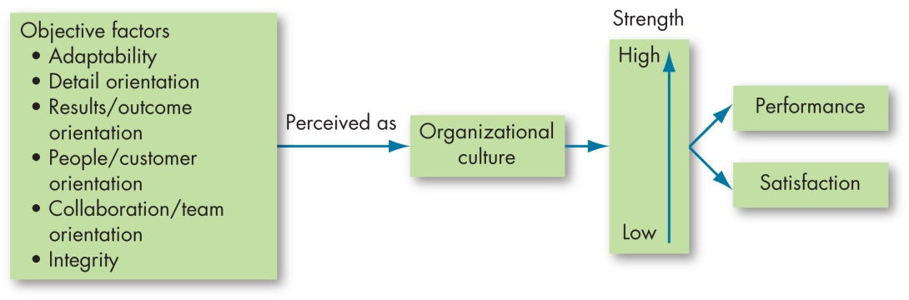
Implications for Managers (1 of 3)
Exhibit 16-6 How Organizational Cultures Have an Impact on Employee Performance and Satisfaction
Notes:
Exhibit 16-6, in summary, depicts organizational culture as an intervening variable. Employees form an overall subjective perception of the organization based on factors such as degree of risk tolerance, team emphasis, and support of people. This overall perception becomes, in effect, the organization’s culture or personality and affects employee performance and satisfaction, with stronger cultures having greater impact.

Slide 34
Implications for Managers (2 of 3)
Realize that an organization’s culture is relatively fixed in the short term. To effect change, involve top management and strategize a long-term plan.
Hire individuals whose values align with those of the organization; these employees will tend to remain committed and satisfied. Not surprisingly, “misfits” have considerably higher turnover rates.
Understand that employees’ performance and socialization depend to a considerable degree on their knowing what to do and not do. Train your employees well and keep them informed of changes to their job roles.
Notes:
Managers should:
Realize that an organization’s culture is relatively fixed in the short term. To effect change, involve top management and strategize a long-term plan.
Hire individuals whose values align with those of the organization; these employees will tend to remain committed and satisfied. Not surprisingly, “misfits” have considerably higher turnover rates.
Understand that employees’ performance and socialization depend to a considerable degree on their knowing what to do and not do. Train your employees well and keep them informed of changes to their job roles.

Slide 35
Implications for Managers (3 of 3)
You can shape the culture of your work environment, sometimes as much as it shapes you. All managers can especially do their part to create an ethical culture and to consider spirituality and its role in creating a positive organizational culture.
Be aware that your company’s organizational culture may not be “transportable” to other countries. Understand the cultural relevance of your organization’s norms before introducing new plans or initiatives overseas.
Notes:
In addition:
As a manager, you can shape the culture of your work environment, sometimes as much as it shapes you. All managers can especially do their part to create an ethical culture and to consider spirituality and its role in creating a positive organizational culture.
Be aware that your company’s organizational culture may not be “transportable” to other countries. Understand the cultural relevance of your organization’s norms before introducing new plans or initiatives overseas.

Slide 36
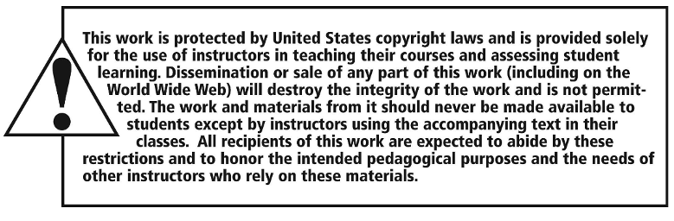
Copyright

