Slide 1
Chapter 23
Rural and Migrant Health

Slide 2
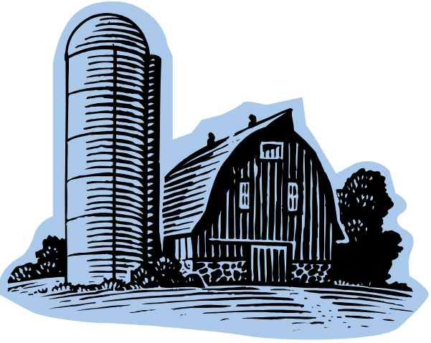
Rural Populations
The largest rural population in history of United States is now.
75% of counties are classified as rural; they contain only 20% of the U.S. population
Number/size of rural counties are highest …
  in the South (35%)
  in the Midwest and West (23%)
  in the Northeast (19%)
Census data
  20% of nation’s children under 18
  15% of nation’s elderly
  More than 50% of nation’s poor

Slide 3
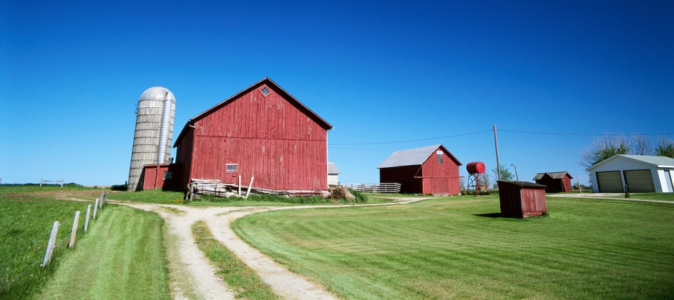
Rural Populations (Cont.)
Economic base is shifting
  Agriculture is the “food and fiber system”
  All aspects of agriculture (core materials to wholesale and retail and food service sectors) are included
  Poverty in rural areas greater than in urban areas

Slide 4
Rural Populations (Cont.)
Poverty continues to be greater in rural America than in urban areas.
Aging-in-place, out-migration of young adults, and immigration of older persons from metro areas.
Greater diversity among residents: a country of immigrants historically and today.
Health disparities exist—rural population more likely to be older, less educated, live in poverty, lack health insurance, and experience a lack of available health care providers and access to health care

Slide 5
Health Disparities Among Rural Americans
Only 10% of U.S. physicians practice in rural areas
Ratio of physicians in rural population is 36:100,000 (nearly double in urban settings)
More often assess their health as fair or poor
More disability days resulting from acute conditions
More negative health behaviors (untreated mental illness, obesity, alcohol, tobacco, and drug use) that contribute to excess deaths and chronic disease and disability rates
Higher number of unintentional injuries

Slide 6
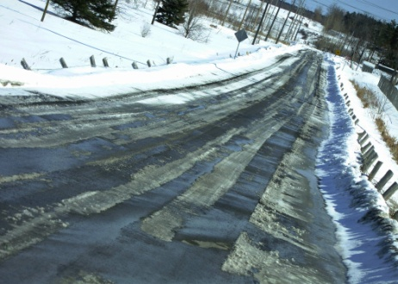
Defining Rural Populations
Population size
  Rural = towns with population of less than 2500 or in open country [farm/nonfarm]
Density
  Rural = fewer than 45 persons per square mile
  Frontier = less than 6 people per square mile

Slide 7

Defining Rural Populations (Cont.)
The Rural-Urban Continuum uses population and adjacency to metropolitan areas
  Core Based Statistical Areas (CBSAs)
    Metropolitan areas = county with at least one urbanized area of 50,000 or more people
    Micropolitan area = area contains a cluster of 10,000 to 50,000 persons
    Outside CBSAs = noncare areas

Slide 8

Describing Rural Health and Populations
Differ in complex geographical, social, and economic areas
Disparities include key indicators of health:
  Employment
  Income
  Education
  Health insurance
  Mortality
  Morbidity
  Access to care

Slide 9
Rural Health Disparities: Context and Composition
Context: characteristics of places of residence
  Geography, environment, political, social, and economic institutions
Composition: collective health effects that result from a concentration of persons with certain characteristics
  Age, education, income, ethnicity, and health behaviors
  – Braveman (2010)

Slide 10
Context: Health Disparities Related to Place
A downward spiral may exist:
  people leave → services are lost → tax base becomes insufficient → fewer services are provided → long distances to get health care → jobs become scarce and more people leave → the cycle continues

Slide 11

Context: Health Disparities Related to Place (Cont.)
Access to health care (#1 priority)
Fewer primary care physicians
General health services lacking
Health insurance coverage …
  Varies according to race and ethnicity;
  age and residence (rural or urban)
  Influences health patterns
  May create financial barriers to health care

Slide 12
Composition: Health Disparities Related to Persons
Income and Poverty
  One of the most important indicators of the health and well-being of all Americans, regardless of where they live.
  Regional differences—highest in the South
  Racial and ethnic minorities—rates among rural racial minorities two to three times higher than for rural whites
  Family composition—female-headed families have highest rates
  Children—among the poorest citizens in rural America

Slide 13
Composition: Health Disparities Related to Persons (Cont.)
Health risk, injury, and death
  Higher rates of obesity, smoking, sedentary lifestyles, alcohol use, firearms usage, suicide, vehicular accidents; lower rates of seat belt use
Risk factors
  Age, education, gender, race, ethnicity, language, and culture
Education and employment
Occupational health risks
Perceptions of health (gender, race, ethnicity)

Slide 14

Agricultural Workers
Accidents and injuries caused by:
  Environmental conditions
  Geographic isolation and working alone
  Use of agricultural machinery
  Delayed access to emergency or trauma care
Acute and chronic illnesses:
  Musculoskeletal discomfort, acute and chronic respiratory conditions, hearing loss, hypertension
  Chemical exposure (pesticides, herbicides, etc.)
  Secondary conditions related to demanding farm work

Slide 15

Migrant and Seasonal Farm Workers (MSFW)
Health Disparities
  Poorest health and the least access
  Low income and migratory status
Cultural, linguistic, economic, and mobility barriers
  Minimal or no preventive care
    Mobile clinic sites form a central link to health services
  Migrant Health Program (MHP) bases services on enumeration of MSFW
    Migrant and Seasonal Farm Worker Enumeration Profile Study (MSFWEPS) (2000)

Slide 16

“Thinking Upstream”
Concepts applied to Rural Health
Attack community-based problems at their roots
Emphasize the “doing” aspects of health
Maximize the use of informal networks

Slide 17

Rural Health Care Delivery System
Health care provider shortages
  Rural shortages likely to become worse
  Need to “grow their own”
  Telemedicine
    Cost-effective alternative to face-to-face care
    Telehealth includes telephones, fax machines, email, and remote monitoring
    Telemedicine permits two-way, real-time, interactive communication between patient and provider

Slide 18
Rural Health Care Delivery System (Cont.)
Managed care in the rural environment
  Possible benefits:
    Potential to lower primary care costs
    Improve the quality of care
    Help stabilize the local rural health care system
  Risks
    Probable high start-up and administrative costs
    Volatile effect of large, urban-based, for-profit managed care companies

Slide 19
Community-Based Care
A myriad of services provided outside the walls of an institution
  Home health and hospice care, occupation health programs, community mental health programs, ambulatory care services, school health programs, faith-based care, elder services (adult day care)
Community participation in decisions about health care services
Focus on all three levels of prevention
An understanding that the hospital is no longer the exclusive health care provider

Slide 20
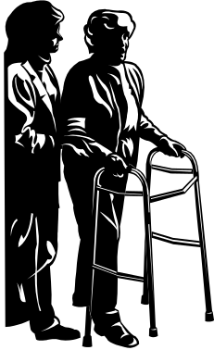
Home Care and Hospice
Nurse case management and development of local resources
  Often hospital based in rural areas
  Use county extension services as a bridge for outreach services
  Improve home care for these patients and provide support for their families
  A partnership between the public health nurse and county extension service could provide support, as well as information groups and caregiving classes, for the important informal provider network.

Slide 21

Faith Communities and Parish Nursing
A strong sense of community, family life, and religious faith
Integrating nursing expertise and faith-based knowledge to provide holistic care to members of congregations
Involved in case management and coordination of services
Collaboration with other organizations to extend limited rural community health resources

Slide 22
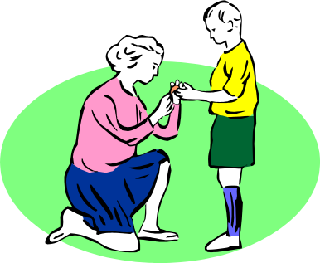
Informal Care Systems
Evolve from self-reliance and self-help traits of rural residents
Include people who have assumed the role of caregiver based on their individual qualities, life situations, or social roles
Provide direct help, advice, or information
Need to identify and combine informal services with formal systems

Slide 23

Rural Public Health Departments
Public health nurses are often the core providers of public health services in rural areas.
  Collaboration of services is key—need to develop partnerships with other heath provider agencies.
  Environmental health, maternal and child health, and communicable disease control are the three highest-priority programs.

Slide 24

Rural Mental Health Care
Lack of specialized mental health providers in rural areas.
Most services provided by primary care providers without adequate preparation or support.
Perceived stigma prevents individuals from seeking mental health services.

Slide 25

Emergency Services
Getting patients from the place of injury to the trauma center within the “golden hour” is frequently not possible because of distance, terrain, climatic conditions, and communication methods.

Slide 26
Emergency Services (Cont.)
Challenges faced by rural EMS systems
  Shortage of volunteers and lower levels of training
  Training curricula that often do not reflect rural hazards (e.g., farm equipment trauma)
  Lack of guidance from physicians
  Lack of physician training and orientation to EMS
  Also contributing to difficult public access for emergency care:
    Low population density
    Large, isolated, or inaccessible areas
    Sever weather
    Poor roads
    Lower density of telephone/communication methods

Slide 27
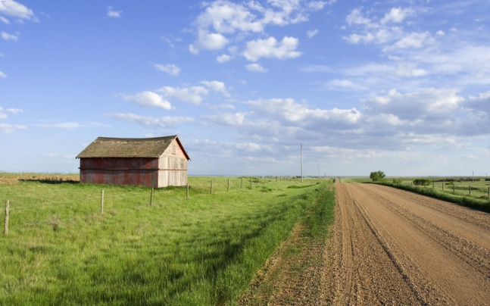
Emergency Preparedness in Rural Communities
Challenges in rural areas:
  Resource limitation
    Human, financial, and social capital
  Separation and remoteness
    Longer response times
  Low population density
    Impacts funding
  Communication
    Warning systems often absent or neglected in remote areas; burden on individuals

Slide 28
Legislation and Programs Affecting Rural Public Health
Programs that augment health care facilities and services
  Community Health Centers (CHC) program
  Migrant Health Clinic (MHC) program and the Migrant Health Program (MHP)
  Medicare’s Rural Hospital Flexibility (RHF) grant program
  Primary care cooperative agreements

Slide 29



Rural Community Health Nursing
“CH nursing along the rural continuum”
Nonmetropolitan Areas
Metropolitan Areas

Slide 30
Rural Nursing …
… is the practice of professional nursing within the physical and sociocultural context of sparsely populated communities. It involves the continual interaction of the rural environment, the nurse, and his or her practice. Rural nursing is the diagnosis and treatment of a diversified population of people of all ages and a variety of human responses to actual (or potential) occupational hazards or actual or potential health problems existent in maternity, pediatric, medical/surgical and emergency nursing in a given rural area.
–– Bigbee (1993), Lee & Winters (2004),
Rosentahl (2005), Williams et al. (2012)

Slide 31

Characteristics of Rural Nursing
Should rural nursing practice be designated as a specialty or subspecialty area because of factors such as isolation, scarce resources, and the need for a wide range of practice skills that must be adapted to social and economic structures?

Slide 32

Characteristics of Rural Nursing (Cont.)
Positive aspects
  Ability to provide holistic care
  Know everyone well
  Develop close relationships with the community and with coworkers
  Enjoy rural lifestyle
  Autonomy and professional status
  Being valued by the agency and community
Negative aspects
  Professional isolation

Slide 33
The newcomer practices nursing in a rural setting, unlike the more experienced nurse, who practices rural nursing. Somewhere between these extremes lies the transitional period of events and conditions through which each nurse passes at her or his own pace. It is within this time zone that nurses experience rural reality and move toward becoming professionals who understand that having gone rural, they are not less than they were, but rather, they are more than they expected to be. Some may be conscious of the transition, and others may not, but in the end, a few will say, "I am a rural nurse.”
– Scharff (1998, p. 38)

Slide 34
Rural Health Research
Research agendas must address:
  The capacity of rural public health to manage improvements in health
  Information technology capacity in rural communities
  Developing and monitoring performance standards in rural public health
  Developing leadership and public health workforce capacity within rural public health
  Interaction and integration of community health systems, managed care, and public health in rural America
  – Berkowitz, Ivory, & Morris (2002)

Slide 35
Capacity of Rural Public Health to Manage Improvements in Health
Healthy People 2020 objectives and intervention strategies
Information Technology in Rural Communities
  EHR and reimbursement
  Preparedness strengthens infrastructure
  Continuing education and advanced education
  Telehealth impact on public health
    Skills via distance learning?
    Costs and infrastructure of IT?
    Gaps in epidemiology and surveillance capacity?

Slide 36
Performance Standards in Rural Public Health
National Public Health Performance Standards Program (NPHPSP) describe an optimal level of performance by public health systems regardless of location.
Used to improve collaborations among key public health partners, educate participants about public health, strengthen the network of public health partners, identify strengths and weaknesses, and provide benchmarks for public health practice improvements

Slide 37
Leadership and Workforce Capacity for Rural Public Health
IOM report (2003)—preparing public health workforce for 21st century
CDC Public Health Improvement Initiative (2012)—accreditation support
Medicaid impact on interaction and integration of community health systems, managed care, and public health
New models of health care delivery for rural and frontier areas being tested

