Slide 1
Chapter 21
Populations Affected by Disabilities

Slide 2
Most people whose lives do not end abruptly
will experience disability.
– Nies & McEwen (2015)

Slide 3
Doing a Self-Assessment
What comes to mind when you think of someone with a disability?
Picture yourself as a person with a disability.
Imagine yourself as a nurse with a visible disability, or a client receiving care from a nurse with a disability.
Think about living in a family affected by disability.
What is the experience of living with disability within your community?

Slide 4
Definitions for Disability
Disability is the interaction between individuals with a health condition and personal and environmental factors.
- World Health Organization, 2012

Slide 5
WHO International Classification of Functioning, Disability, and Health
Disability is an umbrella term covering impairments, activity limitations, and participation restrictions (individual level).
An impairment is a problem in body function or structure—activity limitation or participation restriction (micro level).
A handicap is a disadvantage resulting from an impairment or disability that prevents fulfillment of an expected role (macro level).

Slide 6
Table 21-1
Characteristic | Impairment | Disability | Handicap
Definition | Physical deviation from normal structure, function, physical organization, or development | May be objective and measurable | Not objective or measurable; is an experience related to the responses of others
Measurability | Objective and measurable | May be objective and measurable | Not objective or measurable; is an experience related to the responses of others
Illustrations | Spina bifida, spinal cord injury, amputation, and detached retina | Cannot walk unassisted; uses crutches and/or a manual or power wheelchair; blindness | Reflects physical and psychological characteristics of the person, culture, and specific circumstances
Level of analysis | Micro level (e.g., body organ) | Individual level (e.g., person) | Macro level (e.g., societal)

Slide 7
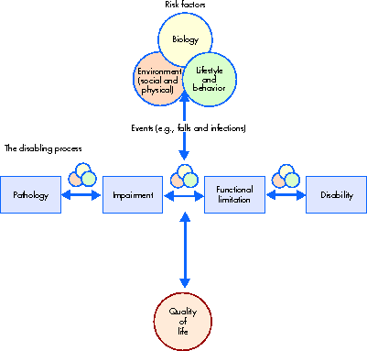
National Agenda for Prevention of Disabilities (NAPD) Model
Figure 21-1 Reprinted with permission from Pope AM, Tarlov AR, editors: Disability in America: toward a national agenda for prevention, Washington, DC, 1991, Institute of Medicine, National Academy Press. Copyright © 1991 by the National Academy of Sciences. Courtesy National Academy Press, Washington, DC.

Slide 8

Quality of Life Issues
Transportation to a needed service
Cost of care
Appointment challenges
Language barriers
Financial issues
Migrant/noninsured issues

Slide 9
Models for Disability
Medical model—a defect in need of cure through medical intervention
Rehabilitation model—a defect to be treated by a rehabilitation professional
Moral model—connected with sin and shame
Disability model—socially constructed

Slide 10
Disability: A Socially Constructed Issue
Disability is a complex, multifaceted, culturally rich concept that cannot be readily defined, explained, or measured (Mont, 2007).
Whether the inability to perform a certain function is seen as disabling depends on socio-environmental barriers (e.g., attitudinal, architectural, sensory, cognitive, and economic), inadequate support services, and other factors (Kaplan, 2009).

Slide 11
“Medicalization” Issues
Nurse needs to differentiate …
  A person who has an illness and becomes disabled secondary to the illness
  versus …
  A person who has a disability, but may not need treatment

Slide 12
“Medicalization” Issues (Cont.)
Nurse’s interaction with PWD and families
  Approach on an eye-to-eye level
  Listen to understand
  Collaborate with the person/family
  Make plans and goals that meet the other’s needs and draw on strengths and improve weaknesses
  Empower and affirm the worth and knowledge of the person/family with a disability
  Promote self-determination and allow choices
  Note: PWD = persons with disabilities

Slide 13
Historical Perspectives
Long history of institutionalization/segregation
Often viewed as sick and helpless
In the 20th century, special interest groups emerged to advocate for PWD (e.g., ARC)
Tragedies include Hitler’s euthanasia program
Deinstitutionalization began in 1960s-1970s
Stereotypical images still common in literature and media; these images influence prevailing perceptions of disability

Slide 14


Historical Context for Disability
Early attitudes toward PWD
  Set apart from others
  Viewed as different or unusual
  Documented in carvings and writings
  Infanticide or left to die (not in Jewish culture)
  Viewed as unclean and/or sinful
  Served as entertainers, circus performers, and sideshow exhibitions

Slide 15

Historical Context
18th and 19th century attitudes
  No scientific model for understanding and treating
  Disability seen as an irreparable condition caused by supernatural agency
  Viewed as sick and helpless
  Expected to participate in whatever treatment was deemed necessary to cure or perform
Industrial Revolution stimulated a societal need for increased education
  If not third-grade level = feeble-minded
  Special schools established in early 1800s

Slide 16


Historical Context (Cont.)
20th century attitudes
  Special interest groups were formed
  First federal vocational rehabilitation legislation passed in early 1920s
  Involuntary sterilization of many with intellectual disabilities
  ARC (Association for Retarded Children) began to advocate for children with intellectual disabilities—today is Association for Retarded Citizens
  ARC is “world’s largest community-based organization of and for people with intellectual and developmental disabilities” (ARC, 2009)

Slide 17

Historical Context (Cont.)
20th century attitudes
  One of the most horrendous tragedies under Hitler’s euthanasia or “good death” program
    Killed at least 5000 mentally and physically disabled children by starvation or lethal overdoses
    Killed 70,274 adults with disabilities by 1941
    Over 200,000 people exterminated because they were “unworthy of life”
  Deinstitutionalization movement in 1960s and 1970s
    Community-based Independent Living Centers established

Slide 18

Historical Context (Cont.)
Contemporary conceptualization
  Stereotypical images remain common in literature and media
    Population portrayed as a burden to society or from pity/pathos or heroic “supercrip” perspectives
    “just as the paralytic cannot clear his mind of his impairment, society will not let him forget it.” (Murphy, 1990, p. 106)
  Societal stigma still exists
    Teasing or bullying often occurs in schools
    Rehabilitation Act of 1973 and American with Disabilities Act of 1990 prohibit “disability harassment”

Slide 19
Characteristics of Disability
Americans with Disabilities Act (ADA) of 1990 and Rehabilitation Act of 1973 defined disability according to limitations in a person’s ability to carry out a major life activity.
  Major life activities: ability to breathe, walk, see, hear, speak, work, care for oneself, perform manual tasks, and learn
U.S. Census Bureau (2006) defines disability as long-lasting physical, mental, or emotional condition that creates a limitation or inability to function according to certain criteria.

Slide 20

Examples of Disabilities
Physical disabilities
Sensory disabilities
Intellectual disabilities
Serious emotional disturbances
Learning disabilities
Significant chemical and environmental sensitivities
Health problems

Slide 21
Measurement of Disability
Survey of Income and Program Participation (SIPP)
  Functional activities
  Activities of daily living (ADLs)
  Instrumental activities of daily living (IADLs)
American Community Survey (ACS)
  Surveys for disability limitation in six areas that affect function or activity (sensory, physical, mental/emotional, self-care, ability to go outside the home, employment)
Other organizations also collect disability data

Slide 22
Prevalence of Disability
In 2010, approximately 18.7% of civilian noninstitutional population aged 5 years and older had a long-lasting condition or disability.
Of those with a disability, 12.6% had a “severe” disability.
Prevalence varies by race, age, and gender.
It is important for health care policymakers and health care providers to recognize that the prevalence of disability is increasing.

Slide 23
Prevalence of Disability in Children
Approximately 15.2% of households with children have at least one child with a special health care need (disabling condition).
– National Survey of Children with
Special Health Care Needs (2009/2010)
A disability is defined by a communication-related difficulty, mental or emotional condition, difficulty with regular schoolwork, difficulty getting along with other children, difficulty walking or running, use of some assistive device, and/or difficulty with ADLs

Slide 24

Recommendation for the Nurse
Listen to parental concerns
  “Something is not right”
  Establishes an important bond with parents
  Nurse can serve as an intermediary
Regularly assess for key developmental milestones
  Compare with predicted values
  Work with team of resource providers on IEP
Be cognizant of disability within the context of culture and aging

Slide 25

Legislation Affecting People with Disabilities
Individuals with Disabilities Education Act (IDEA) (1975); reauthorized in 1997, 2004
  Ensured a free appropriate public education (FAPE) in the least-restrictive setting to children with disabilities based on their needs
  Parents, students, and professionals join together to develop an Individualized Education Program (IEP), including measurable special educational goals and related services for the child.

Slide 26
Americans with Disabilities Act of 1990 and ADA Amendments Act of 2008
ADA: Landmark civil rights legislation that prohibits discrimination toward people with disabilities in everyday activities
  Guarantees equal opportunities for people with disabilities related to employment, transportation, public accommodations, public services, and telecommunications
  Provides protections to people with disabilities similar to those provided to any person on basis of race, color, sex, national origin, age, and religion

Slide 27
Americans with Disabilities Act of 1990 and ADA Amendments Act of 2008 (Cont.)
ADA (Cont.)
  Refers to a “qualified individual” with a disability as a person with a physical or mental impairment that substantially limits one or more major life activities or bodily functions, a person with a record of such an impairment, or a person who is regarded as having such an impairment.
  Qualifying organizations must provide reasonable accommodations unless they can demonstrate that the accommodation will cause significant difficulty or expense, producing an undue hardship.

Slide 28

Ticket to Work and Work Incentives Improvement Act (TWWIIA)
Increases access to vocational services; provides new methods for retaining health insurance after returning to work
Increases available choices when obtaining employment services, vocational rehabilitation services, and other support services needed to get or keep a job
Became law in 1999, amended in 2008

Slide 29

Public Assistance Programs
Cash assistance
  Supplemental Security Income—SSI
  Social Security Disability Insurance—SSDI
Food stamps
Public/subsidized housing
Costs associated with disability
  Gaps in employment, income, education, access to transportation, attendance at religious services

Slide 30

Health Disparities in Quality and Access
Disparities are caused by …
  Differences in access to care
  Provider biases
  Poor provider-patient communication
  Poor health literacy
Persons with disabilities experience …
  Higher rates of chronic illness
  Increased risks for medical, physical, social, emotional, and/or spiritual secondary issues
People with intellectual disabilities are
  Undervalued and disadvantaged

Slide 31
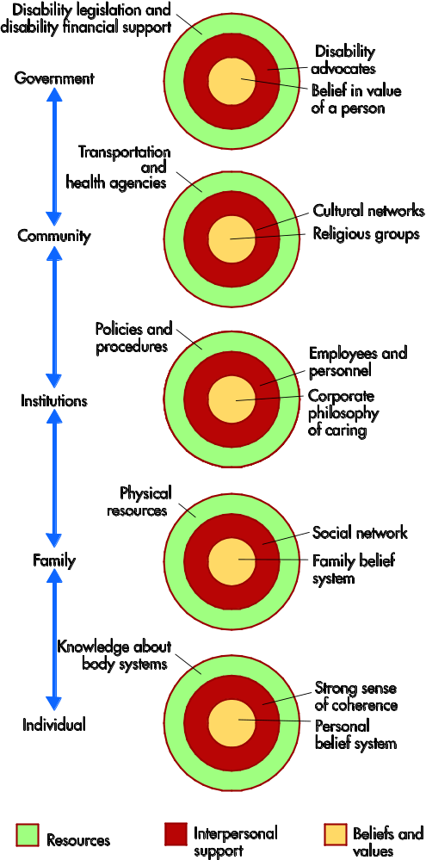
Systems of Support for People With Disabilities
Figure 21-2

Slide 32
The Experience of Disability
PWD may be largest minority group in the United States
Different experiences, depending on …
  Temporary disability
  Permanent disability from accident or disease
  Disability from progressive decline of a chronic illness
Benchmark event is acceptance of the label of “disabled”

Slide 33
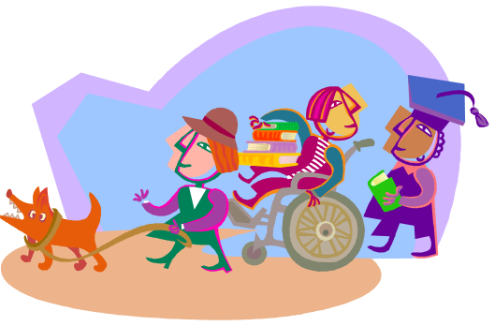
Children With Disabilities (CWD)
Family and caregiver responses
  Redefine image and expectations for child and self
  Sibling response influenced by age, coping, peer relationships, parents, impact on family
Levels of parental adjustment
  The ostrich phase
  Special designation
  Normalization
  Self-actualization

Slide 34
Family Research Outcomes
Established various benefits, amid challenges
Families with satisfying emotional support experience fewer potentially negative effects of unplanned or distressing events.
Parents may grieve the loss of idealized or expected child over time.
Supportive relationship is needed.
Empowerment and enabling decision making on behalf of CWD is important.

Slide 35
Knowledgeable Client
A person who lives with a disability commonly becomes an expert at knowing what works best for his or her body.
Knowledgeable Nurse
The nurse who has information about the disability and the available community and governmental resources.

Slide 36
Strategies for the CH Nurse
Do not assume anything.
Adopt the client’s perspective.
Listen to and learn from client. Gather data from the perspective of the client and family.
Care for the client and family, not for the disability.
Be well informed about community resources.
Become a powerful advocate.

Slide 37

Dealing With Ethical Issues
Spiritual perspectives
Quality of life (QOL) and justice perspectives
Proper use of scientific advances
Self-determination, deinstitutionalization, and disability rights

Slide 38
When the Nurse Has a Disability
Education programs and employers must provide reasonable accommodations for qualified students and nurses.
Technical aspects of nursing tend to discriminate; nursing should emphasize “humanistic” capacities.
Type of setting influences functionability.

Slide 39

Nurses Can …
… become familiar with a variety of ethical frameworks for decision making.
… help the patient and family access needed information to make informed decisions.
… help educate the public on health care issues.
… participate in the development of institutional policies and procedures related to disability.
… take a position on an ethical issue.
… work to influence government policies and laws.

