Slide 1
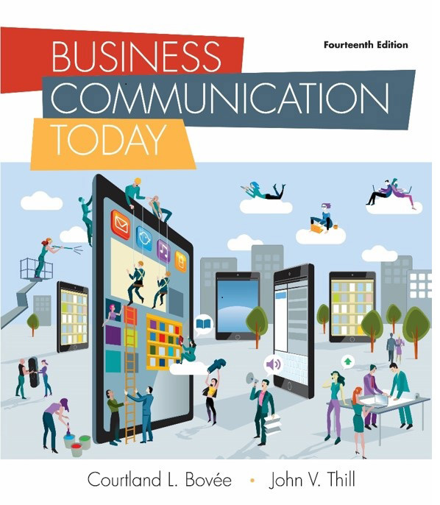
Business Communication Today
Fourteenth Edition
Chapter 1
Professional Communication in a Digital, Social, Mobile World
Copyright © 2018, 2015, 2012 Pearson Education, Inc. All Rights Reserved.
Notes:
If this PowerPoint presentation contains mathematical equations, you may need to check that your computer has the following installed:
1) MathType Plugin
2) Math Player (free versions available)
3) NVDA Reader (free versions available)

Slide 2
Learning Objectives (1 of 2)
1.1 Explain the importance of effective communication to your career and to the companies where you will work.
1.2 Explain what it means to communicate as a professional in a business context.
1.3 Describe the communication process model and the ways social media are changing the nature of business communication.

Slide 3
Learning Objectives (2 of 2)
1.4 Outline the challenges and opportunities of mobile communication in business.
1.5 List four general guidelines for using communication technology effectively.
1.6 Define ethics, explain the difference between an ethical dilemma and an ethical lapse, and list six guidelines for making ethical communication choices.

Slide 4
Understanding Why Communication Matters
LO 1.1 Explain the importance of effective communication to your career and to the companies where you will work.
Notes:
Communication is the process of transferring information and meaning between senders and receivers.

Slide 5
Communication is Important to Your Career
Your career will give you the opportunity to communicate, collaborate and share ideas with many people, both inside and outside your organization
You may be an employee, executive, consultant or freelancer to a company
You may become an entrepreneur
In all these roles, communication skills may be the single most important skill you possess
Notes:
Employers sometimes express frustration at the poor communication skills of many employees—particularly recent college graduates who haven’t yet learned how to adapt their communication styles to a professional business environment. If you learn to write well, speak well, listen well, and recognize the appropriate way to communicate in any situation, you’ll gain a major advantage that will serve you throughout your career.

Slide 6
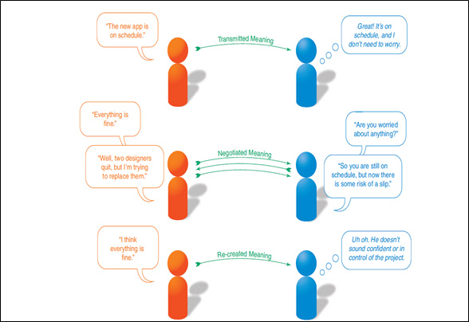
Figure 1.1 Sharing Information
Notes:
These three exchanges between a software project manager (left) and his boss (right) illustrate the variety of ways in which information is shared between senders and receivers. In the top exchange, the sender’s meaning is transmitted intact to the receiver, who accepts what the sender says at face value. In the middle exchange, the sender and receiver negotiate the meaning by discussing the situation. The negotiated meaning is that everything is fine so far, but the risk of a schedule slip is now higher than it was before. In the bottom exchange, the receiver has a negative emotional reaction to the word think and as a result creates her own meaning—that everything probably is not fine, despite what the sender says.

Slide 7
Communication is Important to Your Company
Regardless of where you work, effective communication helps businesses be successful in numerous ways, including
  Building Trust
  Closer Ties to the Community
  Client Relations
  Increased Productivity
  Marketing and Sales
  Employee Relations

Slide 8
What Makes Business Communication Effective?
Give facts rather than vague impressions
Present information in a concise, efficient manner
Clarify expectations and responsibilities
Offer compelling, persuasive arguments and recommendations
Notes:
Provide practical information. Give recipients useful information, whether it’s to help them perform a desired action or understand a new company policy.
●● Give facts rather than vague impressions. Use concrete language, specific detail, and information that is clear, convincing, accurate, and ethical. Even when an opinion is called for, present compelling evidence to support your conclusion.
●● Present information in a concise, efficient manner. Concise messages show respect for people’s time, and they increase the chances of a positive response. Do your best to simplify complex subjects to help your readers, and make sure you don’t inadvertently complicate simple subjects through careless writing. The ability to explain a complex subject in simple terms is immensely valuable, whether you’re training new employees or pitching a business plan to investors.
●● Clarify expectations and responsibilities. Craft messages to generate a specific response from a specific audience. When appropriate, clearly state what you expect from audience members or what you can do for them.
●● Offer compelling, persuasive arguments and recommendations. Show your readers precisely how they will benefit by responding to your message in the way you want them to.

Slide 9
Communicating as a Professional
LO 1.2 Explain what it means to communicate as a professional in a business context.
Notes:
Professionalism is the quality of performing at a high level and conducting oneself with purpose and pride. It means doing more than putting in the hours and collecting a paycheck: True professionals go beyond minimum expectations and commit to making meaningful contributions

Slide 10
Elements of Professionalism
Striving to excel
Being dependable and accountable
Being a team player
Demonstrating a sense of etiquette
Making ethical decisions
Maintaining a positive outlook
Notes:
See Figures 1.2 – Effective/Ineffective Communication and 1.3 – Elements of Professionalism. Pros strive to excel, and excelling at every level is how you build a great career. Pros keep their promises, meet their commitments, learn from their mistakes, and take responsibility for their errors. Pros know how to contribute to a larger cause and make others around them better. Good business etiquette is a sign of respect for those around you; respecting others is not only good—it’s good for your career. Communication is the single most important business skill you can develop. Responsible pros work to avoid ethical lapses and weigh their options carefully when facing ethical dilemmas.

Slide 11
Understanding What Employers Expect from You (1 of 2)
Digital Information Fluency
Ability to Organize Ideas
Ability to Express Ideas Concisely, Coherently and Persuasively
Active Listening Skills
Excellent Communication with People from Diverse Backgrounds

Slide 12
Understanding What Employers Expect from You (2 of 2)
Effective and Efficient Use of Communication Technologies
High Quality Writing and Speaking Standards
Maintaining Business Etiquette at all times
Communicating Ethically at all times
Time Management and Critical Thinking
Notes:
Successful professionals continue to hone communication skills throughout their careers.

Slide 13
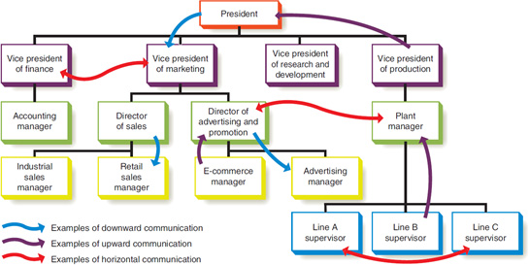
Communicating in an Organizational Context
Figure 1.4 Formal Communication Network
Notes:
The formal communication network is defined by the relationships between the various job positions in the organization. Messages can flow upward (from a lower-level employee to a higher-level employee), downward (from a higher-level employee to a lower-level employee), and horizontally (between employees at the same or similar levels across the organization).

Slide 14
Adopting an Audience-Centered Approach
Focus on the “You” Attitude
  Emotional Intelligence
  Business Etiquette
  What is important to your audience?
    Biases
    Education, Age, and Status
    Style
    Personal and Professional Concerns
Notes:
If you’re addressing people you don’t know and you’re unable to find out more about them, try to project yourself into their position by using common sense and imagination. This ability to relate to the needs of others is a key part of emotional intelligence, a combination of emotional and social skills that is widely considered to be a vital characteristic of successful managers and leaders. The more you know about the people you’re communicating with, the easier it is to concentrate on their needs—which, in turn, makes it easier for them to hear your message, understand it, and respond positively. A vital element of audience-centered communication is etiquette, the expected norms of behavior in any particular situation. In today’s hectic, competitive world, etiquette might seem a quaint and outdated notion. However, the way you conduct yourself and interact with others can have a profound influence on your company’s success and your career. When executives hire and promote you, they expect your behavior to protect the company’s reputation. The more you understand such expectations, the better chance you have of avoiding career-damaging mistakes.

Slide 15
Exploring the Communication Process
LO 1.3 Describe the communication process model and the ways social media are changing the nature of business communication.
Notes:
Even with the best intentions, communication efforts can fail. Messages can get lost or simply ignored. The receiver of a message can interpret it in ways the sender never imagined. This section explores the communication process in two stages: first by following a message from one sender to one receiver in the basic communication model and then by expanding on that approach with multiple messages and participants in the social communication model.

Slide 16
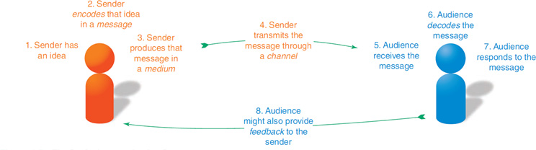
The Basic Communication Model
Figure 1.5 The Basic Communication Process
Notes:
Figure Caption: This eight-step model is a simplified view of how communication works in real life; understanding this basic model is vital to improving your communication skills.
Considering the complexity of this process—and the barriers and distractions that often stand between sender and receiver—it should come as no surprise that communication efforts often fail to achieve the sender’s objective. Fortunately, the better you understand the process, the more successful you’ll be.

Slide 17
Barriers in the Communication Process
Noise and Distractions
Competing Messages
Filters
Channel Breakdowns
Notes:
Within any communication environment, messages can be disrupted by a variety of communication barriers. Minimizing barriers and distractions in the communication environment is everyone’s responsibility.

Slide 18
Inside the Mind of Your Audience
How Audiences Receive Messages
How Audiences Decode Messages
How Audiences Respond to Messages

Slide 19
How Audiences Receive Messages
Consider audience expectations
Ensure ease of use
Emphasize familiarity
Practice empathy
Design for compatibility
Notes:
To truly receive a message, audience members need to sense it, select it, then perceive it as a message. To improve the odds that your messages will be successfully perceived by your audience, pay close attention to expectations, ease of use, familiarity, empathy, and technical compatibility.
Consider audience expectations. Deliver messages using the media and channels that the audience expects. If colleagues expect meeting notices to be delivered by email, don’t suddenly switch gears and start delivering the notices via blog postings without telling anyone. Of course, sometimes going against expectations can stimulate audience attention, which is why advertisers sometimes do wacky and creative things to get noticed. For most business communication efforts, however, following the expectations of your audience is the most efficient way to get your message across.
Ensure ease of use. Even if audiences are actively looking for your messages, they probably won’t see them if you make them hard to find, hard to navigate, or hard to read.
Emphasize familiarity. Use words, images, and designs that are familiar to your audience. For example, most visitors to company websites expect to see information about the company on a page called “About” or “About Us.”
Practice empathy. Make sure your messages speak to the audience by clearly addressing their wants and needs—not yours. People are inclined to notice messages that relate to their individual concerns.
Design for compatibility. For the many messages delivered electronically these days, be sure to verify technological compatibility with your audience. For instance, if your website requires visitors to have a particular video capability in their browsers, you won’t reach those audience members who don’t have that software installed or updated.

Slide 20
How Audiences Decode Messages
Perception
Selective Perception
Cultural Beliefs
Personal Beliefs
Individual Thinking Styles
Notes:
Decoding is a complex process; receivers often extract different meanings from messages than senders attempt to encode in them. Selective perception occurs when people ignore or distort incoming information to fit their preconceived notions of reality. Business strategy might distort or ignore evidence that suggests the strategy is failing. Differences in language and usage also influence received meaning. If you ask an employee to send you a report on sales figures “as soon as possible,” does that mean within 10 seconds, 10 minutes, or 10 days? By clarifying expectations and resolving potential ambiguities in your messages, you can minimize such uncertainties. In general, the more experiences you share with another person, the more likely you are to share perception and thus share meaning (see Figure 1.6). Individual thinking styles are another important factor in message decoding. For example, someone who places a high value on objective analysis and clear logic might interpret a message differently than someone who values emotion or intuition (reaching conclusions without using rational processes).

Slide 21
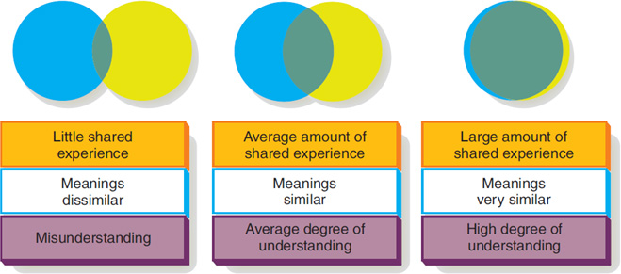
Figure 1.6 How Shared Experience Affects Understanding
Notes:
The more two people or two groups of people share experiences—personal, professional, and cultural—the more likely it is that receivers will extract the intended meanings senders encode into the messages.

Slide 22
How Audiences Respond to Messages
Must Remember Message
Must Be Able to Respond As You Wish
Must Be Motivated to Respond
Notes:
First, the recipient has to remember the message long enough to act on it. Simplifying greatly, memory works in several stages: Sensory memory momentarily captures incoming data from the senses; then, whatever the recipient pays attention to is transferred to short-term memory. Information in short-term memory quickly disappears if it isn’t transferred to long-term memory, which can be done either actively (such as when a person memorizes a list of items) or passively (such as when a new piece of information connects with something else the recipient already has stored in long-term memory). Finally, the information needs to be retrieved when the recipient wants to act on it. In general, people find it easier to remember and retrieve information that is important to them personally or professionally. Consequently, by communicating in ways that are sensitive to your audience’s wants and needs, you greatly increase the chance that your messages will be remembered and retrieved. Second, the recipient has to be able to respond as you wish. Obviously, if recipients simply cannot do what you want them to do, they will not respond according to your plan. By understanding your audience (you’ll learn more about audience analysis in Chapter 4), you can work to minimize these unsuccessful outcomes. Third, the recipient has to be motivated to respond. You’ll encounter many situations in which your audience has the option of responding but isn’t required to. For instance, a record company may or may not offer your band a contract, or your boss may or may not respond to your request for a raise.

Slide 23
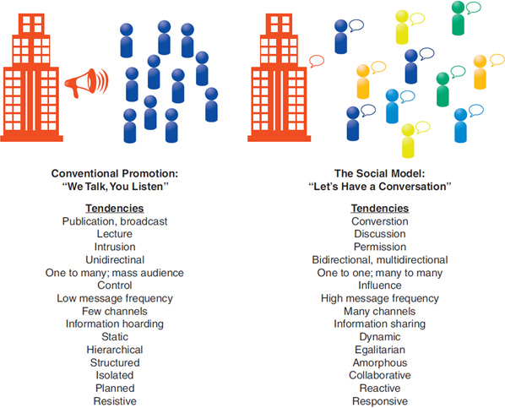
Figure 1.7 The Social Communication Model
Notes:
Figure Caption: The social communication model differs from conventional communication strategies and practices in a number of significant ways. You’re probably already an accomplished user of many new-media tools, and this experience will help you on the job.
In recent years, however, a variety of technologies have enabled and inspired a new approach to business communication. In contrast to the publishing mindset, this social communication model is interactive, conversational, and usually open to all who wish to participate. The social communication model can increase the speed of communication, reduce costs, improve access to expertise, and boost employee satisfaction. For all their advantages, social media tools also present a number of communication challenges.

Slide 24
The Mobile Revolution
LO 1.4 Outline the challenges and opportunities of mobile communication in business.
Notes:
Companies recognize the value of integrating mobile technology, from communication platforms to banking to retail. Mobile apps and communication systems can boost employee productivity, help companies form closer relationships with customers and business partners, and spur innovation in products and services (see Figure 1.8). Given the advantages and the rising expectations of employees and customers, firms on the leading edge of the mobile revolution are working to integrate mobile technology throughout their organizations.

Slide 25
The Rise of Mobile Communication as a Platform (1 of 2)
Globally, more than 80 percent of Internet users access the web with a mobile device
Mobile has become the primary communication tool for many business professionals
A majority of executives under age 40 use mobile as their main communication tool
Notes:
Mobile devices are rapidly taking over as the primary communication platform for many business professionals.

Slide 26
The Rise of Mobile Communication as a Platform (2 of 2)
Email and web browsing rank first and second as the most common nonvoice uses of smartphones
More email messages are now opened on mobile devices than on PCs
Roughly half of U.S. consumers use a mobile device exclusively for their online search needs
Notes:
When people are closely attached to their phones, day and night, they are more closely tied to all the information sources, conversations, and networks that those phones can connect to. As a result, mobile connectivity can start to resemble a continuous stream of conversations that never quite end, which influences the way businesses need to interact with their stakeholders. If wearable technologies become mainstream devices, they will contribute even more to this shift in behaviors (see Figure 1.9).
The parallels between social media and mobile communication are striking: Both sets of technologies change the nature of communication, alter the relationships between senders and receivers, create opportunities as well as challenges, and force business professionals to hone new skills. In fact, much of the rise in social communication can be attributed to the connectivity made possible by mobile devices. Companies that work to understand and embrace mobile, both internally and externally, stand the best chance of capitalizing on this monumental shift in the way people communicate.

Slide 27
How Mobile Technologies are Changing Business Communication (1 of 2)
Constant Connectivity
Small Mobile Displays
Mobile Users are Multitasking
Changes in Traditional Grammar
Sensory and Cognitive Extensions of User
Notes:
●● Constant connectivity is a mixed blessing. As with social media, mobile connectivity can blur the boundaries between personal and professional time and space, preventing people from fully disengaging from work during personal and family time. On the other hand, it can give employees more flexibility to meet their personal and professional obligations. In this regard, mobile plays an important role in efforts to reduce operating costs through telecommuting and other nontraditional work models.
●● Small mobile displays and sometimes-awkward input technologies present challenges for creating and consuming content, whether it’s typing an email message or watching a video. As you’ll read in Chapter 6, for example, email messages need to be written and formatted differently to make them easier to read on mobile devices.
●● Mobile users are often multitasking—roughly half of mobile phone usage happens while people are walking, for instance—so they can’t give full attention to the information on their screens. Moreover, mobile use often occurs in environments with multiple distractions and barriers to successful communication.
●● Mobile communication, particularly text messaging, has put pressure on traditional standards of grammar, punctuation, and writing in general. Chapter 4 has more on this topic.
●● Mobile devices can serve as sensory and cognitive extensions. For example, they can help people experience more of their environment (such as augmented reality apps that superimpose information on a live camera view) and have instant access to information without relying on faulty and limited human memory. The addition of location-aware content, such as facility maps and property information, enhances the mobile experience.

Slide 28
How Mobile Technologies are Changing Business Communication (2 of 2)
Security and Privacy Concerns
Enhanced Productivity and Collaboration
Business-specific Applications
Accelerated Decision-making and Problem-solving
Greater Engagement with Audience
Notes:
●● Mobile devices create a host of security and privacy concerns for end users and corporate technology managers alike. Companies are wrestling with the “bring your own device” or “BYOD” phenomenon, in which employees want to be able to access company networks and files with their personal smartphones and tablets, both in the office and away from it. These devices don’t always have the rigorous security controls that corporate networks need, however, and users don’t always use the devices in secure ways.
●● Mobile tools can enhance productivity and collaboration by making it easier for employees to stay connected and giving them access to information and work tasks during forced gaps in the workday or while traveling.
●● Mobile apps can assist in a wide variety of business tasks, from research to presentations (see Figure 1.10). Companies aren’t restricted to commercially available apps, either. With digital publishing tools, companies can create custom apps with content and capabilities geared specifically toward their customers or employees.
●● Mobile connectivity can accelerate decision making and problem solving by putting the right information in the hands of the right people at the right time. For example, if the people in a decision-making meeting need more information, they can do the necessary research on the spot. Mobile communication also makes it easier to quickly tap into pockets of expertise within a company. Customer service can be improved by making sure technicians and other workers always have the information they need right at hand. Companies can also respond and communicate faster during crises.
●● With interactivity designed to take advantage of the capabilities of mobile devices (including cameras, accelerometers, compasses, and GPS), companies can create more engaging experiences for customers and other users.

Slide 29
Using Technology to Improve Business Communication
LO 1.5 List four general guidelines for using communication technology effectively.
Notes:
Today’s businesses rely heavily on technology to enhance communication. In fact, many of the technologies you might use in your personal life, from microblogs to video games, are also used in business. Poorly designed or inappropriately used technology can hinder communication more than help. To communicate effectively, learn to keep technology in perspective, guard against information overload and information addiction, use technological tools productively, and frequently disengage from the computer to communicate in person.

Slide 30
Keeping Technology in Perspective
Technology Pros | Technology Cons
Useful Tool | Can’t Think for You
Enhances Communication Process | Can’t Fill in Skills Gaps
Assists in Accomplishment of Tasks | Not a Replacement for Communication
Notes:
Don’t rely too much on technology or let it overwhelm the communication process.

Slide 31
Guarding Against Information Overload
Implement Controls on the Messages You Receive
Use Filtering Features
Manage Subscriptions
Avoid Sending Unnecessary Messages
Mark and Save Important Messages
Notes:
You often have some level of control over the number and types of messages you choose to receive. Use the filtering features of your communication systems to isolate high-priority messages that deserve your attention. Also, be wary of subscribing to too many Twitter streams and other sources. Focus on the information you truly need in order to do your job.
As a sender, you can help reduce information overload by making sure you don’t send unnecessary messages. In addition, when you send messages that aren’t urgent or crucial, let people know so they can prioritize. Also, most communication systems let you mark messages as urgent; however, use this feature only when it is truly needed. Its overuse leads to annoyance and anxiety, not action.

Slide 32
Using Technological Tools Productively
Implement Controls on the Messages You Receive
Use Filtering Features
Manage Subscriptions
Avoid Sending Unnecessary Messages
Mark and Save Important Messages
Notes:
Communicating in today’s business environment requires at least a basic level of technical competence.
Social media are a particular source of concern: While they offer great opportunities for connecting with customers and other stakeholders, the potential for distraction can waste significant amounts of employee time.
Inappropriate web use not only distracts employees from work responsibilities, it can leave employers open to lawsuits for sexual harassment if inappropriate images are displayed in or transmitted around the company. Managers need to guide their employees in the productive use of information tools because the speed and simplicity of these tools are also among their greatest weaknesses.

Slide 33
Reconnecting With People
Choose Your Medium Wisely
  Face-to-face or telephonic communication can be integral to effective communication and can limit miscommunications
  Use technology as an aid, not a replacement for communication
  Show people who you really are
Notes:
No matter how much technology is involved, communication is still about people connecting with people. Remember to step out from behind the technology frequently to learn more about the people you work with and to let them learn more about you.

Slide 34
Committing to Ethical and Legal Communication
LO 1.6 Define ethics, explain the difference between an ethical dilemma and an ethical lapse, and list six guidelines for making ethical communication choices.
Notes:
Ethics are the accepted principles of conduct that govern behavior within a society. Ethical behavior is a companywide concern, but because communication efforts are the public face of a company, they are subjected to particularly rigorous scrutiny from regulators, legislators, investors, consumer groups, environmental groups, labor organizations, and anyone else affected by business activities.

Slide 35
Ethical Communication
Includes All Relevant Information
Is True in Every Sense
Is Not Deceptive in Any Way
Notes:
Transparency gives audience members access to all the information they need to process messages accurately. The widespread adoption of social media has increased the attention given to the issue of transparency, which in this context refers to a sense of openness, of giving all participants in a conversation access to the information they need to accurately process the messages they are receiving. In addition to the information itself, audiences deserve to know when they are being marketed to and who is behind the messages they read or hear. For example, with stealth marketing, companies recruit people to promote products to friends and other contacts in exchange for free samples or other rewards, without requiring them to disclose the true nature of the communication. This can range from paying consumers to give product samples as “gifts” to paying popular Vine contributors to work products and brand names into the segments they post on the popular videosharing service. Critics of stealth marketing, including the U.S. Federal Trade Commission (FTC), assert that such techniques are deceptive because they don’t give targets the opportunity to raise their instinctive defenses against the persuasive powers of marketing messages.

Slide 36
Unethical Communication
Plagiarizing
Omitting Essential Information
Selective Misquoting
Misrepresenting Numbers
Distorting Visuals
Failing to Respect Privacy or Security

Slide 37
Distinguishing Ethical Dilemmas from Ethical Lapses
Ethical Dilemmas | Ethical Lapses
Choosing among alternatives that are not clear cut | Clearly unethical choice
Notes:
An ethical dilemma involves choosing among alternatives that aren’t clear-cut. Perhaps two conflicting alternatives are both ethical and valid, or perhaps the alternatives lie somewhere in the gray area between clearly right and clearly wrong. Every company has responsibilities to multiple groups of people inside and outside the firm, and those groups often have competing interests. For instance, employees naturally want higher wages and more benefits, but investors who have risked their money in the company want management to keep costs low so that profits are strong enough to drive up the stock price. Both sides have a valid ethical position. In contrast, an ethical lapse is a clearly unethical choice. With both internal and external communication efforts, the pressure to produce results or justify decisions can make unethical communication a tempting choice. Telling a potential customer you can complete a project by a certain date when you know you can’t is simply dishonest, even if you need the contract to save your career or your company. There is no ethical dilemma here. Compare the messages in Figures 1.11 and 1.12 for examples of how business messages can be unethically manipulated.

Slide 38
Ensuring Ethical Communication
Three Elements
  Ethical Individuals
  Ethical Company Leadership
  Appropriate Policies and Structures
    Code of Ethics
    Ethics Audits
Notes:
These three elements need to work in harmony. If employees see company executives making unethical decisions and flouting company guidelines, they might conclude that the guidelines are meaningless and emulate their bosses’ unethical behavior.
A code is often part of a larger program of employee training and communication channels that allow employees to ask questions and report instances of questionable ethics. To ensure ongoing compliance with their codes of ethics, many companies also conduct ethics audits to monitor ethical progress and to point out any weaknesses that need to be addressed.
In the absence of clear guidelines, ask yourself the following questions about your business communications:
●● Have you defined the situation fairly and accurately?
●● What is your intention in communicating this message?
●● What impact will this message have on the people who receive it or who might be affected by it?
●● Will the message achieve the greatest possible good while doing the least possible harm?
●● Will the assumptions you’ve made change over time? That is, will a decision that seems ethical now seem unethical in the future?
●● Are you comfortable with your decision? Would you be embarrassed if it were printed in tomorrow’s newspaper or spread across the Internet? Think about a person whom you admire and ask yourself what he or she would think of your decision.

Slide 39
Ensuring Legal Communication
Laws and Regulations Govern
  Promotional Communication
  Contracts
  Employment Communication
  Intellectual Property
  Financial Reporting
  Defamation
  Transparency Requirements
Notes:
If you have any doubts about the legality of a message you intend to distribute, ask for advice from your company’s legal department. A small dose of caution can prevent huge legal headaches and protect your company’s reputation in the marketplace.

Slide 40
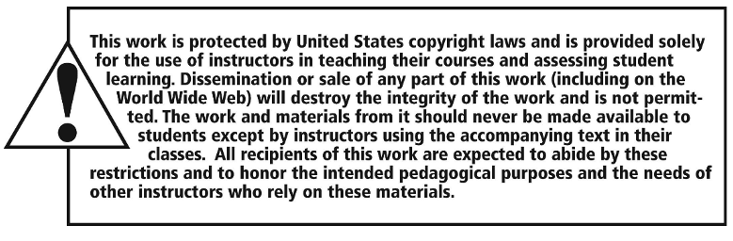
Copyright

