Slide 1
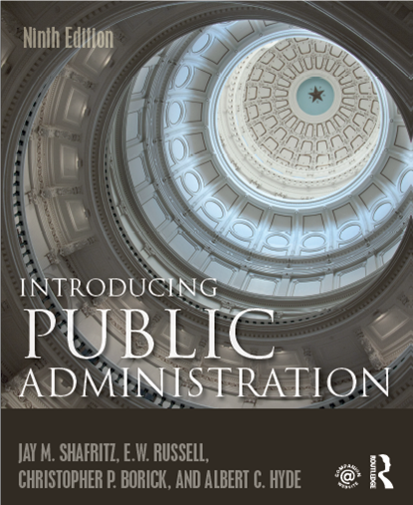
CHAPTER 11
Personnel Management and Labor Relations
https://www.pbs.org/video/zero-tolerance-en2plm/

Slide 2
Personnel Management
The function of a personnel staff, or even an entire personnel agency, is service to line management.
Personnel is a collective term for all of the employees in an organization. Word is of military origin.
Personnel management requires an understanding of law as well as the major developments in the social and behavioral sciences.

Slide 3
Personnel Management (cont.)
Personnel administration has evolved from being largely a clerical function into a professional practice.
Personnel management deals with the technical functions of management, such as:
RECRUITMENT
SELECTION
RETENTION
TRAINING
EVALUATION

Slide 4
The Personnel Function
The key problem for personnel management is the balancing of several contradictory values.
  Merit or neutral competence, executive leadership, political accountability, managerial flexibility, representativeness.
Maximizing some of these values requires arrangements poorly suited for other values.
These matters are further complicated by the rise of public-sector collective bargaining, which emphasizes employer-employee codetermination of personnel policy.

Slide 5
Recruitment.
Recruitment is the process of advertising job openings and encouraging candidates to apply.
Designed to provide organizations with an adequate number of viable candidates to make a selection.
The main objective: the generation of an adequate number of qualified candidates.
Not all positions are open to entry-level applicants.

Slide 6
Personnel Merit Selection
Selection on the basis of merit began with the Pendleton Act of 1883, when abuses of the civil service were rampant in the nation and the civil service were seen to be critical.
The act created the US Civil Service Commission and mandated:
  Open competitive examinations.
  Probationary periods.
  Protection from political pressures.
  Examinations that were to be “practical in character.”

Slide 7
Position Classification & Pay
Position classification principles.
  Positions and not individuals should be classified.
  The individual characteristics of an employee occupying a position should have no bearing on the classification of the position.
  Qualifications with respect to education, experience, knowledge, and skill necessary for the performance of certain duties are determined by the nature of those duties.

Slide 8
Position Classification & Pay
Traditional position classifications organize all jobs in a civil service merit into classes on the basis of duties to establish:
  Chains of command
  Salary scales
  Delineation of authority
  Modern Compensation now makes comparisons of salary and benefit levels of different occupations (job families), factors in geographic prevailing wage levels—to determine appropriate compensation levels to attract talent.
  This has also resulted in major debates about pay comparability.

Slide 9
Performance Appraisals & Training
Performance Appraisal is about the documentation of work performance of employees.
Most appraisals are too subjective and impressionistic to be useful because they are done in-house, and thus evaluators are reluctant to destroy group harmony with negative evaluations.
Because of this, outside consultants are sometimes hired to do ratings.

Slide 10
Performance Appraisal
Five functions.
  Changing or modifying dysfunctional work behavior;
  Communicating to employees managerial perceptions of the quality and quantity of their work;
  Assessing the future potential of an employee to recommend appropriate training or developmental assignments;
  Assessing whether the present duties of an employee’s position have an appropriate compensation level; and
  Providing a documented record for disciplinary and separation actions.

Slide 11
Performance Appraisal
  Five basic types of appraisal.
  Supervisory ratings: most common, supervisor evaluates performance of subordinates.
  Self-ratings: individuals rate themselves using a standard form, narrative report, or work product.
  Peer ratings: each individual rates every employee in his or her division or office at a parallel level in the organization.
  Subordinate ratings: subordinates rate the performance of a supervisor.
  Group ratings: an independent rater, usually an expert, rates the performance of the entire work unit based on selected interviews or on-the-job visitations.

Slide 12
Performance Appraisals & Training
Training has always been considered an option, or luxury in organizations.
In the 1950s it was the premise that since employees were hired on the merit system, they were qualified and training was superfluous.
As opinions changed to view public service as a career, that constantly needed upgrading—attitudes about providing training changed as well.
In 1958, Congress passed the Government Employees Training Act, which mandated training in federal agencies.

Slide 13
Training
The essential question is whether or not a training effort has met its objective.
Training system.
  Training needs assessment.
  Training program design.
  Training program delivery.
  Training program evaluation.

Slide 14
Training
Training formats.
  Skills training.
  Coaching.
  Formal or informal classroom instruction.
  Sensitivity or “T-group” training.
  Job rotation.
  Special conferences and seminars.
  Modeling, games, and seminars.
  Exchange and sabbatical programs.
Notes:
All forms of training are limited by the availability of funding.
Remember, no statement of training accomplishment in an annual report can honestly be made unless it is supported by a sophisticated measure of evaluation.

Slide 15
Management Development
Management Development is undertaken in organizations as an investment in human capital to develop leadership for the organization.
The secondary focus of management development is selection.
The range of experiences, both on or off the job, that managers are expose to over the years leaves records in terms of specific scores or subjective evaluations upon which future advancements may be based.
Notes:
Management development is a hybrid of training and selection.
Any conscious effort on the part of an organization to provide a manager with the skills needed for future duties such as rotational assignments or formal education experiences constitute management development.

Slide 16
Management Development
How does an organization establish criteria for selected inexperienced managers for development?
Assessment programs are geared toward distinguishing which individuals have the potential to move to a management program, and they typically observe individuals in simulations of problem-solving, often within stressful situations.
Notes:
Management development is a hybrid of training and selection.
Any conscious effort on the part of an organization to provide a manager with the skills needed for future duties such as rotational assignments or formal education experiences constitute management development.

Slide 17
Civil Service Reform
Civil Service Reform has gone through several iterations:
1
2
4
3
5
6
7
From spoils to the Merit system
Pres. Garfield assassination caused the passage of Pendleton Act
State and local reform influenced by Pendleton Act
Periods of Reform/Change
The Civil Service Commission
Civil Service Reform Act 1978
“Reinventing Public Personnel” NPR Reforms
Modernizing and Marketization of Public Personnel

Slide 18
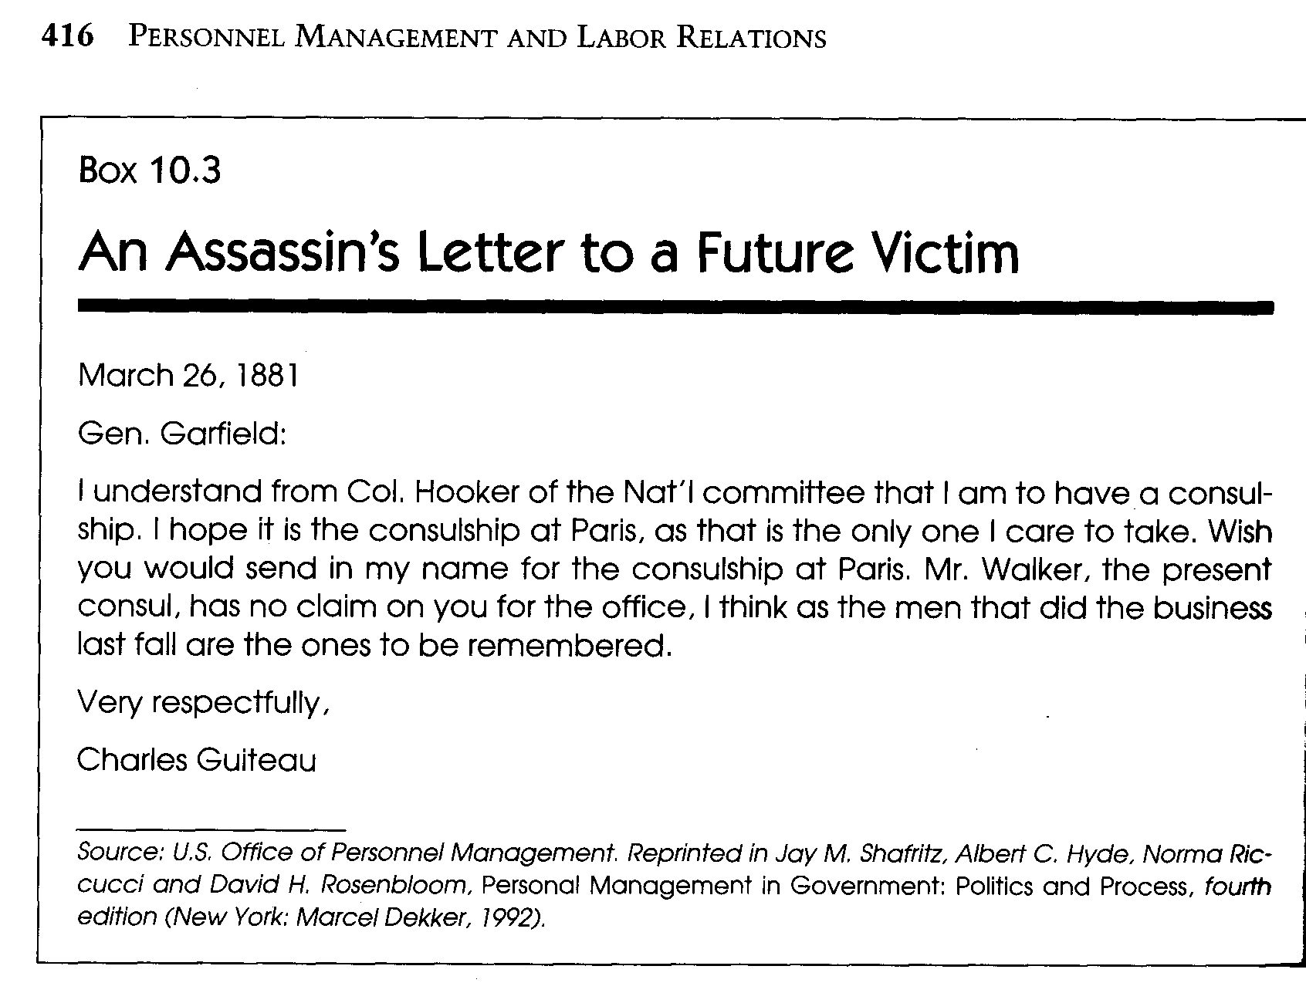
The Pendleton Act

Slide 19
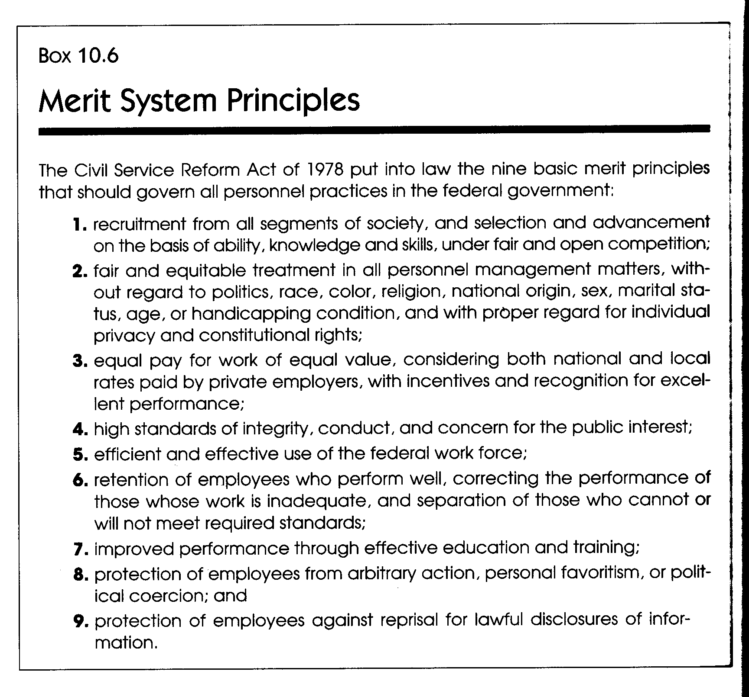
Civil Service Reform Act of 1978

Slide 20
Patronage Appointments
Patronage comes from the word patron. In order to get a “plum” job, you need to have a patron.
The Plum Book: this is the informal name for a publication which comes out after a Presidential election, and lists all the patronage jobs a new president can fill by discretion.
The Constitutionality of Patronage: In Rutan v. Republican Party, the United States Supreme Court ruled that traditional patronage is unconstitutional.
Patronage Firings: Under Elrod v. Burns the Court forbade firings of public employees for not being supporters of the party in power, unless political affiliation was a position requirement.

Slide 21
Veterans Preferences
Veterans merit preferences is the special merit earned by a service man or woman who had honorable military service.
Veterans preference is a variant of patronage that has been in existence since the end of the Civil War, when veterans were given first preference for jobs available in the civil service.
In 1919, this privilege was extended to wives and widows of veterans.
Notes:
Constitutionality of patronage.
Patronage unconstitutional (Rutan v. the Republican Party 1990). Reality: Still exists.
Veteran’s preferences.
First Act 1865, disability.
Superceded in 1919, honorably discharged.
1944, five point bonus on exams.

Slide 22
Public Sector Labor Relations
Unions are groups of employees who create a formal organization (the union) to represent their interests before management.
Labor relations is the term for all of the interactions between the union leaders (representing the employees) and management (representing the corporation or jurisdiction).
Notes:
Reasonable people might be both optimistic and pessimistic about the role of public employee unions.
Pessimistic because of the skill of public employee unions to get crippling pay raises without tradeoff increases in productivity.
Optimistic because unions offer hope of replacing civil service commissions as an instrument for reform of merit and source of leadership in the fight for increased productivity.

Slide 23
Public Sector Labor Relations
Why have the unions been so successful?
They have been better politicians than elected political executives.
  Acceptance of a militant postures arose directly out of civil rights movements and civil disobedience.

Slide 24
Public Sector Labor Relations:
Collective Bargaining
Collective bargaining is a collective term that encompasses the negotiating process to the final goal.
This final goal is the making of the contract between labor and management. The main elements of the contract are:
  Wages
  Hours
  Other conditions of employment
The terms of the public sector model follow the private sector model.
However, no union is equal to the power of management in the public sector—as management is the government and the people as a whole.

Slide 25
Public Sector Labor Relations:
Strikes and other options
A strike is a mutual agreement by workers to a work stoppage. In the past unions used the strike as a powerful tool to attain their goals.
Public opinion began to turn against unions in the latter part of the twentieth century and unions lost their clout in the harsher economic realities of the times.
Strikes have declined in the last decade.
Notes:
A strike is a mutual agreement among workers to a temporary work stoppage to obtain – or to resist – a change in their working conditions.
Considered an essential element in the collective bargaining process.
The use of strikes has declined. Concerns about impact on unstable economy
Workers will not work after a contract has expired.
Union leader is often in a complicated political position. Expectation gap.
A strike may be used as a political weapon against public officials.
Management’s efforts to provoke strikes at a time when unions are relatively weak.
Economic positions of the two sides.

Slide 26
Two Famous Public Strikes
Boston police strike of 1919. Higher wages and right to form a union affiliated with AFL.
Public opposition to compromising public safety sank the strike and set back public sector unionization.
Professional Air Traffic Controllers Organization (1981). (95% went on strike).
Cripple air travel. President Reagan fired all 11,000 controllers. Strike broken by only president who was a labor union leader.

Slide 27
How to break an Impasse without resorting to strikes
An impasse is a condition that exists during labor-management negotiations when either party feels that no further progress can be made toward a settlement unless the process of negotiating changes.
The most common techniques used to break the impasse are mediation and arbitration.

Slide 28
Impasse Resolution
Mediation or conciliation is any attempt by an impartial third party to help settle disputes.
  Mediator has no power but persuasion. Conciliation is more passive, mediation more active.
  the mediator’s suggestions are advisory and may be rejected by both parties.

Slide 29
Impasse Resolution
Arbitration –method of dispute settlement by having an impartial third party (arbitrator) hold a formal hearing and render a decision that may or may not binding on both parties.
  Arbitrator may be an individual or uneven numbered board. May contain representatives of disputants.
  Compulsory arbitration is arbitration under a legal requirement.
  Final or last offer arbitration.
  Binding arbitration frequently used in public sector collective bargaining in place of a strike, but can create problems.
Notes:
Compulsory arbitration is a negotiating process whereby the parties are required by law to arbitrate their dispute. Some state statutes concerning collective bargaining impasses in the public sector mandate that parties who have exhausted all other means of achieving a settlement must submit their dispute to an arbitrator.

Slide 30
Public Sector Labor Relations:
NLRB and FLRA
The National Labor Relations Board was created in 1935 by the National Labor Relations Act to oversee private-sector labor relations.
The Federal Labor Relations Authority was created by the Civil Service Reform Act of 1978. Within this agency is also the Federal Labor Impasses Panel which solves negotiation impasses.
States have their own agencies, called Public Employee Relations Boards (PERBs). Typically their functions are parallel to the NLRB.
Agencies:
  Oversee collective bargaining.
  Make rulings on unfair labor practices.
  Judge legitimacy and scope of bargaining.
  Interpret contracts.
  Make decisions on bargaining units.
  Oversee authorization elections.
  Certify bargaining units.

