Slide 1
Chapter 27
Violence

Slide 2
Overview of Violence
Violence is a national public health problem.
WHO (2013) defines violence as “the intentional use of physical force or power, threatened or actual, against oneself, another person, or against a group or community which either results in or has a high likelihood of resulting in injury, death, psychological harm, maldevelopment, or deprivation.”
Injuries from violence are referred to as intentional injuries.

Slide 3
Factors That Contribute to Violence
Poverty, unemployment, economic dependency
Substance abuse
Dysfunctional family and/or social environment and lack of emotional support
Mental Illness
Media influence (e.g., violent video games, television shows, and movies)
Access to firearms
Political and/or religious ideology
Intolerance and ignorance

Slide 4

History of Violence
Long history of human violence.
  In the Bible, Cain killed his brother Abel out of jealousy and anger
  Audience pleasure (e.g., gladiators in Rome)
  Infanticide—if child was female, a twin, sickly, or deformed
  Children, especially firstborn, sacrificed for religious reasons

Slide 5
History of Violence (Cont.)
Corporal punishment used to control children
  “Spare the rod and spoil the child” (Proverbs, 13:24)
  “Beating some sense into him”
  First legal protection in the United States in 1874
Spousal abuse/marital rape
  “Rule of thumb”
  “Wives be subject to your husband” (Ephesians, 5:22)
  Assault against women not explored until 1960s
Elder abuse
  Often undetected because of lack of awareness of HCP
  Lack of mandatory reporting

Slide 6

Interpersonal Violence
  Crosses all ethnic, racial, socioeconomic, and educational lines
  Interpersonal Violence (IPV) is about control, not anger.
Includes:
  Homicide and suicide
  Intimate partner violence
  Child maltreatment

Slide 7
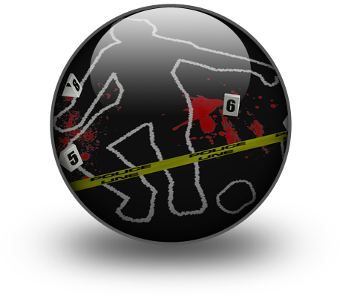
Interpersonal Violence: Homicide
Homicide
  One of the leading causes of death in the United States.
    For black males aged 15 to 34, homicide is the leading cause of death.
  Young people, women, and African American and Hispanic males at higher risk than the general population.
  African Americans were more likely to commit homicide than whites and were more likely to be victims of homicide than whites (2010 data)

Slide 8

Interpersonal Violence: Suicide
  Suicide is 10th leading cause of death for all Americans in all age groups (2010)
  More people die from suicide than homicide.
    Men often use firearms.
    Women use poisoning.
  In Native Americans and Alaska Natives, suicide is the second leading cause of death in persons 15 to 34 years of age.

Slide 9
Interpersonal Violence: Suicide (Cont.)
Risk factors for suicide
  Psychiatric disorders such as major depression, bipolar disorder, and/or schizophrenia
  Substance abuse
  Posttraumatic stress disorder (PTSD)
  Bulimia or anorexia nervosa
  Past history of attempted suicide
  Genetic disposition to suicide
  Age, such as elderly, and white males (highest rate)

Slide 10

Interpersonal Violence: Partner
Intimate partner violence (IPV)
  A pattern of coercive behaviors perpetrated by someone who is or was in an intimate relationship with the victim
  May include battering, resulting in physical injury, psychological abuse, and sexual assault to progressive social isolation and intimidation of the victim
  Typically repetitive and often escalates in frequency and severity

Slide 11

Interpersonal Violence: Partner (Cont.)
Risk factors for IPV
  Low self-esteem
  Poverty
  Risky sexual behavior
  Eating disorders and/or depression
  Substance abuse
  Trust and relationship issues
Victims often suffer in silence and accept abuse as a transgenerational pattern of normal behavior

Slide 12

Interpersonal Violence: Partner (Cont.)
Pregnancy
  May increase stress within the family
  All pregnant women should be routinely screened for abuse for commons sign of IPV
    Delay in seeking prenatal care
    Unexplained bruising or damage to breasts or abdomen
    Use of harmful substances (cigarettes, alcohol, drugs)
    Recurring psychosomatic illnesses
    Lack of participation in prenatal education

Slide 13

Interpersonal Violence: Dating
Abusive, controlling, or aggressive behavior in an intimate relationship that takes the form of emotional, verbal, physical, or sexual abuse
  May involve the use of date rape drugs
  Studies have linked alcohol with dating violence
Stalking—a pattern of repeated and unwanted attention, contact, harassment, or any type of conduct directed at a person that instills fear
Bullying—a repeated oppression, psychological or physical, of a less powerful person by a more powerful person or group of persons

Slide 14
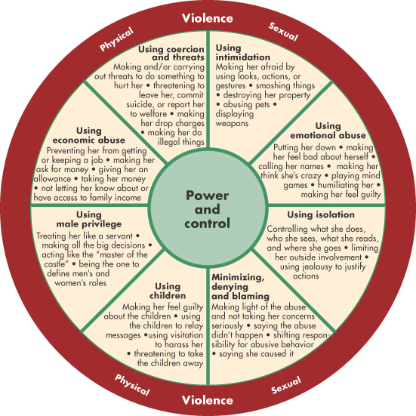
Wheel of Power and Control
Figure 27-1
Developed by the Domestic Abuse Intervention Project. 206 West Fourth Street, Duluth, MN 55806. Used with permission.

Slide 15
Impact of Interpersonal Violence
Victims often experience…
  Chronic fatigue and tension
  Disturbed sleeping and eating patterns
  Vague gastrointestinal and genitourinary complaints
Misdiagnosis often occurs because of the obscurity of symptoms and/or failure to adequately assess
Victims stay in abusive relationships because of cultural, religious, and economic factors

Slide 16
Impact of Interpersonal Violence (Cont.)
Victims who are most likely to leave a battering situation:
  Have resources and power
  No children
  No personal history of abuse (themselves or their mother)
Most dangerous time for victim is when he or she leaves or attempts to leave the relationship
  More likely to be killed at this time than any other time in the relationship

Slide 17

Interpersonal Violence: Child
Child maltreatment
  Most child maltreatment occurs within the family.
  More often abused by parents than other relatives or caregivers.
  More commonly seen in families in poverty, families in disorganization, or with parents who are younger and who are substance abusers.

Slide 18
Interpersonal Violence: Child (Cont.)
Child maltreatment
  Risk factors include but are not limited to
    Special needs children
    Children less than 4 years of age
    Family history of violence
    Substance abuse
    Poverty
    Social isolation

Slide 19
Interpersonal Violence: Child (Cont.)
Child maltreatment
  Four types of child abuse:
    Neglect
    Physical abuse
      Includes beating, burning, biting, and bruising
      Abusive head trauma/shaken baby syndrome is leading cause of death in the United States from abuse
    Emotional abuse
    Sexual abuse

Slide 20
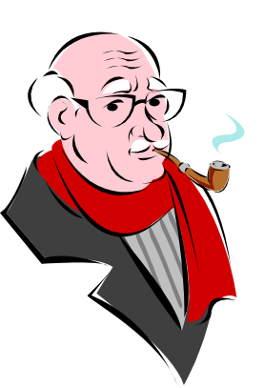
Interpersonal Violence: Elderly
Elder abuse
  Society fails to recognize the cruelty many older adults experience.
    Elders are an “invisible” segment of the population.
  Reasons for underreporting of elder abuse
    Shame on part of victim
    Social and physical isolation from resources
    Failure of health care provider to routinely assess during points of contact
    No uniform reporting system

Slide 21
Interpersonal Violence: Elderly (Cont.)
Elder abuse
  Types of abuse and neglect
    Physical abuse
    Psychological-emotional abuse
    Sexual abuse
    Neglect
    Financial exploitation
    Health care fraud and abuse

Slide 22

Community Violence
Community violence usually occurs suddenly and without warning and can potentially destroy entire segments of the population
Community violence includes
  Workplace violence
  Youth violence
  Gang-related violence
  Hate crimes
  Terrorism

Slide 23

Community Violence: Workplace
Workplace violence includes physical assaults, muggings, and verbal and written threats
Risk factors include:
  Increasing number of acute and chronically mentally ill patients
  Working alone
  Availability of drugs at worksite
  Low staffing levels
  Poorly lit parking areas and corridors
  Long waits for service
  Inadequate security
  Increasing number of substance abusers
  Access to firearms

Slide 24

Community Violence: Youth
Youth-Related Violence
  Concentrated in minority communities and inner cities, causing a disproportionate burden on these communities
  Adolescents and youth increasingly use violence to settle disputes.
  Even when taught peaceful ways of resolving differences, learn by what they observe at home, on television, and in movies.
  Schools have become common sites for violence.

Slide 25
Risk Factors for Youth Violence
(from Textbook, Table 27-3)
Individual Risk Factors | Community Risk Factors
Involvement with drugs, alcohol, or tobacco | Diminished economic opportunities
Antisocial beliefs and attitudes | High concentration of poor residents
Low IQ | High level of family disruption
History of violent victimization | Low levels of community participation
History of early aggressive behavior | Socially disorganized neighborhoods

Slide 26
Risk Factors for Youth Violence
(from Textbook, Table 27-3—Cont.)
Individual Risk Factors | Community Risk Factors
Attention deficits, hyperactivity, or learning disorders | High level of transiency
Poor behavioral control
Deficits in social, cognitive or information-processing abilities
Exposure to violence and conflict in the family
High emotional distress
History of treatment of emotional problems

Slide 27
Risk Factors for Youth Violence
(from Textbook, Table 27-3—Cont.)
Family Risk Factors | Peer/Social Risk Factors
Poor family functioning | Association with delinquent peers
Low emotional attachment to parents of caregivers | Involvement in gangs
Low parental education and income | Social rejection by peers
Parental substance abuse or criminality | Lack of involvement in conventional activities
Poor monitoring and supervision of children | Poor academic performance
Harsh, lax, or inconsistent disciplinary practices | Low commitment to school and school failure
Authoritarian childrearing practices

Slide 28

Community Violence: Gangs
Reasons that young people join gangs:
  Believe that gangs will protect them
  Peer pressure
  The need for respect
  A sense of belonging
Increasingly responsible for crimes and violence throughout the United States
  Crimes include illegal alien smuggling, armed robbery, assault, auto theft, drug and weapon trafficking, identity theft, and murder.

Slide 29

Community Violence: Prison
Prison violence
  The United States has one of the world’s
  highest rates of incarceration
  Inmates are both victims and perpetrators of violence.
  Includes allegations of physical abuse and reports of rape by corrections officers and inmates
  Little sympathy for this population for a variety of reasons, including indifference, disbelief, and denial

Slide 30

Community Violence: Trafficking
Human trafficking is a global problem and a public health issue.
Involves:
  Prostitution
  Sexual exploitation
  Forced labor
  Slavery
  Removal of organs

Slide 31
Community Violence: Hate Crimes
Crimes in which offender is motivated by
  An individual’s race*¹
  Sexual orientation*³
  Religious beliefs*²
  Ethnic background
  National origin
*Rank—most commonly reported
Hate crimes may include
  Murder
  Rape
  Sexual or physical assault
  Harassment
  Attacks on homes or on places of worship
  Vandalism

Slide 32
Community Violence: Terrorism
“The calculated use of unlawful violence or threat of unlawful violence to inculcate fear; intended to coerce or to intimidate governments or societies in the pursuit of goals that are generally political, religious, or ideological.”
(Department of Defense)
All terrorist acts include at least three key elements—violence, fear, and intimidation.

Slide 33

Factors Influencing Violence
Firearms
  A gun in the home…
    …triples the risk for homicide in the home
    …increases the risk for suicide 3 to 5 times
    …increases risk for accidental deaths by 4
  Firearms are the number one weapon of choice in homicides in the United States.
  Direct and indirect costs are staggering.
  “Right to bear arms” arguments persist.

Slide 34
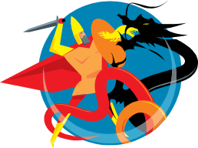


Factors Influencing Violence (Cont.)
Media violence includes exposure to and participation in …
  …violent video games
  …music and music videos that depict date rape or violence
  …virtual violence that allows subscribers to harm or kill victims
Repeated exposure to media violence leads to emotional desensitization to real-life violence

Slide 35
Factors Influencing Violence (Cont.)
Mental illness is considered by many to be a major factor in violence.
  Studies are inconclusive that all violence is committed by mentally unstable persons.
Increasing push for legislation to fund public health strategies that identify and treat mental illness across the country
  Funding issues have forced states to eliminate or reduce availability of mental health services

Slide 36

Violence Is a Public Health Epidemic
The public health system is challenged to go beyond its traditional programs to include prevention and management of violence.
Efforts being made with
  Public health strategies
  Community approaches
  Local, state, and federal governments
Addressed by Healthy People 2020

Slide 37

Prevention of Violence: Primary Prevention
Goal: to stop violence, abuse, or neglect before it occurs
Education may include life skills training:
  Parenting and family wellness
  Anger management
  Conflict resolution
Nurses should:
  Increase awareness of violence
  Identify cases
  Work with the community

Slide 38
Prevention of Violence: Primary Prevention (Cont.)
Must begin at community level to change attitudes
Focuses on stopping transgenerational aspect of abuse
  Start with young children
  Continue across the lifespan
Mentoring and peer programs to promote healthy relationships and decrease conflict
Work with high-risk individuals

Slide 39

Prevention of Violence: Secondary Prevention
Goal: assess, diagnose, and treat victims and perpetrators of violence.
  Consideration of safety of potential victim is critical
Begins with assessment
Once identified, victims must be offered…
  Resources to increase their safety
  Legal options and how to access them

Slide 40
Prevention of Violence: Secondary Prevention (Cont.)
Nurses must screen for abuse. Ask questions
  Within the last year, have you been hit, slapped, kicked, or otherwise physically hurt by someone?
  Since you’ve been pregnant, have you been hit, slapped, kicked, or otherwise physically hurt by someone?
  Within the last year, has anyone forced you to have sexual activities?
Intervene when essential
Interdisciplinary approach leads to optimal outcomes.

Slide 41
Prevention of Violence: Tertiary Prevention
Goal: Aimed at rehabilitation of individuals, families, groups, or communities and includes both victims and perpetrators of violence
May take months or even years
Nurses must work in conjunction with a variety of mental health professionals and social service agencies to provide coordinated care
  Self-care and recognition of own limitations and needs

