Slide 1
Chapter 26
Substance Abuse

Slide 2
More deaths, illnesses, and disabilities are attributed to substance abuse than to any other preventable health conditions in the United States.
– Substance Abuse and Mental Health
Services Administration (SAMSHA)

Slide 3
Social Consequences of Substance Abuse
Crimes while under the influence of drugs, alcohol, or both
Need for money to buy substances
Specific theft of drugs
Almost 75% of inmates report prior drug use
All aggregates in society are potentially affected by substance abuse problems regardless of age or economic level

Slide 4
Etiology of Substance Abuse
Numerous theories try to explain it
  Combination of many factors
  Genetics within families
  Individual (impulsivity and ease of disinhibition)
  Environmental factors
  Medical models
  Biopsychosocial models

Slide 5

Historical Overview of Alcohol and Illicit Drug Use
Alcohol use has gained more social acceptance than other drug use.
Public attitudes and governmental policies have also influenced the history of illicit drug use.

Slide 6
Historical Overview of Alcohol and Illicit Drug Use (Cont.)
Consumption and laws affected by:
  Alcohol-related deaths after lowered drinking age
  Less tolerant national attitudes toward drinking
  Increased societal and legal pressures and actions against drinking and driving
  Increased health concerns among Americans
  Knowledge of addictive properties
  Counterculture acceptance of hallucinogens, cannabis, and heroin
  The “War on Drugs”
  Renewed interest in prevention/treatment efforts

Slide 7
Laws Impacting Substance Abuse
Anti–Drug Abuse Acts of 1986 and 1988
  Increased funding for treatment and rehabilitation
  Created the Office of National Drug Control Policy (“drug czar”)
  Worked on a public health approach to drug control
National Institute on Drug Abuse (NIDA)
  Science on drug abuse and addiction
    Prevention
    Treatment
    Decreasing the spread of HIV/AIDS
    Other priority areas

Slide 8
Laws Impacting Substance Abuse (Cont.)
Substance Abuse and Mental Health Services Administration (SAMHSA)
  Builds and sustains programs, policies, information and data, contracts, and grants toward helping the nation act on the knowledge that promotes behavioral health treatment through all levels of prevention

Slide 9
Prevalence, Incidence, and Trends
Alcohol use by persons aged 12 or older:
  Slightly more than half (52.8%) drink alcohol
  Binge drinking at least once in prior 30 days— (22.6%)
  Heavy drinking—6.2%
  Young adults ages 18-25 had highest prevalence of binge and heavy drinking—39.8%
  Drove under the influence of alcohol at least once in past year—11.1%
– SAMHSA (2011)

Slide 10
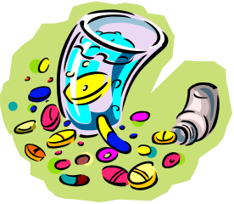
Prevalence, Incidence, and Trends (Cont.)
Illicit drug use by persons aged 12 or older:
  About 8.7% were current drug users, used an illicit drug during the past month
Illicit drugs used
  Marijuana was the most commonly used drug
  Others included cocaine (including crack), heroin, hallucinogens, inhalants, or prescription-type psychotherapeutics (pain relievers, tranquilizers, stimulants, and sedatives) used nonmedically
– SAMHSA (2011)

Slide 11
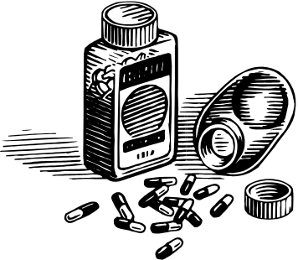
Prevalence, Incidence, and Trends (Cont.)
Nonmedical use of prescription-type psychotherapeutics
  There is a significant increase in the lifetime nonmedical use of pain relievers—specifically Percocet®, Percodan®, Vicodin®, Lortab®, Darvocet®, Darvon®, Tylenol® with Codeine, Propoxyphene, or Codeine Products, Oxycodone, and Hydrocodone
  – NIDA (2010)

Slide 12
Prevalence, Incidence, and Trends (Cont.)
Hallucinogen, inhalant, and heroin use
  LSD (d-lysergic acid diethylamide)
  Peyote cactus
  Psilocybin
  PCP (phencyclidine)
  Inhalants of choice are amyl nitrite, “poppers,” followed by glue, shoe polish, or toluene; correction fluid, degreaser, or cleaning fluid; gasoline or lighter fluid; and spray paints and other aerosols.

Slide 13
Prevalence, Incidence, and Trends (Cont.)
Gender difference
  Males more likely to be current illicit drug users
  Female illicit drug use (12 and older) increasing
Geographic trends
  Highest in West > Midwest > Northeast > South
Racial/ethnic groups
  Highest among American Indians or Alaska natives > African Americans> whites > Hispanics > Asians
– SAMHSA (2010)

Slide 14
Trends in Substance Abuse
May or may not relate to classically or clinically defined dependence or addiction.
Many are turning to recovery before they have developed physiological dependence.
Need to differentiate between use and misuse/abuse.
Use of harmful substances is indirectly and directly related to all of the leading health indicators targeted in Healthy People 2020.

Slide 15
Methamphetamine (MA)
Most widely produced controlled substance in the United States.
Illegal street names of the drug (crank, crystal, meth, ice, or glass).
Can be injected, inhaled, taken orally, or smoked.
Used predominantly by white young persons, with an overrepresentation of females.

Slide 16
Methamphetamine (MA) (Cont.)
Pleasurable effects are caused by the release of high levels of dopamine in the brain, leading to increased energy, a sense of euphoria, and increased productivity.
  Short-term effects: increased heart rate, insomnia, excessive talking, excitation, and aggressive behavior
  Prolonged use results in tolerance and physiological dependence
Negative consequences range from anxiety, convulsions, and paranoia, to brain damage.

Slide 17
Methamphetamine (MA) (Cont.)
The impact of MA abuse on communities, families, and social networks is considerable.
  Young children of users are at risk for abuse and neglect.
  Prenatal use puts children at risk for developmental problems, aggression, and attention disorders.
  Exposure to combustible second-hand fumes.
  Associated with increased incidence of violence (e.g., domestic abuse, homicide, and suicide)

Slide 18

Steroids
Anabolic steroids are synthetic variants of male sex hormone testosterone
  Build muscle and said to be androgenic
  Most commonly used in athletes and other individuals willing to risk potential and irreversible health consequences to build muscle
Potentially fatal risks
  Blood clots, liver damage, premature cardiovascular changes, increased cholesterol
  Increased potential for suicide and aggressive and risky behaviors

Slide 19

Inhalants
Contain volatile components with psychoactive properties
  Many products found in home or workplace (e.g., spray paints, markers, glues, and cleaning fluids)
Produce a rapid high that may resemble alcohol intoxications; may progress to loss of sensation and even unconsciousness
Irreversible effects:
  Hearing loss, limb spasms, CNS or brain damage, or bone marrow damage; may result in death from heart failure or suffocation

Slide 20
Adolescent Substance Abuse
Highest prevalence of illicit drug use during lifetime between 18 and 25 years
  Teen use of cigarettes and smokeless tobacco has declined
  Nearly half of teens try marijuana before they graduate—skepticism about drug’s danger
As harmful, illicit substances come in and out of vogue, CHN needs a good understanding of drug culture, terminology, and differing signs and symptoms

Slide 21
Conceptualizations of Substance Abuse
Conceptualizations have changed over the years, often for political and social reasons rather than for scientific reasons.
“Dependence” or “abuse”
What substances can be abused?
  APA focuses on alcohol, amphetamines, caffeine, cannabis, cocaine, hallucinogens, inhalants, nicotine, opioids, phencyclidine, sedatives, and hypnotics or anxiolytics

Slide 22
Defining Substance Abuse
Substance abuse: a maladaptive pattern of substance use that is manifested by recurrent and significant adverse consequences related to repeated use of a substance.
  Failure to fulfill major role obligations
  Repeated use in physically hazardous situations
  Multiple legal problems
  Recurrent social and interpersonal problems

Slide 23
Defining Substance Abuse (Cont.)
Dependence: a cluster of cognitive, behavioral, and physiological symptoms that indicate continued use of the substance despite significant substance-related problems
  Pattern of repeated, self-administered use
  Tolerance, withdrawal, and compulsive drug-taking behaviors
  A craving or strong desire for the substance
  Preoccupation with supply, money to purchase, and getting through time between periods of use

Slide 24
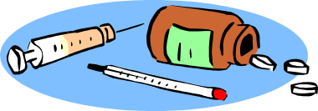
Sociocultural and Political Aspects of Substance Abuse
Determined largely by economic, cultural, and political conditions of potential users
Cultural conditions create ambiguity in clearly determining when a problem exists.
Competing value systems lead to cultural disintegration and a sense of powerlessness and hopelessness.

Slide 25
Course of Substance-Related Problems
Path from initiation to dependency is multidimensional.
  Person + substance + context/environment
Progression varies—from initiation to continuation, transition to abuse, and finally, addiction and dependency
Critical point is transition from use to abuse
Addiction/dependency marked by changes in both behavior and cognition
Once addiction is established, withdrawal symptoms are strong motivators to continue use

Slide 26
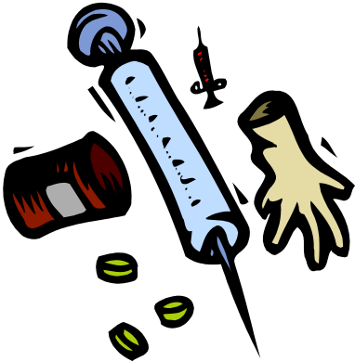
Legal and Ethical Concerns
U.S. policy based on prohibition and criminal sanctions against use and sale of illicit drugs
  Criminal activities (violence and drug trafficking)
  Drinking and driving, working while intoxicated
  Impact on fetus (FAS)
Modes of intervention
  Limit access
  Media campaigns
  Educational programs
  National organizations that promote community education, research, and support

Slide 27

Prevention Strategies
Primary prevention
  Needs assessment to identify high-risk situations and potential problems
  Decriminalization and legalization of drugs(?)
  Community-based programs
  Training of health professionals
  Faith-based initiatives
  Volunteer consumer groups
  Organized sports programs
  Employer programs
Often overshadowed by “War on Drugs”

Slide 28
Prevention Strategies (Cont.)
Secondary prevention
  Screening and finding resources
    CAGE: an alcoholism screening test
    Clinical Institute Withdrawal Assessment (CIWA)
    Use evidence-based programs
  Efforts should be specific to aggregates, rather than directed at the “general public”
  Incorporate culturally sensitive and appropriate interventions and strategies
  Work toward improving individuals’ general competencies, communication skills, and self-esteem

Slide 29

Treatment
For individuals, consider:
  Cultural and educational background
  Resources of the person
  Attitudes of significant others
  Degree of invasiveness of the effects of the substance use The existence of alternatives
  Relapse prevention

Slide 30
Treatment (Cont.)
Inpatient and outpatient treatment programs
  May or may not include detoxification component
  Voluntary vs. compulsory
  Pharmacologically based vs. drug free
  Treatment approaches and models vary
Assessment process is of primary importance.
Therapeutic relationship based on trust is essential.
Physical examination is a valuable tool.
Nonjudgmental attitude minimizes defensiveness.

Slide 31
Treatment (Cont.)
Programs usually include:
  Group and individual therapy and counseling
  Motivational interviewing
  Family counseling
  Education
  Socialization into 12-step mutual self-help groups
  Integrate psychotherapy with pharmacotherapy
  May include other strategies:
    Hypnosis, occupational therapy, confrontation, assertiveness training, blood alcohol level discrimination training, behavior modification approaches

Slide 32
Treatment (Cont.)
Pharmacotherapies
  Used in detoxification, stabilization, maintenance, as antagonists, and as treatment for coexisting disorders
Mutual help groups
  Operate through face-to-face supportive interaction focusing on a mutual goal; AA was first
Harm reduction
  Elimination of the more harmful effects of substance use through behavior and policy modifications

Slide 33
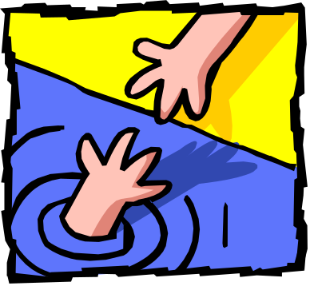
Social Network Involvement
Therapy that involves the family has proved to be most effective in aiding recovery.
Family and friends
  Highly influential or aid and abet
  Codependency and enabling
Effects on the family
  Functional or dysfunctional families
  Psychological and financial burdens
Professional enablers
  Treatment of symptoms by medication
  Reluctant to bring up this taboo subject

Slide 34
Vulnerable Aggregates: Preadolescents and Adolescents
Times of experimentation, searching, confusion, rebellion, poor self-image, alienation, and insecurity
Use of legal substances (e.g., tobacco, alcohol) almost always precedes use of illegal drugs.
Poor school performance and drug use among peers are strongest predictors of subsequent drug involvement, followed by lack of strong family bond.
The younger the initiation, the greater the probability of prolonged and accelerated use.
Feeling of powerlessness; selling drugs seen as a viable economic solution to poverty.

Slide 35
Vulnerable Aggregates: Preadolescents and Adolescents (Cont.)
Primary prevention focuses on:
  Advocating for these vulnerable children
  Educating teachers on the vital importance of maintaining a validating, nonjudgmental attitude toward these students
  Supporting strong families in the community
  Improving knowledge through education and media
  Early detection of predisposing factors
  Providing structured clubs and organizations
  Facilitating school success, career skills, family communication skills, and conflict resolution

Slide 36

Vulnerable Aggregates: Elderly
Elderly experience
  Diminished physiological tolerance
  Increased use/misuse of medically
  prescribed drugs
  Cultural and social isolation
Misuse of prescription drugs may be the most common form of drug abuse among the elderly
  Use prescription medications approximately three times as frequently as general population

Slide 37

Vulnerable Aggregates: Women
Alcohol use and abuse affects women much differently than men.
Women absorb and metabolize alcohol differently.
  Body composition differences and production of less gastric alcohol dehydrogenase
  Metabolize alcohol at a different rate

Slide 38
Vulnerable Aggregates: Women (Cont.)
Increased risk stems from economic, social, and cultural factors.
  Marginalization of certain groups
  History of child abuse
  Physical and medical problems related to reproductive systems
  Use during pregnancy has long-term developmental consequences for the newborn

Slide 39
Vulnerable Aggregates: Ethnocultural Considerations
African Americans, Hispanics, and Native Americans—increased risk for substance abuse.
  Economically disenfranchised groups
  Discrimination and racism
  Socioeconomic, political, and historical realities
  Myths and stereotypes
  Social support—positive effect on treatment/outcome
  Environmental cues and conditioned reinforcement
Treatment poses special challenges.

Slide 40
Vulnerable Aggregates: Other Aggregates
Substance abuse is most common psychopathological problem in the general population.
  Dual-diagnosis individuals
    Psychiatric disorder + substance abuse disorder
  Risk for multiple vulnerabilities in one individual
  Impact of substance abuse on STDs
  Substance abuse among health care professionals

Slide 41
Nursing Interventions in the Community
Understand own experiences and prejudices.
Routinely assess substance use patterns when performing client histories.
Be alert to environmental cues in the home that indicate substance abuse.
Increase the individual’s and family’s awareness of the problem.
Involve the social network in getting the client into treatment.
Develop a caring nursing relationship.

Slide 42
Other Traditional Nursing Roles and Interventions
Health teaching regarding addictive illness and addictive effects of different substances
Advocating that EBP treatment works in special populations through problem-solving courts (drug courts), specialized adolescent treatment, and other community case management programs.
Providing direct care for abuse- and dependence-related medical problems
Educating clients and families about problems related to substance abuse
Collaborating with other disciplines to ensure continuity of care

Slide 43
Other Traditional Nursing Roles and Interventions (Cont.)
Coordinating health care services for the client to prevent prescription drug abuse and avoid fragmentation of care
Providing consultation to nonmedical professionals and lay personnel
Facilitating care through appropriate referrals and follow-up
Knowing how to use community resources for working with substance abuse, mental health, and other issues

