Slide 1
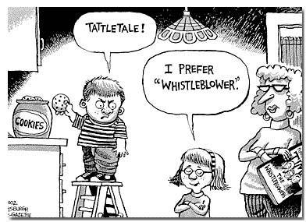
Whistleblower Law

Slide 2

WHISTLEBLOWER PROTECTION UNDER SARBANES-OXLEY ACT (“SOX”)

Slide 3
Sarbanes–Oxley Act (“SOX”) Whistleblower Protection
18 US Code s. 1514A
The “SOX” Act of 2002 significantly protects corporate whistleblowers
The act provides legal protection for discharged employees
Publicly traded companies have to have a system for reporting whistleblower complaints internally
Retaliation against whistleblowers is actionable by law
The whistleblowers can file complaints with the U.S. Department of Labor in case of retaliation
Employees who win in SOX cases are entitled to "make whole" remedy which includes employee reinstatement, back pay and attorneys fees as well as additional damages (emotional distress), but no punitive damages.
Discrimination complaints should be filed with the Department of Labor (DOL) within 90 days of the discriminatory act

Slide 4
Whistleblower Provisions of Sarbanes-Oxley
Taking a harmful action against any person to retaliate is unlawful
If an employee loses a civil whistleblower case, s/he may be liable in subsequent legal proceedings
Anyone who retaliates against a whistleblower is liable under the Securities Exchange Act of 1934
SOX’s § 3(b) empowers broadly the SEC and the Department of Justice to enforce the Act’s provisions in civil and criminal cases
SOX offers a general framework for protection of employees (including auditors and attorneys) who disclose useful information of law violation, even if it may hurt investors.

Slide 5
Dodd-Frank: Wall Street Reform and Consumer Protection Act of 2010
The Dodd Frank act amended the Securities Exchange Act of 1934 by § 21F (securities whistleblower incentives and protection)
§ 21F allows the SEC to give monetary awards to individuals who provide original information that leads to successful SEC enforcement action
The SEC established the office of the whistleblower within the SEC's division of Enforcement
The Dodd-Frank Act and the SEC also implemented regulations to prohibit retaliation towards whistleblowers

Slide 6

SEC’s Office of the Whistleblower
Office of the Whistleblower established under Dodd-Frank to protect whistleblowers
Whistleblowers can help Securities and Exchange Commission to identify fraud and other law violations sooner rather than later
By early detection of fraud, the harm to investors can be minimized
The SEC can provide monetary awards for people who report original information leading to SEC's enforcement action

Slide 7
15 U.S. Code § 78u–6, Securities whistleblower incentives and protection
Covered judicial or administrative action – Brought by the Commission resulting in more than $1 million in monetary sanctions (instituted by Dodd-Frank, 2010)
Investor Protection Fund – established by the SEC for awards if “original information” is provided by whistleblowers, set up in 2012
For voluntarily provided original information to the Commission, leading to covered judicial or administrative action
  The awards are between 10% and 30% of the total collected monetary sanctions
  The determination of the award is at the discretion of the SEC
Awards cannot be given to a whistleblower who is an employee or officer of a:
  Regulatory agency
  The Department of Justice
  A self – regulatory organization
  The Public Company Accounting Oversight Board (PCAOB)

Slide 8
15 U.S. Code § 78u–6 (cont.)
Required reports to Congress
Each year the SEC needs to submit to the Committee on Banking, Housing, and Urban Affairs of the Senate, and the Committee on Financial Services of the House of Representatives the following reports:
  The whistleblower award program
  Description of granted awards
  The type of cases receiving awards
  The balance of the Fund at the beginning of the preceding fiscal year
  The amounts deposited into the fund
  The amount of earnings on investments
  The amount paid from the fund to whistleblowers
  The balance of the Fund at the end of the fiscal year
  Audited financial statements such as
  A balance sheet
  Income statement, and
  Cash flow analysis

Slide 9
Prohibition against retaliation under DODD-FRANK
Employers cannot suspend, harass, or discriminate against whistleblowers
Enforcement
  A whistleblower who alleges discrimination may bring an action in the appropriate District Court of the United States
Relief
  Reinstatement with the same status
  Double amount of back pay owed the individual
  Compensation for legal costs and expert witness fees
Confidentiality
  The Commission should not disclose information provided by whistleblower if this information could reveal whistleblower’s identity
Information can be shared with:
  The Attorney General of the United States
  And not appropriate regulatory authority
  A foreign securities authority
  A foreign law enforcement authority

Slide 10
18 U.S. Code § 1514A: SOX
Civil action to protect against retaliation in fraud cases
Public companies registered under section 12 of the Securities Exchange Act of 1934 cannot discriminate against employees in terms and conditions of employment because of a lawful act performed by employee:
  When an employee provides information, or assists in investigation regarding an unlawful conduct within the company
When employee reasonably believes that there is a violation of 18 U.S. Code:
  § 1341 (frauds and swindlers),
  § 1343 (mail fraud),
  § 1344 (Bank fraud), or
  § 1348 (securities and commodities fraud), or
  Any rule or regulation of the SEC or any provision of Federal Law relating to fraud against shareholders

Slide 11
SEC Summary on Whistleblower Program
Total awards by the SEC – between 2012 and December 2018, more than $387 million to 66 whistleblowers
About 28,000 tips. This gives a success rate of 2 per thousand, and an expected (average) payout of about $13,800 per tip.
SEC had successful enforcement actions resulting in over $584 million in financial sanctions
More than $346 million in disgorgement of illegal gains
Critical aspect of the whistleblower program is strong enforcement of anti-retaliation protections
In 2018 the SEC received 5,282 tips representing a 76% increase over the number of tips received in 2012
The SEC brought actions against companies for retaliating against employees or obstructing (through severance agreements) their employees ability to report to the SEC
Approximately 65% of the whistleblowers have been insiders of the company

Slide 12
Examples of whistleblower awards
The SEC has awarded more than $387 million to 66 whistleblowers since issuing its first award in 2012:
SEC Announces Its Largest-Ever Whistleblower Awards March 19, 2018
Former Company Insider Earns More Than $4.1 Million for Whistleblower Tip Dec. 5, 2017
More Than $16 Million Awarded to Two Whistleblowers Nov. 30, 2017
SEC Announces Whistleblower Award of More Than a Million Dollars Oct. 12, 2017
SEC Announces Whistleblower Award of More Than $1.7 Million July 27, 2017
SEC Announces $2.5 Million Whistleblower Award July 25, 2017
Whistleblower Award of More Than Half-Million Dollars for Company Insider May 2, 2017
SEC Awards Nearly $4 Million to Whistleblower April 25, 2017
Source: https://www.sec.gov/whistleblower

Slide 13
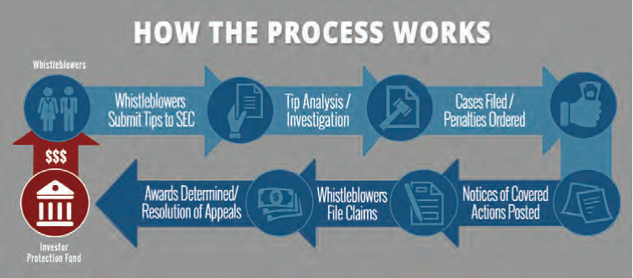

Slide 14
Example Companies fined in Whistleblowing Cases
International Game Technology (IGT) – paid $500,000 for firing an employee who reported to the SEC and senior management that the company's financial statements might be fraudulent
Anheuser-Bush InBev SA/NV – paid for violation of the Exchange Act by entering into a separation agreement with an employee discouraging the employee from communicating with the SEC by threatening the employee with a large financial penalty
BlueLinx Holdings, Inc. agreed to pay $265,000 penalty for using language in severance agreements that required terminated employees to waive their rights to monetary recovery if they filed a complaint with the SEC
Merrill Lynch paid $415 million to settle charges that it violated customer protection rules and prevented employees from providing information to the SEC in severance agreement language

Slide 15
Recent Whistleblower Legal Developments
Until recently, the federal Courts of Appeals were divided on the issue whether the Dodd-Frank anti-retaliation provisions apply to individuals
  Who report only internally potential violations of the securities laws or
  Only to those individuals who report directly to the SEC
Historically, SEC interpreted the statute to prohibit retaliation against a whistleblower who raises concerns internally within the company but who does not actually contact the SEC.
SEC encouraged district and appellate courts to accept the SEC rule protecting individual whistleblowers (“Chevron Deference”) who reported violation of securities laws to their employer regardless of whether they reported it to the SEC
  If individuals are not assured that they are protected when reporting internally purported violation, they will not report
  This will undermine the internal compliance program role in assisting the SEC
    To prevent
    To detect
    To stop securities law violations
  BUT – see next Page:

Slide 16
  The United States Supreme Court rejected that interpretation in
  Digital Realty Trust, Inc. v. Somers, No. 16-1276, 2018 WL 987345
  (Feb. 21, 2018).
  The Court in Somers decided that the protection only extends to those who actually report to the SEC . This is in contrast to Sarbannes-Oxley, which required whistleblowers to first report “up the ladder” and go to the SEC only if internal complaints were “exhausted” with no response.
  See commentary: https://www.scotusblog.com/2018/02/opinion-analysis-whistling-work-whistling-wind-dodd-frank-whistleblowers-need-inform-sec/ https://www.bizjournals.com/boston/news/2019/03/06/viewpoint-u-s-whistleblower-law-should-be-amended.html (by J. Stodder)

Slide 17
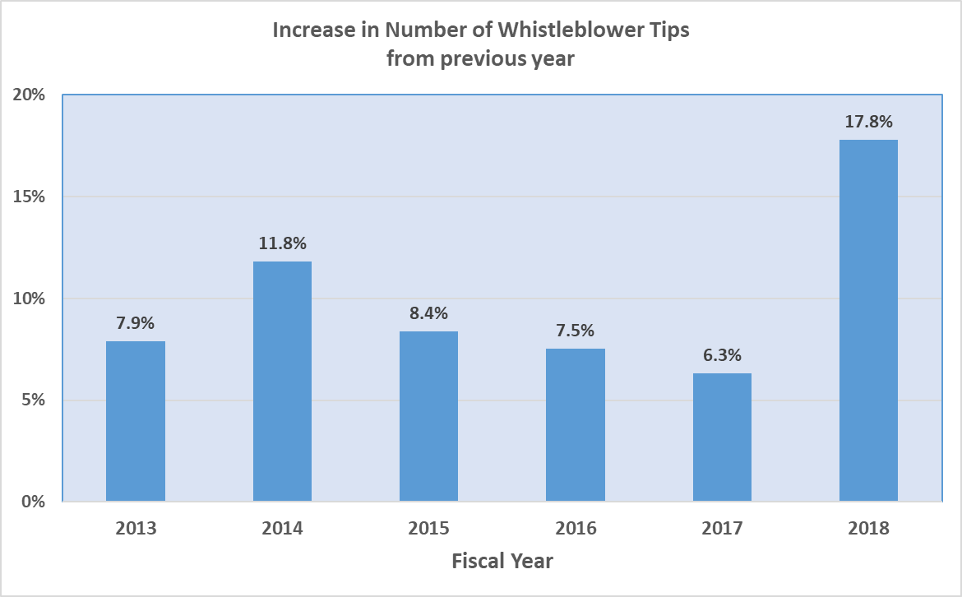
Impact of Digital Realty v. Sommers
https://www.sec.gov/sec-2018-annual-report-whistleblower-program.pdf

Slide 18
Whistleblower-Plaintiff’s Law Firms:
https://www.jeffreynewmanlaw.com/
https://attorneys.superlawyers.com/whistleblower/massachusetts/boston/

Slide 19
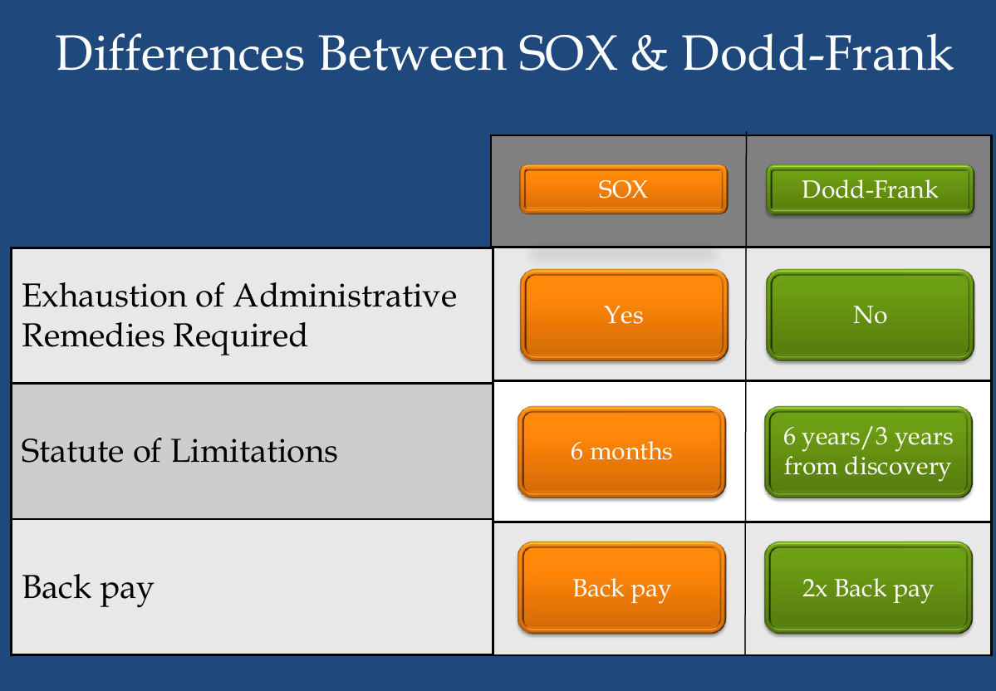

Slide 20
OVERVIEW OF IMPACT

Slide 21
Whistleblower allegation types reported in 2016
Corporate disclosures and financials (938)
Offering Fraud (646)
Manipulation (472)
Insider Trading (262)
Trading and Pricing (257)
FCPA (Foreign Corruption Practices Act) (238)
Unregistered offerings (143)
Market event (102)
Municipal securities and public pensions (67)

Slide 22
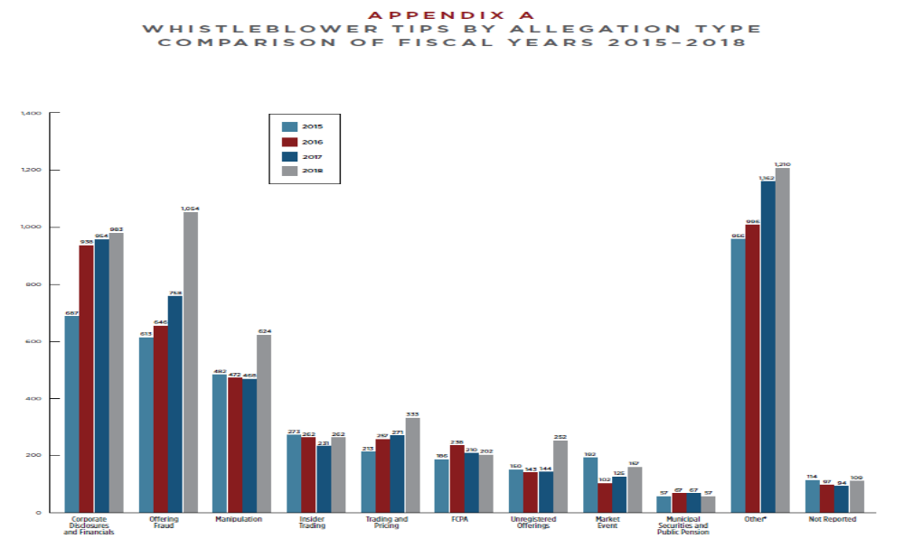
Whistleblower tips by allegation type (2015-2018)

Slide 23
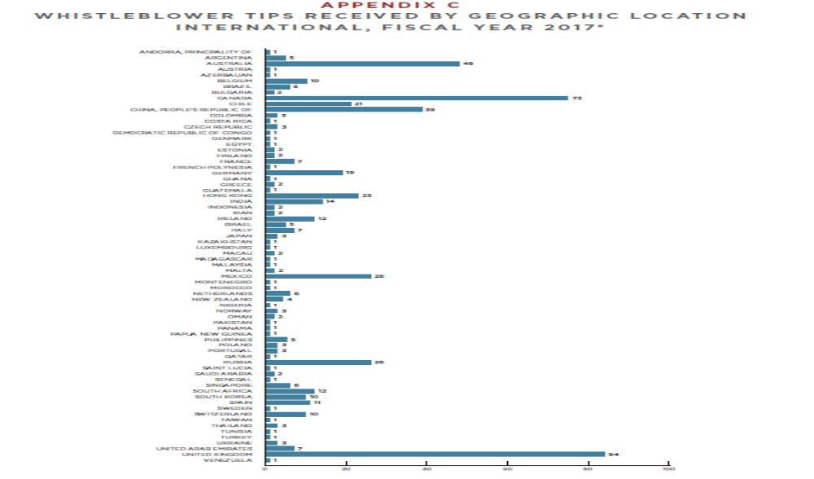
Whistleblower tips from international sources (2017)
(UK, Canada, Australia, China, Mexico – in that order)

Slide 24
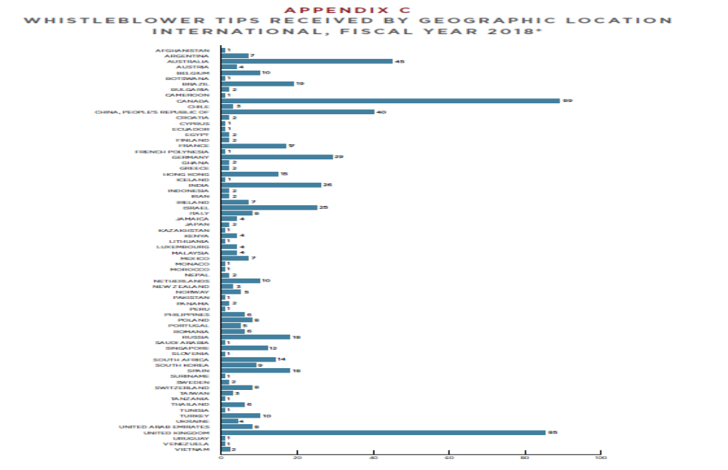
Whistleblower tips from international sources (2018)
(Canada, UK, Australia, China, Germany – in that order)

Slide 25


Slide 26
Challenging Employee or Whistleblower?
A long-term employee was passed over for a promotion.
Within days, she sends a letter raising concerns about various accounting practices related to mutual fund accounting. First she writes that she the differences could be a matter of opinion...
But she later writes more letters saying that the company is committing fraud.
Employee is in the finance group but claims to be performing a compliance/oversight role as it relates to mutual fund accounting.
The company investigates each allegation the employee makes and comes to the conclusion that there is no fraud.
The employee continues to escalate concerns and continues to make more allegations that she says amount to fraud. She also acts up in the workplace, telling her boss she is clueless, not attending meetings and not meeting deadlines. She is given warnings for this behavior.
The employee alleges that she is being treated horribly by her bosses after sending her letters.
The employee quits, says she had to because of the terrible retaliation by the company, and files a lawsuit.

Slide 27
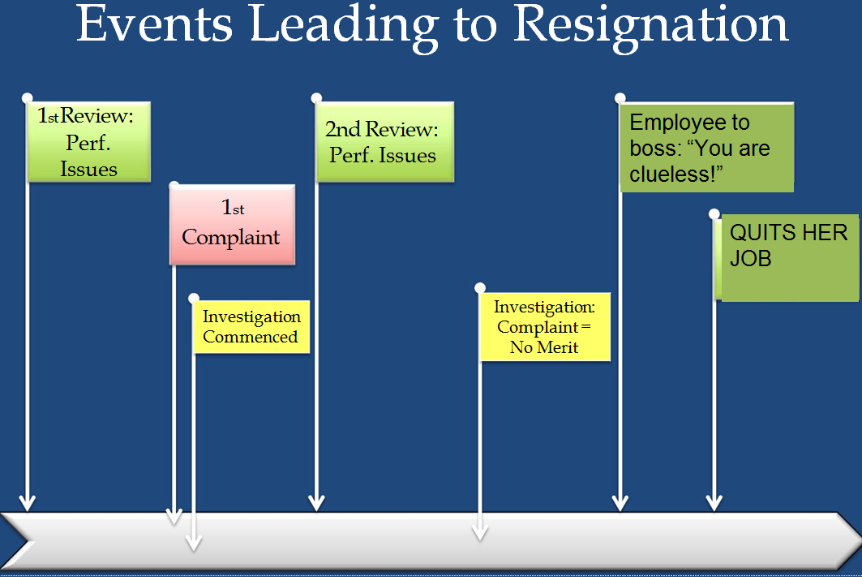

Slide 28
SMALL GROUP DISCUSSION QUESTIONS
1) Is she a whistleblower?
2) Does she need to complain to OSHA/SEC?
3) Does it matter if she is wrong about her allegation?
4) Does it matter that she says she’s in a compliance role?
5) Did the company have to put up with her bad behavior towards her boss and her poor work performance because she raised complaints?

Slide 29


Slide 30
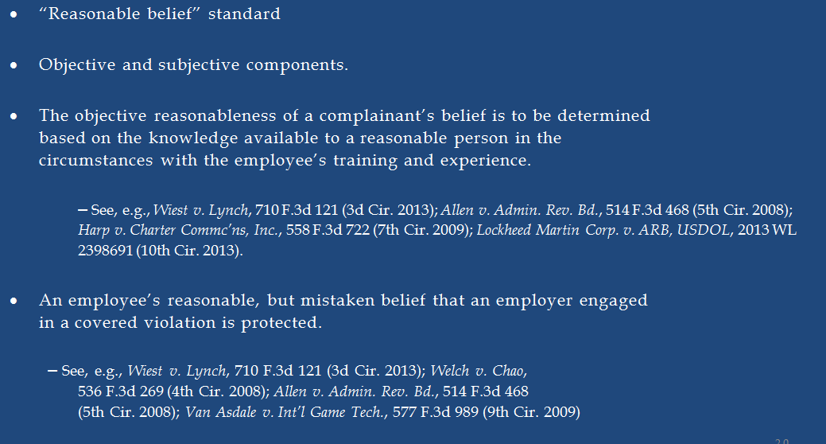
Wrong, But Protected Anyway

Slide 31
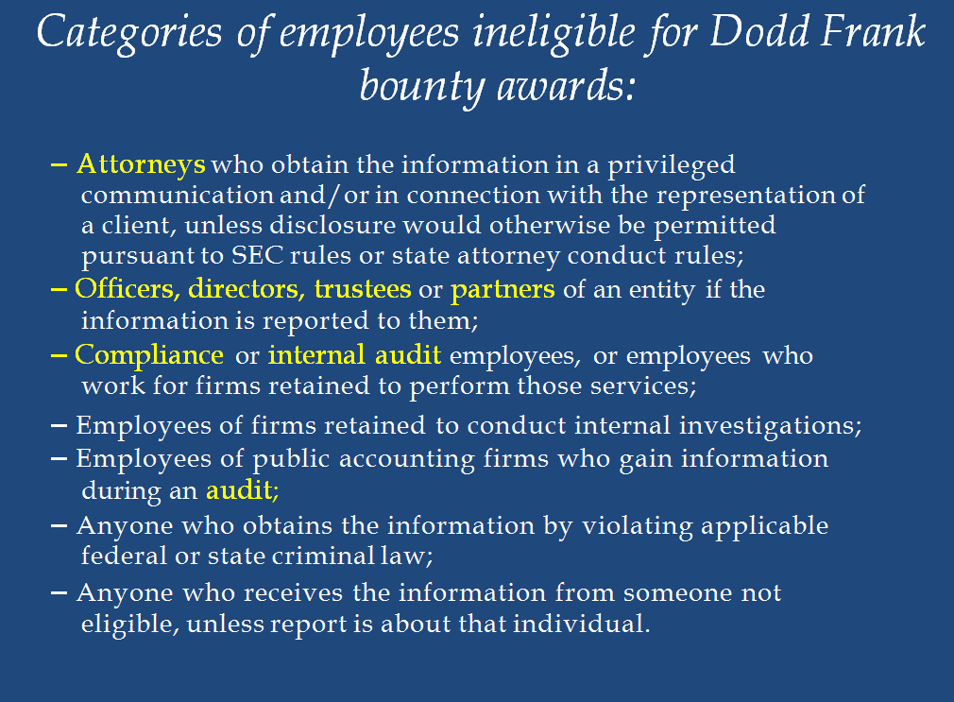

Slide 32
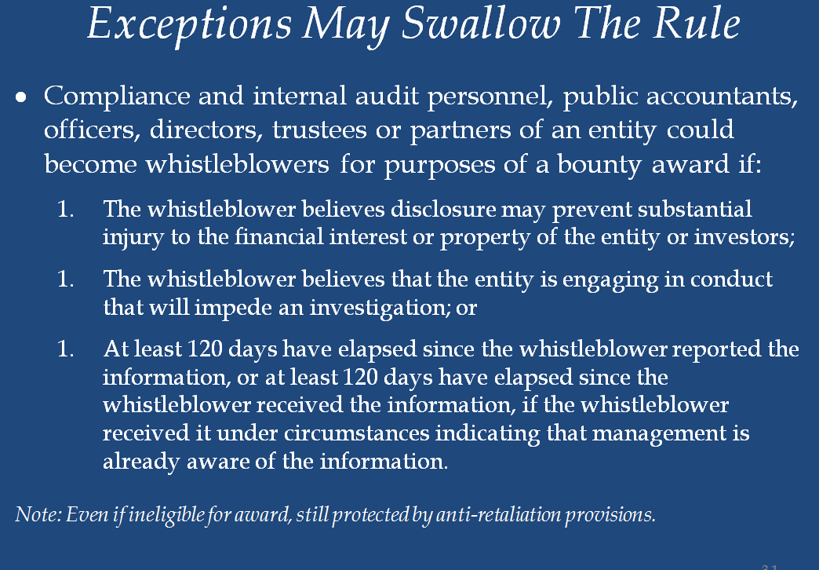

Slide 33
References:
15 U.S. Code § 78u–6 - Securities whistleblower incentives and protection
18 U.S. Code § 1514A - Civil action to protect against retaliation in fraud cases
Stephen M. Kohn, Sarbanes-Oxley Act: Legal Protection for Corporate Whistleblowers, National Whistleblower Center (NWC)
M. Megan O’Malley, Whistleblower protections, retaliation issues, and investigative issues arising under the Sarbanes-Oxley and the Dodd-Frank Act, The American Bar Association Annual Meeting, July 31, 2015, Chicago, IL
2016 & 2017 -- Annual Reports to Congress on the Dodd-Frank Whistleblower Program, U.S. SEC
https://www.sec.gov/files/owb-annual-report-2016.pdf,
https://www.sec.gov/files/sec-2017-annual-report-whistleblower-program.pdf .
U.S. SEC Office of the Whistleblower (https://www.sec.gov/whistleblower)

