Slide 1
Racketeer Influenced and Corrupt Organizations (RICO) Act (Private RICO)
Enacted in 1970 to curb organized crime
Persons injured by racketeering activities could bring a private civil action to court
RICO has broadly defined the predicate acts of racketeering to include:
  Cases of fraudulent sales of securities
Mandated trebled (multiplied i.e. tripled) damages to injured parties
In 1995, PSLRA (Private Securities Litigation Reform Act) amended RICO and eliminated securities fraud as a predicate act of racketeering
Congress believed that RICO claims distorted the incentives and remedies in securities litigations
PSLRA left the opportunity for private RICO securities claims – if the action is brought against a person convicted criminally of securities fraud
Criminal enforcement by the U.S. Department of Justice supplements the SEC enforcement of the federal securities law

Slide 2
RICO Prohibits engaging in pattern of racketeering activities
The RICO Act covers four circumstances:
  Purchasing an enterprise or part there of with racketeering profits
  Acquiring an enterprise or any interest in it through racketeering activities
  Conducting business in an enterprise through racketeering activities
  Any conspiring to perform 1) through 3)
Pattern is described as performing two or more acts of wrongful behavior including
  Mail and wire fraud and
  Fraud in sale of securities
“Enterprise” is a separate element of RICO offense (ongoing organization, formal or informal, where associates function)
Criminal RICO sanctions include imprisonment for up to 20 years, pre-trial asset freezes, fines, and mandatory forfeiture of property acquired while violating RICO

Slide 3
Sentencing of Organizations
Organizations act through agents, and are liable, under federal criminal law, for acts committed by their agents
Agents, personally are also liable for their individual acts
Organizations and agents are usually co-defendants in criminal cases
Sanctions against organizations and individuals are imposed to provide just punishment and incentives to prevent, detect, and report criminal acts
The law orders the organizations to make whole the victims of the crime caused by the organization
If the organization exists only for the criminal purpose, it needs to be dissolved, the fines need to be sufficiently high to preclude future activities
The fines are set based on the severity of the crime and the culpability of the organization
Probation is acceptable sentence for a defendant if steps can be ensured towards reducing likelihood of future criminal activities

Slide 4
Examples of Securities Enforcement Actions
SAC Capital Advisors, founded by Stephen A. Cohen – settled criminal charges for insider trading in a criminal law suit brought by the DoJ.
  Agreed to pay criminal fine of $1.2 billion after
  Paying $616 million in civil settlement for insider trading brought by the SEC
  Steve A. Cohen also faces criminal charges
Goldman Sachs settled charges brought by the SEC on misleading the investors in collateralized debt obligations (CDO)
  Agreed to pay $550 million
Raj Rajaratnam – founder of the Galleon Hedge Fund was convicted for insider trading and was sentenced to 11 years in prison, was ordered to pay $10 million fine, and forfeit $53.8 million in trading profits.
  He received tips from former Intel employee
  Bribed a partner of McKinsey & Co. to receive tips
  Obtained tips from a Goldman Sachs Board member about bank’s earning reports

Slide 5
Determination of the culpability of the organization
Determining the ultimate punishment
  Level of involvement in criminal activity or tolerance of the same
  Previous history of criminal involvement
  Violation of an order
  Obstruction of justice
Mitigating the ultimate punishment
  Existence of effective compliance and ethics program
  Cooperation, self-reporting, acceptance of responsibility
These guidelines and steps are meant to reduce and hopefully eliminate criminal activities in organizations
Organizations are encouraged to self-police and comply with applicable laws through compliance and ethics programs

Slide 6
Organizations – Persons that are not individuals
Corporations
Partnerships
Associations
Joint-stock companies (like corporation, except that stockholders are liable for the debts of the company)
Unions (representatives of workers)
Trusts (One party [trustor] gives another party [trustee] a right to hold assets for the benefit of a third party [beneficiary])
Pension Funds
Unincorporated organizations (two or more people pursuing common lawful purpose)
Governments
Political subdivisions (counties, cities, towns, villages)
Non-profit organizations

Slide 7
Determining the sentences and options
Determine offense level
Determine the base fine
Calculate the culpability score (min and max multipliers)
Determine the min and max fine range and the actual fine
Find out the necessity of disgorgement (potentially increase the fine)
Special assessments, costs, forfeitures
Obstruction-related adjustments
Victim-related adjustments

Slide 8
Definitions and specific terms
“Offense” – offence of conviction and all relevant offences
  For more specifics: “federal offense”, “offence of conviction” – to distinguish from previous or subsequent offenses
“High level personnel of the organization” – individuals with substantial control and authority to make policy – directors, executive officers, heads of sales, finance, administration
“Pecuniary gain” – additional profit that “defendant” has generated based on the relevant criminal conduct or offense.

Slide 9
Restitutions and Remedies
If a victim is identifiable, the court
  Enters a restitution order for the full amount of victim’s loss under 18 U.S.C. § 2248, § 2259, § 2264, § 2327, § 3663, or § 3663A
  Imposes a probation term requiring restitution for the full amount of victim’s loss, if the offense meets the criteria for restitution under 18 U.S.C. § 3663(a)(1) even if it is not an offense under this section
Restitution can be paid in
  Single lump sum
  Periodic payments
  In-kind payments
Remedial orders require organizations to remedy the harm inflicted by the offense and to reduce the risk of future harm
Organizations may be required to take corrective actions in order to prevent injury from the instant offense (product recalls, environmental clean-up, etc.)

Slide 10
Organizations can pay remedies through community service
Community Service can be used as condition of probation
  Where such community service could repair the offense-caused harm
Organization can pay its employees to perform community service
Appropriate when the organization has expertise and skills that uniquely qualifies it to repair damage caused by the offense

Slide 11
Organizational Compliance and Ethics
Effective Compliance and Ethics Program (CEP)
  Exercise due diligence to detect and prevent criminal activities
  Promote organizational culture that encourages ethical conduct
  The organization’s governing authority should be knowledgeable of the CEP
  Designated individuals should ensure day-to-day appropriate practices and report periodically up-the-ladder
  Individuals who have engaged in illegal activities should not be designated as authorities in the organization
  Organizations should institute training programs to communicate rules and procedures to employees for their individual roles and responsibilities
  Mentoring and auditing programs to detect criminal conduct
  Evaluate the effectiveness of the ethics and compliance program
  System where employees can confidentially report illegal activities
  Institute appropriate disciplinary measures for engaging in criminal conduct

Slide 12
Base Fine Determination for Criminal Offense
The greater of
  The amount from the table or
  The pecuniary gain that the organization obtained because of the offense
Offense level fine table
Offense Level | Amount
6 or less | $8,500
7 | $15,000
8 | $15,000
9 | $25,000
10 | $35,000
11 | $50,000
Offense Level | Amount
23 | $3,000,000
24 | $3,500,000
25 | $5,000,000
26 | $6,500,000
27 | $8,500,000
28 | $10,000,000
Offense Level | Amount
33 | $40,000,000
34 | $50,000,000
35 | $65,000,000
36 | $80,000,000
37 | $100,000,000
38 or more | $150,000,000.

Slide 13
Base Offense Levels and Specific Offense Characteristics
“Each type of crime is assigned a base offense level, which is the starting point for determining the seriousness of a particular offense. More serious types of crime have higher base offense levels (for example, a trespass has a base offense level of 4, while kidnapping has a base offense level of 32)
In addition to base offense levels, each offense type typically carries with it a number of specific offense characteristics. These are factors that vary from offense to offense, but that can increase or decrease the base offense level and, ultimately, the sentence an offender receives.
Example:
  One of the specific base offense characteristics for fraud (which has a base offense level of 7) increases the offense level based on the amount of loss involved in the offense. If a fraud involved a $6,000 loss, there is to be a 2-level increase to the base offense level, bringing the level up to 9. If a fraud involved a $50,000 loss, there is to be a 6-level increase, bringing the total to 13”*
An Overview of the FEDERAL SENTENCING GUIDELINES

Slide 14
Culpability Scores – Minimum and Maximum Multipliers
Culpability Score | Minimum Multiplier | Maximum Multiplier
10 or more | 2.00 | 4.00
9 | 1.80 | 3.60
8 | 1.60 | 3.20
7 | 1.40 | 2.80
6 | 1.20 | 2.40
5 | 1.00 | 2.00
4 | 0.80 | 1.60
3 | 0.60 | 1.20
2 | 0.40 | 0.80
1 | 0.20 | 0.40
0 or less | 0.05 | 0.20.

Slide 15
Culpability Score (§8C2.5) and
Max and Min Multipliers (§8C2.6)
After calculating the base fine, the Court determines the culpability score
The starting point is a culpability score of 5 and points are subtracted/added to adjust the score for
  Mitigating factors (if ethics and compliance program was in place, if the organization self-reported the offense) and
  Aggravating factors (authority personnel, previous offenses, judicial order violation, obstruction of justice)
Maximum and minimum multipliers
  To determine the range of the fine (i.e. for culpability score of 5, and base fine of $50,000, the range, based on multipliers 1 (min) and 2 (max), is [$50,000; $100,000]
Determining the fine within the range
  Based on the specifics of the case

Slide 16
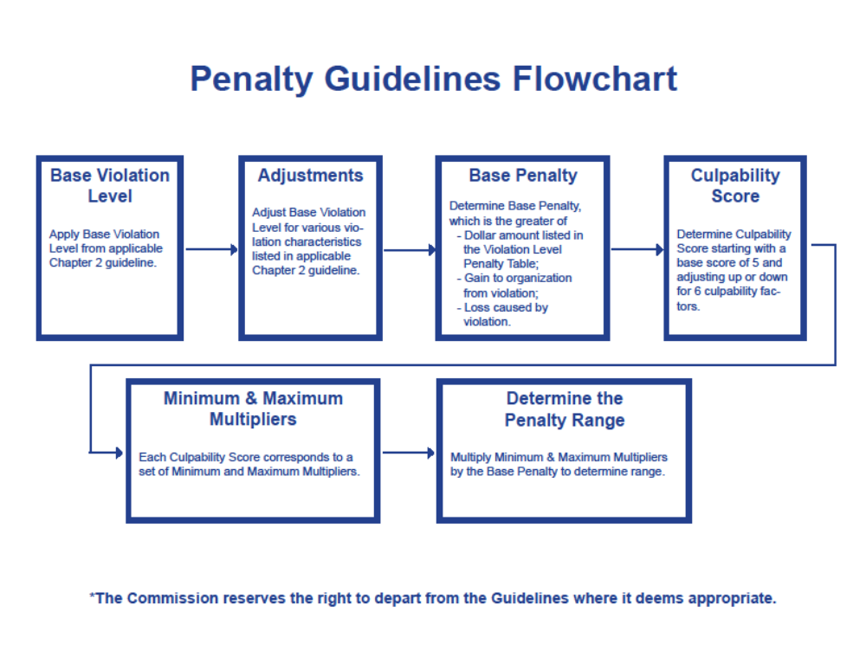
Federal Energy Regulation Commission (FERC)
https://www.ferc.gov/media/news-releases/2010/2010-1/flowchart-M-1.pdf

Slide 17
Fighting corporate fraud and misconduct
The U.S. economy and ultimately the protection of the U.S. citizens and residents depends on effective enforcement of criminal and civil laws
An effective way to fight corporate misconduct is to seek accountability from the perpetrators of the wrongdoings in order to:
  Deter future breaking of the law
  Motivate a change in corporate culture
  Ensure that wrongdoers are held responsible, and
  Increase confidence in the U.S. justice system
Important task of the legal system is to understand and bring out the individual responsibility of an organization wrongdoing
Often, it is not obvious whether certain individuals of authority or leadership possessed knowledge of the illegal activities

Slide 18
Six key steps in pursuing individual corporate wrongdoing
To qualify for cooperation credit, corporations have to provide [to the Department of Justice] all relevant information pertaining to the individual(s) involved in the misconduct
Civil and criminal investigations should from the beginning focus on individual misconduct
Civil and criminal lawyers should be in continuous communication with one another during the investigation(s)
In the process of resolving an investigation matter with the corporation, individuals implicated in the matter will not be released from civil or criminal liabilities
There has to be a clear plan of resolution for individual cases when the Department prepares resolutions pertaining to the corporations
Civil attorneys should consider whether to bring suits against individuals based on individuals’ abilities to pay
Yates Memorandum, September 9, 2015 (Individual accountability for corporate wrongdoing)

Slide 19
Prosecution of Corporate Crime
High priority for the Department of Justice
Safeguarding the integrity of the economic and capital markets
Protecting consumers, businesses, investors from companies that violate the law and take advantage of people
Preventing violations of environmental laws
Corporate directors owe
  fiduciary duties to shareholders
  Honest dealing duties to consumers and the investment public
Prosecutors should be mindful not only of the results that are achieved, but also of:
  The manner (professionalism and civility) of the investigation that promotes self-regulation, cooperation, compliance
HOWEVER:
  https://features.marketplace.org/why-no-ceo-went-jail-after-financial-crisis/

Slide 20
Focus on individual wrongdoers
In corporate investigations, individuals who are criminally culpable need to be identified early in the process
Under the “respondeat superior” doctrine, corporation can be legally liable for the misconduct of its directors, officers, employees, agents
  If actions were in scope of individuals’ duties within the corporation
  The actions were intended to benefit the corporation
See United States v. Cincotta, 689 F.2d 238, 241-42 (1st Cir. 1982); United States v. Automated Medical Laboratories, Inc., 770 F.2d 399 (4th Cir. 1985); United States v. Potter, 463 F.3d 9, 25 (1st Cir. 2006);
Primary factors in determining whether to charge the corporation are:
  The nature and the seriousness of the crime
Corporation can be charged even if the wrongdoing is minor if the wrongful act is prevalent and it is undertaken by significant number of employees
Management is an important factor in corporate culture and should be held responsible if criminal conduct is implicitly encouraged

Slide 21
18 U.S. Code § 1348 - Securities and commodities fraud
Applies to anyone who knowingly executes or attempts to execute a scheme to:
  Defraud any person in connection with commodity or futures delivery
  Option on a commodity for future delivery or any security registered under section 12 of the Securities Exchange Act of 1934
  Obtain any money or property for future delivery of any securities, by defrauding a person by false promises and misleading representations
Fines and imprisonment are determined based on the severity of the case and the damage inflicted to the victim
The coverage of § 1348 is broader than Rule 10(b)-5 since
Rule 10(b)-5 requires:
  Actual trading in securities (not required by the first clause of § 1348)
  Deception related to the security in question (not required by the second clause of § 1348)
Code § 1348 security fraud crime covers only publicly traded companies unlike Rule 10(b)-5

Slide 22
References:
United States Sentencing Commission “Sentencing of Organizations” Chapter 8 (2015) (https://www.ussc.gov/guidelines/2015-guidelines-manual/2015-chapter-8)
An Overview of the FEDERAL SENTENCING GUIDELINES (https://www.ussc.gov/sites/default/files/pdf/about/overview/Overview_Federal_Sentencing_Guidelines.pdf)
Chapter Eight Fine Primer: Determining the Appropriate Fine Under the Organizational Guidelines (https://www.ussc.gov/sites/default/files/pdf/training/primers/Primer_Organizational_Fines.pdf)
Memorandum for Assistant Attorney General – Department of Justice (https://www.justice.gov/archives/dag/file/769036/download)
18 U.S. Code § 1348 - Securities and commodities fraud (https://www.law.cornell.edu/uscode/text/18/1348)
US Attorneys Manual Prosecution of Business Organizations (https://www.justice.gov/usam/usam-9-28000-principles-federal-prosecution-business-organizations)
Federal Energy Regulation Commission (FERC) (https://www.ferc.gov/media/news-releases/2010/2010-1/flowchart-M-1.pdf)
Palmiter, Alan, Securities Regulation: Examples and Explanations, 6th Ed., ISBN-13: 978-1454833925, ISBN-10: 1454833920

