Slide 1
Quality Improvement & Patient Safety
Rev. Fall 2014
L. Landseadel, MS, RN-C, CNE

Slide 2
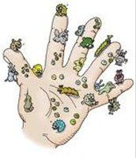
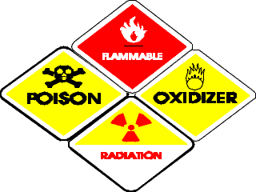
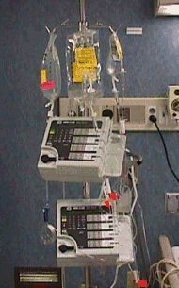
Maintaining safe environments
http://www.momentumpeople.co.uk/204.htm
http://www.co.monroe.mi.us/government/department
http://www.cdc.gov/niosh/topics/hazdrug/
Notes:
What does this mean for you as the Nurse?

Slide 3
Statement of Quality of Care
The IOM concluded that
Quality can be defined and measured
Quality problems are serious and extensive
Current approaches to quality improvement are inadequate
There is an urgent need for rapid change

Slide 4
Focus Areas of To Err is Human
The IOM recommended (Box 10-3)
Enhance knowledge and leadership regarding safety
Identify and learn from errors
Set performance standards and expectations for safety
Implement safety systems within health care organizations

Slide 5
Crossing the Quality Chasm Conclusions
The gaps between actual care and high-quality care could be attributed to key inter-related areas in the health care system
  The growing complexity of science and technology
  An increase in chronic conditions
  A poorly organized delivery system of care and constraints on exploiting the revolution in information technology

Slide 6
Ten Rules to Govern Health Care Reform for the 21st Century
Care is based on a continuous healing relationship
Care is provided based on patient needs and values
Patient is source of control of care
Knowledge is shared and free-flowing
Decisions are evidence-based

Slide 7
Safety as a system property
Transparency is necessary; secrecy is harmful
Anticipate patient needs
Waste is continually decreased
Cooperation between health care providers

Slide 8
Quality
The Institute of Medicine (IOM) defines quality as “the degree to which health services for individuals and populations increase the likelihood of desired health outcomes and are consistent with current and professional knowledge”
(IOM, 2001, p. 232)

Slide 9
Six Aims for Improving Quality in Health Care
Health care should be
Safe
Effective
Patient-centered
Timely
Efficient
Equitable
Notes:
Safe: avoiding injuries to patients from the care that is intended to help them.
Effective: providing services based on scientific knowledge to all who could benefit and refraining from providing services to those not likely to benefit (avoiding underuse and overuse).
Patient-centered: providing care that is respectful of and responsive to individual patient preferences, needs, and values and ensuring that patient values guide all clinical decisions.
Timely: reducing waits and sometimes harmful delays for both those who receive and those who give care.
Efficient: avoiding waste, in particular waste of equipment, supplies, ideas, and energy.
Equitable: providing care that does not vary in quality because of personal characteristics such as gender, ethnicity, geographic location, and socioeconomic status.

Slide 10
Risk Management
Service occurrence
Serious error
Sentinel event
Notes:
What does Risk Management do? RM Addresses liabilities that could lead to financial losses in an organization. Assesses factors leading to such losses if they occur.
Quality Management aka Continuous Quality Improvement (CQI) in health care is a structured process in an organization which does planning for a continuous flow of improvements to provide quality health care. Could be things already needing improvement or things in progress.

Slide 11
The Economic Climate in the Health Care System
Economic perspective
Regulation and competition
Nursing labor market
Notes:
Objectives:
Analyze historical, social, political, and economic trends affecting the nursing profession and the healthcare delivery system.
Explain the importance of quality improvement to the nurse, patient, organization, and healthcare delivery system.
Promote the role of the nurse in the contemporary healthcare environment.
OUTLINE:
The Economic Climate In The Health Care System
Economic Perspective
Regulation and Competition
Nursing Labor Market
Defining and Identifying the Nursing Shortage
Factors contributing to the Nursing Shortage

Slide 12
Factors Influencing Economic Climate
Economic
Regulation
Competition
Nursing labor market

Slide 13

Safety in the U.S. Health Care System
Types of errors
Error identification and reporting
Developing a culture of safety
Organizations, agencies, and initiatives supporting quality and safety in the health-care system
Notes:
Objectives:
Discuss the history of quality and safety within the U.S. healthcare system.
Analyze historical, social, political, and economic trends affecting the nursing profession and the healthcare delivery system.
Examine factors contributing to medical errors and evidence-based methods for the prevention of medical errors.
Explain the use of technology to enhance and promote safe patient care, educate patients and consumers, evaluate healthcare delivery, and enhance the nurse’s knowledge base.
Promote the role of the nurse in the contemporary healthcare environment.
OUTLINE:
SAFETY IN THE U.S. HEALTH CARE SYSTEM
Types of Errors
Error Identification and Reporting
Developing a Culture of Safety
Organizations, Agencies, and Initiatives supporting Quality and Safety in the HC System
Government Agencies
Healthcare Provider Professional Organizations
Non-profit Organizations and Foundations
Quality Organizations
Integrating Initiatives and Evidenced-based Practices into Client Care

Slide 14

Notes:
What action should the infection control nurse take to most effectively reduce the incidence of health care-associated infections?
http://www.polleverywhere.com/multiple_choice_polls/5qgWsGuulYEFsBl

Slide 15
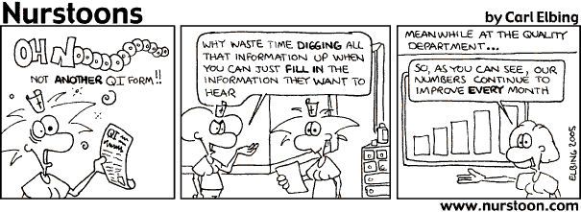
Quality Improvement: Not just another department!
Notes:
What is QI? What is QM? Why do we need these in nursing?
Continuous quality improvement (CQI) is a
process of identifying areas of concern (indicators), continuously collecting data on these indicators,
analyzing and evaluating the data, and implementing needed changes.
QM: a set of management practices throughout the organization, geared to ensure the organization consistently meets or exceeds customer requirements.

Slide 16

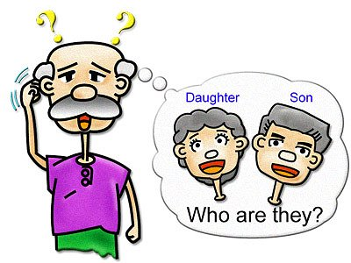

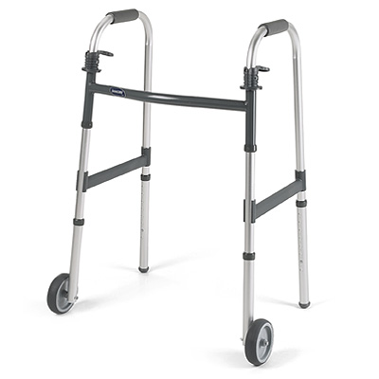
Accident & Injury Prevention
CONSIDER:
Notes:
Age, mobility, cognitive/sensory awareness, emotional state, lifestyle & safety awareness
Be prepared to Assess, Know procedural safety guidelines & protocols, Know security plans

Slide 17
Notes:
Which policy will the infection control RN implement to most effectively reduce the incidence of catheter-associated UTI's?
http://www.polleverywhere.com/multiple_choice_polls/amEiIcAXqrT1Dur

Slide 18
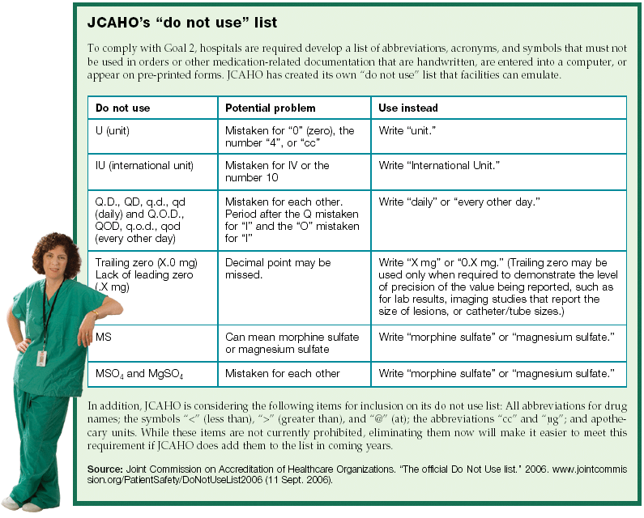
Patient Safety
SAFE NURSES:
Prevent Falls
Know Restraint Policy
Teach Fire & Home Safety
Advocate for Community Safety
Practice Ergonomics
Administer Medications Safely
Use Patient Identification
Notes:
What is JCAHO? What happens if facility is cited?

