Slide 1
ITS 835 enterprise risk management
Chapter 6
Strategic Risk Management at the LEGO Group

Slide 2
introduction
LEGO Group history
Strategy
Legacy risk management
Enterprise risk management at LEGO
  Initial ERM
  Monte Carlo simulation
  Active Risk Assessment of Business Projects (AROP)
  Preparing for Uncertainty
The PAPA model
Risk management ROI

Slide 3
Lego group history
Headquarters in Billund, Denmark
Family owned
Second largest toy manufacturer (globally)
Founded in 1932
  Iconic bricks first introduced
  Bricks manufactured since 1958 fit with one another
2400 different brick shapes
Manufactured in plants across four countries

Slide 4
Lego strategy
LEGO mission
  “Inspire and develop the builders of tomorrow”
LEGO vision
  “Inventing the future of play”
Growth strategy
Innovation strategy

Slide 5
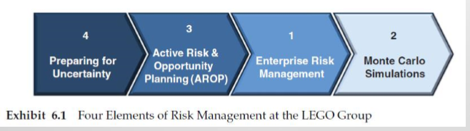
ERM at lego
Risk management developed in 4 stages
  Step 1: Enterprise risk management
  Step 2: Monte Carlo simulations
  Step 3: Active Risk & Opportunity Planning (AROP)
  Step 4: Preparing for Uncertainty
Order is by initiation sequence
  Steps 1 & 2 are damage control
  Steps 3 & 4 are proactive

Slide 6
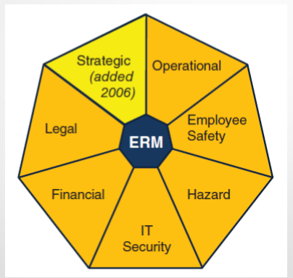
Erm Step 1: enterprise risk management

Slide 7
ERM Step 2: Monte Carlo Simulations
Monte Carlo simulation
  Method of evaluating the effect of input variances on a model of a complex system
  In short, it helps to see how input variances affect outcomes
Helps to define risk tolerance
Implemented in three areas
  Budget simulation
  Credit risk portfolio
  Consolidation of risk exposure

Slide 8
Erm step 3: arop
Active Risk Assessment of Business Projects (AROP)
Formal approach to defining and handling project risk
Includes multiple steps
  Identification
  Assessment
  Handling
  Reassessment
  Follow-up
  Reporting

Slide 9
Erm step 4: preparing for uncertainity
Preparing for Uncertainty
  Defining and Testing Strategies
Workshops precede strategic planning sessions
Four scenarios
  Agree on two key drivers of uncertainty
  Describe each of four quadrants of 2x2 matrix
  Define strategic issues
  Actions to take
    “who is doing what by when?”

Slide 10
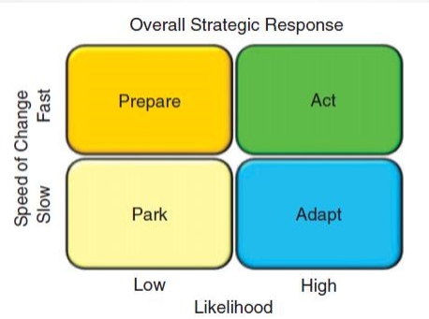
The papa model
Park, Adapt, Prepare, Act: PAPA
  Park
  Adapt
  Prepare
  Act

Slide 11
Risk management roi
Strong support from upper management
Efforts have resulted in value
Many LEGO key planning processes now include risk management
More visibility of enterprise risk
  More opportunity to address risk

Slide 12
summary
Risk management is not risk aversion
ERM allows LEGO to take risks when appropriate
  Grow
  Create value
LEGO strategic risk management mission
  “Drive conscious choices”

