Slide 1
Chapter 14
Environmental Health

Slide 2
Environmental Health Is …
... all the physical, chemical, and biological factors external to a person and all the related factors impacting behaviors.
… encompasses the assessment and control of those environmental factors that can potentially affect health.
… targeted toward preventing disease and creating health-supportive environments.
– WHO (2013)

Slide 3
Environmental Health
The purpose of environmental health is to ensure the conditions of human health and provide healthy environments for people to live, work, and play.
Accomplished through…
  Risk assessment
  Prevention
  Intervention

Slide 4
Using a Critical Theory Approach
Uses “thinking upstream” framework.
Raises questions about oppressive situations.
Involves community members in the definition and solution of problems.
Facilitates interventions that reduce health-damaging effects of environments.
Asks critical questions about clients’ work and home environments to help discern the contributions of specific hazards to health.

Slide 5
Benefits of an Environmental Health History
Increased awareness of environmental/ occupational factors
Improved timelines and accuracy of diagnosis
Prevents disease and aggravation of conditions
Identifies potential work-related environmental hazards and/or environmental hazards in and around clients’ homes

Slide 6
I PREPARE
Environmental Exposure History
  I – Investigate potential exposures
  P – Present work
  R – Residence
  E – Environmental concerns
  P – Past work
  A – Activities
  R – Referrals and Resources
  E – Educate

Slide 7
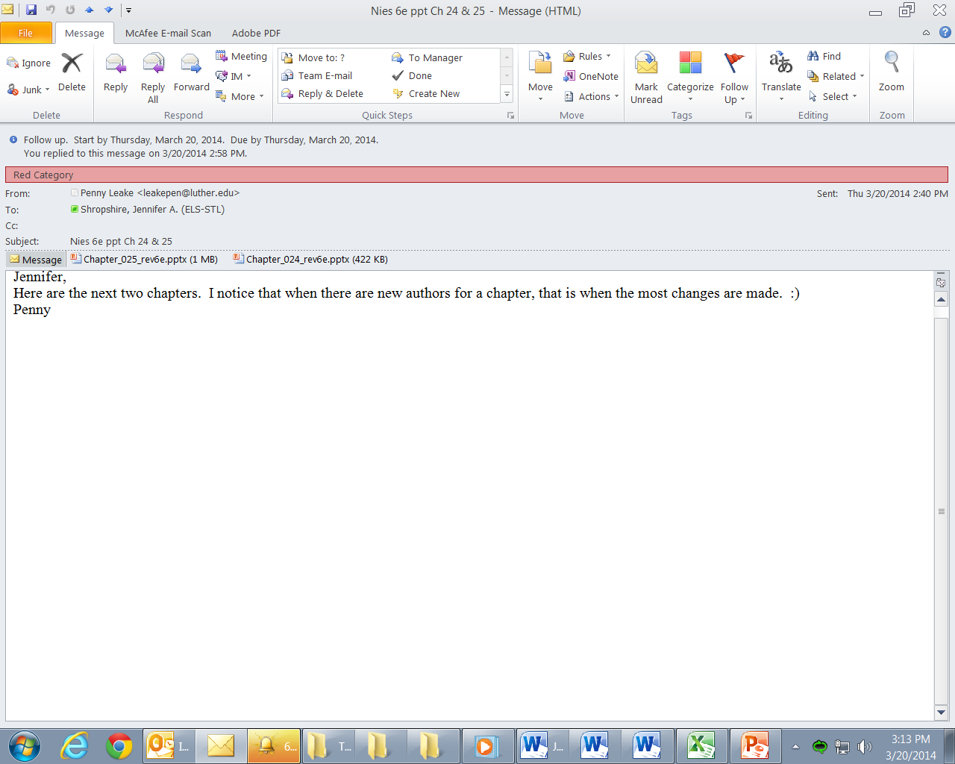
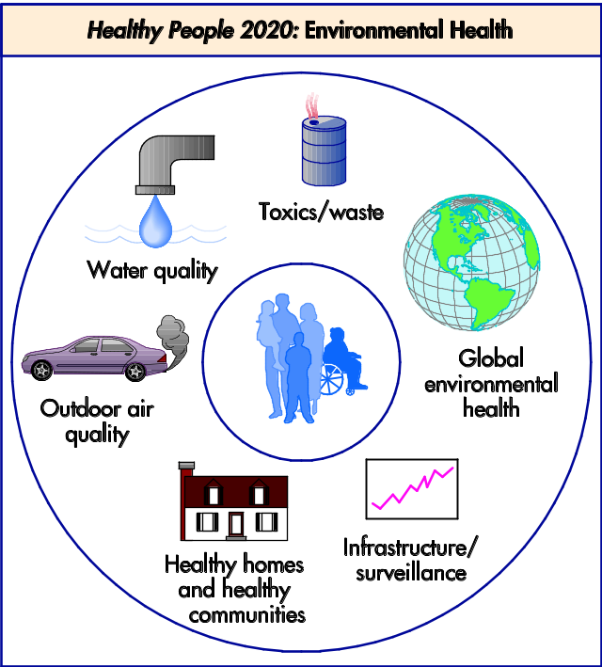
Figure 14-1
From U.S. Department of Health and Human Services: Healthy People 2010, ed 2, Washington, DC, U.S. Government Printing Office, 2000.

Slide 8

Areas of Environmental Health
Built environment
Work-related exposures
Outdoor air quality
Healthy homes
Water quality
Food, safety, and waste management

Slide 9

Built Environment
  The connection between people, communities, and their surrounding environments that affects health behaviors and habits, interpersonal relationships, cultural values, and customs

Slide 10

Built Environment: Examples
Drunk driving
Second-hand smoke
Noise exposure
Urban crowding
Technological hazards

Slide 11

Work-Related Exposure
Poor working conditions that result in potential injury or illness

Slide 12

Work-Related Exposure: Examples
Asbestosis
Asthma
Lung cancer
Agricultural accidents

Slide 13
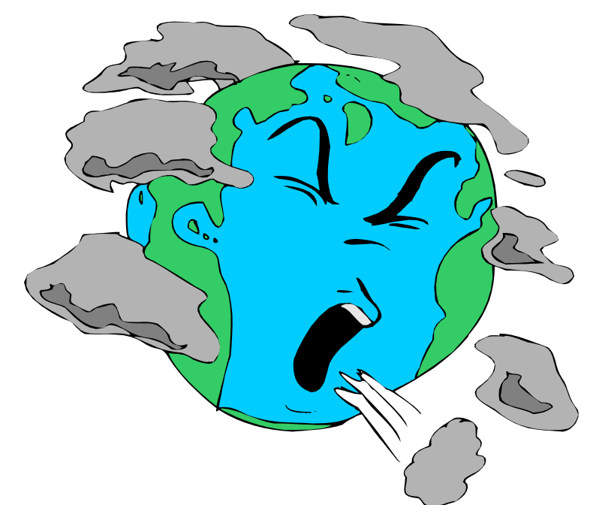
Outdoor Air Quality
The purity of the air and the presence of air pollution

Slide 14

Outdoor Air Quality: Examples
Gaseous pollutants
Greenhouse effect
Destruction of the ozone layer
Aerial spraying of herbicides and pesticides
Acid rain

Slide 15

Healthy Home
The availability, safety, structural strength, cleanliness, and location of shelter, and indoor air quality

Slide 16

Healthy Home: Examples
Homelessness
Rodent and insect infestation
Poisoning from lead-based paint
Sick building syndrome
Unsafe neighborhoods

Slide 17

Water Quality
The availability, volume, mineral content levels, toxic chemical pollution, and pathogenic microorganism levels
The balance between water contaminants and existing capabilities to purify water for human use and plant and wildlife sustenance

Slide 18

Water Quality: Examples
Contamination of drinking supply by human waste
Oil spills in the world’s waterways
Pesticide or herbicide infiltration of ground water
Aquifer contamination by industrial pollutants
Heavy metal poisoning of fish

Slide 19

Food Safety
Availability, accessibility, and relative costs of healthy food free from contamination of harmful herbicides, pesticides, and bacteria

Slide 20


Food Safety: Examples
Malnutrition
Bacterial food poisoning
Food adulteration
Disrupted food chains by ecosystem destruction
Carcinogenic chemical food additives
FDA food safety campaign:
http://www.fightbac.org/safe-food-handling
http://www.foodsafety.gov/
Figure 14-5

Slide 21

Waste Management
The handling of waste materials resulting from industry, municipal processes, and human consumption as well as efforts to minimize waste production

Slide 22

Waste Management: Examples
Use of nonbiodegradable plastics
Poorly designed solid waste dumps
Inadequate sewage systems
Transport and storage of hazardous waste
Illegal industrial dumping

Slide 23

Waste Management: Examples (Cont.)
Nuclear facility emissions
Radioactive hazardous wastes
Radon gas seepage in homes and schools
Nuclear testing
Excessive exposure to x-rays

Slide 24
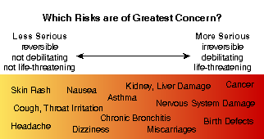
Effects of Environmental Hazards
Figure 14-6 From Environmental Protection Agency: Air Pollution and Health Risk. http://www.epa.gov/ttnatw01/3_90_022.html. Retrieved March 27, 2013.

Slide 25
Emerging Issues in Environmental Health
Environmental public health infrastructure
Natural disasters
Global climate change
Ozone depletion
Fossil fuel burning
Marine dumping
Active land mine abandonment in war-torn areas
Destruction of tropical rain forests

Slide 26

Critical Community Health Nursing Practice
Approach environmental health at the population level
Take a stand; advocate for change
Ask critical questions
Facilitate community involvement
Form coalitions
Using collective strategies

