Slide 1
Chapter 13
Cultural Diversity and Community Health Nursing
Notes:
1

Slide 2
Cultural Competence
Cultural competence is respecting and understanding the values and beliefs of a certain cultural group so that one can function effectively in caring for members of that cultural group.
Culturally competent community health nursing requires that the nurse understand…
  Lifestyle
  Value system
  Health and illness behaviors of diverse individuals, families, groups, and communities

Slide 3
Standards of Practice for Culturally Competent Nursing Care
Social Justice
Critical Reflection
Knowledge of Cultures
Culturally Competent Practice
Cultural Competence in Health Care Systems and Organizations
Patient Advocacy and Empowerment
Multicultural Workforce
Education and Training in Culturally Competent Care
Cross-Cultural Communication
Cross-Cultural Leadership
Policy Development
Evidence-Based Practice and Research
From: Expert Panel on Global
Nursing and Health (2010)

Slide 4
Population Trends
In 1970
  Minority groups were 16% of population
By 2010
  Minority groups increased to 36% of population
By 2025
  More than half of all children will be minorities
By 2050
  More than 54% of total population will be minorities
  First time in U.S. history that minorities will make up a majority of the population
Notes:
4

Slide 5

Population Trends (Cont.)
By 2060, projected demographic trends:
  White 44%
  Hispanic 30%
  African American 15%
  Asian 9%
  American Indians & Alaska Natives 2%
Notes:
5

Slide 6

Immigration to the United States
Since 1991, more than 13 million legal immigrants
In 2010, almost 40 million foreign-born individuals in the United States (12.9% of population) from:
  Latin America 53.1%
  Asia 28.2%
  Europe 12.1%
  Other regions 9%

Slide 7

Diversity Among Nurses
Minorities are generally underrepresented by nursing workforce (HRSA, 2009):
  White/non-Hispanic 81.8%
  African American 4.2%
  Hispanic 1.7%
  Asian and Pacific Islander 3.1%
  Native American and Alaska Native 0.3%
Minority groups tend to be geographically distributed in the United States.
Notes:
7

Slide 8


Cultural Perspectives and Healthy People 2020
Developed a set of national health targets…eliminating racial and ethnic disparities in health
Embraced and focused on ways to close the gaps in health outcomes
Focused on disparities among racial and ethnic minorities, women, youth, older adults, people of low income and education, and people with disabilities
Notes:
8

Slide 9
Health Disparities
AHCRQ (2005) reveals that:
Cancer mortality rates are 35% higher in African Americans than in whites.
African Americans with diabetes are seven times more likely to have amputations and develop renal failure than are whites with diabetes.
30% of Hispanics and 20% of African Americans lack a usual source of health care (compared with less than 16% of whites).
Notes:
9

Slide 10
Health Disparities (Cont.)
AHCRQ (2005) reveals that:
Hispanic children are nearly three times as likely as non-Hispanic white children to have no usual source of health care.
African Americans (16%) and Hispanic Americans (13%) are more likely to rely on hospitals or clinics for health care than are whites (8%).

Slide 11

Addressing Racial and Ethnic Disparities in Health Care
Disparities can be reduced or eliminated when adults have:
  Health insurance and
  A medical home
  – Commonwealth Fund, 2007
Notes:
11

Slide 12
Transcultural Nursing
“…a formal area of study and practice focused on a comparative analysis of different cultures and subcultures in the world with respect to cultural care, health and illness beliefs, values, and practices with the goal of using this knowledge to provide culture-specific and culture-universal nursing care to people.”
– Leininger (1978)
Notes:
12

Slide 13
Transcultural Nursing Terminology
Culture specific refers to the “particularistic values, beliefs, and patterning of behavior that tend to be special, ‘local,’ or unique to a designated culture and which do not tend to be shared with members of other cultures”
– Leininger (1991)
Culture universal refers to the “commonalties of values, norms of behavior, and life patterns that are similarly held among cultures about human behavior and lifestyles and form the bases for formulating theories for developing cross-cultural laws of human behavior”
– Leininger (1978)
Notes:
13

Slide 14
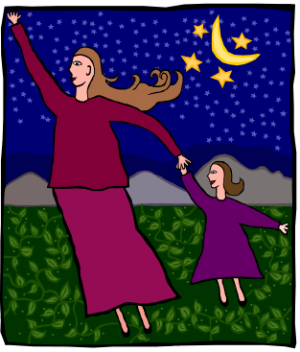
Transcultural Nursing Terminology (Cont.)
Ethnocentrism is a person’s tendency to view his or her own way of life as the most desirable, acceptable, or best, and to act in a superior manner toward another culture.
Cultural imposition is a person’s tendency to impose his or her own beliefs, values, and patterns of behavior on individuals from another culture.
Notes:
14

Slide 15
Leininger’s Theory of Culture Care Diversity and Universality
Describes, explains, and projects nursing similarities and differences focused primarily on human care and caring in human cultures.
Uses world view, social structure, language, ethnohistory, environmental context, and the generic or folk and professional systems to provide a comprehensive and holistic view of influences in cultural care and well-being.
Notes:
15

Slide 16
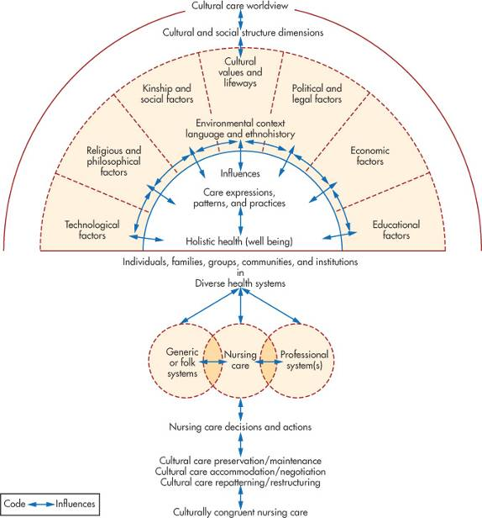
Leininger’s Sunrise
Model depicting the
theory of cultural
care diversity and
universality
Figure 13-1
From Leininger MM: Culture, care, diversity, and universality: a theory of nursing, New York, 1991, National League for Nursing Press.
Notes:
16

Slide 17
Overview of Culture
Culture refers to the complex whole, including knowledge, beliefs, art, morals, law, customs, and any other capabilities and habits acquired by virtue of the fact that one is a member of a particular society (Tylor, 1871).
Culture represents a person’s way of perceiving, evaluating, and behaving within his or her world, and it provides the blueprint for determining his or her values, beliefs, and practices.
Notes:
17

Slide 18
Overview of Culture (Cont.)
Four basic characteristics of culture—it is:
Learned from birth through the processes of language acquisition and socialization
Shared by members of the same cultural group
Adapted to specific conditions related to environmental and technical factors and to the availability of natural resources
Dynamic
– Sir Edward Tylor, 1871

Slide 19
Subculture
A fairly large aggregate of people who share characteristics that are not common to all members of the culture
Enables them to be a distinguishable subgroup
May be based on ethnicity, religions, occupation, health-related characteristics, age, gender, sexual preferences, or geographic location

Slide 20
Culture and Formation of Values
Common human problems related to values and norms:
  What is the character of innate human nature (human nature orientation)?
  What is the relationship of the human to nature (person-nature orientation)?
  What is the temporal focus of human life (time orientation)?
  What is the mode of human activity (activity orientation)?
  What is the mode of human relationships (social orientation)?

Slide 21

Human-Nature Orientation
Innate human nature may be good, evil, or a combination of good and evil.
The dominant U.S. cultural group chooses to believe the best about a person until that person proves otherwise.
– Kohls (1984)

Slide 22

Person-Nature Orientation
Destiny, in which people are subjugated to nature in a fatalistic, inevitable manner.
Harmony, in which people and nature exist together as a single entity.
Mastery, in which people are intended to overcome natural forces and put them to use for the benefit of humankind.

Slide 23
Time Orientation
The focus may be on the past, with traditions and ancestors playing an important role in the client’s life.
The focus may be on the present, with little attention paid to the past or the future.
The focus may be on the future, with progress and change highly valued.

Slide 24

Activity Orientation
Being, in which a spontaneous expression of impulses and desires is largely nondevelopmental in nature.
Growing, in which the person is self-contained and has inner control, including the ability to self-actualize.
Doing, in which the person actively strives to achieve and accomplish something that is regarded highly.

Slide 25
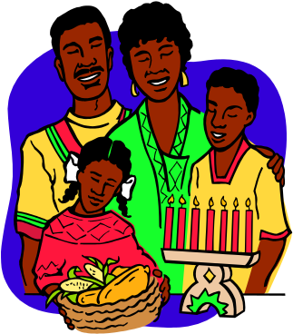
Social Orientation
Lineal relationships: Exist by virtue of heredity and kinship ties. Follow an ordered succession and have continuity through time.
Collateral relationships: Focus primarily on group goals—and family orientation is important.
Individual relationships: Personal autonomy and independence dominate; group goals become secondary.

Slide 26
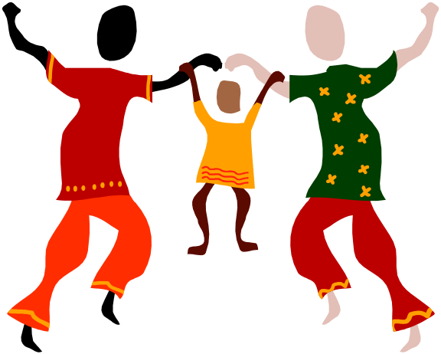
Culture and the Family
Cross-cultural differences may exist in:
  Structural differences
  Functional diversity
  Socialization context
  Sex roles and parenting values

Slide 27
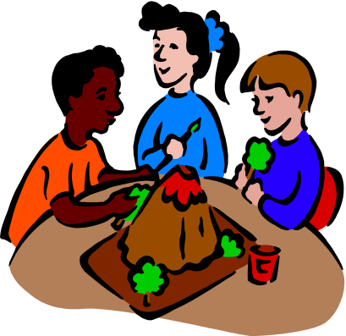
Culture and Socioeconomic Factors
Socioeconomic status (SES) is a composite of the economic status of a family or unrelated individuals based on:
  Income
  Wealth
  Occupation
  Educational attainment
  Power

Slide 28
Culture and Socioeconomic Factors (Cont.)
Poverty guidelines
  Determined by comparing pretax cash income with the poverty threshold adjusted for family size and composition issued annually by USDHHS.
  The U.S. Census Bureau (2012) reported that the poverty rate in 2011 was 15%
    African American population—27.6%
    Asian population—12.3%
    Hispanic population—25.3%
    Children under 6 years—24.5%

Slide 29
Culture and Socioeconomic Factors (Cont.)
Distribution of resources
  Upper, middle, and lower classes
    Total family income, occupation, and educational level
    Age, sex, material possessions, health status, family name, location of residence, family composition, amount of land owned, religion, race, and ethnicity
  A disproportionate number of individuals from the racially and ethnically diverse subgroups are members of the lower socioeconomic class
  Outcome of social stratification is social inequality

Slide 30
Culture and Socioeconomic Factors (Cont.)
Education
  Perhaps the single most important factor in SES.
  Child’s educational development affected more by differences in levels of formal schooling than by cultural differences or economic indices.

Slide 31

Culture and Nutrition
Culturally competent nutrition assessment:
  Cultural definition of food
  Frequency and number of meals eaten away from home
  Form and content of ceremonial meals
  Amount and types of food eaten
  Regularity of food consumption
  Social contacts during meals
Beware of cultural stereotyping.
Cultural food preferences are often interrelated with religious dietary beliefs and practices.

Slide 32

Culture and Religion
Culturally competent nursing care and religious factors:
  Gain a general understanding of religious calendars.
    Know the customary days of religious worship.
    Learn about special days of observance or celebration.
  Ask clients what religious practices they follow.
Religious beliefs may influence a client’s belief about the cause of illness, perception of its severity, choice of healer, and source of consolation.
Assess spiritual needs of clients.
Know the difference between religion and spirituality.
Remember that various religions have shared beliefs.

Slide 33
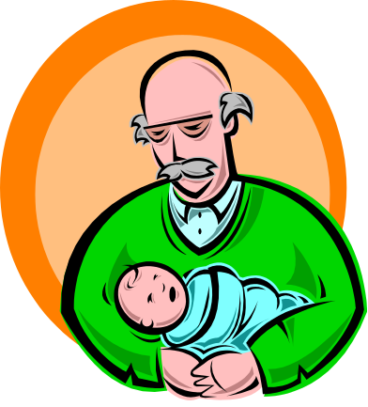
Culture and Aging
Different cultures view older adults in very different ways.
Tasks of older adults
  To achieve a sense of integrity in accepting responsibility for their own lives
  To have a sense of accomplishment
Older adults develop their own means of coping with illness through self-care, assistance from others, and social support groups.

Slide 34

Cross-Cultural (Intercultural) Communication …
… between a nurse and client attempts to understand the other’s point of view from a cultural perspective.
  Nurse-client relationship
  Space, distance, and intimacy
  Overcoming communication barriers
  Nonverbal communication
  Language
  Touch
  Gender

Slide 35
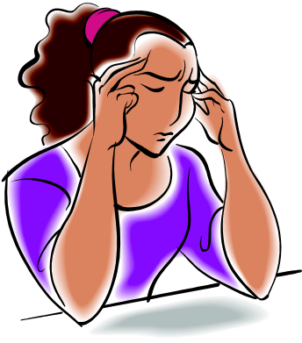
Health-Related Beliefs and Practices
Understand personal culturally based values, beliefs, attitudes, and practices.
Include the client’s beliefs about the cause of illness:
  Biomedical perspective
  Naturalistic perspective
  Magicoreligious perspective
Understand the role and value of folk or religious healers.

Slide 36

Health-Related Beliefs and Practices (Cont.)
Cultural variations exist in how symptoms and disease conditions are perceived, diagnosed, labeled, and treated.
Expression of pain is culturally determined.
Some conditions are culturally defined—a culture-bound syndrome.

Slide 37
Management of Health Problems:
A Cultural Perspective
First effort at treatment is often self-care.
  Mobilizes client’s social support network
  Provides a caring environment
Cultural negotiation is used when conceptual differences exist between client and nurse.
  Same words but different meanings
  Same phenomenon; different notions of causation
  Different memories or emotions associated with the term and its use

Slide 38
Cornerstones of Public Health Nursing
Focus on health of entire population
Reflect communities’ priorities and needs
Establish caring relationships
Remain grounded in social justice
Provide care for the whole person
Promote health based on epidemiological evidence (evidence-based practice)
Collaborate with community resources
– Keller, Strohschein, & Schaffer, 2011

Slide 39
Management of Health Problems in Culturally Diverse Populations
Providing health information and education
Delivering and financing health services
Developing health professionals from minority groups
Enhancing cooperative efforts with the nonfederal sector
Promoting a research agenda on minority health issues

Slide 40

Providing Health Information and Education
Developing programs to increase public awareness about health problems.
  Plan health information campaigns:
    Be sensitive to cultural factors.
    Involve community leaders.
    Acknowledge existing cultural beliefs and practices.
    Involve families, churches, employers, and community organizations as support systems.
    Use lay volunteers to organize community support networks.
  Client education should be interpersonal; carefully use credible printed materials and audiovisuals.

Slide 41
Role of the Community Health Nurse
Conduct a “culturological” assessment.
Conduct a cultural self-assessment.
Seek knowledge about local cultures.
Recognize political issues of culturally diverse groups.
Provide culturally competent care.
Recognize culturally based health problems.

Slide 42
Culturological Assessment
Brief history of ethnic and racial origins of the cultural group with which the client identifies
Values orientation
Cultural sanctions and restrictions
Communication
Health-related beliefs and practices
Nutrition

Slide 43
Culturological Assessment (Cont.)
Socioeconomic considerations
Organizations providing cultural support
Educational background
Religious affiliation
Cultural aspects of disease incidence
Biocultural variations
Developmental considerations

Slide 44
Resources for Minority Health
U.S. Department of Health and Human Services and Public Health Service
  Office of Minority Health
    Disadvantaged Minority Health Improvement Act of 1990
  Indian Health Service
    Indian Self-Determination Act of 1975
National Institutes of Health
  National Center on Minority Health and Health Disparities (NCMHD)

Slide 45
Federally Sponsored Initiatives to Improve Health of Minority Groups
HRSA Health Disparity Collaboratives (HDC)
Racial and Ethnic Approaches to Community Health (REACH 2010)
National Breast and Cervical Cancer Early Detection Program (NBCCEDP)
Ryan White Comprehensive AIDS Resources Emergency (CARE) Act B
National Center on Minority Health and Health Disparities (NCMHD)

