Slide 1
Chapter 4
Health Promotion and Risk Reduction
.

Slide 2
Health Promotion Is…
…any combination of health education and related organizational, economic, and environmental supports for behavior of individuals, groups, or communities conducive to health (Green & Kreuter, 1991)
…that which is motivated by the desire to increase well-being and to reach the best possible health potential (Parse, 1990)

Slide 3
Health Protection Is …(Cont.)
… those behaviors in which one engages with the specific intent to prevent disease, detect disease in the early stages, or maximize health within the constraints of disease (Parse, 1990)
… an important step in maintaining health

Slide 4
Defining Health
The way health is defined has shifted from a focus on the curative model, to a focus on multidimensional aspects such as the social, cultural, and environmental facets of life and health (Benson, 1996)
Health is viewed not only as an important goal, but as a resource for living (WHO, 1986)

Slide 5

Healthy People 2020 …
… is the health promotion initiative for the nation.
… challenges individuals, communities, and professionals … to take specific steps to ensure that good health, as well as long life, are enjoyed by all.
– U.S. Department of Health and
Human Services, 2012

Slide 6
Healthy People 2020 …
(Cont.)
Broad goals
  Attain high-quality, longer lives free of preventable disease, disability, injury, and premature death.
  Achieve high equity, eliminate disparities, and improve the health of all groups.
  Create social and physical environments that promote good health for all.
  Promote quality of life, healthy development, and healthy behaviors across all life stages.

Slide 7

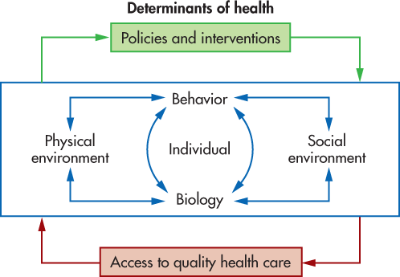
Determinants of Health
Biology
Behaviors
Social environment
Physical environment
Policies and interventions
Access to high-quality health care

Slide 8
Figure 4-1
From U.S. Department of Health and Human Services.

Slide 9

Theories in Health Promotion
Pender’s Health Promotion Model (HPM)
Health Belief Model (HBM)
Transtheoretical Model (TTM)
Theory of Reasoned Action (TRA)

Slide 10
Risk and Health
Risk is “the probability that a specific event will occur in a given time frame” (Oleckno, 2002).
A risk factor is an exposure that is associated with a disease (Friis & Sellers, 2004).
Risk Assessment is a systematic way of distinguishing the risks posed by potentially harmful exposures.

Slide 11





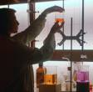


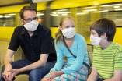
Steps in Risk Assessment
Hazard identification
Risk description
Exposure assessment
Risk estimation

Slide 12

Risk Assessment
Modifiable risks
  Individual has control
  Examples: smoking, lifestyle, eating habits, activities
Nonmodifiable risks
  Individual has little or no control
  Examples: genetics, gender, age, environmental exposure

Slide 13

Risk Reduction …
  … is a proactive process
  … enables individuals to react to actual or potential threats to their health
Risk communication …
  … is the process of informing the public regarding threats
  … is affected by perceptions, process, and actions

Slide 14

Tobacco and Health Risk
Leading cause of preventable death
Most common in less educated populations and those living below poverty level
Most common form of chemical dependency
Tobacco in all forms is harmful.

Slide 15

Health Promotion Activities
Look for teachable moments
Assess client’s tobacco use
Explore willingness to quit
Refer to cessation programs
Encourage attempts to quit

Slide 16

Alcohol Consumption and Health
Third leading lifestyle-related cause of death for the nation
Short-term use causes acute risks
Long-term effects have major impact on health and social issues
Influenced by legal drinking age
  # 1 used and abused drug among U.S. youth

Slide 17

Health Promotion Activities (Cont.)
Prevent underage drinking
Assist with enforcement of legal drinking age
Identify individuals and groups at risk of abuse and dependence
Educate adults and youth on dangers of alcohol
Requires a community-wide effort to address the problem on several fronts

Slide 18
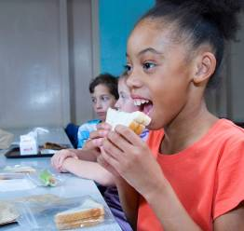
Diet and Health
Diet—one of most modifiable risk factors
Imbalance of caloric intake and physical activity
Complex interplay among metabolism, genetics, behavior, environment, culture, and socioeconomic status
Geographic areas, age, ethnicity all influence weight

Slide 19

Health Promotion Activities (Cont.)
Special populations have different nutritional needs
For individualized plans, see http://myplate.gov/
Educate clients about:
  Balancing caloric intake and physical activity
  Servings vs. portion control
  Eating away from home affects “portion distortion”
  Using social media and mobile applications to help

Slide 20

Physical Activity and Health
Physical activity serves both health promotion and disease prevention purposes
Leisure activities are influenced by level of education, gender, age, economic level, geography
One’s environment plays a significant role in activity level

Slide 21
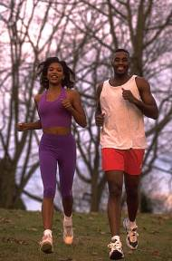
Health Promotion Activities (Cont.)
Support and develop “walkable” neighborhoods and cities
Determine recommended exercise levels for individuals
Visit http://www.cdc.gov/physicalactivity/data/facts.html

Slide 22

Sleep and Health
Sleep is an essential component of chronic disease prevention and health promotion
Requirements change with age and life circumstances
Regulated by waking time and circadian rhythms
Hormones during sleep affect memory, blood pressure, and kidney function.

Slide 23

Health Promotion Activities (Cont.)
Sleep assessment is important
  Identify disorders that may affect daily activities
  Keep sleep log
Practice sleep hygiene
  Establish environment that promotes sleep
  Avoid food and activities that interfere with sleep

