Slide 1
Environmental
Scanning and
Industry Analysis
Chapter 4

Slide 2
Environmental Scanning
Environmental scanning
  the monitoring, evaluation, and dissemination of information relevant to the organizational development of strategy
Notes:
Environmental scanning is the monitoring, evaluation and dissemination of information relevant to the organizational development of strategy

Slide 3
Identifying External
Environmental Variables
Natural environment
  includes physical resources, wildlife and climate that are an inherent part of existence on Earth
  form an ecological system of interrelated life
Notes:
The natural environment includes physical resources, wildlife and climate that are an inherent part of existence on Earth. These factors form an ecological system of interrelated life.

Slide 4
Identifying External
Environmental Variables
Societal environment
  mankind’s social system that includes general forces that do not directly touch on the short-run activities of the organization, but that can influence its long-term decisions
  economic, technological, political-legal and sociocultural (PEST)
Notes:
The societal environment is mankind’s social system that includes general forces that do not directly touch on the short-run activities of the organization, but that can influence its long-term decisions. These factors affect multiple industries and are as follows: economic, technological, political-legal and sociocultural.

Slide 5
Scanning the Societal Environment: STEEP Analysis
STEEP Analysis
  monitoring trends in the societal and natural environments
  sociocultural, technological, economic, ecological and political-legal forces
Notes:
This scanning can be called STEEP Analysis, the scanning of sociocultural, technological, economic, ecological, and political–legal environmental forces.

Slide 6
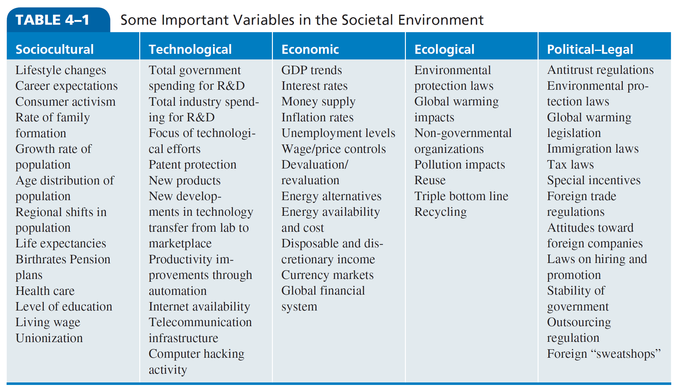
Some Important Variables in the Societal Environment
Notes:
As shown in Table 4–1, large corporations categorize the natural and societal environments in any one geographic region into five areas and focus their scanning in each area on trends that have corporatewide relevance.

Slide 7
Identifying External
Environmental Variables
Task environment
  those elements or groups that directly affect a corporation and, in turn, are affected by it
  government, local communities, suppliers, competitors, customers, creditors, unions, special interest groups/trade associations
  What is another name for such groups?
Notes:
The task environment includes those elements or groups that directly affect a corporation and, in turn, are affected by it. These are governments, local communities, suppliers, competitors, customers, creditors, employees/labor unions, special-interest groups and trade associations.

Slide 8
Identifying External
Environmental Variables
Industry analysis
  an in-depth examination of key factors within a corporation’s task environment
Notes:
Industry analysis is an in-depth examination of key factors within a corporation’s task environment.

Slide 9
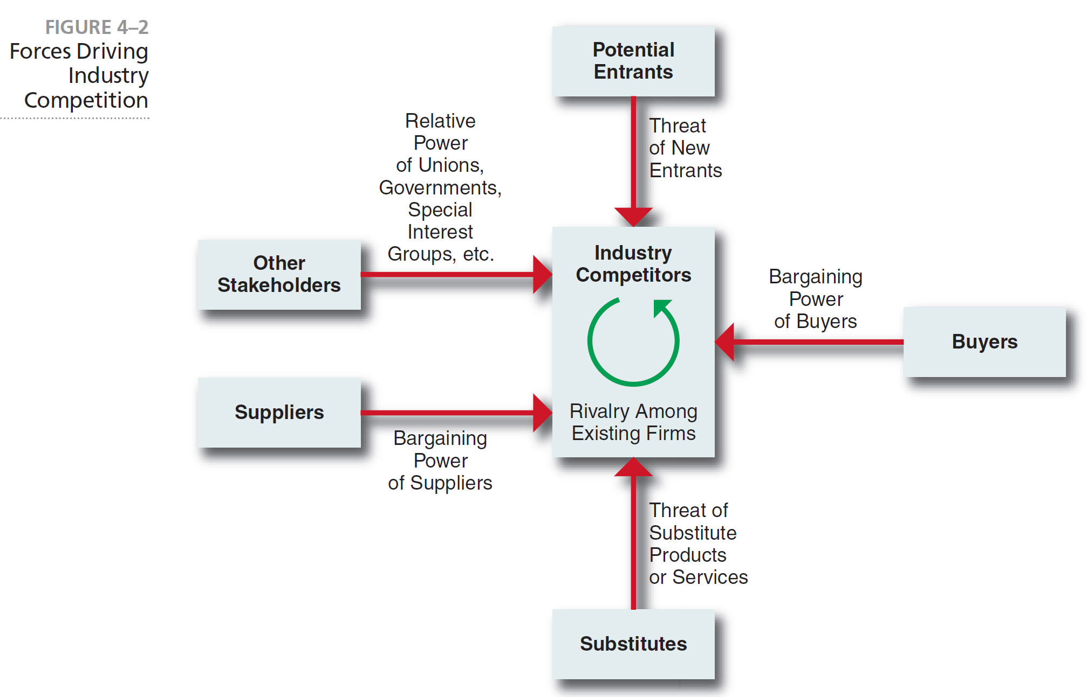
Forces Driving Industry Competition
Notes:
Michael Porter, an authority on competitive strategy, contends that a corporation is most concerned with the intensity of competition within its industry. The level of this intensity is determined by basic competitive forces, as depicted in Figure 4–2.

Slide 10
Threat of New Entrants
Threat of new entrants
  new entrants to an industry bring new capacity and resources, a desire to gain market share and substantial resources.
  How will existing competitors react?
Entry barrier
  an obstruction that makes it difficult for a company to enter an industry
Notes:
New entrants to an industry typically bring to it new capacity, a desire to gain market share and potentially substantial resources.
An entry barrier is an obstruction that makes it difficult for a company to enter an industry.

Slide 11
Barriers to Entry
Economies of scale
Product differentiation
Capital requirements
Switching costs
Access to distribution channels
Cost disadvantages due to size
Government policies
Notes:
Some of the possible barriers to entry are:
• Economies of scale
• Product differentiation
• Capital requirements
• Switching costs
• Access to distribution channels
• Cost disadvantages due to size
• Government policies

Slide 12
Rivalry among Existing Firms
Number of competitors
Rate of industry growth
Product or service characteristics
Amount of fixed costs
Capacity
Height of exit barriers
Diversity of rivals
Notes:
According to Porter, intense rivalry is related to the presence of several factors, including:
• Number of competitors
• Rate of industry growth
• Product or service characteristics
• Amount of fixed costs
• Capacity
• Height of exit barriers
• Diversity of rivals

Slide 13
Threat of Substitute
Products or Services
Substitute product
  a product that appears to be different but can satisfy the same need as another product
  Switching costs affect the level of the threat; which affects the potential returns of industry
The identification of possible substitute products means searching for products that can perform the same function, even though they have a different appearance. Not easy to identify.
Notes:
A substitute product is a product that appears to be different but can satisfy the same need as another product. The identification of possible substitute products or services means searching for products or services that can perform the same function, even though they have a different appearance and may not appear to be easily substitutable.

Slide 14
The Bargaining Power of Buyers
Bargaining power of buyers
  ability of buyers to force prices down, bargain for higher quality and play competitors against each other
  Large purchases, backward integration, alternative suppliers, low cost to change suppliers, product represents a high percentage of buyer’s cost, buyer earns low profits, product is unimportant to buyer
Notes:
Buyers affect an industry through their ability to force down prices, bargain for higher quality or more services and play competitors against each other. A buyer or a group of buyers is powerful if some of the following factors hold true: large purchases, backward integration, alternative suppliers, low cost to change suppliers, product represents a high percentage of buyer’s cost, buyer earns low profits and product is unimportant to buyer.

Slide 15
The Bargaining Power of Buyers
Buyers affect an industry through their ability to force down prices, bargain for higher quality or more services and play competitors against each other.
Notes:
Buyers affect an industry through their ability to force down prices, bargain for higher quality or more services and play competitors against each other.

Slide 16
The Bargaining Power of Suppliers
A supplier is powerful if some of the following factors hold true:
Industry is dominated by few suppliers
Unique product or service
Substitutes are not readily available
Ability to forward integrate
Notes:
A buyer or a group of buyers is powerful if some of the following factors hold true:
• Industry is dominated by a few companies
• Unique product or service
• Substitutes are not readily available
• Ability to forward integrate
• Unimportance of product or service to the industry

Slide 17
Industry Evolution
Fragmented industry
  no firm has a large market share and each firm only serves a small piece of the total market in competition with other firms
Consolidated industry
  domination by a few large firms, each struggles to differentiate products from its competition
Notes:
A fragmented industry is one where no firm has large market share, and each firm serves only a small piece of the total market in competition with
others (for example, cleaning services).
A consolidated industry is one dominated by a few large firms, each of which struggles
to differentiate its products from those of the competition

Slide 18
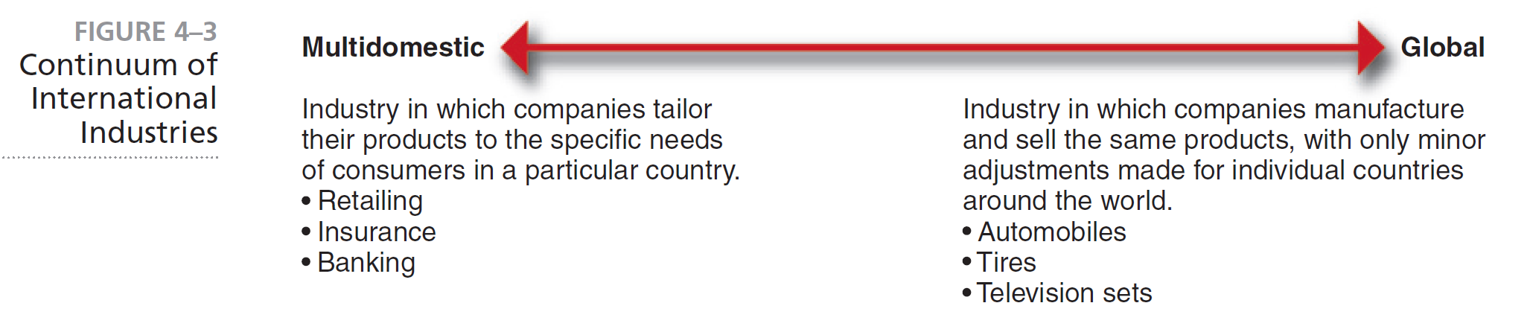
Continuum of
International Industries
Notes:
According to Porter, worldwide industries vary on a continuum from multi-domestic to global (see Figure 4–3).

Slide 19
Strategic Groups
Strategic group
  a set of business units or firms that pursue similar strategies with similar resources
Notes:
A strategic group is a set of business units or firms that “pursue similar strategies with similar resources.”

Slide 20
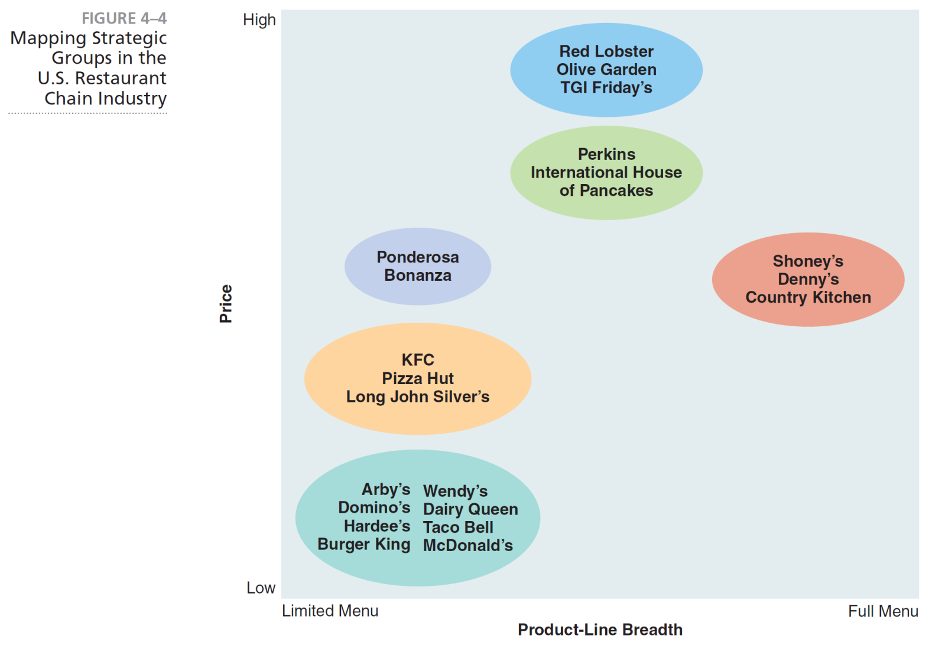
Mapping Strategic Groups in the
U.S. Restaurant Chain Industry
Notes:
Strategic groups in a particular industry can be mapped by plotting the market positions of industry competitors on a two-dimensional graph, using two strategic variables as the vertical and horizontal axes (see Figure 4–4).

Slide 21
Strategic Types
Defenders
  focus on improving efficiency (limited product line)
Prospectors
  focus on product innovation and market opportunities
Analyzers
  focus on at least two different product market areas (one product stable, the other variable)
Reactors
  lack a consistent strategy-structure-culture relationship
Notes:
These general types have the following characteristics:
Defenders are companies with a limited product line that focus on improving the efficiency of their existing operations.
Prospectors are companies with fairly broad product lines that focus on product innovation and market opportunities.
Analyzers are corporations that operate in at least two different product-market areas, one stable and one variable.
Reactors are corporations that lack a consistent strategy-structure-culture relationship.

Slide 22
Competitive Intelligence
Competitive intelligence
  a formal program of gathering information on a company’s competitors
  also called business intelligence
Sources of competitive intelligence:
Information brokers
Internet
Industrial espionage
Investigatory services
Notes:
Competitive intelligence is a formal program of gathering information on a company’s competitors. Often called business intelligence, it is one of the fastest growing fields within strategic management. Sources of competitive intelligence are:
• Information brokers
• Internet
• Industrial espionage
• Investigatory services

Slide 23
Useful Forecasting Techniques
Extrapolation
Brainstorming
Expert opinion
Delphi technique
Statistical modeling
Prediction markets
Cross impact analysis
Notes:
Some useful forecasting techniques are:
• Extrapolation
• Brainstorming
• Expert opinion
• Delphi technique
• Statistical modeling
• Prediction markets
• Cross impact analysis

Slide 24
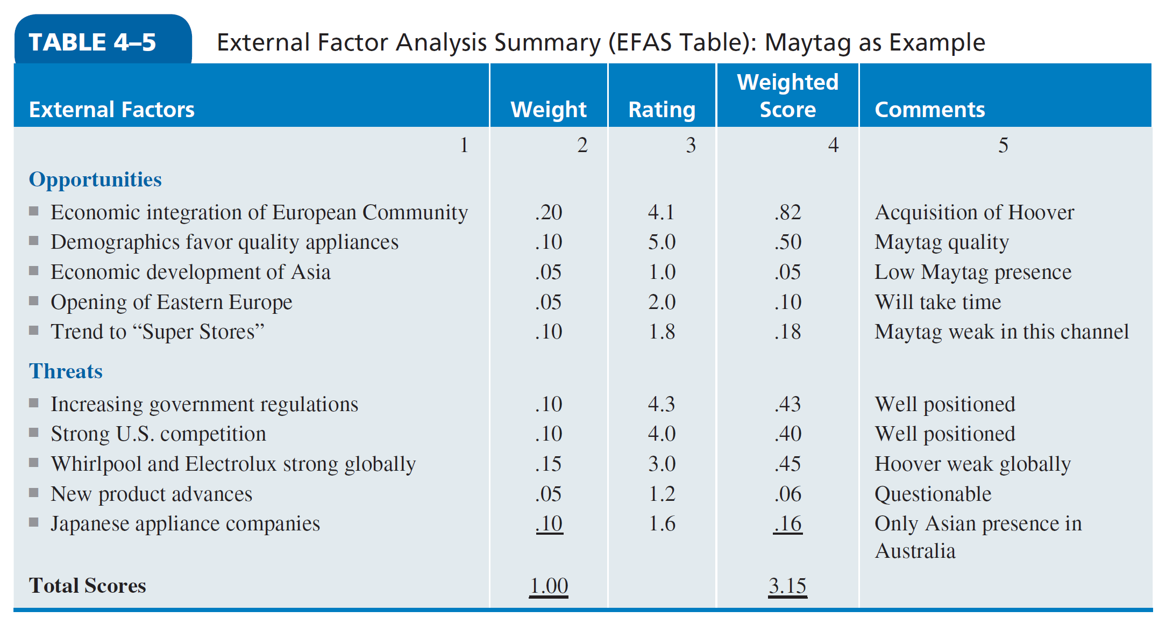
Synthesis of External Factors—EFAS
Notes:
After strategic managers have scanned the natural, societal and task environments and identified a number of likely external factors for their particular corporation, they may want to refine their analysis of these factors by using a form such as that given in Table 4–5.

