Slide 1
Chapter 6
Community Assessment

Slide 2
Defining the Community
Aggregate of people
  The “who”
  Share personal characteristics and risks
Location in space and time
  The “where” and “when”
  Physical location frequently delineated by boundaries and influenced by the passage of time
Social system
  The “why” and “how”
  Interrelationships of aggregates fulfilling community functions

Slide 3
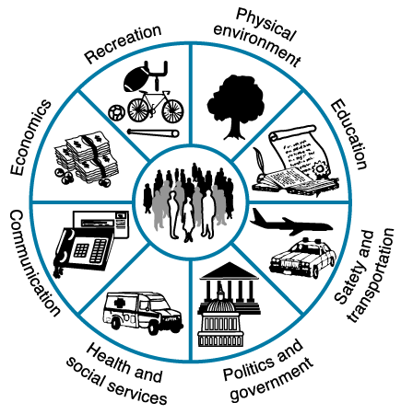
Diagram of Assessment Parameters
Figure 6-1

Slide 4
Community Assessment Parameters
Geography
Population
Environment
Industry
Education
Recreations
Religion
Communication
Transportation
Public services
Political organization
Community development or planning
Disaster programs
Health statistics
Social problems
Health manpower
Health professional organizations
Community services

Slide 5
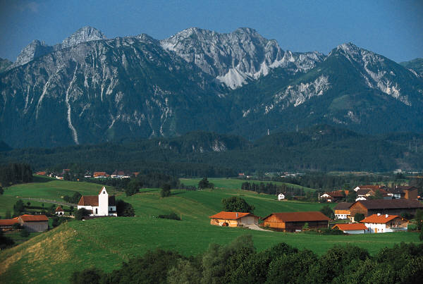

Healthy Communities
A movement to help community members bring about positive health changes
Interconnectedness between people and the public and private sectors is essential to make changes.
Each community has its unique perspective.

Slide 6

Assessing the Community
Windshield survey
  Gain an understanding of environmental layout
  Locate possible areas of environmental concern through “sight, sense, and sound”
  Gives nurse an opportunity to observe people and their role in the community

Slide 7

Windshield Survey
Community vitality
Indicators of social and economic conditions
Health resources
Environmental conditions related to health
Social functioning
Attitudes toward health and health care

Slide 8
Assessing the Community (Cont.)
Sources of data:
  Census data and other census reports
  Vital statistics
  NCHS survey data
  Local, regional, and state government reports
  Locally generated data collection
Analysis of demographic information provides descriptive information about the population

Slide 9

Assessing the Community (Cont.)
Needs assessment
  Used to understand the community’s perspective
  Interview key community informants
  Use community forums, focus groups, or surveys
  12 Steps in a Needs Assessment

Slide 10
Steps in the Needs Assessment Process
Identify aggregate for assessment
Engage the community in planning the assessment
Identify required information
Select method of data gathering
Develop questionnaires or interview questions
Develop procedures for data collection

Slide 11
Steps in the Needs Assessment Process (Cont.)
Train data collectors
Arrange for a sample representative of the aggregate
Conduct needs assessment
Tabulate and analyze data
Identify needs suggested by data
Develop an action plan

Slide 12

Nursing Process
The nursing process can be applied to the community as a client.
                Needs assessment
                Diagnosing health problems (actual and potential)
                Planning
                Intervention
                Evaluation

Slide 13
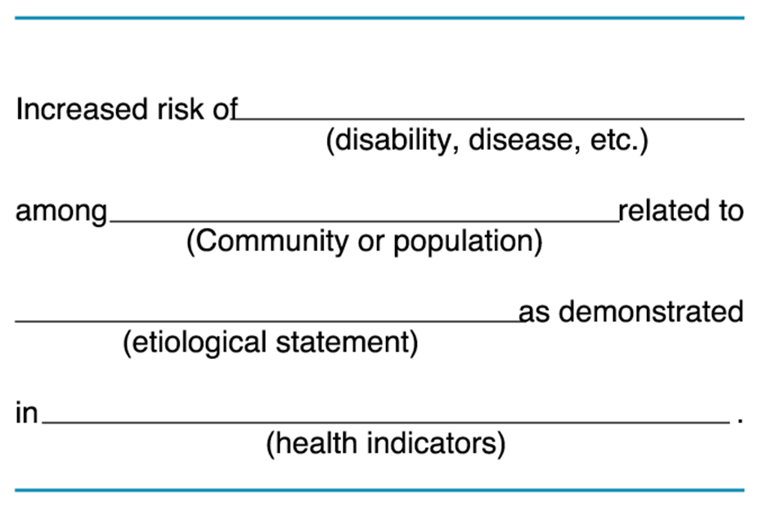
Format for Community Health Diagnosis
Figure 6-3 Redrawn from Muecke MA: Community health diagnosis in nursing, Public Health Nurs 1:23-35, 1984. Used with permission of Blackwell Scientific Publications.

Slide 14
Epidemiological Studies Used Throughout the Nursing Process
Support planning by establishing effectiveness of certain interventions in specific aggregates
Construct benchmarks to gauge achievement of program objectives
Compare data with other rates
Identify objectives of successful programs
Document effectiveness with epidemiological data

