Slide 1
Chapter 2
Historical Factors:
Community Health Nursing in Context

Slide 2
Stages* in the Disease History of Humankind
Hunting and gathering (before 10,000 B.C.)
Settled villages (10,000 to 6000 B.C.)
Preindustrial cities (6000 B.C. to 1800 A.D.)
Industrial cities (1700 to 1800 A.D.)
Present period (1900 to 2000 A.D.)
  *Stages overlap and time periods are widely debated in the field of anthropology. Some form of each stage remains evident in the world today.

Slide 3
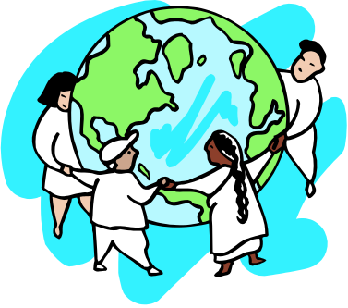
Aggregate Impact on Health
Increased population
Increased population density
Imbalanced human ecology
  Resulted in changes in cultural adaptation

Slide 4

Evolution of Early Public Health Efforts
Prerecorded historic times (before 5000 B.C.)
  Practices based on superstition or sanitation
  Health practices evolved to ensure survival

Slide 5
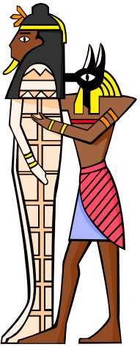
Evolution of Early Public Health Efforts (Cont.)
Classical times (3000 to 200 B.C.)
  Devised ways to flush water; constructed drainage systems
  Developed pharmaceutical preparations
  Embalmed the dead
  Dealt with pollution
  Hygienic code to protect food and water
  Greek and Roman impact public health

Slide 6
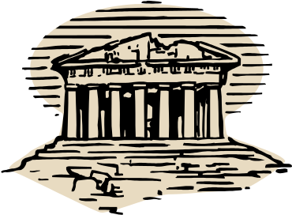
Evolution of Early Public Health Efforts (Cont.)
Greeks
  Literature contains accounts of communicable diseases
    Endemic, epidemic, and pandemic
  Hippocratic book on Airs, Waters and Places
  Hygeia, goddess of health, or good living
  Panacea, goddess of curative medicine
  Balance of human life with environmental demands

Slide 7
Disease Definitions
Disease | Definitions
Endemic | Diseases that are always present in a population (e.g., colds and pneumonia).
Epidemic | Diseases that are not always present in a population but flare up on occasion (e.g., diphtheria and measles).
Pandemic | The existence of disease in a large proportion of the population—a global epidemic (e.g., HIV, AIDS, and annual outbreaks of influenza type A).

Slide 8
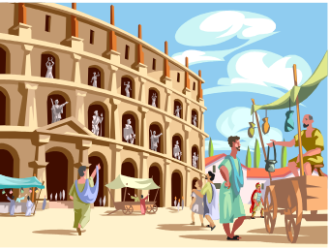
Evolution of Early Public Health Efforts (Cont.)
Romans
  Surpassed Greek engineering
    Massive aqueducts, bathhouses, and sewer systems
  Addressed occupational health threats
  Priests mediated diseases and dispensed medicine
  Public physicians worked in designated towns
    Worked in groups much like today’s HMOs
    Eared money to care for the poor
  Hospital for sick poor established by Fabiola, a Christian woman

Slide 9
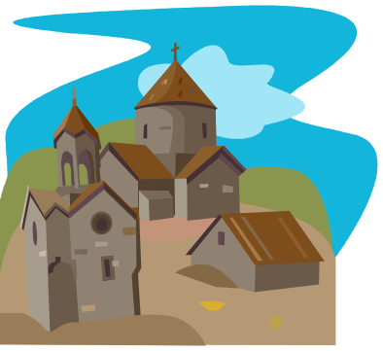
Evolution of Early Public Health Efforts (Cont.)
Middle Ages (500 to 1500 A.D.)
  Monasteries promoted collective activity to protect public health.
  Churches enforced hygienic codes.
  A pandemic ravaged the world in the 14th century.
  Modern public health practices (e.g., isolation, disinfection, quarantines) emerged.

Slide 10
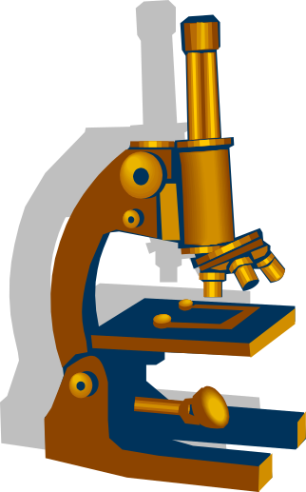
Evolution of Early Public Health Efforts (Cont.)
Renaissance (15th, 16th, 17th centuries)
  A theory about the cause of infection evolved.
  Leeuwenhoek described microscopic organisms.
  Elizabethan Poor Laws were enacted.

Slide 11
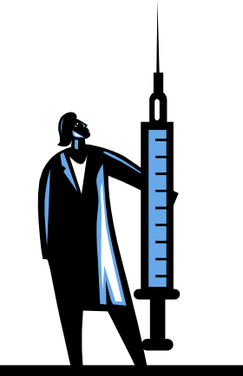
Evolution of Early Public Health Efforts (Cont.)
18th century
  The Industrial Revolution occurred.
  Poor children were forced into labor.
  Vaccination was discovered by Edward Jenner.
  Sanitary Revolution’s public health
  reforms were taking place.

Slide 12
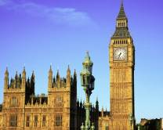
Evolution of Early Public Health Efforts (Cont.)
19th century
  Communicable diseases ravaged the population that lived in unsanitary conditions.
  Edwin Chadwick examined death rates by occupation and class in England.
  The General Board of Health for England was established in 1848.

Slide 13
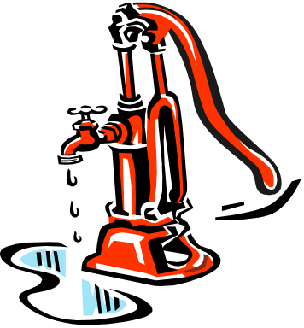
Evolution of Early Public Health Efforts (Cont.)
19th century (Cont.)
  Public health laws were enacted in 1849:
    Healthy mental and physical development of citizens
    Prevention of all dangers to health
    Control of disease
  John Snow demonstrated the transmission
  of cholera via the public water source.

Slide 14
Evolution of Early Public Health Efforts (Cont.)
19th century (Cont.)
  Waves of epidemics occurred in the United States.
  Lemuel Shattuck published vital statistics in Massachusetts; he called for child health reform.
  The first Board of Health was formed in response.
  The AMA was asked to collected vital statistics.
  Efforts focused on determinants of health.
  The advent of “modern” health care occurred.

Slide 15
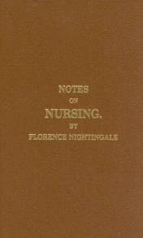
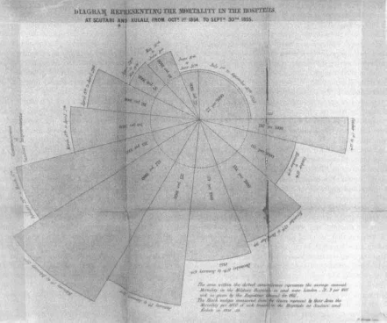
Florence Nightingale (1820-1910)
Credited with establishing “modern nursing”
Concern for environmental determinants of health
Emphasis on sanitation, community assessment, and analysis
Use of graphically depicted statistics and comparable census data
Political advocate
Education reform for nurses
Figure 2-2
Public domain; courtesy University of Chicago Library.

Slide 16
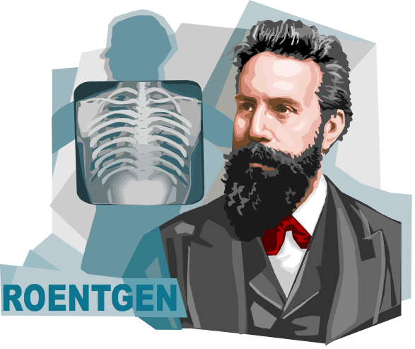
Impact of Important Scientists
Louis Pasteur
  Theory of existence of germs
  Discovered immunizations in 1881 and the rabies vaccine in 1885
Robert Koch
  Discovered causative agent for cholera and the tubercle bacillus in 1882
Joseph Lister
  Surgical success with wound care

Slide 17

“Modern” Medical Care
Emergence of germ theory focused diagnosis and treatment on individual organism and individual disease.
Community outcry for social reforms forced governments to take action.
Boards of health and health departments began in 1866.
TB surveillance began in 1889.

Slide 18

“Modern” Medical Care (Cont.)
Flexner Report (1910) outlined shortcomings of U.S. medical schools.
Philanthropic foundations influenced health care efforts.
1916: Rockefeller Foundation
established first school of
public health at Johns Hopkins.

Slide 19
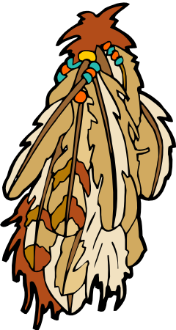
Community Caregiver
Traditional healer common in non-Western, ancient, and primitive societies.
Societies retain folk practices because of their success.
Folk healing practices are socially cohesive and involve support systems.
Although often overlooked, cultural
practices affect health.

Slide 20

Establishment of Public Health Nursing
In England
  District Nursing in England, 1850s
  Rathbone worked with Nightingale to educate “health nurses,” 1859
  Health Visiting in Manchester, England, 1862
In the United States
  Visiting Nurses, 1877
  Henry Street Settlement, 1893

Slide 21
Lillian Wald (1867-1940)
Established Henry Street Settlement in 1893 (along with Mary Brewster)
Played an important role in establishing public health nursing in the United States—later called “Visiting Nurses Association of NYC”
Role of Henry Street Settlement was “one of helping people to help themselves” (Wald, 1871)
The Children’s Bureau and the
Social Security Act Legislation
formed as a result of these efforts

Slide 22
Other Key Dates in the Establishment of PH Nursing
First School Nurse, Linda Rogers, 1902
Metropolitan Life Insurance Company provided home nurses for policyholders, 1909
Department of Nursing and Health at Teachers’ College of Columbia University in NYC, 1910
National Organization of Public Health Nurses formed, 1912 (Lillian Wald was first president)
Public Health Service appointed its first public health nurse, 1913

Slide 23
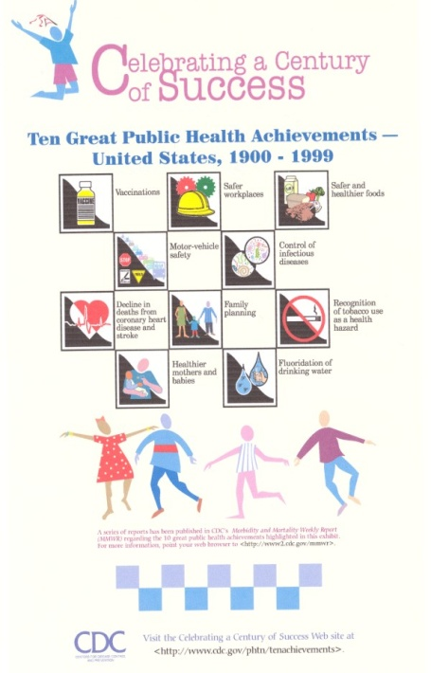
Changing Perspectives on Mortality in the 20th Century and Beyond
Change from infectious diseases to chronic conditions
Modern medical advances (vaccination programs and antibiotics)
Holistic approach to health
Better sanitation and nutrition
Grecian Hygeia (i.e., healthful living) vs. Panacea (i.e., cure) dichotomy
Multi-causal, not uni-causal,
view of disease

Slide 24
Challenges for Community Health Nursing
Promote the health of populations
Need a broadened focus on the multiple causes of morbidity and mortality
Aware of increased technological advances
Understand the community need for a focus on prevention, health promotion, and home care
Focus on holistic care

Slide 25
Challenges for Community Health Nursing (Cont.)
Emphasis on population-based focus nursing
  Work on behalf of aggregates
  Understand social determinants of health
  Gather information and statistics to make decisions
  Be part of the solution to find ways to solve persistent health problems
  Emphasize society’s responsibility for health
  Empower people to help themselves

