Slide 1
Chapter 1
Health: A Community View
Notes:
Nies: Power Points, Evolve Resources for Nies/McEwen: Community Health Nursing, 4th ed.
1

Slide 2
Community/Public Health Nursing …
… is the synthesis of nursing practice and public health practice.
… has the major goal to preserve the health of the community and surrounding populations.
… focuses on health promotion and health maintenance.
… is associated with health and identification of populations at risk rather than an episodic response to patient demand.
Notes:
Nies: Power Points, Evolve Resources for Nies/McEwen: Community Health Nursing, 4th ed.
2

Slide 3

The mission of public health is …
… social justice, which entitles all people to basic necessities such as adequate income and health protection and accepts collective burdens to make this possible.
http://www.health.gov/phfunctions/public.htm
Notes:
Nies: Power Points, Evolve Resources for Nies/McEwen: Community Health Nursing, 4th ed.
3

Slide 4
How Do We Define Health?
A state of complete well-being, physical, social, and mental, and not merely the absence of disease or infirmity.
– World Health Organization, 1958
The extent to which an individual or group is able, on the one hand, to realize aspirations and satisfy needs; and, on the other hand, to change or cope with the environment. Health is, therefore, seen as a resource for everyday life, not the objective of living; it is a positive concept emphasizing social and personal resources, and physical capacities.
    – World Health Organization, 1986
Notes:
Nies: Power Points, Evolve Resources for Nies/McEwen: Community Health Nursing, 4th ed.
4

Slide 5

Community …
… a group or collection of locality-based individuals, interacting in social units and sharing common interests, characteristics, values, and/or goals.
Nies and McEwen, 2013
Notes:
Nies: Power Points, Evolve Resources for Nies/McEwen: Community Health Nursing, 4th ed.
5

Slide 6
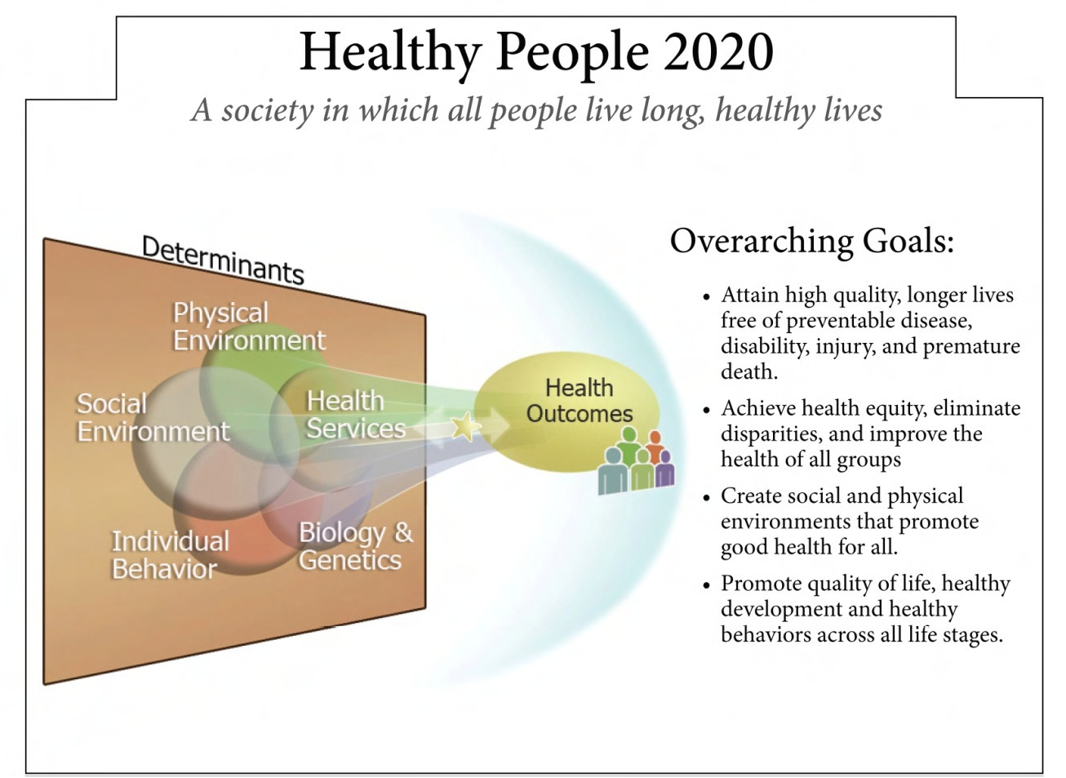
Figure 1-2
From U.S. Department of Health and Human Services Office of Disease Prevention and Health Promotion. Federal Interagency Workgroup: The vision, mission, and goals of Healthy People 2020. http://www.healthypeople.gov/2020/Consortium/HP2020Framework.pdf. Accessed July 2013.
Notes:
Nies: Power Points, Evolve Resources for Nies/McEwen: Community Health Nursing, 4th ed.
6

Slide 7

Healthy People 2020 Leading Health Indicators
Access to Health Services
Clinical Preventive Services
Environmental Quality
Injury and Violence
Maternal, Infant, and Child Health
Mental Health
Nutrition, Physical Activity, and Obesity
Oral Health
Reproductive and Sexual Health
Social Determinants
Substance Abuse
Tobacco Use
Notes:
Nies: Power Points, Evolve Resources for Nies/McEwen: Community Health Nursing, 4th ed.
7

Slide 8
Public and Community Health
Public health is the Science and Art of …
  (1) preventing disease,
  (2) prolonging life, and
  (3) promoting health and efficiency through organized community effort…
  C.E. Winslow…
Community health extends the realm of public health …
  …to include organized health efforts at the community level through both government and private efforts.

Slide 9
Core Public Health Functions
Assessment: Regular collection, analysis, and information sharing about health conditions, risks, and resources in a community.
Policy development: Use of information gathered during assessment to develop local and state health policies and to direct resources toward those policies.
Assurance: Focuses on the availability of necessary heath services throughout the community. It includes maintaining the ability of both public health agencies and private providers to manage day-to-day operations and the capacity to respond to critical situations and emergencies.
– Institute of Medicine (1988)
Notes:
Nies: Power Points, Evolve Resources for Nies/McEwen: Community Health Nursing, 4th ed.
9

Slide 10
10 Essential Services
Assessment
  Monitor health status to identify community health problems.
  Diagnose and investigate health problems and health hazards in the community.
  Research for new insights and innovative solutions to health problems.
Notes:
Nies: Power Points, Evolve Resources for Nies/McEwen: Community Health Nursing, 4th ed.
10

Slide 11
10 Essential Services (Cont.)
Policy Development
  Inform, educate, and empower people about health issues.
  Mobilize community partnerships to identify and solve health problems.
  Develop policies and plans that support individual and community health efforts.
  Research for new insights and innovative solutions to health problems.
Notes:
Nies: Power Points, Evolve Resources for Nies/McEwen: Community Health Nursing, 4th ed.
11

Slide 12
10 Essential Services (Cont.)
Assurance
  Enforce laws and regulations that protect health and ensure safety.
  Link people to needed personal health services and ensure the provision of health care when otherwise unavailable.
  Ensure a competent public health and personal health care workforce.
  Evaluate effectiveness, accessibility, and quality of personal and population-based health services.
  Research for new insights and innovative solutions to health problems.
Notes:
Nies: Power Points, Evolve Resources for Nies/McEwen: Community Health Nursing, 4th ed.
12

Slide 13
The Three Levels of Prevention
Primary prevention
  Prevention of problems before they occur
  Health promotion and health protection
Secondary prevention
  Early detection and intervention
  Early diagnosis and treatment
Tertiary prevention
  Correction and prevention of deterioration of a disease state
  Limitation of disability and rehabilitation
Notes:
Nies: Power Points, Evolve Resources for Nies/McEwen: Community Health Nursing, 4th ed.
13

Slide 14
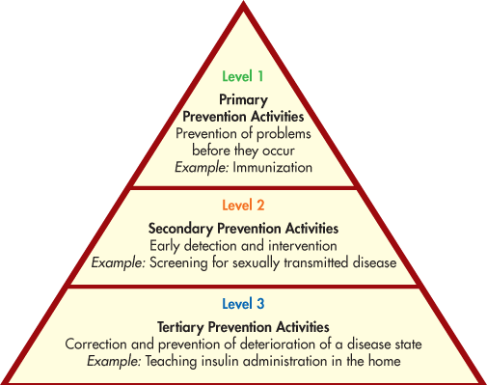
The Three Levels of Prevention (Cont.)
Figure 1-2
Notes:
Nies: Power Points, Evolve Resources for Nies/McEwen: Community Health Nursing, 4th ed.
14

Slide 15
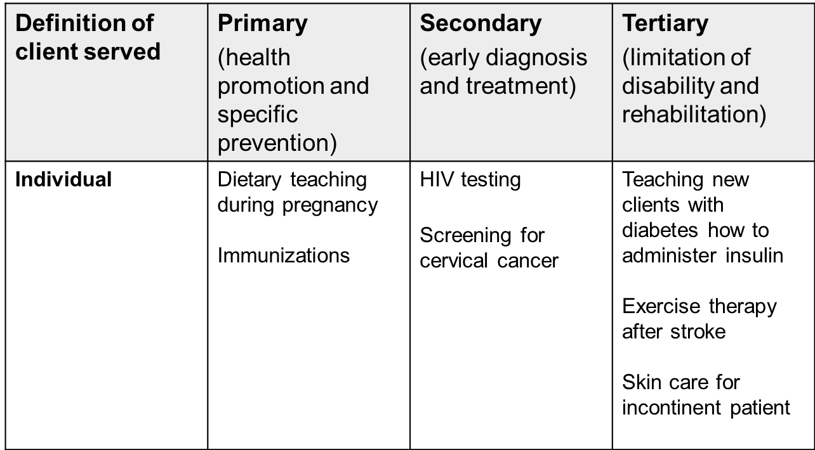
Level of Prevention—Individual
Notes:
Nies: Power Points, Evolve Resources for Nies/McEwen: Community Health Nursing, 4th ed.
15

Slide 16
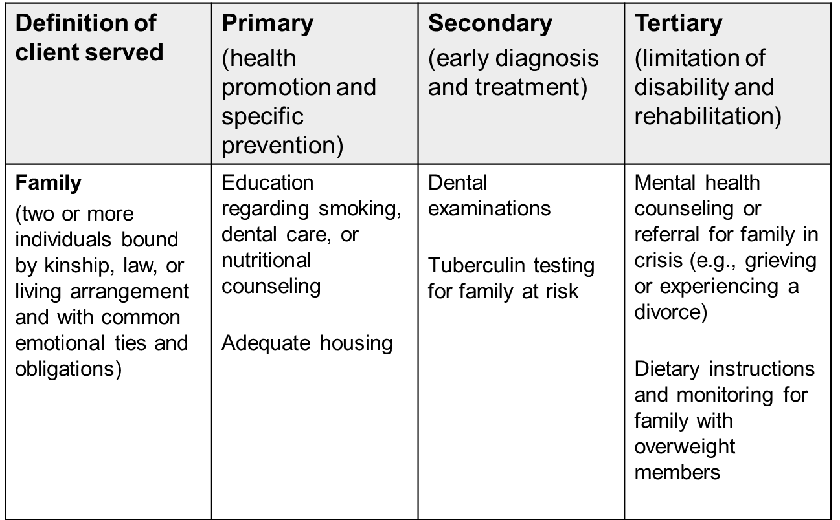
Level of Prevention—Family
Notes:
Nies: Power Points, Evolve Resources for Nies/McEwen: Community Health Nursing, 4th ed.
16

Slide 17
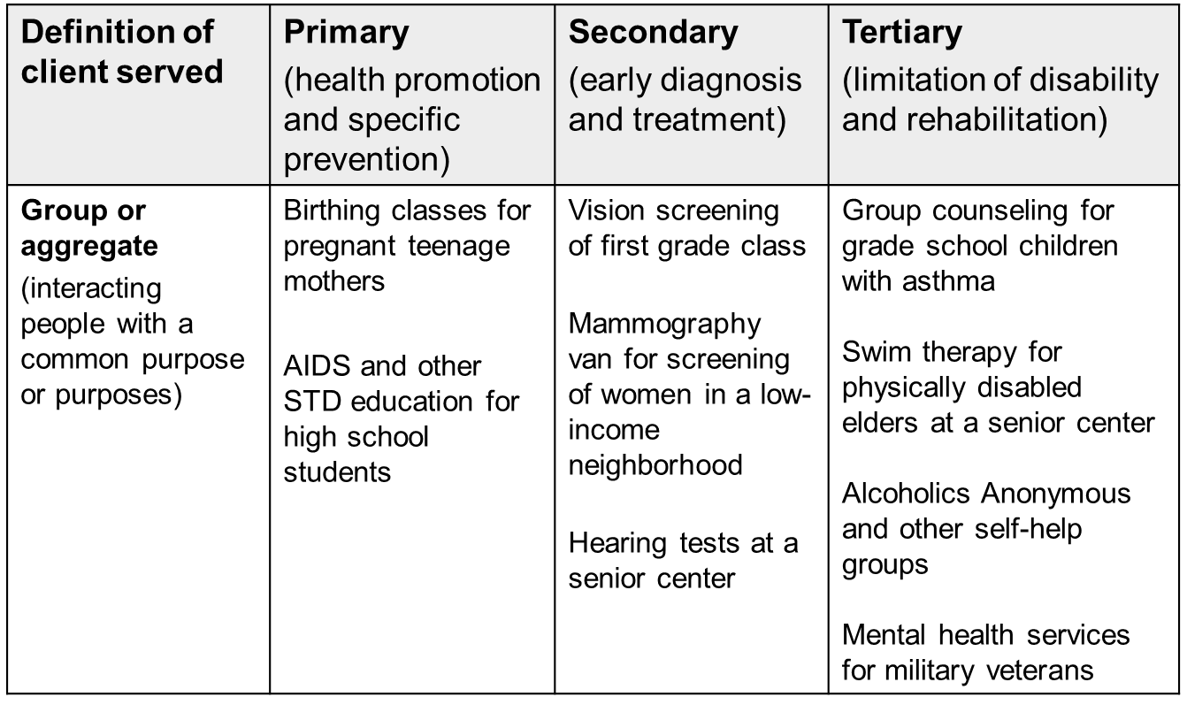
Level of Prevention—Group
Notes:
Nies: Power Points, Evolve Resources for Nies/McEwen: Community Health Nursing, 4th ed.
17

Slide 18
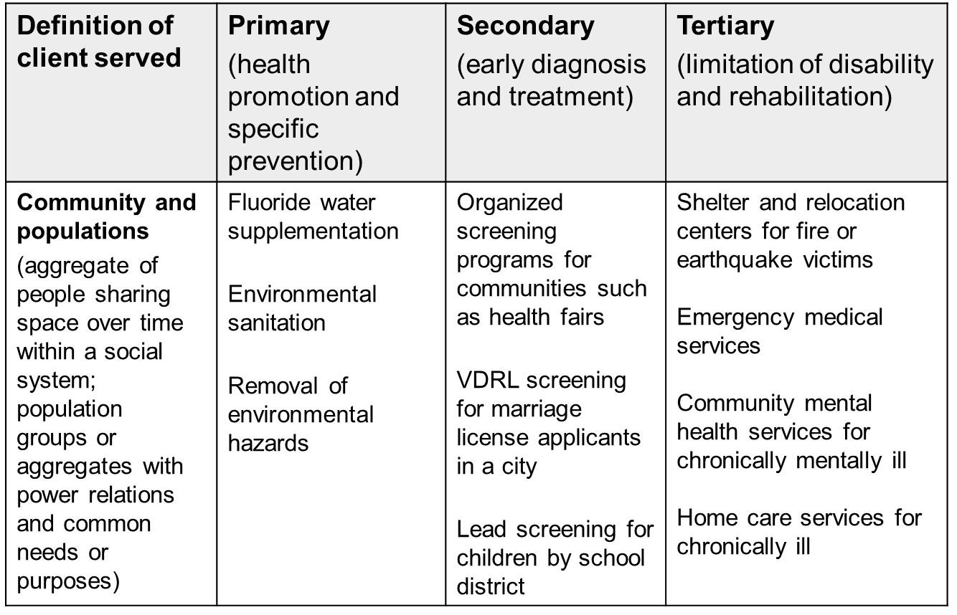
Level of Prevention—Community
Notes:
Nies: Power Points, Evolve Resources for Nies/McEwen: Community Health Nursing, 4th ed.
18

Slide 19

Healthy People 2020
Vision
  A society in which all people live long, healthy lives.
Overarching Goals
  Attain high-quality, longer lives free of preventable disease, disability, injury, and premature death.
  Achieve health equity, eliminate disparities, and improve the health of all groups.
  Create social and physical environments that promote good health for all.
  Promote quality of life, healthy development, and healthy behaviors across all life stages.
Notes:
Nies: Power Points, Evolve Resources for Nies/McEwen: Community Health Nursing, 4th ed.
19

Slide 20
Healthy People 2020
(Cont.)
HP2020 has 42 focus areas
  The objectives and related information and materials can help guide health promotion activities and can be used to aid in community-wide initiatives.
  (USDHHS, 2013)
  All health care practitioners…
    should focus on the relevant areas in their practice
    incorporate objectives into programs, events, and publications whenever possible
    use them as a framework to promote healthy cities and communities
Notes:
Nies: Power Points, Evolve Resources for Nies/McEwen: Community Health Nursing, 4th ed.
20

Slide 21
Healthy People 2020 Topic Areas
Access to Quality Health Services
Adolescent Health ^{New}
Arthritis, Osteoporosis and Chronic Back Conditions
Blood Disorders and Blood Safety ^{New}
Cancer
Chronic Kidney Disease
Dementias, including Alzheimer’s Disease ^{New}
Diabetes
Disability and Secondary Conditions
Early and Middle Childhood
Educational and Community-based Programs
Environmental Health
Family Planning
Food Safety
Genomics ^{New}
Global Health ^{New}
Notes:
Nies: Power Points, Evolve Resources for Nies/McEwen: Community Health Nursing, 4th ed.
21

Slide 22
Healthy People 2020 Topic
Areas (Cont.)
Health Communication and Health Information Technology
Healthcare-Associated Infections ^{New}
Health-Related Quality of Life and Well-Being ^{New}
Hearing and Other Sensory or Communication Disorders
Heart Disease and Stroke
HIV
Immunization and Infectious Diseases
Injury and Violence Prevention
Lesbian, Gay, Bisexual, and Transgender
Health ^{New}
Maternal, Infant, and Child Health
Medical Product Safety
Notes:
Nies: Power Points, Evolve Resources for Nies/McEwen: Community Health Nursing, 4th ed.
22

Slide 23
Healthy People 2020 Topic Areas (Cont.)
Mental Health and Mental Disorders
Nutrition and Weight Status
Occupational Safety and Health
Older Health ^{New}
Oral Health
Physical Activity
Preparedness ^{New}
Public Health Infrastructure
Respiratory Disease
Sexually Transmitted Diseases
Sleep Health ^{New}
Social Determinants of Health ^{New}
Substance Abuse
Tobacco Use
Vision
Notes:
Nies: Power Points, Evolve Resources for Nies/McEwen: Community Health Nursing, 4th ed.
23

Slide 24
Public Health Nursing
ANA definition (2007)
  The practice of promoting and protecting the health of populations
  Uses knowledge from nursing, as well as social and public health sciences, to promote and protect the health of populations.
  Is population focused, with the goals of promoting health and preventing disease and disability for all people
Notes:
Nies: Power Points, Evolve Resources for Nies/McEwen: Community Health Nursing, 4th ed.
24

Slide 25
Community Health Nursing
ANA definition (1980)
  Synthesis of nursing practice and public health to promote and preserve the health of populations
  Care is directed to individuals, families, groups
  Contributes to health of the total population
  *The terms Public Health Nursing and Community Health Nursing are used interchangeably in Nies and McEwen, 6th edition.

Slide 26

Community-Based Nursing
“Application of the nursing process in caring for individuals, families and groups where they live, work or go to school or as they move through the health care system”
–McEwen and Pullis, 2009
Setting-specific
Emphasis is on acute and chronic care

Slide 27

Community and Public Health Nursing Practice
Nurses practice disease prevention and health promotion
Practice is collaborative
Practice is based on research and theory
Applies the nursing process to the care of…
  Individuals
  Families
  Aggregates
  The community

Slide 28
Population-Focused Nursing
Focuses on the entire population
Is based on assessment of the population’s health status
Considers the broad determinants of health
Emphasizes all levels of prevention
Intervenes with communities, systems, individuals, and families
– Minnesota Department of Health, 2003
Notes:
Nies: Power Points, Evolve Resources for Nies/McEwen: Community Health Nursing, 4th ed.
28

Slide 29
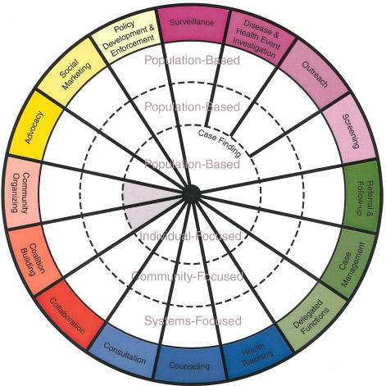
PHN Intervention Wheel
Is population based
Contains three levels of practice (individual, community, and system)
Identifies 17 public health interventions
Figure 1-3
Illustration from Minnesota Dept. of Health Center for Public Health Nursing.
Notes:
Nies: Power Points, Evolve Resources for Nies/McEwen: Community Health Nursing, 4th ed.
29

Slide 30
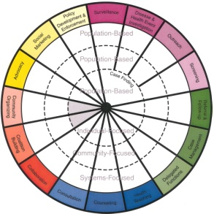
Public Health Interventions
(purple section)
Surveillance: Describes and monitors health events through ongoing and systematic collection, analysis, and interpretation of health data for the purpose of planning, implementing, and evaluating public health interventions.
Disease and other health event investigation: Systematically gathers and analyzes data regarding threats to the health of populations, ascertains the source of the threat, identifies cases and others at risk, and determines control measures.
Notes:
Nies: Power Points, Evolve Resources for Nies/McEwen: Community Health Nursing, 4th ed.
30

Slide 31
Public Health Interventions
(purple section) (Cont.)
Outreach: Locates populations of interest or populations at risk and provides information about the nature of the concern, what can be done about it, and how services can be obtained.
Screening: Identifies individuals with unrecognized health risk factors or asymptomatic disease conditions in populations.
Case finding: Locates individuals and families with identified risk factors and connects them with resources.
Notes:
Nies: Power Points, Evolve Resources for Nies/McEwen: Community Health Nursing, 4th ed.
31

Slide 32
Public Health Interventions
(green section)
Referral and follow-up: Helps individuals, families, groups, organizations, and/or communities identify and access necessary resources to prevent or resolve problems or concerns.
Case management: Optimizes self-care capabilities of individuals and families and the capacity of systems and communities to coordinate and provide services.
Delegated functions: Direct care tasks a registered professional nurse carries out under the authority of a health care practitioner as allowed by law.
Notes:
Nies: Power Points, Evolve Resources for Nies/McEwen: Community Health Nursing, 4th ed.
32

Slide 33
Public Health Interventions
(blue section)
Health teaching: Communicates facts, ideas, and skills that change knowledge, attitudes, values, beliefs, behaviors, and practices of individuals, families, systems, and/or communities.
Counseling: Establishes an interpersonal relationship intended to increase or enhance capacity for self-care and coping with a community, system, and family or individual.
Consultation: Seeks information and generates optional solutions to perceived problems or issues through interactive problem-solving with a community, system, and family or individual.
Notes:
Nies: Power Points, Evolve Resources for Nies/McEwen: Community Health Nursing, 4th ed.
33

Slide 34
Public Health Interventions
(red section)
Collaboration: Commits two or more persons or organizations to achieve a common goal through enhancing the capacity of one or more of the members to promote and protect health.
Coalition building: Promotes and develops alliances among organizations or constituencies for a common purpose.
Community organizing: Helps community groups identify common problems or goals, mobilize resources, and develop and implement strategies for reaching the goals they collectively have set.
Notes:
Nies: Power Points, Evolve Resources for Nies/McEwen: Community Health Nursing, 4th ed.
34

Slide 35
Public Health Interventions
(yellow section)
Advocacy: Plead someone’s cause or act on someone’s behalf, with focus on developing the capacity of the community, system, and individual or family to plead their own cause or act on their own behalf.
Social marketing: Uses commercial marketing principles and technologies for programs designed to influence the knowledge, attitudes, values, beliefs, behaviors, and practices of the population of interest.
Policy development and enforcement: Places health issues on decision-makers’ agendas, acquires a plan of resolution, and determines needed resources, resulting in laws, rules, regulations, ordinances, and policies. Policy enforcement compels others to comply with laws, rules, regulations, ordinances, and policies.
Notes:
Nies: Power Points, Evolve Resources for Nies/McEwen: Community Health Nursing, 4th ed.
35

Slide 36
Providing population-based care… a shift in thinking
Populations are not homogeneous; must address the needs of special subpopulations.
High-risk and vulnerable subpopulations must be identified early in the care delivery cycle.
Nonusers of services often become high-cost users; essential to develop outreach strategies.
Quality and cost of all health care services are linked together across the health care continuum.
(Kaiser Family Foundation, 2013)

