Slide 1
Chapter 21
Managing Patient Care
Notes:
The National Council of State Boards of Nursing (NCSBN) identified competencies that registered nurses (RNs) and licensed practical nurses (LPNs)/licensed vocational nurses (LVNs) need on entry to practice
[Review Box 21-1, Entry-Level Nurse Competencies, with students.]
Regardless of the type of setting in which you eventually choose to work as a staff nurse, you will be responsible for using organizational resources, participating in organizational routines while providing direct patient care, using time productively, collaborating with all members of the health care team, and using certain leadership characteristics to manage others on the nursing team.

Slide 2
Leadership Skills for Nursing Students
Clinical Care Coordination | Team Communication
Delegation | Knowledge Building
Notes:
It is important that as a nursing student you prepare yourself for leadership roles.
Learn to become a leader by consulting with instructors and nursing staff to obtain feedback in making good clinical decisions, learning from mistakes and seeking guidance, working closely with professional nurses, and trying to improve your performance during each patient interaction.
These skills require you to think critically and solve problems in the clinical setting. Thinking critically allows nurses to provide higher-quality care, meet the needs of patients while considering their preferences, consider alternatives to problems, understand the rationale for performing nursing interventions, and evaluate the effectiveness of interventions.
Important leadership skills to learn include clinical care coordination, team communication, delegation, and knowledge building.

Slide 3
Surviving being a Nursing Student
Clinical Decisions
Priority Setting
Organizational Skills
Use of Resources
  ATI Resources & Templates
Time Management
Evaluation
Notes:
Clinical care coordination includes clinical decision making, priority setting, use of organizational skills and resources, time management, and evaluation.
The activities of clinical care coordination require use of critical reflection, critical reasoning, and clinical judgment.
They are important first steps in developing a caring relationship with a patient. Use a critical thinking approach, applying previous knowledge and experience to the decision-making process.

Slide 4
Clinical Decisions
Apply the nursing process
Know your patient
Use clinical decision making practices
Accurate clinical decision-making keeps you focused on the proper course of action
Notes:
Your ability to make clinical decisions depends on application of the nursing process.
Knowing the patient involves more than gathering formal assessment data. It requires learning a patient’s typical patterns of responses and his or her current situation and knowing the patient as an individual.
If you do not make accurate clinical decisions about a patient, undesirable outcomes will probably occur. The patient’s condition worsens or remains the same when you lose the potential for improvement.
Never hesitate to ask for assistance when a patient’s condition changes.

Slide 5
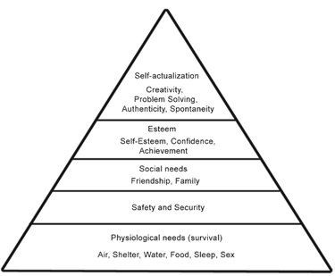
Clinical Decision Making: Nursing Process & Maslow
Identify Patient(s) Needs
Begin to Apply Strategy to Begin Decision Making:
  Assessments or Implementations
  Physical or Psychosocial
  ABC’s
  Evaluate

Slide 6
Priority Setting
Determine which patient’s needs should be addressed first:
  High priority: immediate threat to patient survival or safety
  Intermediate priority: nonemergent, non–life threatening
  Low priority: actual or potential problems may or may not be directly related to patient’s illness or disease
Notes:
After forming a picture of the patient’s total needs, you set priorities by deciding which patient needs or problems need attention first. Classify patient problems in three priority levels:
High priority—An immediate threat to a patient’s survival or safety.
Intermediate priority—Nonemergency, non-life-threatening actual or potential needs that a patient and family members are experiencing.
Low priority—Actual or potential problems that are not directly related to a patient’s illness or disease.
Many patients have all three types of priorities, requiring you to make careful judgments in choosing a course of action. Obviously high-priority needs demand immediate attention.
To identify which patients require assessment first, rely on information from the change-of-shift report, your own most recent assessment of the patient, and information from the medical record.

Slide 7
Priority Setting… Things to Consider
What tasks to be completed?
Are there things that require action before they can happen?
Are there things that are time sensitive?
Are there things that other people can do?
Are there any things that require an appointment time/need to be scheduled?
How many items per room need to be accomplished?
Notes:
When starting out in the clinical setting.

Slide 8
Prioritization Strategy
Acute vs. Chronic
Real vs. Potential
Unexpected vs. Expected
Unstable vs. Stable
ABC’s
Notes:
Especially helpful for exam and NCLEX!

Slide 9
Organizational Skills
Do the right things.
Do things right.
Inform and prepare patient.
Clean and organize work area.
Keep patient’s needs at the center of attention.
Notes:
Implementing a plan of care requires you to be effective and efficient. Effective use of time means doing the right things, whereas efficient use of time means doing things right.
A well-organized nurse approaches any planned procedure by having all of the necessary equipment available and making sure that the patient is prepared. If the patient is comfortable and well informed, the likelihood that the procedure will go smoothly increases.

Slide 10
Use of Resources
Appropriate use of resources is an important aspect of clinical care coordination.
Administration of patient care occurs more smoothly when staff members work together.
Notes:
Appropriate use of resources is an important aspect of clinical care coordination. Resources in this case include members of the health care team.
Never hesitate to have staff help you, especially when there is an opportunity to make a procedure or activity more comfortable and safer for patients.
Consulting with an experienced RN confirms findings and ensures that you take the proper course of action for the patient.
A leader knows his or her limitations and seeks professional colleagues for guidance and support.

Slide 11
Time Management
Remain goal oriented
Identify priorities
Establish personal goals
Notes:
One useful time-management skill involves making a priority to-do list. Good time management also involves setting goals to help you complete one task before starting another.
Time management requires the ability to anticipate the activities of the day and combine activities when possible.
[Review Box 21-5, Principles of Time Management, with students.]

Slide 12
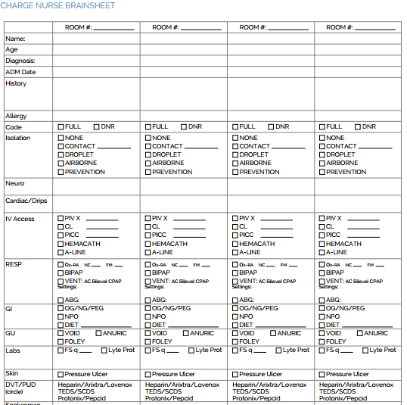

Time Management: Nursing “Brain”
Notes:
The development and use of a nursing report sheet (aka. Brain) is imperative to good time management!

Slide 13
Evaluate
Evaluate process.
Evaluate patient response.
Evaluate therapy efficacy.
Evaluate patient and expected outcomes.
Notes:
Evaluation is ongoing, just like other steps of the nursing process. Once you assess a patient’s needs and begin therapies directed at a specific problem area, immediately evaluate whether therapies are effective and the patient’s response.
When expected outcomes are not met, evaluation reveals the need to continue current therapies for a longer period, revise approaches to care, or introduce new therapies.
Keeping a focus on evaluation of the patient’s progress lessens the chance of becoming distracted by the tasks of care.

Slide 14
Delegation
Transfers responsibility while remaining accountable for outcomes
Requires knowing which skills are transferable
Results in improved quality, safe patient care, improved efficiency, increased productivity, an empowered staff, and skill development of others
Notes:
The Nurse Practice Act of your state, along with principles of authority, accountability, and responsibility, is the basis for effective delegation.
Delegation is an essential part of management.
Never delegate a task that you dislike doing or would not do yourself because this creates negative feelings and poor working relationships.
As a nurse you are responsible and accountable for providing care to patients and delegating care activities to the nursing assistive personnel (NAP). However, you do not delegate the steps of the nursing process of assessment, diagnosis, planning, and evaluation because these steps require nursing judgment.
Patient teaching is also the responsibility of an RN and should not be delegated.
As an RN, you are always responsible for the assessment of a patient’s ongoing status; but if a patient is stable, you delegate vital sign monitoring to the NAP.
Appropriate delegation begins with knowing which skills you are able to delegate. Know your state’s Nurse Practice Act.
As a professional nurse you cannot simply assign the NAP tasks without considering the implications. Assess the patient and determine a plan of care before identifying which tasks someone else is able to perform.
Efficient delegation requires constant communication.
[Recall that Jennifer in the Case Study was able to delegate a unit clerk to check on one patient while she finished caring for another.]

Slide 15
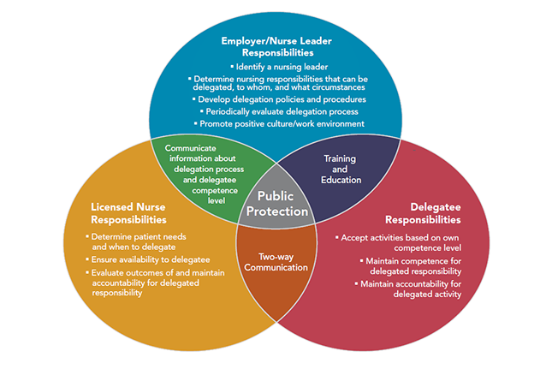
Delegation in Nursing

Slide 16
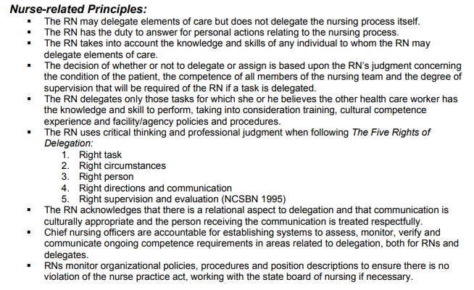

Slide 17
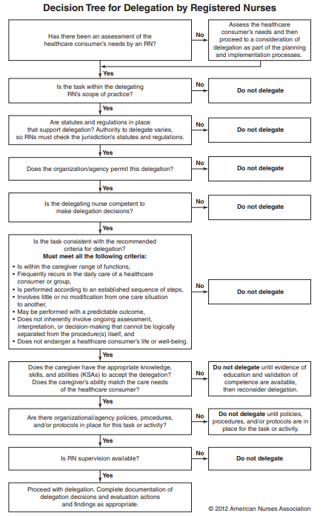

Slide 18
The Five Rights of Delegation
  Right Task
  Right Circumstance
  Right Person
  Right Direction
  Right Supervision
Notes:
The right task is one that can be delegated for a specific patient, such as tasks that are repetitive, require little supervision, are relatively noninvasive, have results that are predictable, and have potential minimal risk.
Appropriate patient setting, available resources, and other relevant factors are considered in determining the right circumstance.
The right person is delegating the right tasks to the right person to be performed on the right person.
Right direction/communication indicates that a clear, concise description of the task, including its objective, limits, and expectations, is given.
Right supervision/evaluation means that appropriate monitoring, evaluation, intervention as needed, and feedback are provided.
[Review Box 21-6, The Five Rights of Delegation, with students.]

Slide 19
Delegation
Steps to Effective Delegation
  Assess the knowledge and skills of the delegatee.
  Match tasks to the delegatee’s skills.
  Communicate clearly:
    Task, outcome, time
  Listen attentively.
  Provide feedback.
Notes:
Provide clear instructions and desired outcomes when delegating tasks. These instructions initially focus on the procedure itself, what will be accomplished, when it should be completed, and the unique needs of the patient.
Important steps in delegation are evaluation of the staff member’s performance, achievement of the patient’s outcomes, the communication process used, and any problems or concerns that occurred.
As an RN, you may be delegating tasks to NAP. To assess knowledge and skills, ask open-ended questions that elicit conversation and details about what he or she knows.
You will need to know which tasks and skills are within the scope of practice and job description for team members to whom you delegate.
Always provide clear directions by describing a task, the desired outcome, and the time period within which NAP should complete the task.
Listen to the response of NAP after you provide directions. Help sort out priorities if needed.
Always give NAP feedback regarding performance, regardless of outcome.

Slide 20
Delegation Don’ts
Nursing Process & Development of Care Plan
  Assessments that identify needs and problems which diagnose human responses.
    Admission/change of status assessments
  Planning & Evaluation
  Teaching
Notes:
UAP = tasks/skills that can be trained
LPN/LVN = stable patients with expected outcomes that do not need any of the above
RN= unstable patients or those with varying outcomes and/or those requiring the above

