Slide 1
Chapter 20
Family Health

Slide 2
Working with Families
Working with families has never been more complex or rewarding than now.
Nurses understand the actual and potential impact that families have in changing the health status of individual family members, communities, and society as a whole.
Families have challenging health care needs that are not usually addressed by the health care system.
.

Slide 3










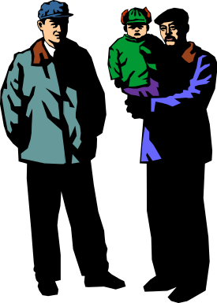


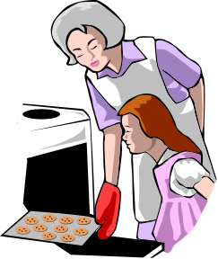
How Do You Define a Family?

Slide 4
Definitions of a Family
Historical definitions:
The environment affecting individual clients
Small to large groups of interacting people
A single unit of care with definable boundaries
A unit of care within a specific environment of a community or society
Current theorists:
Two or more individuals who depend on one another for emotional, physical, and economic support. Members of family are self-defined.
– Hanson & Kaakimen (2005)
The family is who they say they are.
– Wright & Leahey (2000)

Slide 5
Inclusive Definitions of Family
“Family” means any person(s) playing a significant role in an individual’s life. This may include person(s) not legally related to the individual. Members of “family” include spouses, domestic partners, and both different-sex and same-sex significant others. “Family” includes a minor patient’s parents, regardless of gender of either parent … without limitation as encompassing legal parents, foster parents, same-sex parent, step-parents, those serving in loco parentis, and others operating in caretaker roles.
– Human Rights Campaign ( 2009)

Slide 6
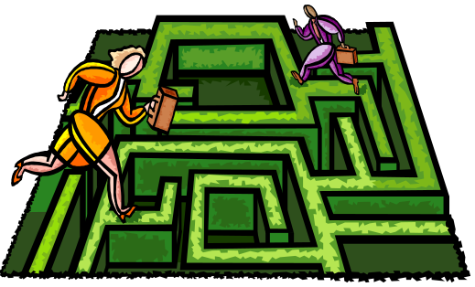
The Changing Family
Purposes of the family
  To meet the needs of society
  To meet the needs of individual family members
Examples of different family types
  Traditional, nuclear family
  Multigenerational family household
  Cohabitating families
  Single-parent families
  Grandparent-headed families
  Gay or lesbian families
  Unmarried teen mothers

Slide 7
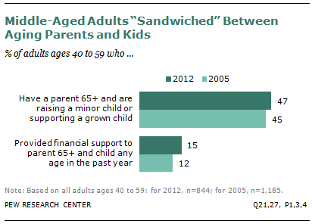
The “Sandwich” Generation
Figure 20-1 From Pew Research Center: Social and Demographic Trends: The Sandwich Generation. http://www.pewsocialtrends.org/2013/01/30/the-sandwich-generation/. Accessed March 15, 2013.

Slide 8
Why Is It Important for the CHN to Work with Families?
The family is a critical resource.
Any dysfunction in a family unit will affect the members and the unit as a whole.
Case finding can identify a health problem that leads to risks for the entire family.
Nursing care can be improved by providing holistic care to the family and its members.
  – Friedman, Bowden, & Jones (2003)

Slide 9

Approaches to Meeting the Health Needs of Families
Moving from the Individual to the Family
Moving from the Family to the Community

Slide 10

Moving from the Individual to the Family
Family interviewing
  Manners
  Therapeutic conversations
  Genogram and Ecomap
  Therapeutic questions
  Commending family or individual strengths
  Issues in family interviewing
    Many locations, family informant, family health portrait, involvement of children
Intervention in cases of chronic illness

Slide 11
Moving from the Family to the Community
The health of communities is measured by the well-being of its people and families.
Families are components of communities.
Cross-comparison of communities must include health needs as well as resources.
Cross-compare the needs of the families within the community and set priorities.
Delegation of scarce resources is essential.
A double standard in public health is tolerated.

Slide 12
Family Theory Approach
Any “dysfunction” that affects one member will probably affect others and the family as a whole.
The family’s wellness is highly dependent on the role of the family in every aspect of health care.
The level of wellness of the whole family can be raised by reducing lifestyle and environmental risks by emphasizing health promotion, self-care, health education, and family counseling.

Slide 13
Family Theory Approach (Cont.)
Commonalities in risk factors and diseases shared by family members can lead to case finding within family.
Individual is assessed within larger context of family.
Family is vital support system to individual member.
– Friedman (1994)

Slide 14

Systems Theory Approach
  The family as a unit interacts with larger units outside the family (suprasystem) and with smaller units inside the family (subsystem).
– Friedman (1998)

Slide 15
Healthy Families
Members interact with each other; listen and communicate repeatedly in many contexts.
Healthy families establish priorities. Members understand that family needs are the priority.
Healthy families affirm, support, and respect each other.
Members engage in flexible role relationships, share power, respond to change, support the growth/autonomy of others, and engage in decision making that affects them.
– DeFrain (1999) and Montalvo (2004)

Slide 16
Healthy Families (Cont.)
The family teaches family and societal values and beliefs and shares a religious core.
Healthy families foster responsibility and value service to others.
Healthy families have a sense of play and humor and share leisure time.
Healthy families have the ability to cope with stress and crisis and grow from problems. They know when to seek help from professionals.
– DeFrain (1999) and Montalvo (2004)

Slide 17
Structural-Functional Conceptual Framework
Internal structure
  Family composition, gender, rank order, functional subsystem, and boundaries
External structure
  Extended family and larger systems (work, health, welfare)
  Context: ethnicity, race, social class, religion, environment
Instrumental functioning (routine ADLs)
Expressive functioning
  Emotional, verbal, nonverbal, circular communication; problem solving; roles; influence; beliefs; alliances and coalitions

Slide 18


Developmental Theory
Family life cycle (Duvall & Miller, 1985)
  Leaving home
  Beginning family through marriage or commitment as a couple relationship
  Parenting the first child
  Living with adolescent
  Launching family (youngest child leaves home)
  Middle-age family (remaining marital dyad to retirement)
  Aging family (from retirement to death of both spouses)

Slide 19

Family Health Assessment Tools
Genogram
  A tool that helps the nurse outline the family's structure
Family health tree
  Family’s medical and health histories
Ecomap
  Depicts a family’s linkages to their suprasystems

Slide 20
Family Health Assessment Tools
Family Health Assessment
  Addresses family characteristics, including structure and process and family environment
  Information obtained through interviews with one or more family members, subsystems within the family, or group interviews of more than two members of the family
  Additional information obtained through observation of family and their environment

Slide 21
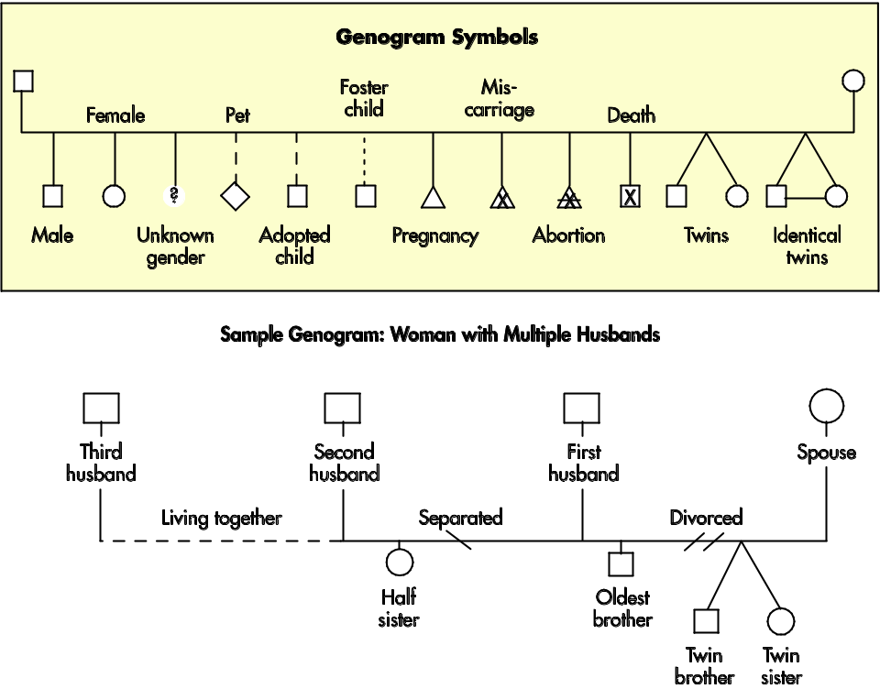
Genogram
Figure 20-2 Redrawn from Genopro Software: Symbols used in genograms, 2009: www.genopro.com.

Slide 22
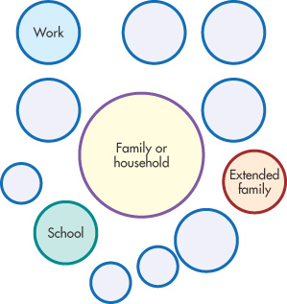
Ecomap
Figure 20-4 Redrawn from Hartman A: Diagrammatic assessment of family relationships, Soc Casework 59:496, 1978.

Slide 23
Social and Structural Constraints
Identify what prevents families from receiving needed health care or achieving a state of health
Usually based on social and economic causes
  Literacy, education, employment
  If disadvantaged, often unable to buy health care from private sector
  Hours of service, distance and transportation, availability of interpreters, and criteria for receiving services (age, sex, income barriers)

Slide 24
Family Health Interventions
Institutional context of family therapists
  Ecological framework: A blend of systems and developmental theory that focus on the interaction and interdependence of families within the context of their environment
  Social Network Framework: Involves all connections and ties within a group; social support
  Transactional model: A system that focuses on process as opposed to a linear approach

Slide 25
Applying the Nursing Process
Knowledge of self, previous life experiences, and values is crucial in planning home visits
Gather referral information, review assessment forms, and gather intervention tools (e.g., screening materials, supplies) before going to the home
Flexibility is important in working with families

