Slide 1
INFORMATICS SOLUTION PROPOSAL
NAME: Stella Nasseri
Class: HSN 376
Date : 03/18/2019

Slide 2
ELECTRONIC HEALTH RECORDS
Electronic Health Records (EHR) is a patient’s medical history in an electronic version. Information on EHR is usually maintained by the patient’s medical provider.
Information on EHR includes all of the key administrative clinical data that is relevant to the patient’s care.EHR records are shared across different health care settings through network-connected, enterprise-wide information systems and exchanges (Heider, 2014).

Slide 3
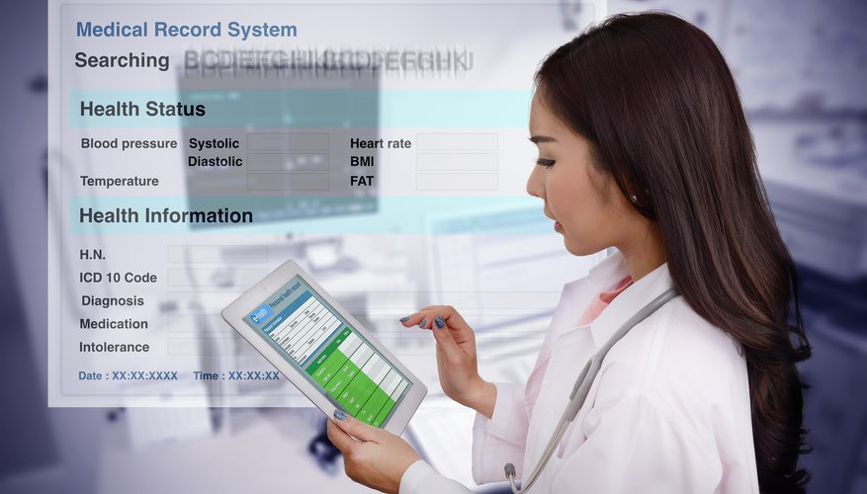
EHR cont.
Information on EHR has important personal statistics of the patient. For example;
Age
Weight
Marital status
Emergency contacts
Billing information.

Slide 4
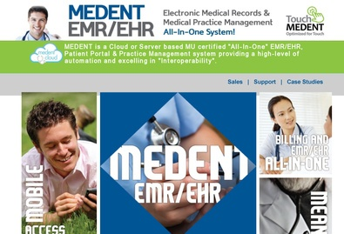

EHR Products
EHR has a wide range of participating products. This presentation focuses on two verified products.
MEDENT-Community Computer Service Inc.
eClinical Works.

Slide 5

MEDENT
MEDENT by Community Computer Service (CCS) is a cloud based MU which is a certified EHR/EMR.
It has incorporated electronic medical records and practice management tools in a software which has been designed to make the office ‘paperless’
MEDENT is maintained by CSS to offer software and hardware installation and training while offering ongoing support and supplies.
MEDENTS services are utilized by more than 7,000 healthcare providers.

Slide 6
MEDENT Cont.
To make the system easier to use, CSS added basic messaging and communications subscription service to MEDENT in 2013.
Through this feature, different healthcare providers can engage each other for clarification or consultation about a particular patient.
Basic messaging and Communication allows specific and protected health information to be securely and instantaneously transmitted between healthcare providers saving time when making care decisions.

Slide 7
MEDENT Cont.
MEDENT is a EHR product that supports increased efficiency, better patient outcomes, informed healthcare decisions and lower healthcare costs.
It has the following features:
Combined practice management and EMR solution.
Automated electronic posting of insurance payments.
Medical office management.
Free electronic claims submission to over 750 insurance companies.
Customer support.
For clarity, the Meaningful Use (MU) dashboard and comparison graph allows healthcare providers to monitor meaningful use compliance of HER systems(Sitting, 2015).

Slide 8
eClinicalWorks
eClinical Works is a software service EHR product that can be purchased individually or collectively.
When eClinical modules are intergrated, they inform providers with reviews of patient health records, current medications, past visits, diagnostics and lab tests.
eClinical systems also provide additional services such as managing patients’ accounts and verifying their eligibility for services.

Slide 9
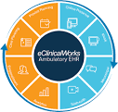
eClinicalWorks Cont
Patients who use eClinicalWorks can also send messages to physicians, request subscription refills as well as viewing lab results and receiving appointment notifications and reminders.
eClinicalWorks offers a mobile browser which healthcare providers can use to access relevant information conveniently through smart phones.
The system has embedded a messaging service that is based on voice over IP allowing care providers and patients to interact more effectively.
This EHR product can interact with any hospital system which uses the Integrating the Healthcare Enterprise standard ( Elmir , 2015)

Slide 10
eClinicalWorks Cont.
eClinicalWorks supports electronic referrals making it easier for healthcare providers to share patient information such as summary of care record with other healthcare providers over the network.
eClinicalWorks has a subsidiary, Healow, which has intergrated the system with leading wearable technology and fitness trackers which post records directly to the system as progress reports for healthcare providers who can view them remotely.

Slide 11
eClinicalWorks
The cost is per provider, per month.
It is considered a next generation IT solution which allows practices to enhance patient care and improve efficiency.
The platforms such a mobile browsers and Healow app make the system convenient and easier to use than most participating EHR products.

Slide 12
References
Elmir, A., Elmir, B., & Bounabat, B. (2015). Inter organizational System Management for integrated service delivery: an Enterprise Architecture Perspective
Heider, A. R., Maloney, N. A., Satchidanand, N., Allen, G. M., Mueller, R., Gangloff, S., & Singh, R. (2014). Developing a communitywide electronic health record disease registry in primary care practices: Lessons learned from the Western New York Beacon Community. EGEMS , 2(3)
Sittig, D. F., Murphy, D. R., Smith, M. W., Russo, E., Wright, A., & Singh, H. (2015). Graphical display of diagnostic test results in electronic health records: a comparison of 8 systems. Journal of the American Medical Informatics Association, 22(4), 900-904.
http://www.medent.com

