Slide 1
Child Welfare
Child Abuse Prevention and Treatment Act

Slide 2
What is the Child Welfare System?
“The Child Welfare System is a group of services designed to promote the well-being of children by ensuring safety, achieving permanency, and strengthening families to care for their children successfully”
-Childwelfare.gov

Slide 3
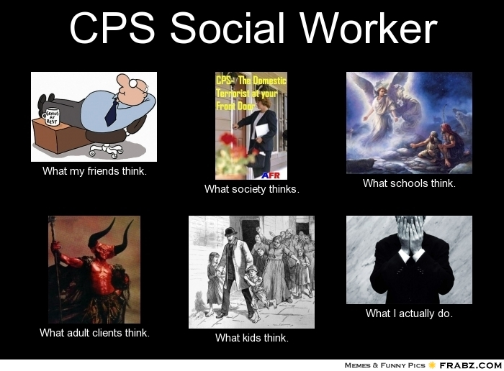

Slide 4
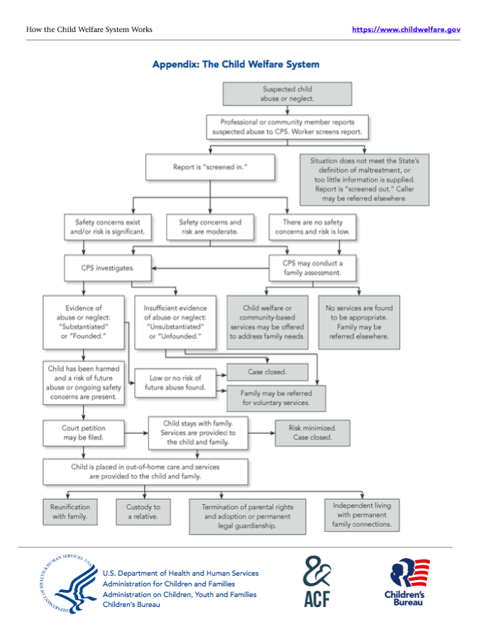

Slide 5
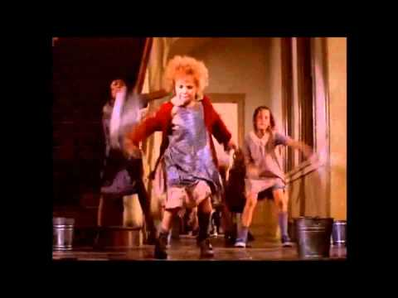
Annie
Set in 1933 during the great depression
40 years before the child abuse prevention and treatment act

Slide 6
Description of Problem
How many people affected by problem
  49 states reported a total of 1700 fatalities in 2016
  For perspective, average of nearly five children dying each day due to abuse or neglect
  Researchers say the exact number is hard to pinpoint because of underreporting
Demographic characteristics
  70% of child fatalities involved children younger than three-years-old
  Children under one-year-old accounted for 44.4% of all fatalities
Is number changing
  7.4% more fatalities than in 2012

Slide 7
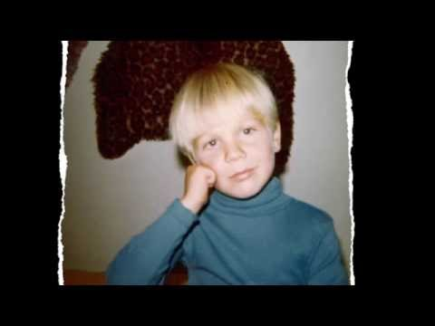
Personalizing the Problem
Derek Clark: history of child abuse

Slide 8
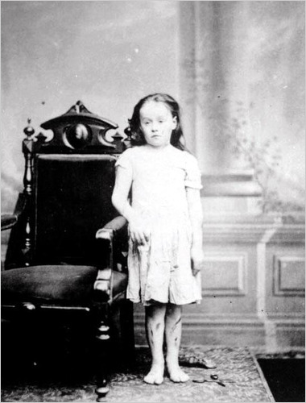
Historical Background: The First Case
The first anti-cruelty laws were on behalf of animals, not children: American Society for the Prevention of Cruelty to Animals (ASPCA)
Etta Wheeler was a church worker who found out about the case of an abused child named Mary Ellen
Etta Wheeler took the situation to the ASPCA and successfully removed the child from the home
Mary Ellen’s Court Statement

Slide 9
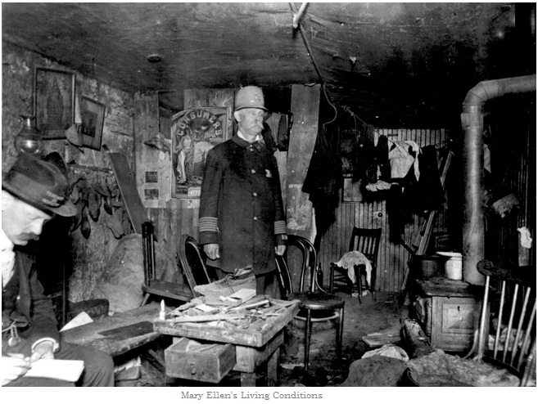

Slide 10
Historical Background
Originally enacted on January 31, 1974
Has been amended several times and was last reauthorized on December 20, 2010
Was amended in 2015, 2016, and 2018
Most recently, certain provisions of the act were amended on January 7,2019
  by the Victims of Child Abuse Act Reauthorization Act of 2018

Slide 11
Historical Background 2018
States are required to come up with a plan to not inappropriately diagnose children with
  Mental Illness
  Emotional/ behavioral disorders
  Medically fragile conditions
  Developmental disabilities
Updated services for children under the age of five: to address needs of all vulnerable children. Foster care, in-home, community-based settings
Took steps to track and prevent child maltreatment deaths:
Family reunification services are made more of a priority
Updated the Chafee program: program to provide funding to support youth aging out of the foster care system

Slide 12
Description of Policy
Budget
  Consolidated Appropriations Act of 2018
    Appropriated $85.3 million for the CAPTA state grant in the 2018 fiscal year
  Is budget changing?
    Child Welfare Services: increase from $269 million to $325 million
    Promoting Safe and Stable Families: increase from $365 million to $505 million
    Adoption Opportunities Act: increase by $60 million
    Adoption and Kinship Incentives Fund: required to fund at $75 million

Slide 13
Policy Goals
Funding to states to support prevention, assessment, investigation, persecution, and treatment
Grants to public agencies and nonprofit organizations
Remove children from unsafe environments where they are experiencing abuse or neglect, including referrals to child protective services
Also includes newborns affected by prenatal exposure to alcohol or illegal drugs according to laws in each state
Develop a plan of self care for infants and children
Aid in the process of young adults aging out of the foster care system

Slide 14
Major Issues/Problems with Policy
The Chafee program (provides funding to help youth aging out of foster care): no more than 30% of funds may be used for room and board
Too few health care and court personnel are aware of the mandatory reporting requirements (not noticing markers for prenatal substance exposure is a big one)
Only state law, not much federal overview: CAPTA does not have a definition under federal law of what constitutes child abuse/neglect

Slide 15
Proposals/Possibilities for Reform of the Policy
Who is advocating for reform of the policy
  Child Welfare League of America (CWLA)
    A coalition of hundreds of private and public agencies that have worked to serve children and families who are vulnerable since 1920
  Court Appointed Special Advocates (CASA) and Guardians ad Litem (GAL)
    Each volunteer is appointed by a judge to advocate for a child’s best interest in court.
    Help judges get a fuller picture of each child’s life, enabling the judge to make a well-informed decision for the child

Slide 16
Reformation
How are they accomplishing this?
  CWLA
    Advocating for Congress to fully fund CAPTA at $120 million and Community-Based Grants for the Prevention of Child Abuse and Neglect (CB-CAP) at $80 million
      In 2012, the US paid $80 billion to address child abuse and neglect. Fully funding CAPTA would help to prevent child abuse and neglect before it happens

Slide 17
Reformation
  CASA
    Believe children who have been abused and/or neglected are amongst the most vulnerable populations
    Fighting to maintain current level of service to children by retaining the provision allowing the CAPTA GAL to be an attorney or CASA
Chance of success
  Hopeful for both organizations to succeed in advocating for reformation

Slide 18
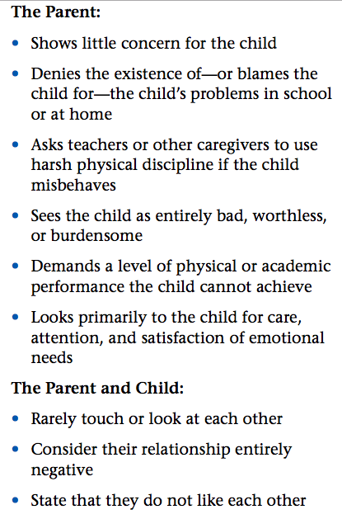
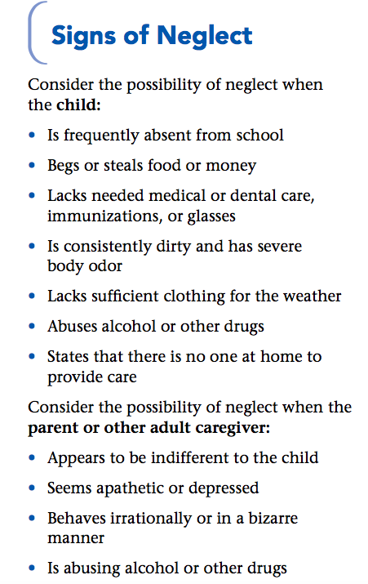
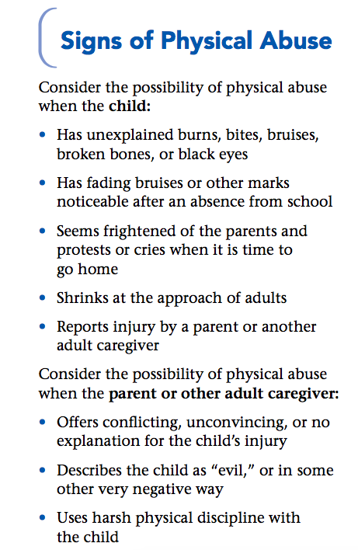
Signs to look for:

Slide 19
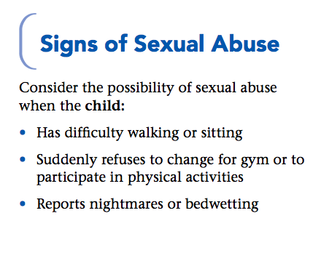
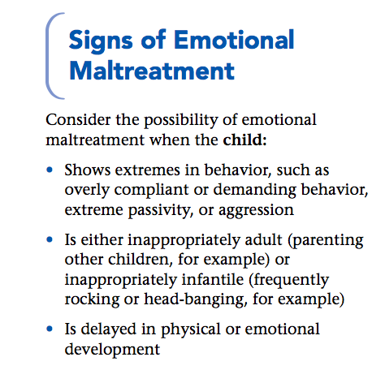
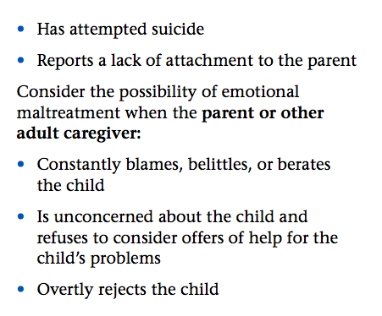
Signs to look for Pt.2

Slide 20
What did we learn?
The Child Welfare System has affected many throughout the years.
If it wasn’t for Etta Wheeler advocating safety for children in New York, where would we be right now?
Updating programs and making the youth a priority has helped the system expand
Budgets have increased in the past years for prevention purposes which is a good thing :) we can’t go anywhere if there isn’t money.
Child Welfare is multifaceted but the ultimate goal is to protect children!

Slide 21
References
Administration for Children and Families. (2018). Retrieved from acf.hhf.gov: https://www.acf.hhs.gov/sites/default/files/cb/pi1806.pdf
Chasnoff, I. J., Barber, G., Brook, J., & Akin, B. A. (2018). The Child Abuse Prevention and Treatment Act: Knowledge of Health Care and Legal Professionals.Child Welfare, 96(3), 41–58. Retrieved from http://search.ebscohost.com.ezproxy.uta.edu/login.aspx?direct=true&db=a9h&AN=131357343&site=ehost-live
Child Welfare Information Gateway. (2019). About CAPTA: A Legislative History.Retrieved April 1, 2019, from https://www.childwelfare.gov/pubPDFs/about.pdf

Slide 22
References
Child Welfare Information Gateway. (2019). About CAPTA: A Legislative History.Retrieved April 11, 2019 from https://www.childwelfare.gov/pubs/factsheets/about/
Child Welfare League of America. (2018). Legislative Agenda 2018.Retrieved from cwla.org: https://www.cwla.org/wp-content/uploads/2018/04/118415-CWLA-Legislative-Agenda.pdf
Court Appointed Special Advocates. (2019). Child Abuse Prevention and Treatment Act. Retrieved from casaforchildren.org: https://casaforchildren.org/advocate-for-children/advocate-for-legislation/capta/

Slide 23
References
The New York Society for the Prevention of Cruelty to Children (2017). History: 1870-1874: The Catalyst. Retrieved from https://nyspcc.org/about-the-new-york-society-for-the-prevention-of-cruelty-to-children/history/

