Slide 1
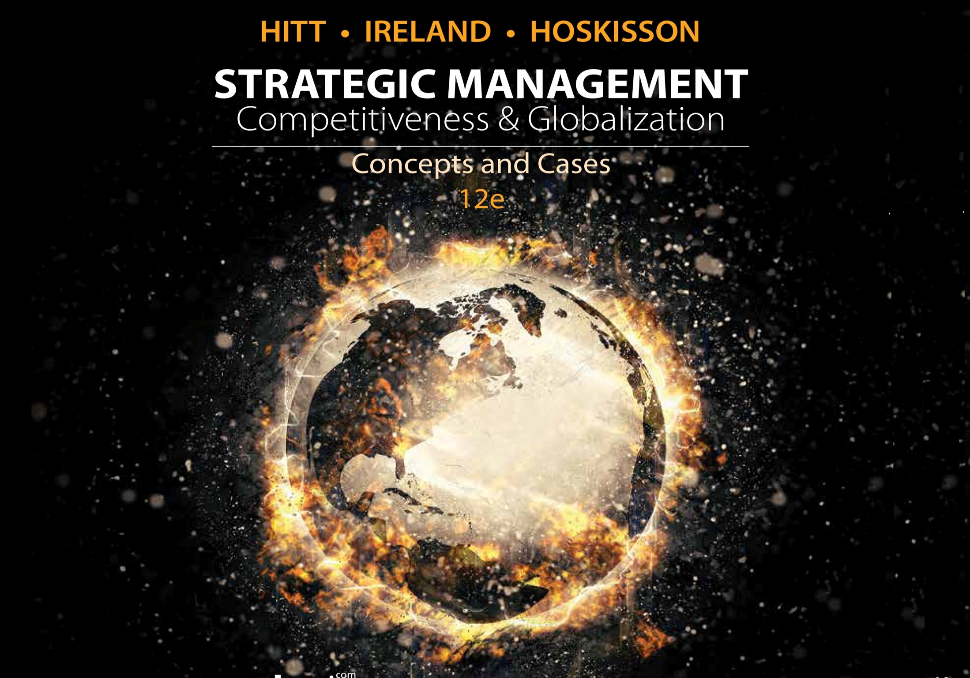
Chapter 12
Strategic Leadership

Slide 2
Learning Objectives
Studying this chapter should provide you with the strategic management knowledge needed to:
Define strategic leadership and describe top-level managers’ importance.
Explain what top management teams are and how they affect firm performance.
Describe the managerial succession process using internal and external managerial labor markets.
Discuss the value of strategic leadership in determining the firm’s strategic direction.
Describe the importance of strategic leaders in managing the firm’s resources.
Explain what must be done for a firm to sustain an effective culture.
Describe what strategic leaders can do to establish and emphasize ethical practices.
Discuss the importance and use of organizational controls.

Slide 3
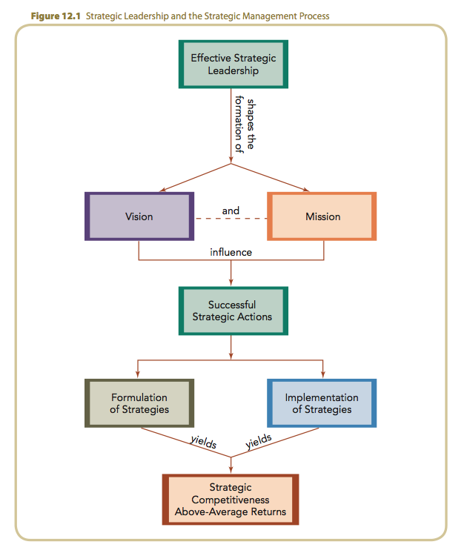
Strategic Leadership and Strategic Management Process

Slide 4
Strategic Leadership and Style
Strategic leadership requires the ability to:
  anticipate and envision.
  maintain flexibility.
  empower others to create strategic change through selecting and implementing a firm’s strategies as necessary.
Strategic leadership is:
  multi-functional work involving working through others.
  consideration of the entire enterprise rather than just a sub-unit.
  a managerial frame of reference.

Slide 5
Strategic Leadership (cont’d)
Effective strategic leaders:
  manage the firm’s operations effectively.
  sustain a high performance over time.
  make better decisions than their competitors.
  make candid, courageous, pragmatic decisions.
  understand how their decisions affect the internal systems in use by the firm.
  solicit feedback from peers, superiors and employees about their decisions and visions.

Slide 6
The Role of Top-Level Managers
Managers often use their discretion when making strategic decisions and implementing strategies.
Factors affecting the amount of decision-making discretion
  External environmental sources
  Characteristics of the organization
  Characteristics of the manager

Slide 7
Factors Affecting Managerial Discretion
External
Environment
Industry structure
Rate of market growth
Number and type of competitors
Nature and degree of political/legal constraints
Degree to which products can be differentiated

Slide 8
Factors Affecting Managerial Discretion
External
Environment
Size
Age
Culture
Availability of resources
Patterns of interaction among employees
Characteristics
of the Organization

Slide 9
Factors Affecting Managerial Discretion
External
Environment
Tolerance for ambiguity
Commitment to the firm and its desired strategic outcomes
Interpersonal skills
Aspiration level
Degree of self-confidence
Characteristics
of the Organization
Characteristics
of the Organization

Slide 10
Factors Affecting Managerial Discretion
External
Environment
Characteristics
of the Organization
The degree of latitude for action when making strategic decisions, especially those concerned with effective implementation of strategies.
How managers exercise discretion when determining appropriate strategic actions is critical to the firm’s success.
Characteristics
of the Organization
Managerial
Discretion

Slide 11
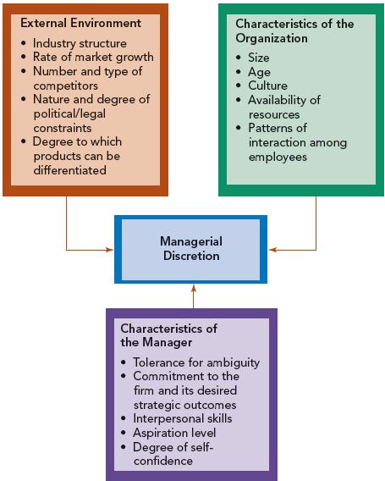
Factors Affecting Managerial Discretion

Slide 12
Top Management Teams
Composed of the key managers who are responsible for selecting and implementing the firm’s strategies.
A heterogeneous top management team:
  has varied expertise and knowledge.
  can draw on multiple perspectives.
  will evaluate alternative strategies.
  builds consensus.

Slide 13
Top Management Teams, Firm Performance, and Strategic Change
Heterogeneous top management teams:
  have difficulty functioning effectively as a team.
  require effective management of the team to facilitate the process of decision making, but …
  are associated positively with innovation and strategic change.
  may force the team or members to “think outside of the box” and be more creative.
  have greater capacity to provide effective strategic leadership in formulating strategy.

Slide 14
CEO and Top Management Team Power
Higher performance is achieved when board of directors are more directly involved in shaping strategic direction.
A powerful CEO may:
  appoint sympathetic outside board members.
  have inside board members who report to the CEO.
  have significant control over the board’s actions.
  may also hold the position of chairman of the board (CEO duality).

Slide 15
CEO and Top Management Power
Duality often relates to poor performance and slow response to change.
  CEOs of long tenure can also wield substantial power.
  CEOs can gain so much power that they are virtually independent of oversight by the board of directors.
The most effective forms of governance share power and influence among the CEO and board of directors.

Slide 16
Managerial Succession
Organizations select managers and strategic leaders from two types of managerial labor markets
  Internal managerial labor market
    Advancement opportunities related to managerial positions within a firm.
  External managerial labor market
    Career opportunities for managers in organizations other than the one for which they currently work.

Slide 17
Managerial Labor Markets
Advantages of internal managerial labor market include:
  experience with the firm and industry environment.
  familiarity with company products, markets, technologies, and operating procedures.
  lower turnover among existing personnel.
Advantages of the external managerial labor market include:
  long-tenured insiders may be “stale in the saddle”—outsiders may bring fresh perspectives.

Slide 18
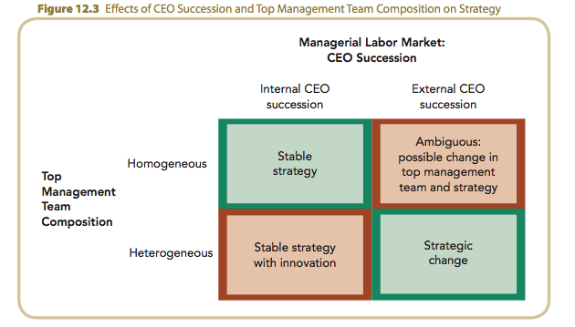
Effects of CEO Succession and Top Management Team Composition on Strategy

Slide 19
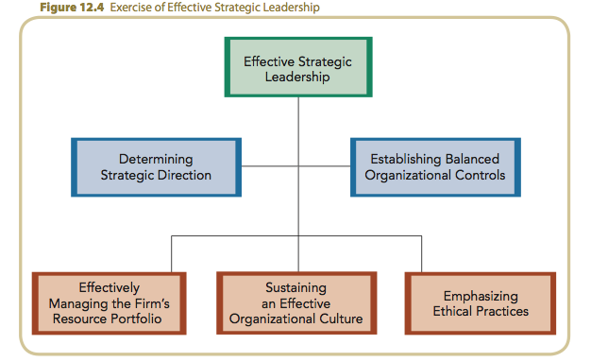
Exercise of Effective Strategic Leadership

Slide 20
Key Strategic Leadership Actions: Determining Strategic Direction
Determining strategic direction involves developing a long-term vision of the firm’s strategic intent.
  Five to ten years into the future
  Philosophy with goals
  The image and character the firm seeks
Ideal long-term vision has two parts
  Core ideology
  Envisioned future

Slide 21
Effectively Managing the Resource Portfolio:
Exploiting and Maintaining Core Competencies
Core competencies
  Resources and capabilities of a firm that serve as a source of competitive advantage over its rivals.
  Leadership must verify that the firm’s competencies are emphasized in strategy implementation efforts.
  Firms must continuously develop or even change their core competencies to stay ahead of competitors.

Slide 22
Effectively Managing the Resource Portfolio:
Developing Human Capital and Social Capital
Human capital
  The knowledge and skills of the firm’s entire workforce are a capital resource that requires investment in training and development.
Social capital
  Relationships inside and outside the firm that help it accomplish tasks and create value for customers and shareholders.

Slide 23
Sustaining an Effective
Organizational Culture
Organizational Culture
  The complex set of ideologies, symbols and core values shared through the firm, that influences the way business is conducted.
Entrepreneurial Mind-set (Orientation)
  Personal characteristics that encourage or discourage entrepreneurial opportunities.
    Autonomy
    Proactiveness
    Innovativeness
    Risk taking

Slide 24
Sustaining an Effective
Organizational Culture (cont’d)
Changing a firm’s organizational culture is more difficult than maintaining it.
  Effective strategic leaders recognize when change in culture is needed.
Shaping and reinforcing culture requires:
  effective communication
  problem solving skills
  selection of the right people
  effective performance appraisals
  appropriate reward systems

Slide 25
Emphasizing Ethical Practices
Effectiveness of processes used to implement the firm’s strategies increases when based on ethical practices.
Ethical practices create social capital and goodwill for the firm.

Slide 26
Emphasizing Ethical Practices (cont’d)
Actions that develop an ethical organizational culture include:
  establishing and communicating specific goals to describe the firm’s ethical standards.
  continuously revising and updating the code of conduct.
  disseminating the code of conduct to all stakeholders to inform them of the firm’s ethical standards and practices.

Slide 27
Emphasizing Ethical Practices (cont’d)
Actions that develop an ethical organizational culture include:
  developing and implementing methods and procedures to use in achieving the firm’s ethical standards.
  creating and using explicit reward systems that recognize acts of courage.
  creating a work environment in which all people are treated with dignity.

Slide 28
Establishing Balanced
Organizational Controls
Controls
  Formal, information-based procedures used by managers to maintain or alter patterns in organizational activities.
Controls help strategic leaders to:
  build credibility
  demonstrate the value of strategies to the firm’s stakeholders
  promote and support strategic change

Slide 29
Establishing Balanced
Organizational Controls (cont’d)
The Balanced Scorecard
  A framework used to verify that the firm has established both strategic and financial controls to assess its performance.
  Prevents overemphasis of financial controls at the expense of strategic controls
Four perspectives of the balanced scorecard
  Financial
  Internal business processes
  Learning and growth
  Customer

Slide 30
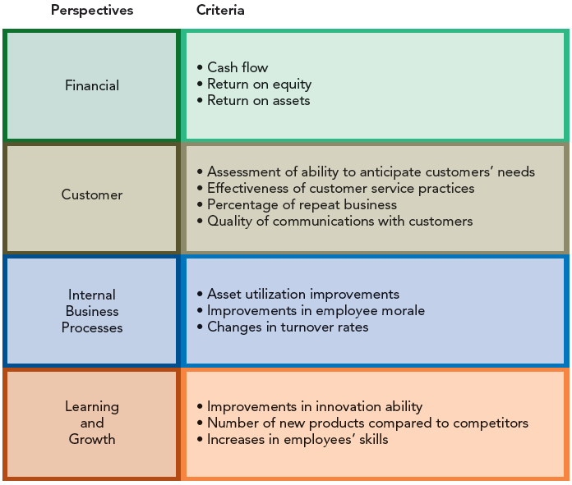
Establishing Balanced
Organizational Controls (cont’d)

