Slide 1
CHAPTER 13
Motivation, Teaching, and Learning
© 2018 McGraw-Hill Higher Education. All rights reserved.

Slide 2
Learning Goals
Define motivation and compare the behavioral, humanistic, cognitive, and social perspectives on motivation
Discuss the important processes in motivation to achieve
Explain how relationships and sociocultural
contexts can support or undercut motivation
Recommend how to help students with achievement difficulties

Slide 3
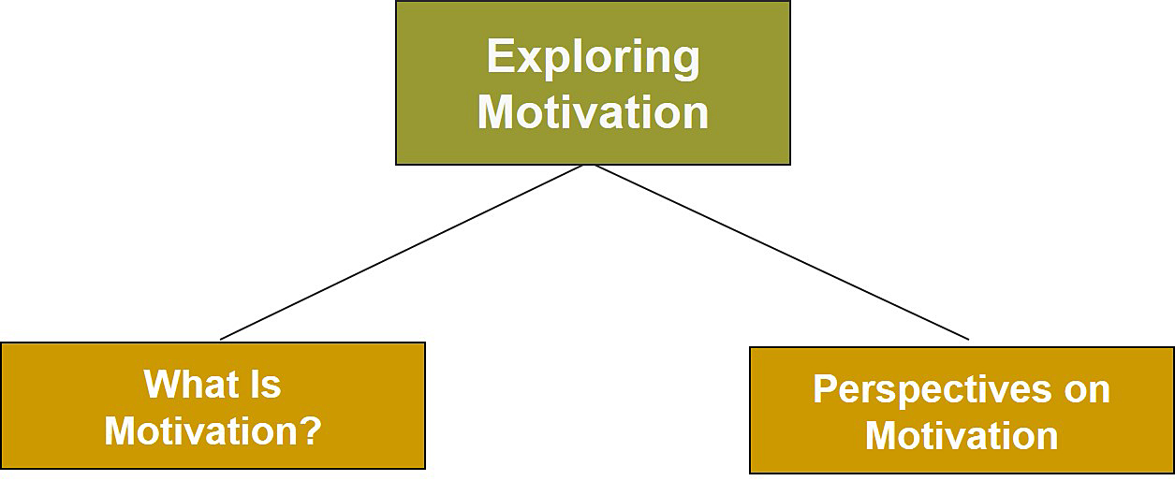
Motivation, Teaching, and Learning, 1

Slide 4
Connecting with Teachers
Jaime Escalante, a math teacher at Garfield High School in East Los Angeles, was committed and motivated to help his students become successful
  When he began teaching, many of the students had little confidence in their math abilities
    Most of the teachers had low expectations for their success
  His inspiring teaching style raised Garfield High School to 7th place among U.S. schools in calculus
  His experiences were portrayed in the film Stand and Deliver

Slide 5
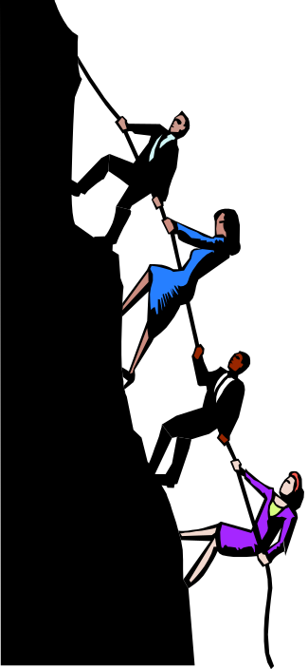
Motivation
Involves the processes
that energize, direct, and sustain behavior

Slide 6
Perspectives on Motivation, 1
The behavioral perspective
emphasizes external rewards and punishments as keys in determining student motivation
Notes:
Incentives - Positive or negative stimuli or events that can motivate a student’s behavior

Slide 7
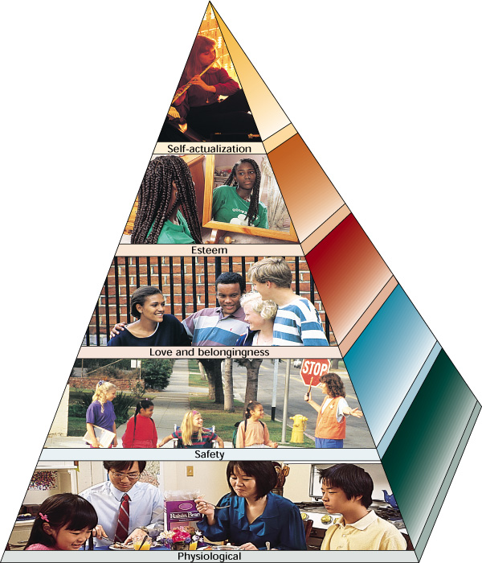
Perspectives on Motivation, 2
The humanistic perspective
stresses students’
capacity for personal growth, freedom to
choose their own destinies, and positive qualities
Notes:
Humanistic perspective is closely associated with Maslow’s hierarchy of needs.
Individual needs must be satisfied in a sequence:
Physiological needs (lowest level)
Safety needs
Love and belongingness needs
Esteem needs
Self-actualization needs (highest level)
Self-actualization is the motivation to develop one’s full potential as a human being. It is the highest and most elusive of Maslow’s needs.

Slide 8

Perspectives on Motivation, 3
The cognitive perspective
focuses on students’ competence motivation, the idea that people are motivated to deal effectively with their environment, to master their world, and to process information efficiently

Slide 9
Perspectives on Motivation, 4
The social perspective
stresses the need for affiliation
or relatedness that involves
establishing, maintaining,
and restoring warm, close
personal relationships

Slide 10
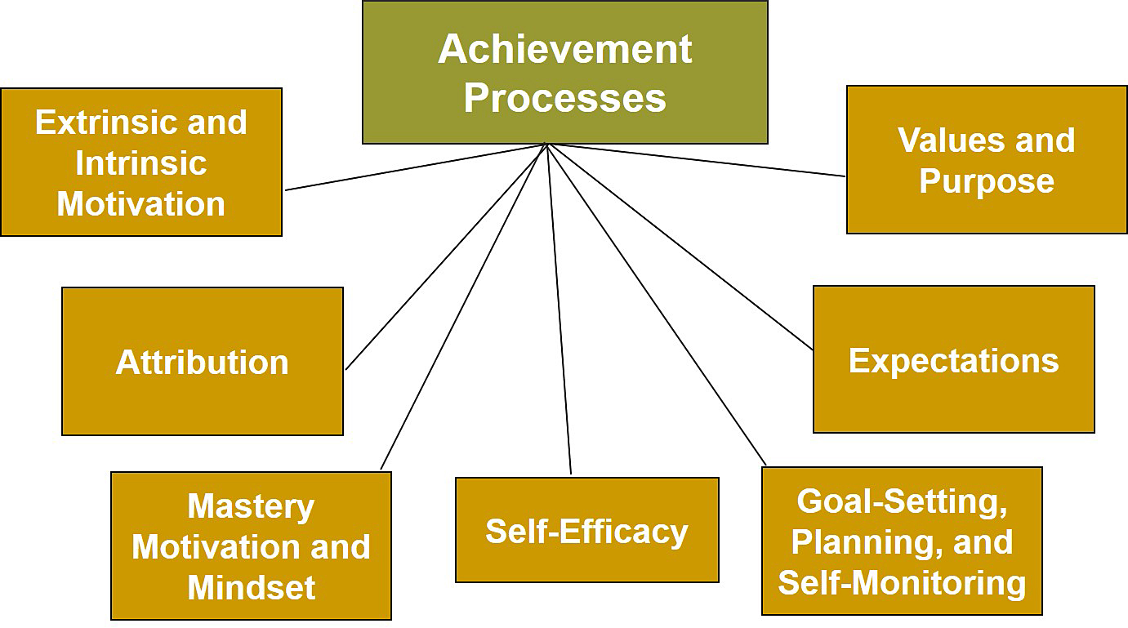
Motivation, Teaching, and Learning, 2

Slide 11
Extrinsic versus Intrinsic Motivation
Extrinsically motivated students:
Do something to obtain something else
Are influenced by rewards and punishments
Intrinsically motivated students:
Are internally motivated to doing something for its own sake
Have increased motivation when they are given some personal choice
Notes:
Behavioral perspective favors extrinsic motivation.
Humanistic and cognitive approaches stress intrinsic motivation.
Four types of intrinsic motivation:
Self-determination and personal choice
Optimal experiences and flow
Interest
Cognitive engagement and self-responsibility

Slide 12
Self-Determination and Personal Choice
Students want to believe they are doing something because of their own will, not because of external success or rewards
Autonomy-supportive teachers
  Teachers who create circumstances for students to engage in self-determination
Students’ internal motivation and intrinsic interest increase when students have choice and opportunities to take personal responsibility for their learning

Slide 13
Best Practices for Student Self-Determination and Choice
Talk to students about why learning activities are important
Provide students opportunities to make meaningful choices
Be attentive to students’ feelings
Manage the classroom effectively and allow students to make personal choices
Establish learning centers; let students work independently or collaborate with others
Create self-selected interest groups

Slide 14
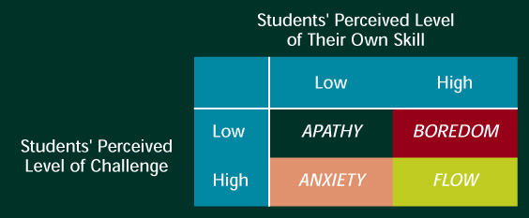
Optimal Experiences and Flow
Flow occurs:
  When students develop a sense of mastery and are absorbed in a state of concentration while they engage in an activity
  When students are engaged in challenges they find neither too difficult nor too easy
Notes:
According to Csikszentmihalyi (1990, 1993), flow is the optimal experiences in life.
Flow occurs when people are engaged in challenges that are neither too difficult nor too easy.

Slide 15
Best Practices for Helping Students Achieve Flow
Be competent and motivated; become a content expert; and show enthusiasm when you teach
Create an optimal match and encourage students to achieve challenging but reasonable goals
Remove classroom distractions
Raise confidence and encourage students to tackle learning with confidence

Slide 16
Cognitive Engagement and Self-Responsibility
Variation on intrinsic motivation
Emphasize the importance to create learning environments that encourage students to become cognitively engaged and take responsibility for their learning
  Motivated students will expend the effort to persist and master ideas rather than doing enough work to just get by

Slide 17
Extrinsic Rewards and Intrinsic Motivation
Classroom rewards can be useful (Cameron & Pierce, 2008); the two uses are:
  Incentive to engage in tasks (goal is to control a student’s behavior)
    Rewards used as incentives lead to perceptions that the behavior was caused by an external reward
  To convey information about mastery
    Reward used to convey information about mastery can increase intrinsic motivation by increasing one's sense of competence
Notes:
Most psychologists and educators believe children need to develop internalization and intrinsic motivation as they age.
Researchers have found that as students age (move from early elementary school to high school years), their intrinsic motivation decreases.

Slide 18
Attribution Theory
Bernard Weiner
Attribution theory: In their effort to make sense of their own behavior or performance, individuals are motivated to discover the underlying causes
  Locus: Whether the cause is internal or external to the actor
  Stability: The extent to which the cause remains the same or changes
  Controllability: The extent to which the individual can control the cause

Slide 19
Attribution Theory
Combination of Causal Attributions | Reason Students Give for Failure
Internal-Stable-Uncontrollable | Low aptitude
Internal-Stable-Controllable | Never study
Internal-Unstable-Uncontrollable | Sick the day of the test
Internal-Unstable-Controllable | Did not study for this particular test
External-Stable-Uncontrollable | School has tough requirements
External-Stable-Controllable | The instructor is biased
External-Unstable-Uncontrollable | Bad luck
External-Unstable-Controllable | Friends failed to help

Slide 20
Weiner’s Attribution Theory
Theory into Practice, 1
James believes he did well on a test because he was lucky
Q.1: Describe James's attribution along Weiner's dimensions
Steve believes he did poorly on a test because he is stupid
Q.2: Describe Steve's attribution along Weiner’s dimensions
Notes:
A1: Locus - External
Stability - Unstable
Controllability - Uncontrollable
A2: Locus - Internal
Stability - Stable
Controllability - Uncontrollable

Slide 21
Weiner’s Attribution Theory
Theory into Practice, 2
Sally believes she did poorly on a test because she didn’t study enough for this test
Q.3: Describe Sally’s attribution along Weiner’s dimensions
Sandra believes she did poorly in a class because the teacher doesn’t like her
Q.4: Describe Sandra's attribution along Weiner’s dimensions
Notes:
A3: Locus - Internal
Stability - Unstable
Controllability - Controllable
A4: Locus - External
Stability - Stable
Controllability - Uncontrollable

Slide 22
Achievement Goal Orientation
Mastery Orientation
  Students focus on the task rather than their ability
  Generate solution-oriented strategies
Helpless Orientation
  Students focus on their personal inadequacies
Performance Orientation
  Students are concerned with the outcome rather than the process

Slide 23
Goal Theory (Mastery Motivation)
Theory into Practice, 1
Susan struggles with math. She often tells her teacher that she can’t do the assigned homework During class, she often just stares out of the window Not surprisingly, she does not do well
Q: What goal orientation is Susan demonstrating?
Notes:
A: Helpless orientation

Slide 24
Goal Theory (Mastery Motivation)
Theory into Practice, 2
Shana struggles with math. She tries very hard by asking for help when she needs it, completing her homework to the best of her ability, and studying hard for tests
When she does better than her usual score, she is very happy
Q: What goal orientation is Shana demonstrating?
Notes:
A: Mastery orientation

Slide 25
Goal Theory (Mastery Motivation)
Theory into Practice, 3
Sally does well in math. She aces most tests and competes with Steve, who also does well, to see who will get the highest score
She excitedly pumps her fist in the air and whoops with pleasure each time she earns the highest score in the class
Q: What goal orientation is Sally demonstrating?
Notes:
A: Performance orientation

Slide 26
Goal Theory (Mastery Motivation)
Theory into Practice, 4
Steve does well in math. He aces most tests. He often works on things that are beyond what his classmates are doing because he enjoys the challenge and wants to learn more
When he does not understand a concept, he tries to work it out and asks for help if he needs it. He shakes his head when Sally does her fist-pumping routine
Q: What goal orientation is Steve demonstrating?
Notes:
A: Mastery orientation

Slide 27
Mindset
Individuals develop a cognitive view of themselves (Dweck, 2006)
Individuals have one of two mindsets:
  Fixed mindset - Belief that qualities are carved in stone and cannot be changed.
    Helpless orientation
  Growth mindset - Belief that qualities can change and improve through effort.
    Mastery motivation

Slide 28

Self-Efficacy
Teach specific
strategies
Combine strategy training with goals
Provide students with support
Guide students in setting short- and long-term goals
Help students believe in their cognitive abilities
Give students performance-contingent rewards to signal mastery
Notes:
Self-efficacy - Belief that one can master a situation and produce positive outcomes
It has much in common with mastery motivation and intrinsic motivation.

Slide 29
Enter the Debate
Should teachers help students who struggle by giving them assignments they can easily accomplish?
YES
NO
Notes:
During a slideshow, text may be written on the slides in the yes/no boxes, and then saved for later reference.

Slide 30
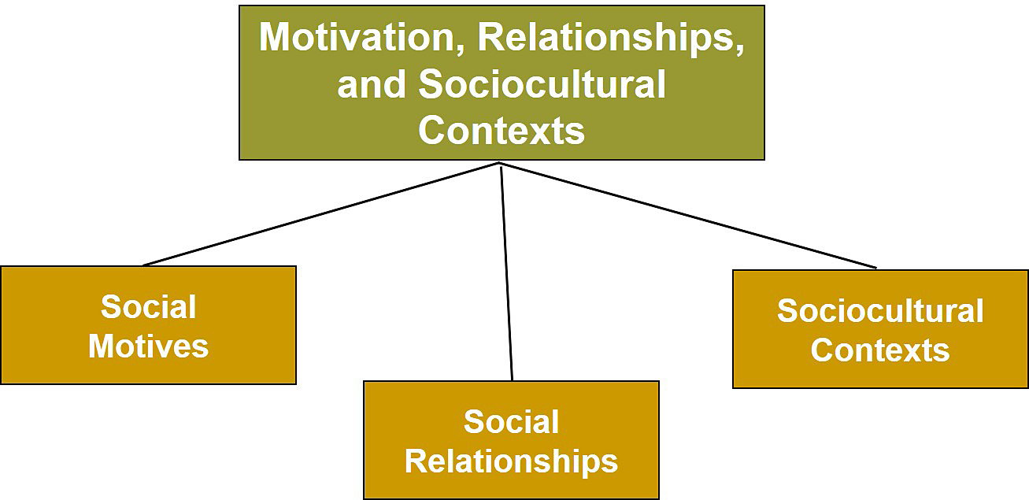
Motivation, Teaching, and Learning, 3

Slide 31
Social Motives
Social motives: Needs and desires that are learned through experiences with the social world
  Need for affiliation or relatedness
Important social motives
  Teacher approval and peer approval
Adolescence - Important time in achievement motivation and social motivation

Slide 32
Social Relationships
Parents
should provide
the right
amount of
challenge in a
positive
environment
and model
achievement
behavior.
Motivation
to Achieve
Teachers
optimize
achievement
when they provide
challenging
tasks in a
supportive
environment.
Peers
with high
achievement
standards will
support student
achievement in
others.
Notes:
Students’ relationships with parents, peers, friends, teachers, mentors, and others can tremendously affect their achievement and social motivation.

Slide 33
Sociocultural Contexts, 1
 | TEACHERS WHO CARE | TEACHER WHO DO NOT CARE
Teaching behaviors | Makes an effort to make class interesting; teaches in a special way | Teaches in a boring way, gets off-task, teaches while students aren’t not paying attention.
Communication style | Talks to me, pays attention, asks questions, listens | Ignores, interrupts, screams, yells
Equitable treatment and respect | Is honest and fair, keeps promises, trusts me, tells the truth | Embarrasses, insults
Concern about individuals | Asks what’s wrong, talks to me about my problems, acts as a friend, asks when I need help, takes time to make sure I understand, calls on me | Forgets name, does nothing when I do something wrong, doesn’t explain things or answer questions, doesn’t try to help me.

Slide 34
Sociocultural Contexts, 2
Ethnicity | There is diversity in achievement motivation within ethnic minority groups.
Socioeconomic Status | When ethnicity and socioeconomic status are investigated in the same study, SES is often the better predictor of achievement.
Notes:
Diversity within ethnic minority groups is evident in their achievement. However, achievement differences are more closely related to socioeconomic status than to ethnicity.

Slide 35
Motivation and Gender
Males
Females
Have higher competence beliefs in math and sports
Receive more teacher attention, yet receive lower grades
List more career options
Have higher competence beliefs for English, reading,
and social activities
Often experience conflicts between gender roles and achievement
Are more compliant, get less teacher attention, by middle school have lower self-esteem
Notes:
This information is not in the text. It is included here for discussion about gender differences and motivation.

Slide 36
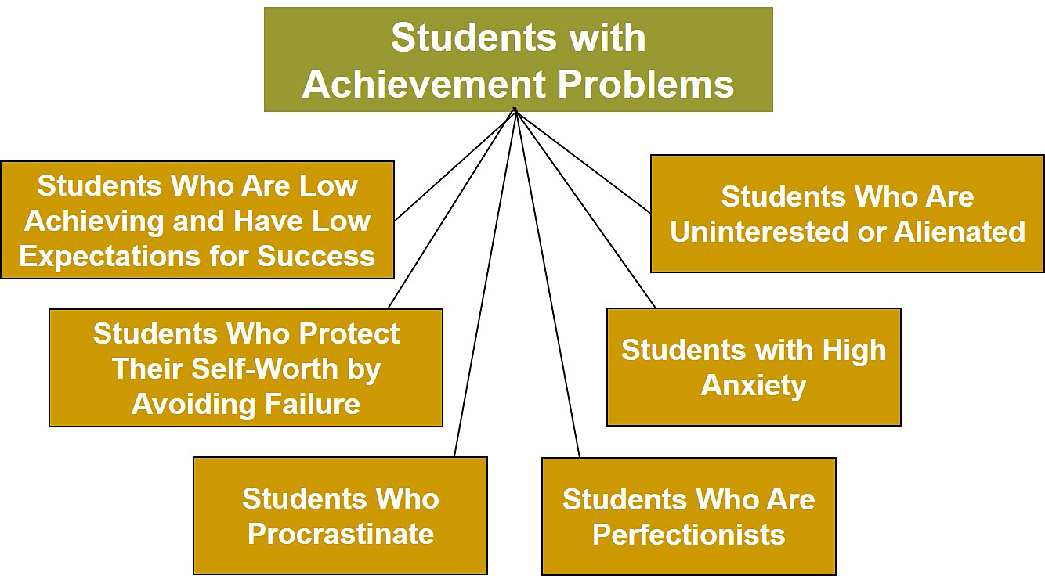
Motivation, Teaching, and Learning, 4

Slide 37
Working with Students with Achievement Problems, 1
Protection
of Self-Worth
by Avoiding
Failure
Guide setting of realistic goals, strengthen link between effort and self-worth, and encourage positive self-perceptions
Low Achievers
with Low Expectations
Provide reassurance and cognitive retraining and reward effort and progress toward realistic goals
High
Anxiety
Modify negative thoughts by engaging students in more positive, task-focused thoughts
Notes:
Failure syndrome - Students with low success expectations give up at the first sign of difficulty.
Students who protect their self-worth by avoiding failure engage in ineffective strategies (nonperformance, procrastination, setting unreachable goals, and using self-handicapping strategies).

Slide 38
Working with Students with Achievement Problems, 2
Procrastinators
Encourage acknowledgment of problems, assist in time management and task analysis, and teach behavioral and cognitive strategies for dealing with problems
Perfectionists
Identify cost/benefits, decrease self-criticism, set realistic goals and time limits, and encourage acceptance of criticism

Slide 39
Strategies to Reach Uninterested or Alienated Students
Develop positive teacher-student relationships
Make school more interesting
Teach strategies to make learning enjoyable
Consider including a mentor

Slide 40
Classroom Connections: Crack the Case—The Reading Incentive Program, 1
What are the issues in this case?
Analyze the case from the perspective of extrinsic and intrinsic motivation
Analyze the case from a goal-orientation perspective
Notes:
This case is on page 494 of the text.

Slide 41
Classroom Connections: Crack the Case—The Reading Incentive Program, 2
Why do you think Sami went from receiving 1 star the first month to receiving 30 stars the next? Why does she no longer read in her free time at school?
What are the problems with this type of incentive program? How might an incentive program be developed that does not undermine students’ motivation to read?
Notes:
This case is on page 494 of the text.

Slide 42

Reflection and Observation
Reflection:
How have teachers used games to help you learn?
How have they affected your motivation to learn?
Notes:
This slide accompanies the video segment, Geography Jeopardy, on the McGraw-Hill DVD Teaching Stories: A Video Collection for Educational Psychology.

