Slide 1
CHAPTER 10
Social Constructivist Approaches
© 2018 McGraw-Hill Higher Education. All rights reserved.

Slide 2
Learning Goals
Compare the social constructivist approach with other constructivist approaches
Explain how teachers and peers can jointly contribute to children’s learning
Discuss effective decisions in structuring small-group work

Slide 3
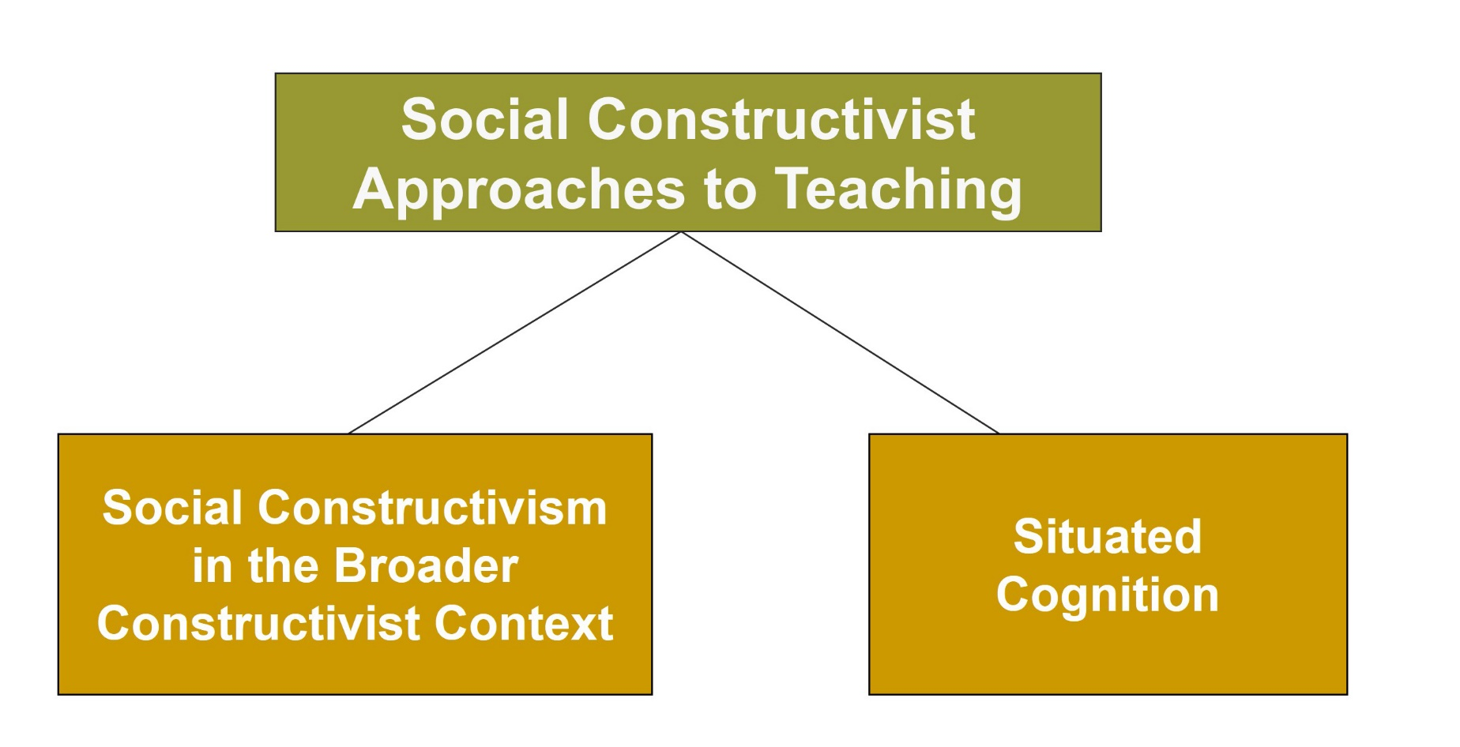
Social Constructivist Approaches

Slide 4
Connecting with Teachers
Chuck Rawls, a teacher at Appling Middle School in Macon, Georgia, discussed peer tutoring, a social constructivist approach to instruction
Chris, a student at the school, switched places with Rawls and taught his class using many of Rawls’s intentional and unintentional phrases and mannerisms
  Chris became Rawls’s resident expert of subject-verb agreement
  Rawls learned two lessons
    Don’t be afraid to try something different, and peer tutoring works

Slide 5
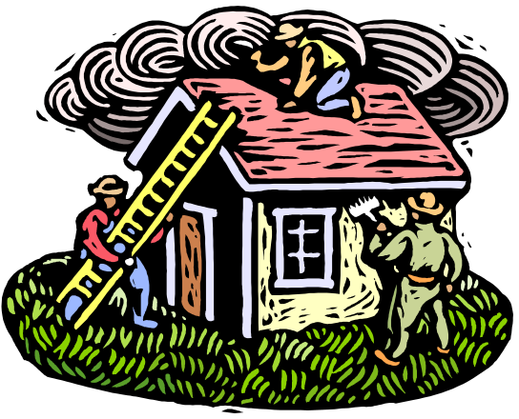
Constructivist vs. Social Constructivist Approaches to Teaching
Constructivism emphasizes how individuals actively construct knowledge and understanding
Social constructivist approach emphasizes the social contexts of learning and that knowledge is mutually built and constructed
Notes:
Vygotsky’s social constructivist model is of a social child embedded in a sociohistorical context.
Vygotsky’s social constructivist approach emphasizes that students construct knowledge through social interactions with others.
The content of knowledge is influenced by the culture in which the student lives and includes language, beliefs, and skills.

Slide 6

Situated Cognition
Idea that thinking is “situated” in social and physical contexts, not within an individual’s mind
Notes:
Knowledge is embedded in, and connected to, the context in which the knowledge developed.
Learning situations that are close to real-world circumstances should be developed.

Slide 7
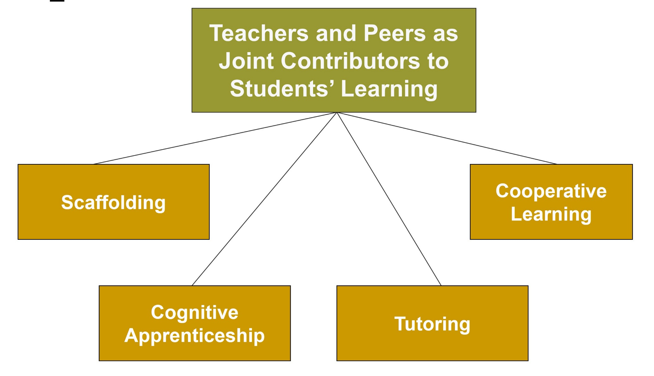
Teachers and Peers as Joint Contributors

Slide 8
Teachers and Peers as Joint Contributors to Students’ Learning
Scaffolding:
Changing the
level of
support over
the course
of a teaching
session
Cooperative Learning: Students work
in small groups
to help each other
Cognitive Apprenticeship:
An expert
stretches and
supports the
novice’s
understanding
and use of
a culture’s skills
Tutoring:
Cognitive apprenticeship between an expert and a novice
Notes:
Classroom aides, volunteers, and mentors - Able to assist students in situations when the teacher must focus on the needs of the class as a whole
Tutoring programs include Reading Recovery and Success for All (SFA).
Peer tutoring programs include Peer-Assisted Learning Strategies (PALS), Reciprocal Peer Tutoring (RPT), ClassWide Peer Tutoring (CWPT), and Valued Youth program.

Slide 9
Strategies for Using
Peer Tutoring
Spend time training tutors
Use cross-age rather than same-age tutoring when possible
Let students participate as tutor and tutee
Don’t let tutors give tests to tutees
Don’t overuse peer tutoring
Let parents know that their child will be involved in peer tutoring

Slide 10
Enter the Debate
Should teachers use high-ability students to tutor their struggling students?
YES
NO
Notes:
During a slideshow, text may be written on the slides in the yes/no boxes, and then saved for later reference.

Slide 11

Cooperative Learning Research
(Slavin, 1995)
Cooperative learning can improve student achievement when:
  Group rewards are generated
  Individuals are held accountable
Notes:
Cooperative learning - Students work in small groups to help each other learn.
Group size varies; four is typical. In some cases, cooperative learning can be done in dyads (2 students).
Cooperative learning contributes to increased motivation, interdependence, and connection with other students.

Slide 12
Figure 10.1 - Cooperative Learning Approaches, 1
STAD (STUDENT-TEAMS-ACHIEVEMENT DIVISIONS)
STAD involves team recognition and group responsibility for learning in mixed-ability groups (Slavin, 1994). Rewards are given to teams whose members improve the most over their past performances. Students are assigned to teams of four to five members. The teacher presents a lesson, usually over one or two class periods. Next, students study worksheets based on material presented by the teacher. Students monitor their team members' performance to ensure that all members have mastered their material. Teams practice working on problems together and study together, but the members take quizzes individually. The resulting individual scores contribute to the team's overall score. An individual's contribution to the team score is based
on that individual's improvement, not on an absolute score, which motivates students to work hard because each contribution counts. In some STAD classrooms, a weekly class newsletter is published that recognizes both team and individual performances.
The STAD approach has been used in a variety of subjects (including math, reading, and social studies) and with students at different grade levels. It is most effective for learning situations that involve well-defined objectives or problems with specific answers or solutions. These include math computation, language use, geography skills, and science facts.

Slide 13
Figure 10.1 - Cooperative Learning Approaches, 2
THE JIGSAW CLASSROOM
In chapter 5. “Sociocultural Diversity,” we described the jigsaw classroom, which involves having students from different cultural backgrounds cooperate by doing different parts of a project to reach a common goal. Here we elaborate on the concept.
Robert Slavin (1994) created Jigsaw II, a modified version of Jigsaw I. Whereas Jigsaw I consists of teams of six, Jigsaw II usually has teams of four or five. All team members study the entire lesson rather than one part, and individual scores are combined to form an overall team score, as in STAD. After they have studied the entire lesson, students become expert on one aspect of the lesson, then students with the same topics meet in expert groups to discuss them. Subsequently, they return to their teams and help other members of the team learn the material.
Developed by Eliot Aronson and his colleagues (1978), Jigsaw I is a cooperative learning approach in which six- member teams work on material that has been broken down into parts. Each team member is responsible for a part. Members of different teams who have studied the same part convene, discuss their part, and then return to their teams, where they take turns teaching their part to other team members.
LEARNING TOGETHER
Created by David and Roger Johnson (1994), this approach has four components: (1) face-to-face interaction, (2) positive interdependence, (3) individual accountability, and (4) development of interpersonal group skills. Thus, in addition to Slavin’s interest in achievement, the Johnsons'
cooperative learning approach also focuses on socio-emotional development and group interaction. In learning together, students work in four- or five-member heterogeneous groups on tasks with an emphasis on discussion and team building (Johnson & Johnson, 2003).

Slide 14
Figure 10.1 - Cooperative Learning Approaches, 3
GROUP INVESTIGATION
Developed by Shlomo Sharan (1990; Sharan & Sharan, 1992), this approach involves a combination of independent learning and group work in two- to six-member groups), as well as a group reward for individual achievement. The teacher chooses a problem for the class to study, but students decide what they want to study in exploring the problem. The work is divided among the group’s members,
who work individually. Then the group gets together, integrating, summarizing, and presenting the findings as a group project. The teacher's role is to facilitate investigation and maintain cooperative effort. Students collaborate with the teacher to evaluate their effort. In Sharan's view, this is the way many real-world problems are solved in communities around the world.
COOPERATIVE SCRIPTING
Students work in reciprocal pairs, taking turns summarizing information and orally presenting it to each other (Dansereau, 1988; McDonald & others, 1985). One member of the pair presents the material. The other member
listens, monitors the presentation for any mistakes, and gives feedback. Then the partner becomes the teacher and presents the next set of material while the first member listens and evaluates it.

Slide 15



Creating a Cooperative Community
Class cooperation
Interclass cooperation
School-wide cooperation
School-parent cooperation
School-neighborhood cooperation
Notes:
David and Roger Johnson (2002, pp. 144–146) - Cooperation and positive interdependence need to occur at a number of different levels.
Learning group of students within a classroom, the classroom, between classrooms, school, school-parent, and school-neighborhood

Slide 16
Evaluating Cooperative Learning
Positive aspects of cooperative learning
  Increased interdependence and interactions with other students
  Enhanced motivation to learn
  Improved learning by teaching material to others
Possible drawbacks
  Some students prefer to work alone
  Low-achieving students may slow down the progress of high-achieving students
  Some students may do all the cognitive work while others do little (social loafing)

Slide 17
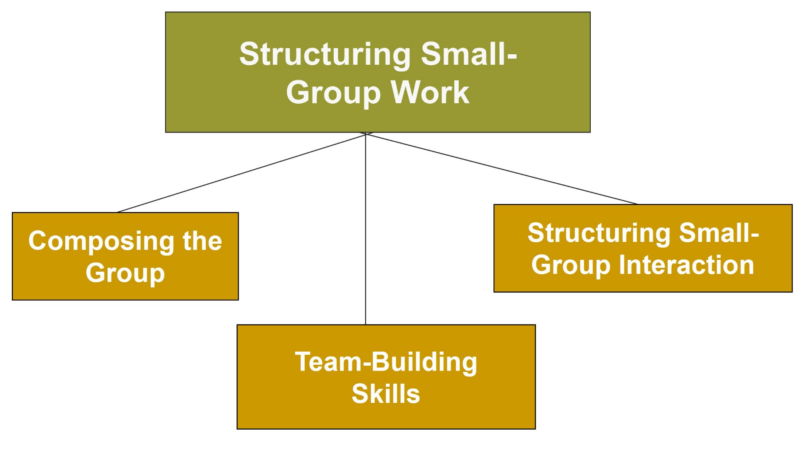
STRUCTURING SMALL-GROUP WORK, 1

Slide 18
Structuring Small-Group Work, 2
Composing the Group: Heterogeneous groups work
  Caution should be used so that average-ability students don’t get lost as high- and low-ability students form relationships like those between student and teacher
Team-building skills: Help students become better listeners
  Give students practice contributing to a team product
  Discuss the value of team leaders
Structuring group interaction: Assigning students to specific roles within the group gives all members a sense of importance
Notes:
Roles students can assume in a cooperative learning group:
Encourager
Gatekeeper
Coach
Checker
Taskmaster
Recorder
Quiet captain
Materials monitor

Slide 19
Strategies for Developing Students’ Team-Building Skills
Don’t begin the year on a difficult task
Do team building at the level of the cooperative group (2 to 6 students) rather than the level of the entire class
Work with students to help them become better listeners
Give students practice contributing to a common product
Discuss the value of group leadership
Work with team leaders as they deal with problems

Slide 20

Reflection & Observation
Reflection:
Think about your educational experiences with group work. What worked well? What did not work well? Why or why not?
Notes:
This slide accompanies the video segment, Social Constructivist Practices, on the McGraw-Hill DVD Teaching Stories: A Video Collection for Educational Psychology.

