Slide 1
CHAPTER 9
Complex Cognitive Processes
© 2018 McGraw-Hill Higher Education. All rights reserved.

Slide 2
Learning Goals
Discuss conceptual understanding and teaching concepts.
Describe several types of thinking and ways that teachers can foster them.
Take a systematic approach to problem solving.
Define transfer and explain how to enhance it as a teacher.

Slide 3
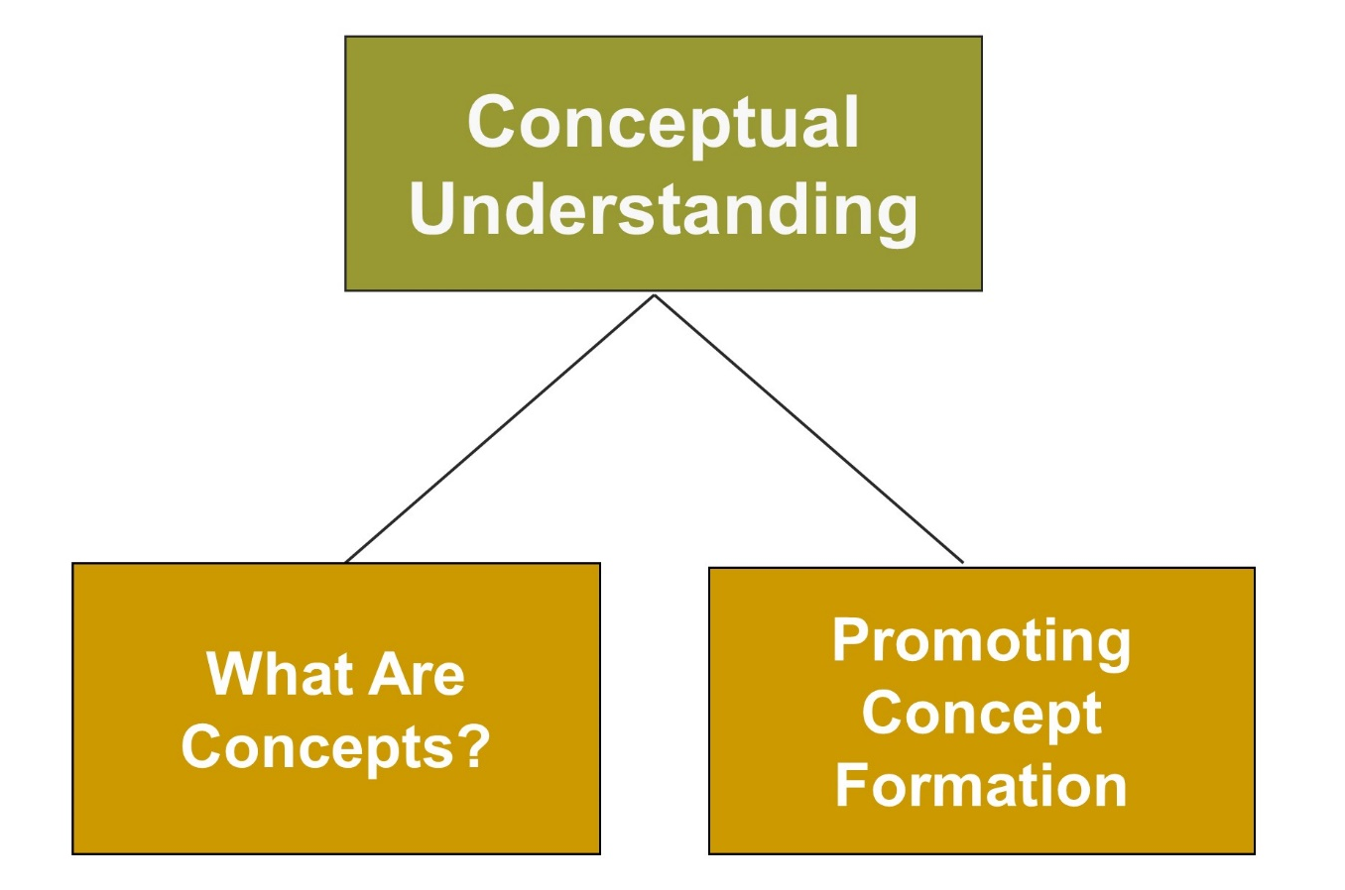
Complex Cognitive Processes

Slide 4
Connecting with Teachers
Marilyn Whirry’s teaching philosophy centers around embracing and celebrating the art of learning
She feels teachers need to help students become motivated to search for knowledge and discover answers to questions about why and how
One of Marilyn’s most important goals as a teacher is to get students to think deeply as they read and write

Slide 5

Conceptual Understanding
Concepts are categories that group objects, events, and characteristics on the basis of common properties
Concept formation
  Learning about the features of concepts
  Defining concepts and providing examples
  Hierarchical categorization and concept maps
  Hypothesis testing
  Prototype matching
Notes:
Rule-example strategy (four steps):
Define the concept
Clarify terms in the definition
Give examples to illustrate key features or characteristics
Provide additional examples

Slide 6
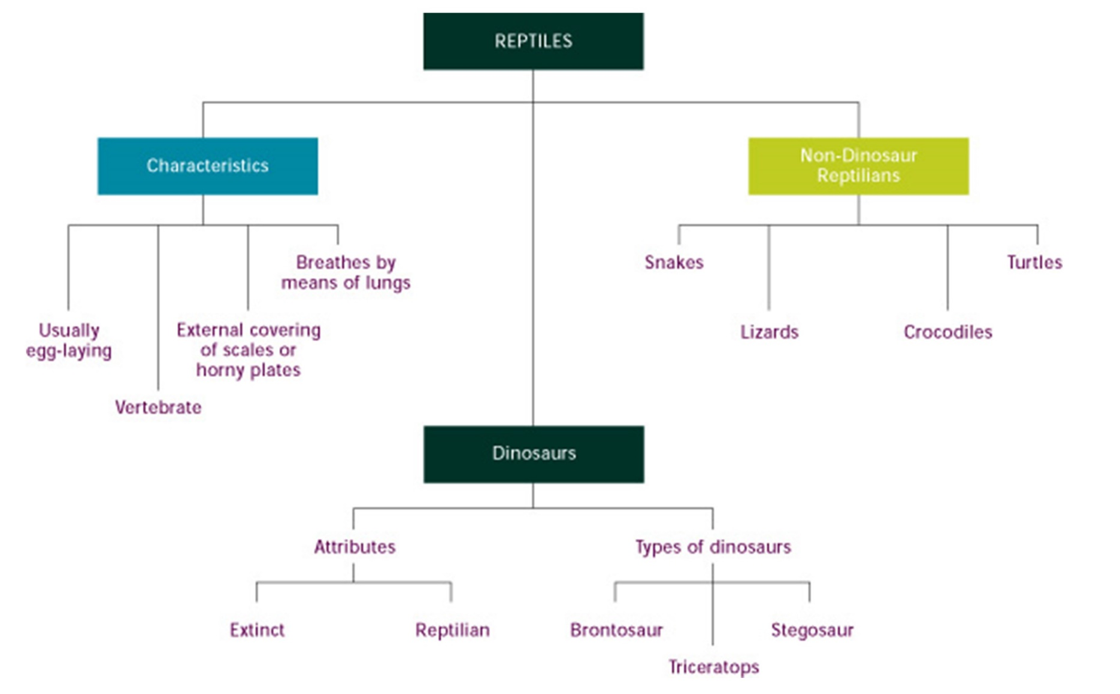
Concept Map
Notes:
Hierarchical categorization - Students can know that a triceratops is a reptile because they know that dinosaurs are reptiles and that a triceratops is a dinosaur
Concept maps - Visual presentation of a concept’s connections and hierarchical organization

Slide 7

Promoting Concept Formation
Use the rule-example strategy
Help students learn what a concept is and what it is not
Provide clear, concrete examples
Relate new concepts to already-known
concepts
Create concepts maps
Generate hypotheses about concepts
Match prototype
Check for understanding and generalization

Slide 8
Enter the Debate
Can teachers teach students to think?
YES
NO
Notes:
During a slideshow, text may be written on the slides in the yes/no boxes, and then saved for later reference.

Slide 9
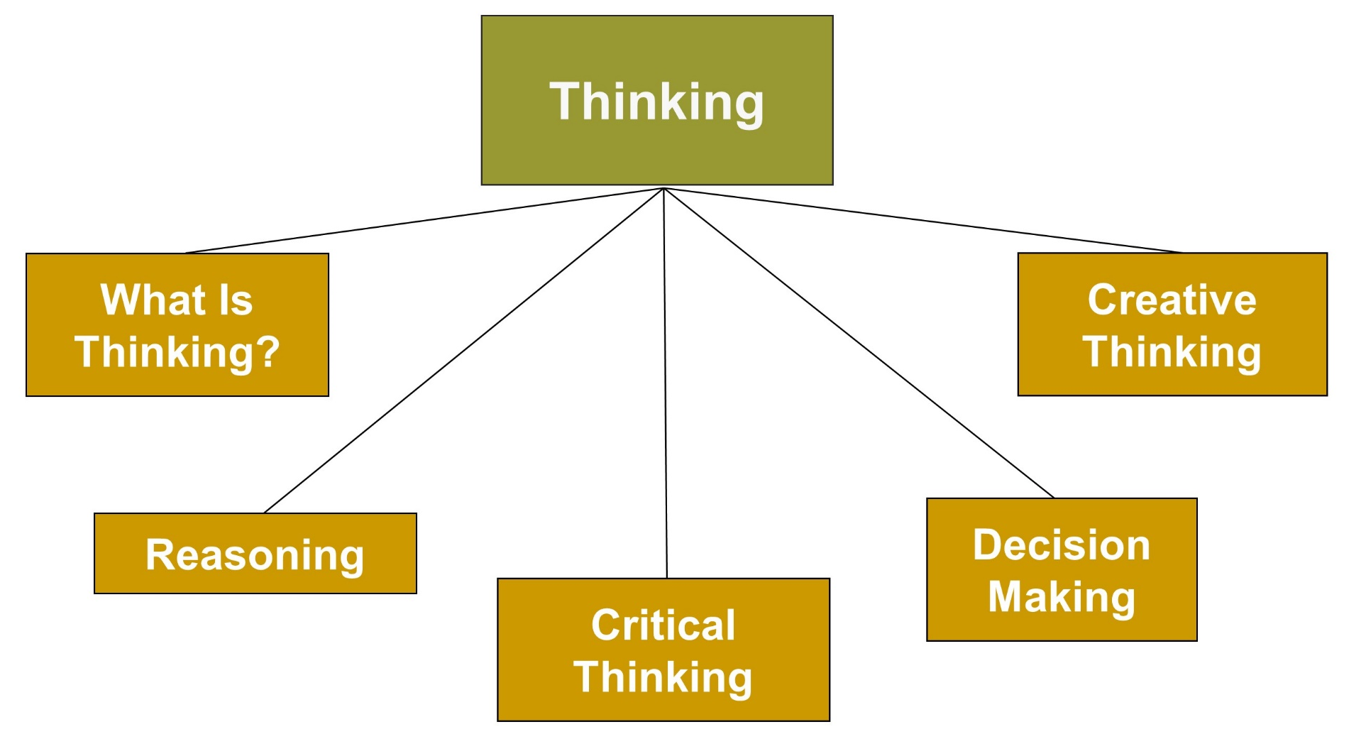
Complex Cognitive Processes, 1

Slide 10
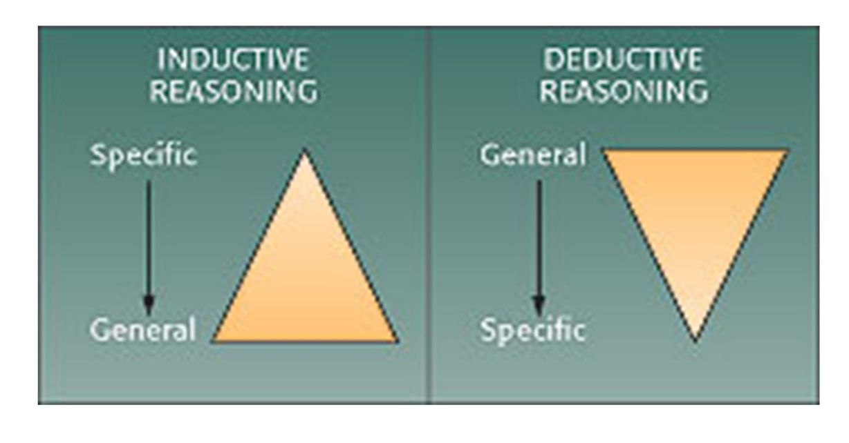
Thinking
Involves manipulating and transforming information in memory

Slide 11
Reasoning - Inductive
Reasoning from the specific to the general
Drawing conclusions about all members of a category based on observing some members
Requires repeated observations
Conclusions are never entirely certain and can be inconclusive
Is basic to analogies

Slide 12
Reasoning – Deductive
Reasoning from the general to the specific
Used in solving puzzles or riddles
Occurs when students learn a general rule and understand how it applies to some situations but not others

Slide 13

Critical Thinking
Thinking reflectively and productively and evaluating the evidence
Ways Teachers Encourage Thinking
  Help students construct their own thinking
  Use thinking-based questions
  Provide positive role models for thinking
  Be a thinking role model for students
  Keep up-to-date on the latest developments in thinking
Notes:
Mindfulness - Key to critical thinking as well as being alert, mentally present, and cognitively flexible while going through life’s everyday activities and tasks
If a solid basis of fundamental skills (literacy and math skills) is not developed during childhood, adolescents will be unlikely to develop critical-thinking skills.

Slide 14

Decision Making, 1
Decision making involves thinking in which individuals evaluate alternatives and make choices among them
Confirmation bias: The tendency to search for
information that supports our ideas rather than refutes them
Belief perseverance: The tendency to hold on to a belief in the face of contradictory evidence

Slide 15
Decision Making, 2
Overconfidence bias: The tendency to have more confidence in judgments and decisions than we should, based on past experience
Hindsight bias: The tendency to falsely report, after the fact, that we accurately predicted the event
Notes:
Older adolescents make better decisions than younger adolescents; younger adolescents make better decisions than children. Most individuals make better decisions when they are calm.

Slide 16
Strategies for Making Good Decisions for Yourself and Your Students
Examine the costs and benefits of various outcomes
Avoid confirmation bias
Resist belief perseverance
Avoid overconfidence bias
Avoid hindsight bias
Read and think about what influences the adolescent decision-making process

Slide 17
Creative Thinking
The ability to think about something in novel and unusual ways and come up with unique solutions to problems
Convergent Thinking
Aims to produce one correct answer
Divergent
Thinking
Aims to produce many answers to the same question
Notes:
Steps in the creative process:
Preparation
Incubation
Insight
Evaluation
Elaboration

Slide 18
Teaching and Creativity
Strategies for becoming a more creative teacher:
  Try to be surprised by something every day
  Try to surprise at least one person every day
  Each day, write down what surprised you and how you surprised others
  Follow what sparks your interest
  Wake up with a specific goal to look forward to
  Spend time in settings that stimulate your creativity

Slide 19

Ways to Improve Creativity, 1
Encourage creative thinking on an individual and group basis
Provide stimulating
environments
Encourage internal
motivation
Don’t overcontrol students
Guide students to help them think in flexible ways

Slide 20
Ways to Improve Creativity, 2
Build students’ self-confidence
Guide students to be persistent and delay gratification
Encourage students to take risks
Introduce students to creative people
Connect with technology

Slide 21
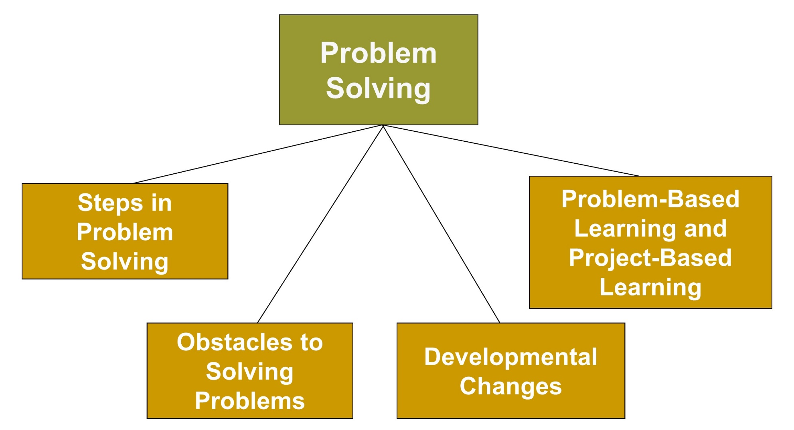
Complex Cognitive Processes, 2

Slide 22
Problem Solving
Involves finding an appropriate way to attain a goal
  Find and frame problems
  Develop good strategies:
    Subgoaling
    Algorithms
    Heuristics
    Means-end analysis
  Evaluate solutions
  Rethink and redefine problems and solutions over time

Slide 23

Obstacles to Problem Solving
Fixation
Lack of Motivation
Lack of Persistence
Inadequate Emotional Control
Notes:
Fixation - Using a prior strategy and failing to look at a problem from a new perspective
A mental set is a type of fixation; an individual tries to solve a problem in a way that worked in the past.
Highly motivated people can focus on a problem and solve it; too much anxiety or fear can hinder a student’s ability to solve a problem.

Slide 24

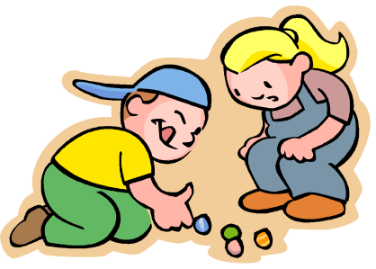
Developmental Changes
Children’s ability to use rules increases
Children become better planners
Increased complexity of problem solving
Effective strategies in problem solving

Slide 25


Problem- and Project-Based Learning
Problem-based learning emphasizes solving authentic problems like those that occur in daily life
Project-based learning emphasizes students working on real, meaningful problems to create tangible products
Notes:
Problem-based learning (5 phases):
Orient students to the problem
Organize students for study
Assist with independent and group investigations
Develop and present artifacts and exhibits
Analyze and evaluate work
Project-based learning environments (5 main features):
A driving question
Authentic, situated inquiry
Collaboration
Scaffolding
End product

Slide 26

Problem-Based Learning
Strategies for improving students’ problem solving
  Provide opportunities to solve real-world problems
  Monitor effective/ineffective strategies
  Involve parents
  Improve students’ use of rules, knowledge, and strategies
  Use technology effectively

Slide 27
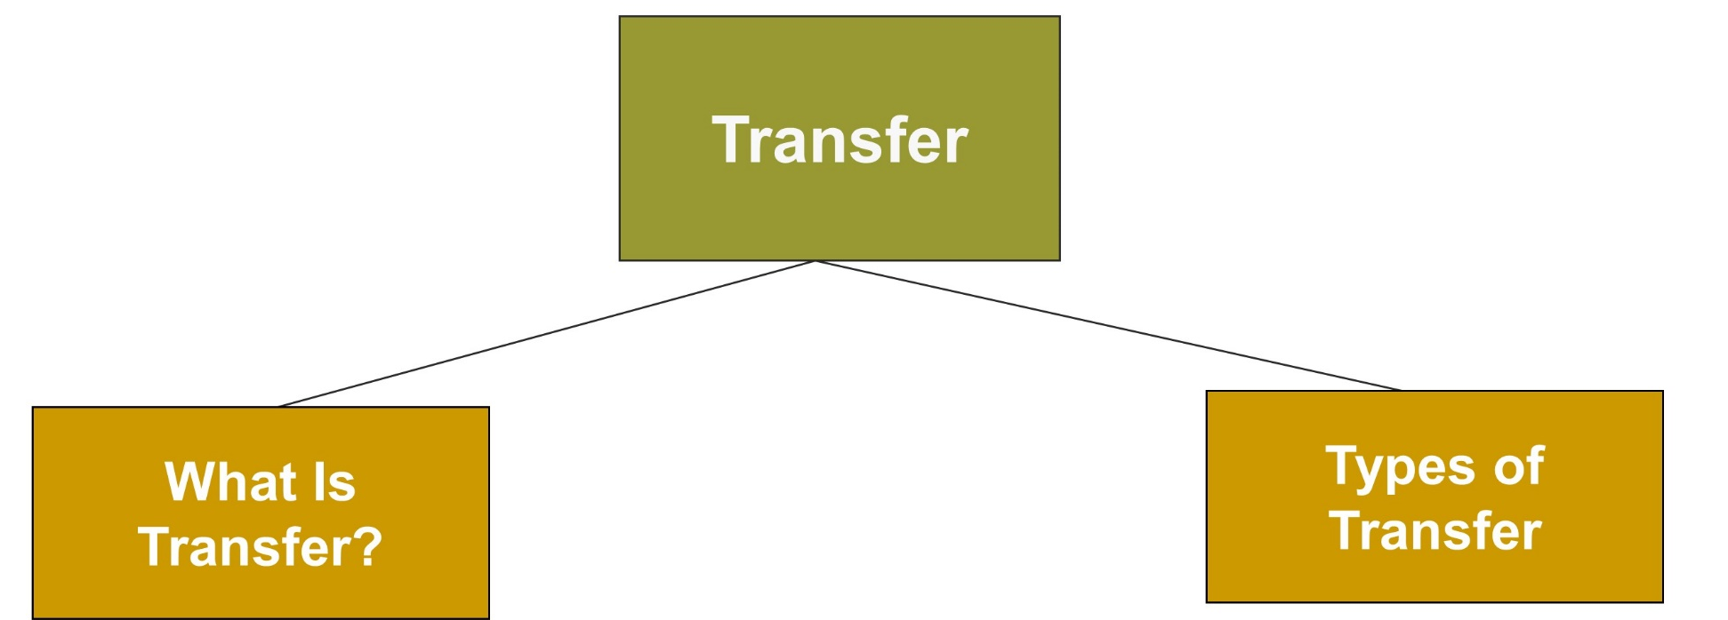
Complex Cognitive Processes, 3

Slide 28
Types of Transfer
 | Learning Situation:
Near transfer → | Is similar to initial learning
Far transfer → | Is different from initial learning situation
Low-road → | Is previous learning almost unconsciously transfers to a new situation
High-road → | Is conscious and effortful
Notes:
Transfer - Occurs when a person applies previous experiences and knowledge to learning or problem solving in a new situation

Slide 29

High-Road Transfer Can Be…
 | Learning Situation:
Forward-reaching transfer → | Occurs when students think about how to use information in a new situation
Backward-reaching transfer → | Occurs when students look back to previous situations for information to solve problems in a new context

Slide 30
Cultural Practices and Transfer
Cultural practices may influence the ease or difficulty of knowledge transfer
  Prior knowledge includes the kind of knowledge students acquire through cultural experiences
  In some cases, cultural knowledge can support student learning and transfer; in other cases, it may interfere
  For some students, cultural background may provide a minimal fit or transfer between what they have learned at home and what is taught in school

Slide 31
Best Practices for Helping Students Transfer Information
Think about what students need to be successful
Give students opportunities for real-world learning
Root concepts in application; present, define, and have students generate examples for concepts
Teach for depth of understanding and meaning
Encourage students to engage in self-explanation
Teach strategies that will generalize

Slide 32
Classroom Connections: Crack the Case—The Case of the Statistics Test
What are the issues in this case?
What went wrong for Cassandra?
What should she do differently if she wants to do better on the next test?
If you were the teacher of Cassandra’s class, how would you help your students to prepare for this type of test?
Notes:
This case is on page 343 of the text.

Slide 33

Reflection & Observation
Reflection:
What strategies have your teachers used to encourage complex thinking?
Why were they effective?
Notes:
This slide accompanies the video segment, Promoting Critical Thinking, on the McGraw-Hill DVD Teaching Stories: A Video Collection for Educational Psychology.

