Slide 1
CHAPTER 7
Behavioral and Social Cognitive Approaches
© 2018 McGraw-Hill Higher Education. All rights reserved.

Slide 2
Learning Goals
Define learning and describe five approaches to studying it.
Compare classical conditioning and operant conditioning.
Apply behavior analysis to education.
Summarize social cognitive approaches to learning.

Slide 3
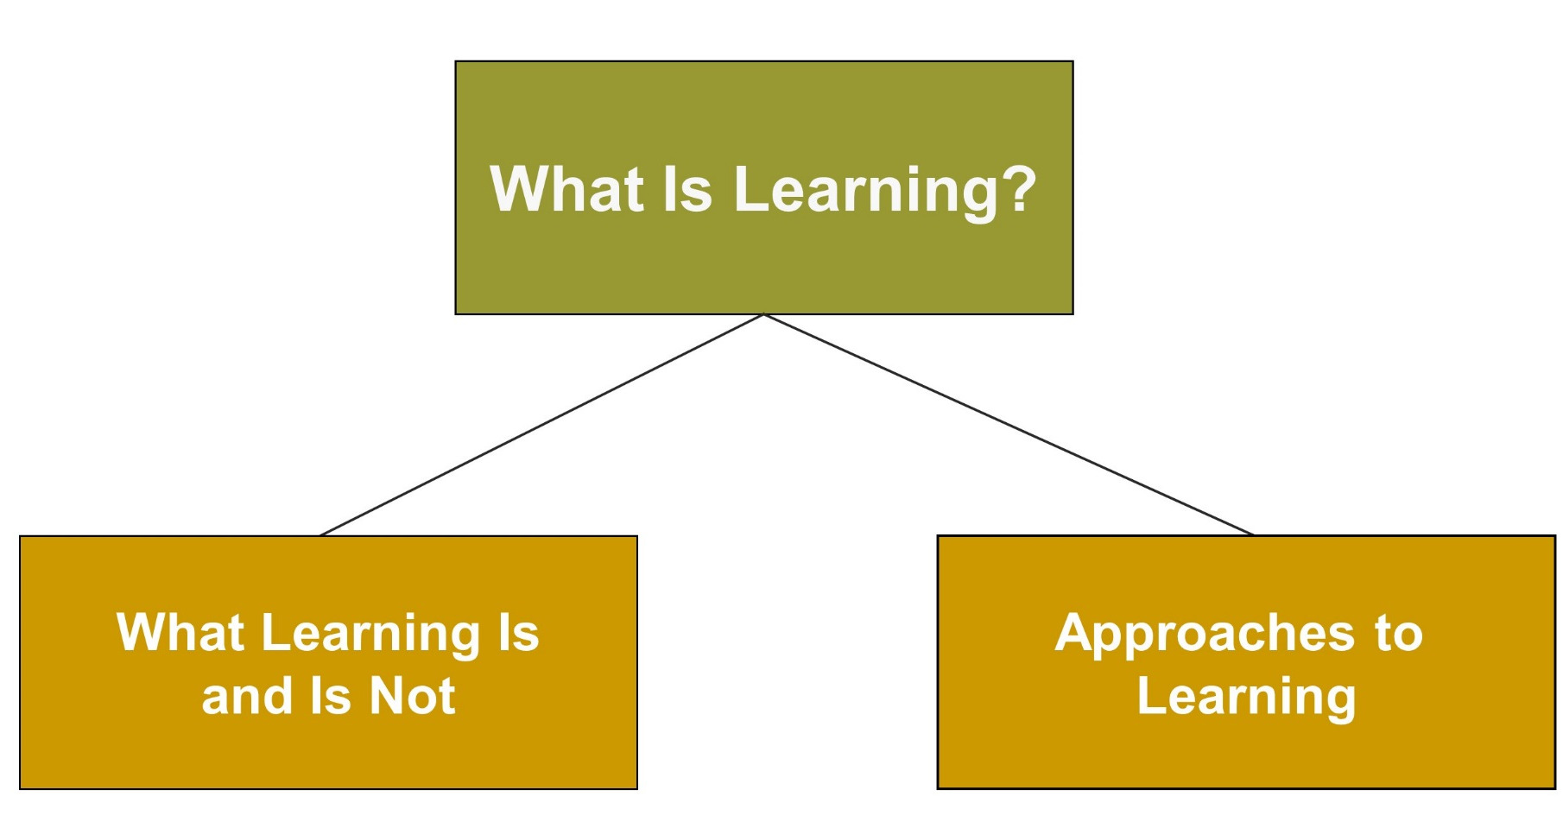
Behavioral and Social Cognitive Approaches, 1

Slide 4
Connecting with Teachers
Ruth Sidney Charney, a teacher of more than 35 years, has developed a responsive classroom approach to teaching and learning.
  Her approach emphasizes positive reinforcement of students’ good behavior.
  She reinforces students by noticing their positive attempts to follow classroom rules and meet classroom expectations.
  She reinforces students when they practice new skills or when they demonstrate recently modeled behaviors.

Slide 5
Behavioral and Cognitive Approaches to Learning, 1
Learning: A relatively permanent influence on behavior, knowledge, and thinking skills, which comes about through experience
Notes:
Behaviorism - View that behavior should be explained by observable experiences, not by mental processes
Mental processes - Defined as the thoughts, feelings, and motives that each of us experiences but that cannot be observed by others

Slide 6
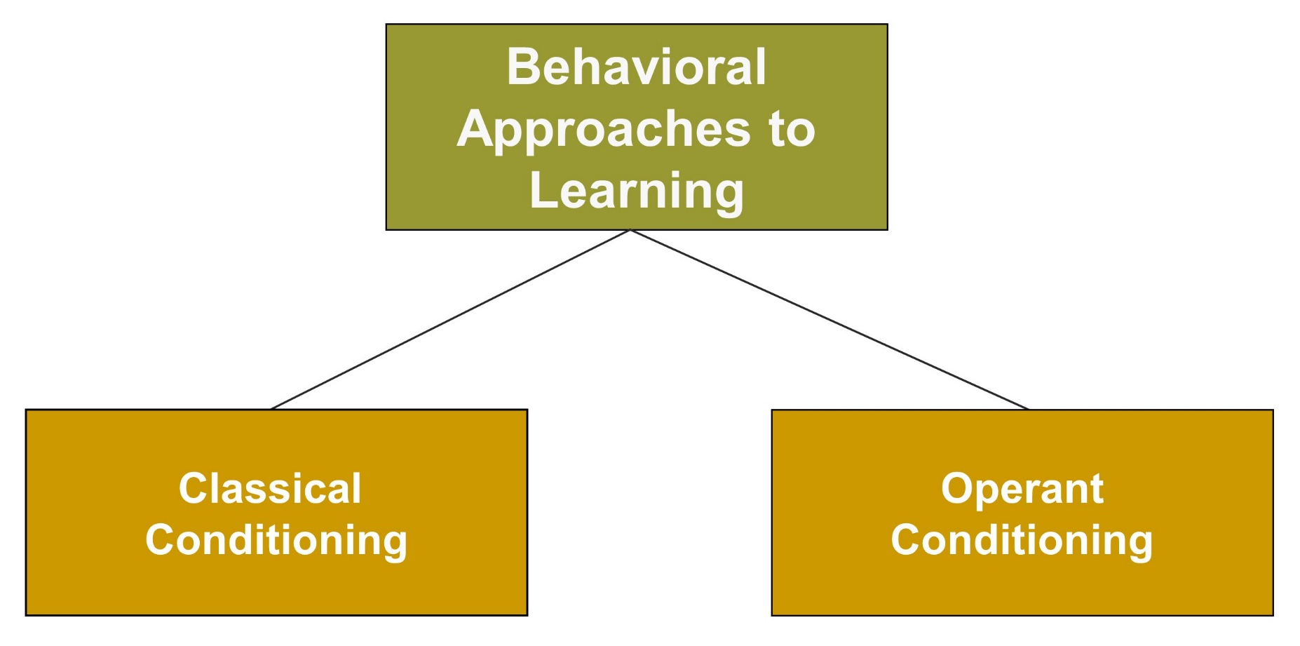
Behavioral and Cognitive Approaches to Learning, 2
Notes:
Behavioral views - Both classical conditioning and operant conditioning emphasize associative learning.
Associative learning - Consists of learning that two events are connected or associated

Slide 7
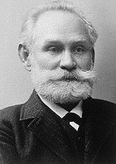
Ivan Pavlov - Classical Conditioning
Classical conditioning is a type of learning in which an organism learns to connect, or associate, stimuli. A neutral stimulus becomes associated with a meaningful stimulus and acquires the capacity to elicit a similar response.

Slide 8
Classical Conditioning
Notes:
Unconditioned stimulus (UCS) - A stimulus that automatically produces a response without any prior learning (food)
Unconditioned response (UCR) - An unlearned response that is automatically elicited by the UCS (dog’s salivation in response to food)
Conditioned stimulus (CS) - A previously neutral stimulus that eventually elicits a conditioned response after being associated with the UCS (various sights and sounds that occurred prior to the dog’s actual eating of the food)
Conditioned response (CR) - A learned response to the conditioned stimulus that occurred after the UCS-CS pairing

Slide 9
Classical Conditioning Principles
Generalization → | The tendency of a new stimulus similar to the original conditioned stimulus to produce a similar response
Discrimination → | The organism responds to certain stimuli but not others.
Extinction → | The weakening of the conditioned response (CR) in the absence of the unconditioned stimulus (UCS)

Slide 10

Systematic Desensitization
Reduces anxiety by getting the individual to associate deep relaxation with successive
visualizations of
increasingly
anxiety-producing
situations
Notes:
Systematic desensitization involves a type of counterconditioning.
Classical conditioning helps us understand some aspects of learning better than others.
It is helpful in understanding students’ anxieties and fears; it is not as effective in explaining voluntary behaviors.

Slide 11
Pavlov’s Classical Conditioning
Theory into Practice, 1
Patty does poorly on a math test. This makes her feel anxious. From this point on, she always becomes anxious when taking a math test. As the school year progresses, she begins experiencing anxiety when she has tests in other subject areas as well.
Q.1: Identify the US in the example above.
Q.2: Identify the UR in the example above.
Q.3: Identify the CS in the example above.
Q.4: Identify the CR in the example above.
Notes:
A1: The unconditioned stimulus is doing poorly on the math test.
A2: The unconditioned response is anxiety. Anxiety is a natural response to failure.
A3: The conditioned stimulus is math tests. Once Patty has associated the test with failure, she begins to experience anxiety in response to math tests.
A4: The conditioned response is anxiety.

Slide 12
Pavlov’s Classical Conditioning
Theory into Practice, 2
Patty does poorly on a math test. This makes her feel anxious. From that point on, she always becomes anxious when taking a math test. As the school year progresses, she begins experiencing anxiety when she has tests in other subject areas as well.
Q.5: Why would Patty begin to experience anxiety in response to tests in content areas other than math?
Notes:
A: She is experiencing stimulus generalization. She has generalized her anxiety response to similar stimuli—tests in other content areas.

Slide 13
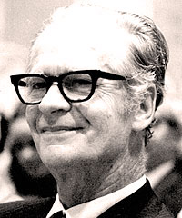

Skinner’s Operant Conditioning
Consequences are contingent on the organism’s behavior.
  Reinforcement increases the probability that a behavior will occur.
  Punishment decreases the probability that a behavior will occur.
Notes:
Operant conditioning is also called instrumental conditioning.
It is a form of learning in which the consequences of behavior produce changes in the probability that the behavior will occur.

Slide 14
Punishment vs. Reinforcement
 | TYPE | CONSEQUENCE | BEHAVIOR CHANGE
Reinforcement | positive | good when imposed | increases
 | negative | bad when not imposed | increases
Punishment | removal | good when not imposed | decreases
 | presentation | bad when imposed | decreases
Notes:
1. Reinforcement (reward) is a consequence that increases the probability that the behavior will occur.
2. Punishment is a consequence that decreases the probability that the behavior will occur.
3. Two forms of reinforcement: positive reinforcement and negative reinforcement
Positive reinforcement - The frequency of a response increases because it is followed by a rewarding stimulus.
Negative reinforcement - The frequency of the response increases because it is followed by the removal of an aversive (unpleasant) stimulus.

Slide 15
Operant Conditioning Principles
Generalization → | Giving the same response to similar stimuli
Discrimination → | Differentiating among stimuli or environmental events
Extinction → | Previously reinforced response is no longer reinforced, and the response decreases

Slide 16
Skinner’s Operant Conditioning
Theory into Practice
Nick frequently gets out of his seat and entertains his classmates with humorous remarks. Mr. Lincoln often scolds Nick for his behavior. However, Nick’s classmates laugh when Nick makes remarks. The scolding rarely has any impact. Nick continues with his antics.
Q.1: What is Mr. Lincoln attempting to do when he scolds Nick?
Q.2: Why does Nick continue his antics in spite of being scolded?
Q.3: What are three strategies Mr. Lincoln could try to keep Nick more on task?
Notes:
A1: He is attempting to present Nick with an aversive stimulus; he is attempting to punish Nick.
A2: Nick’s classmates are reinforcing his behavior by laughing, and/or Nick does not mind being scolded. Perhaps he enjoys the attention.
A3:
Differential reinforcement - He could reinforce Nick for behaving appropriately.
Contracting - He could contract with Nick. If Nick behaves appropriately for a period of time, he would receive some sort of reinforcement.
Prompting - He could develop a signal to Nick to get back on task. This could be a frown, a tap on the shoulder or desk, or just making eye contact.
Terminate reinforcement - He could stop giving Nick attention for his behavior (this may not work because it is difficult to elicit the cooperation of the rest of the class to not laugh at something that is funny).
Remove desirable stimuli - Nick may benefit from time-out.
Response cost - Nick could lose privileges when he misbehaves.

Slide 17
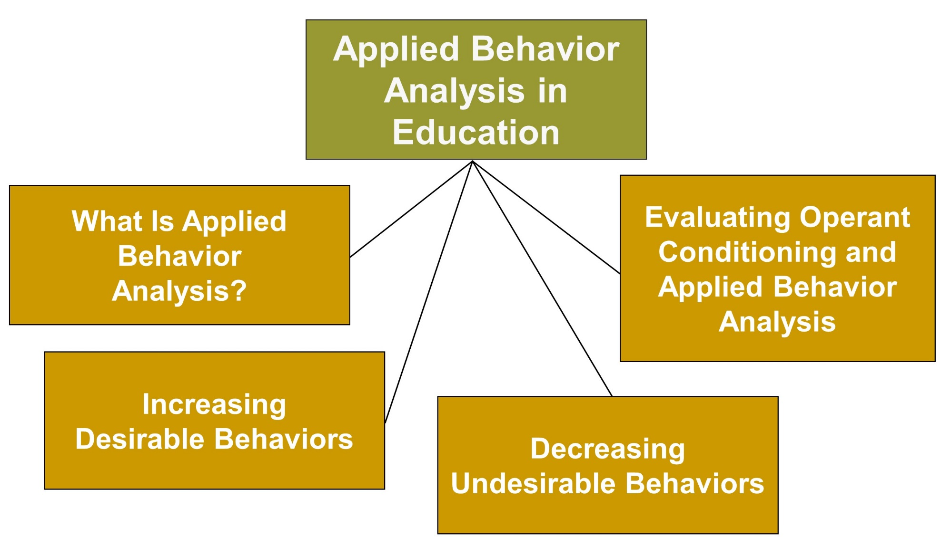
Behavioral and Social Cognitive Approaches, 2

Slide 18
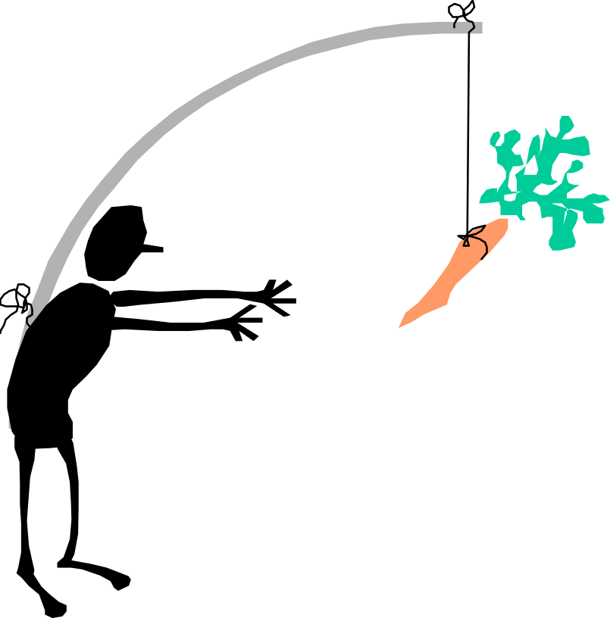
Applied Behavior Analysis
Applying principles of operant conditioning to change human behavior
Notes:
Three uses of applied behavior analysis are important in education: (1) increasing desired behavior, (2) using prompts and shaping, and (3) decreasing undesirable behavior.

Slide 19
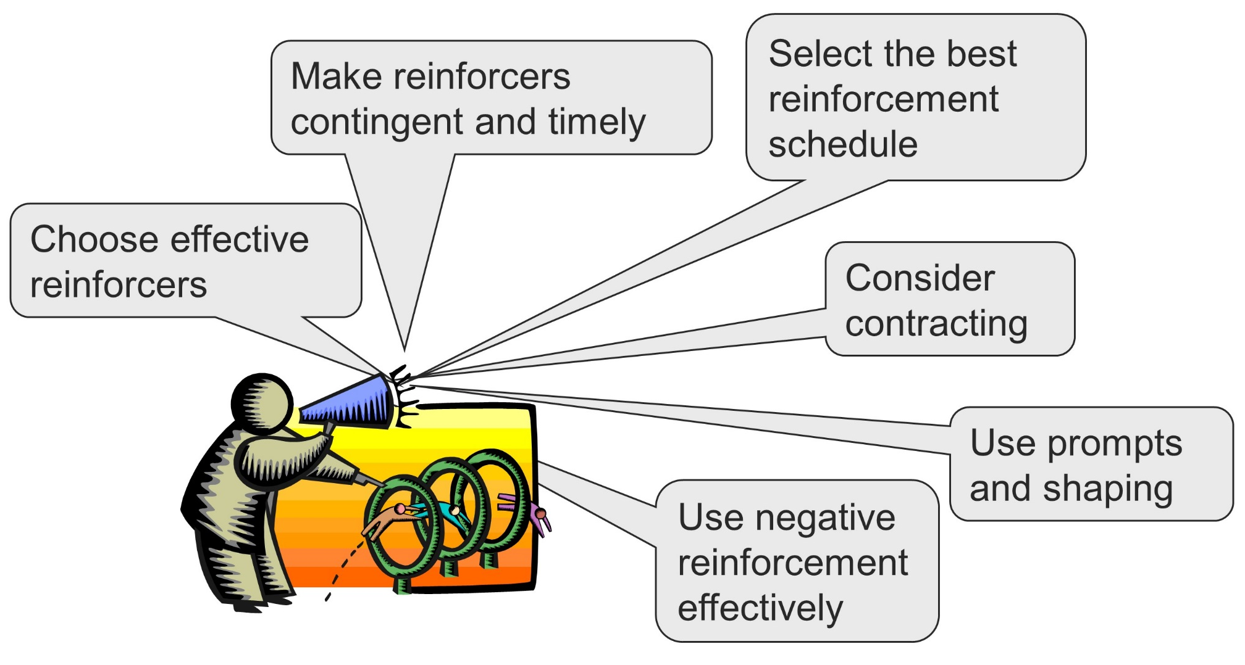
Increasing Desirable Behaviors

Slide 20
Reinforcement Schedules, 1
Fixed-Ratio | Reinforce after a set number of responses
Variable-Ratio | Reinforce after an average but unpredictable number of responses
Fixed-Interval | Reinforce appropriate responses after a fixed amount of time
Variable-Interval | Reinforce appropriate responses after a variable amount of time
Notes:
Initial learning is usually faster with continuous rather than partial reinforcement.
When students are first learning a behavior, continuous reinforcement works best.
Partial reinforcement produces greater persistence and greater resistance to extinction than continuous reinforcement.
Once students master a response, partial reinforcement works better than continuous reinforcement.

Slide 21
Reinforcement Schedules, 2
Notes:
Children on fixed schedules show less persistence and faster response extinction than children on variable schedules.
Children show the most persistence on a variable-interval schedule.

Slide 22
Reinforcement
The Premack principle states that a high-probability activity can serve as a reinforcer for a low-probability activity.
“Eat your dinner and you can go out to play.”
Guidelines for the classroom:
Initial learning is better with continuous reinforcement.
Students on fixed schedules show less persistence and faster response extinction.
Students show greatest persistence on variable-interval schedules.

Slide 23
Reinforcement: Prompts and Shaping, 1
Prompts: Added stimuli that are given just before a response that increases the likelihood that the behavior will occur
  Used to initiate behavior
  Once the desired behavior is consistent, remove prompts.

Slide 24
Reinforcement: Prompts and Shaping, 2
Shaping: Involves teaching new behaviors by reinforcing successive approximations of the desired behavior
  First, reinforce any response that in some way resembles the target behavior.
  Next, reinforce responses that resemble the desired behavior until the target behavior is performed.
  Finally, reinforce only target behavior.

Slide 25
Decreasing Undesirable Behaviors
Use differential reinforcement
Terminate reinforcement (extinction)
Remove desirable stimuli
Present aversive stimuli (punishment)
Notes:
Differential reinforcement - The teacher reinforces behavior that is more appropriate or is incompatible with what the child is doing.
Terminate reinforcement (extinction) - The teacher withdraws positive reinforcement from a child’s inappropriate behavior.
Remove desirable stimuli - The two strategies for removing desirable stimuli include time-out and response cost.
Present aversive stimuli (punishment) - Should be used only as the last alternative and always in conjunction with providing the child with information about appropriate behavior.

Slide 26
Present Aversive Stimuli (Punishment)
Most people associate the presentation of aversive (unpleasant) stimuli with punishment.
  However, an aversive stimulus is punishment only if it decreases the undesirable behavior.
Too often, aversive stimuli are not effective punishments; they do not decrease the unwanted behavior.
  They sometimes increase the unwanted behavior over time.

Slide 27
Enter the Debate
Should teachers use tangible reinforcers to reward good behavior?
YES
NO
Notes:
During a slideshow, text may be written on the slides in the yes/no boxes, and then saved for later reference.

Slide 28

Reflection and Observation
Reflection:
In your educational experience, what types of incentives did teachers use?
How effective was their use? Why were they effective or ineffective?
Notes:
This slide accompanies the video segment, First Grade Incentives, on the McGraw-Hill DVD Teaching Stories: A Video Collection for Educational Psychology.

Slide 29
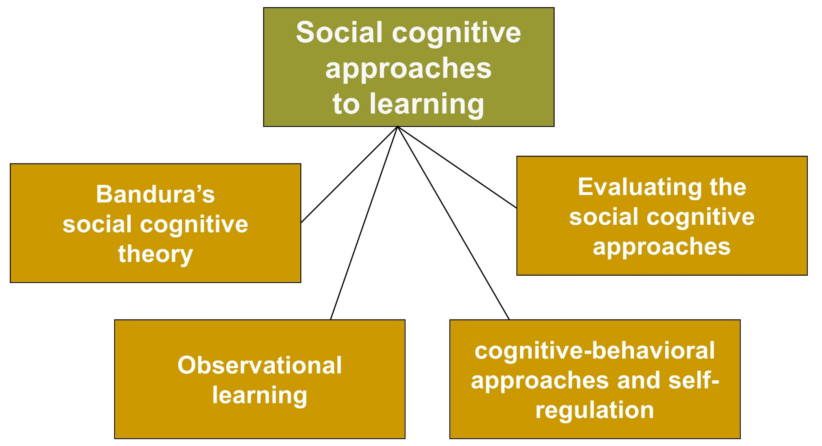
Behavioral and Social Cognitive Approaches, 3

Slide 30
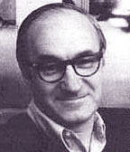
Bandura’s Social Cognitive Theory
Social, cognitive, and behavioral factors play important roles in learning.
Self-efficacy: The belief that one can master a situation and produce positive outcomes
Observational learning: Learning that involves acquiring skills, strategies, and beliefs by observing others
Notes:
Social cognitive theory states that social and cognitive factors, as well as behavior, play important roles in learning.

Slide 31
Bandura’s Reciprocal Determinism
Notes:
Bandura’s reciprocal determinism model consists of three main factors: behavior, person/cognition, and environment. These factors can interact to influence learning.

Slide 32
Observational Learning
Attention Students must attend to what a model is doing or saying. | Retention Students must code information and keep it in memory so that they can retrieve it.
Production Students must be able to reproduce the model’s behavior. | Motivation Students must be motivated to imitate the modeled behavior.
Notes:
Observational learning is learning that involves acquiring skills, strategies, and beliefs by observing others.
Bandura argues that reinforcement is not always necessary for observational learning to take place.

Slide 33
Bandura’s Social Cognitive Theory
Theory into Practice
Nick frequently gets out of his seat and entertains his classmates with humorous remarks. Mr. Lincoln often scolds Nick for his behavior. However, Nick’s classmates laugh when Nick makes remarks. The scolding rarely has any impact. Nick continues with his antics. After several days of this, other boys in the class begin to get out of their seats and make humorous remarks as well.
Q.1: Why do the other boys begin to misbehave? Explain.
Q.2: What does this say about Nick?
Notes:
A1: They have learned from observing Nick that such behavior results in reinforcement from peers. Therefore, they imitate him.
A2: Because children are more likely to imitate a high-status model, we might assume that Nick has a high status among his peers.

Slide 34
Best Practices and Strategies:
Effectively Using Observational Learning
Think about the type of model you present to students.
Demonstrate and teach new behaviors.
Think about ways to use peers as effective models.
Think about ways mentors can be used as models.
Evaluate which classroom guests will provide good models for students.
Consider the models students observe on television, videos, and computers.

Slide 35
A Model of Self-Regulatory Learning
Notes:
Cognitive behavior approaches - Emphasis is on getting students to monitor, manage, and regulate their own behavior rather than letting it be controlled by external factors (also called cognitive behavior modification).
Self-regulatory learning - Consists of the self-generation and self-monitoring of thoughts, feelings, and behaviors in order to reach a goal, which mat be academic or may be socioemotional

Slide 36
Best Practices and Strategies:
Encouraging Students to Be Self-Regulated Learners
Gradually guide students to become self-regulated learners.
Make the classroom learning experience challenging and interesting.
Provide tips about thoughts and actions that will help students engage in self-regulation.
Give students opportunities to experience activities that will foster self-evaluation.
Model self-regulated learning.
Make sure students don’t just self-regulate but combine self-regulation with effective learning strategies.

Slide 37
Classroom Connections: Crack the Case: Consequences
What are the issues in this case?
Why did Adam continue to disrupt the class despite the consequences?
What has Adam learned?
Why did the other students join Adam in his disruptive behavior?
What should Mr. Potter do now?
Notes:
This case is on page 247 of the text.

